Slide 1
Images From the Assembler
Topic On the “More Tools” Page

Slide 2
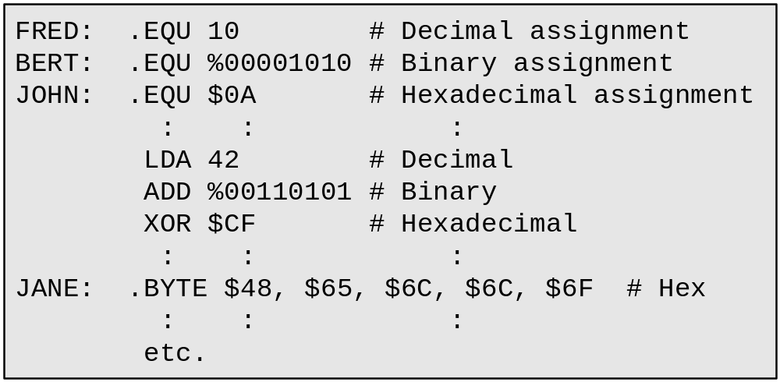
Existing assembler supports only decimal, binary, and hex assignments

Slide 3
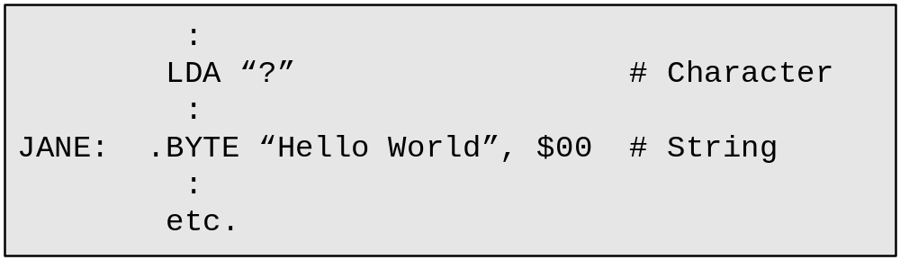
It would be useful to support character and string assignments

Slide 4
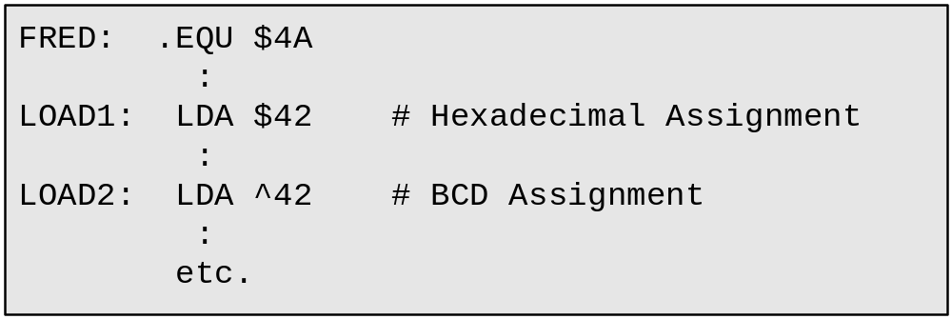
It would be useful to support BCD assignments

Slide 5
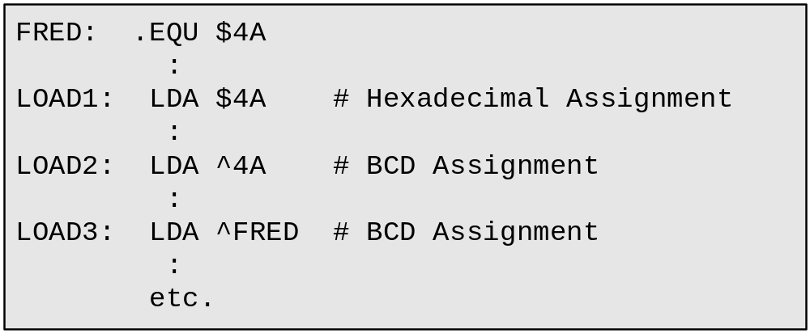
BCD assignments would help the assembler trap errors

Slide 6
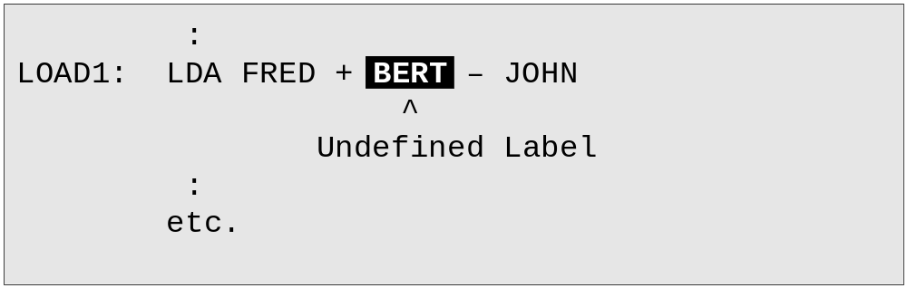
Better error reporting (highlighting errors plus display messages in source)

Slide 7
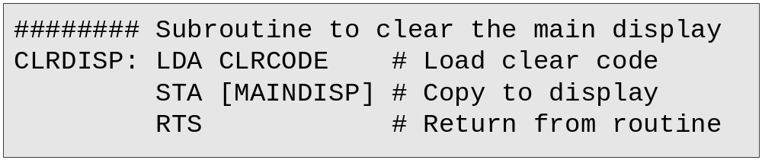
Individual subroutine stored in its own source code file

Slide 8
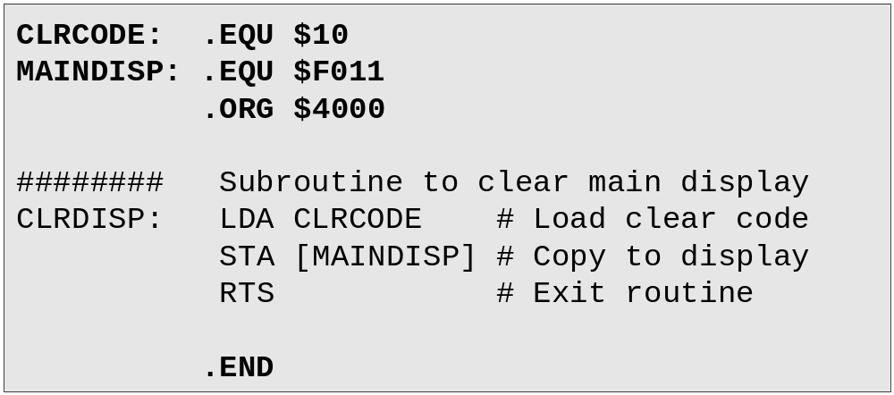
Need to add special “wrapping” statements to test routine
(better to have a special File > Assemble Subroutine command)

Slide 9
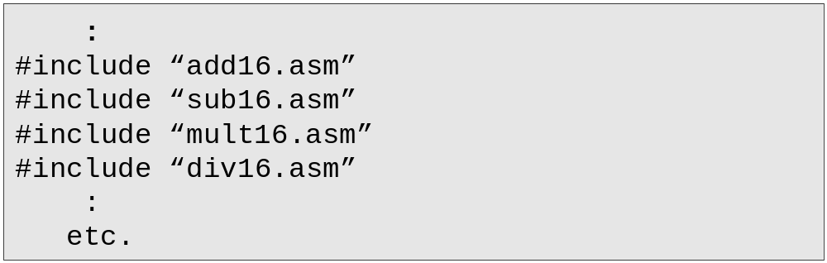
Using #include statements

