Slide 1
Images From the BASIC Interpreter
Topic On the “More Tools” Page

Slide 2
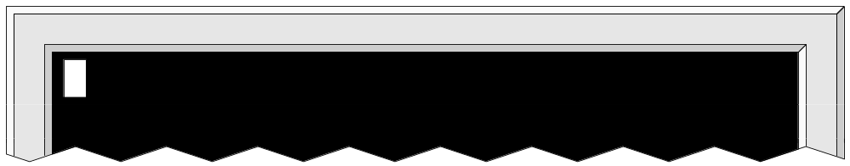
Top section of console window with flashing cursor in upper-left corner

Slide 3
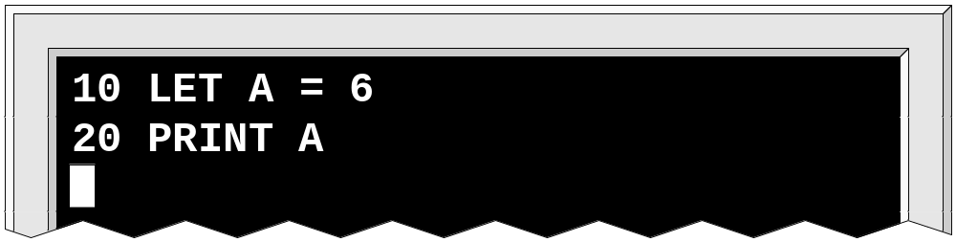
A very simple program

Slide 4
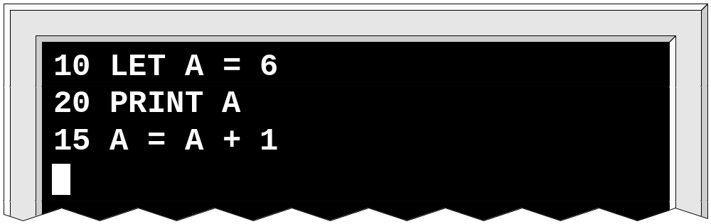
Making a change (adding an intermediate line)

Slide 5
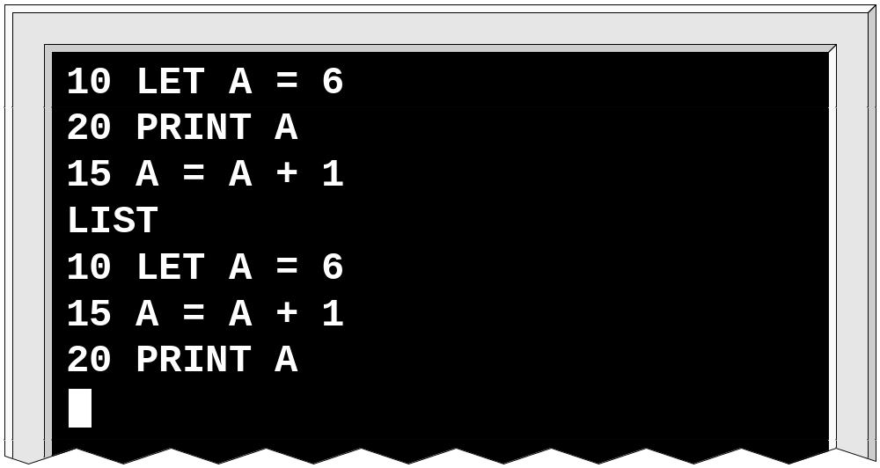
Using the LIST command

Slide 6
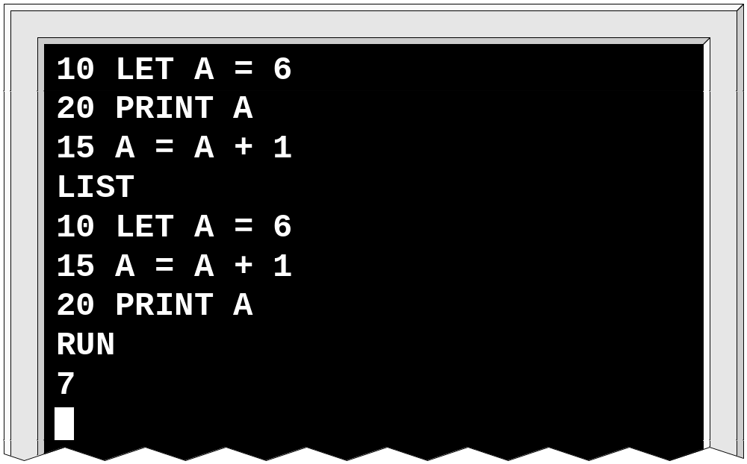
Using the RUN command

Slide 7
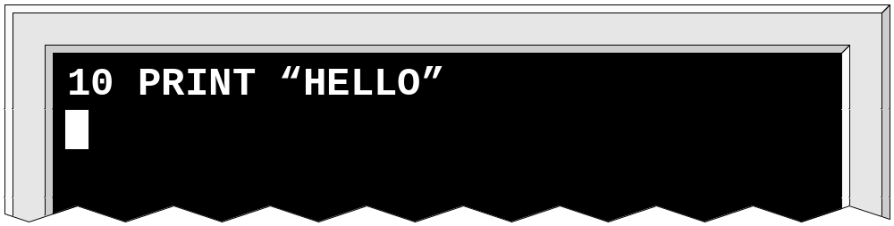
A simple 1-line program

Slide 8
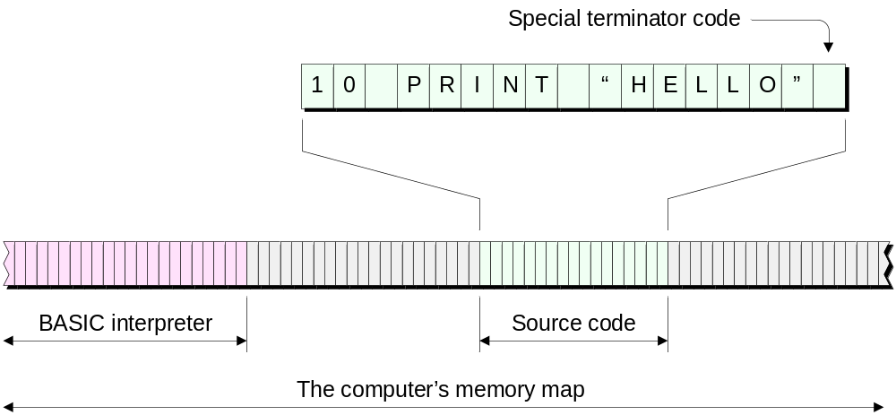
One technique is to store the source code “as-is” in the memory

