Slide 1
Images From the C Compiler
Topic On the “More Tools” Page

Slide 2
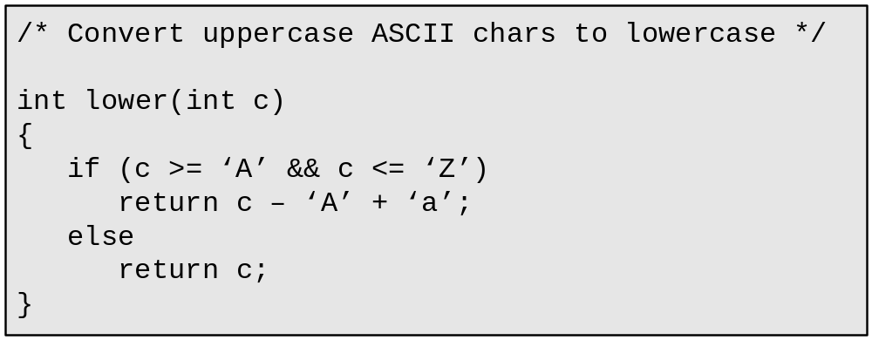
A simple function in C

Slide 3
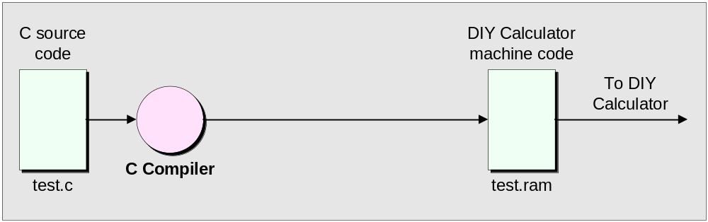
The C compiler could output the DIY Calculator’s machine code

Slide 4
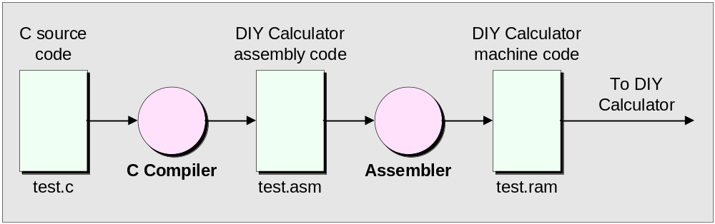
The C compiler could output the DIY Calculator’s assembly code

Slide 5
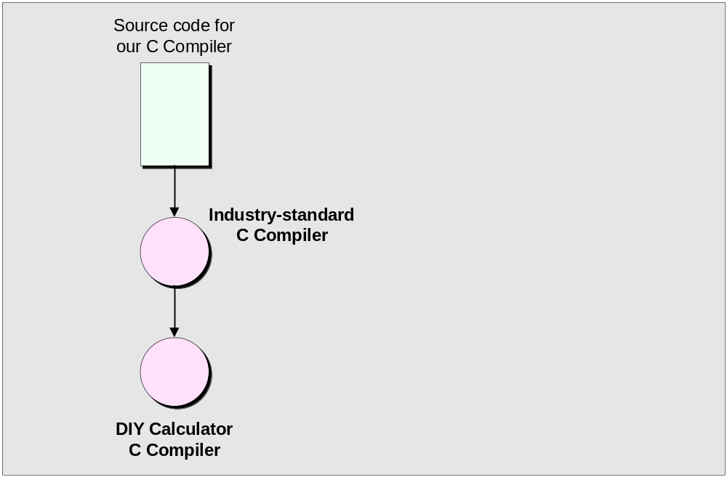
First we use an industry-standard compiler
to generate our DIY Calculator compiler

Slide 6
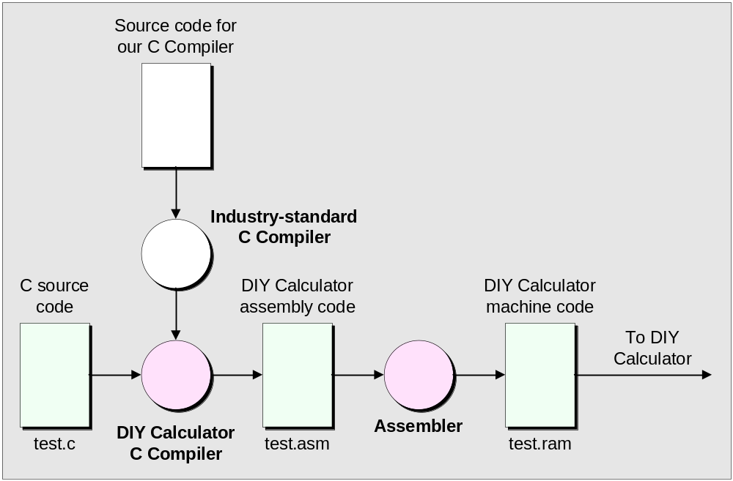
Then we compile our programs using our new DIY Calculator compiler

Slide 7
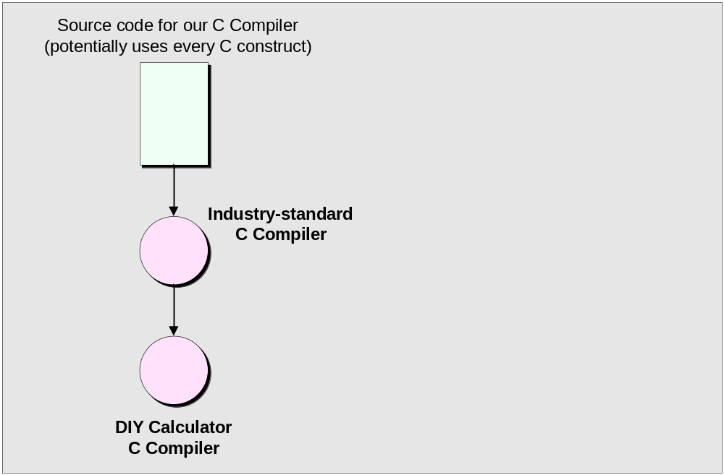
The source code for our C compiler could potentially
use every construct in the C programming language

Slide 8
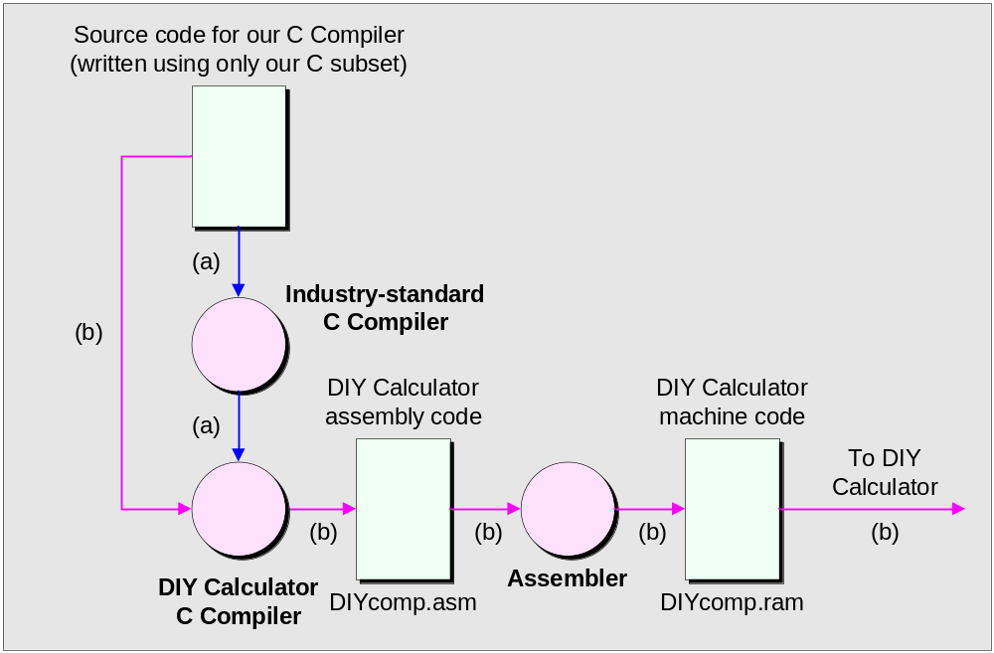
But if the source code for our C compiler uses only our subset, this opens the door to an interesting (if somewhat mind-boggling) scenario

