Slide 1
Images From the Code Coverage
Topic On the “More Tools” Page

Slide 2
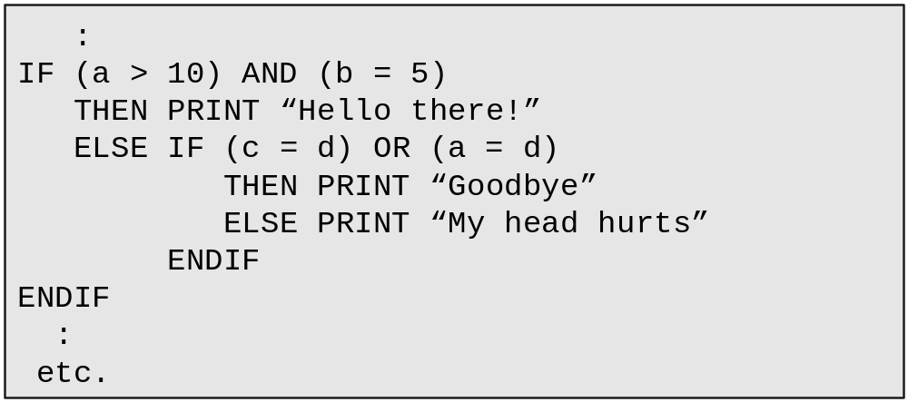
A not-so-complex nested conditional statement

Slide 3
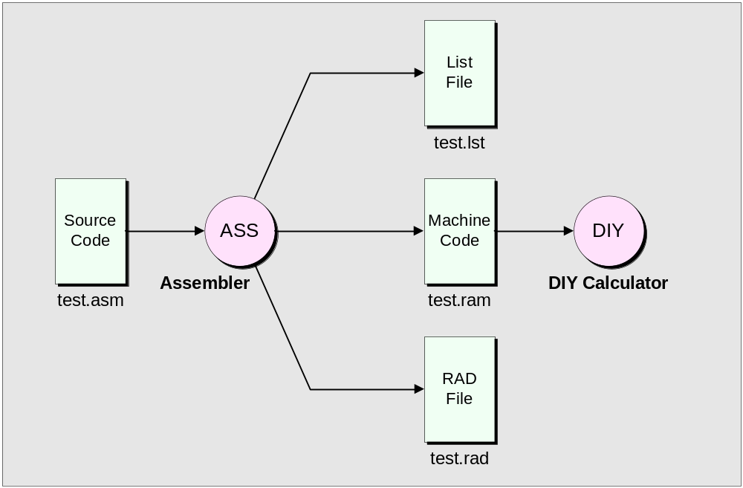
Files generated by the assembler

Slide 4
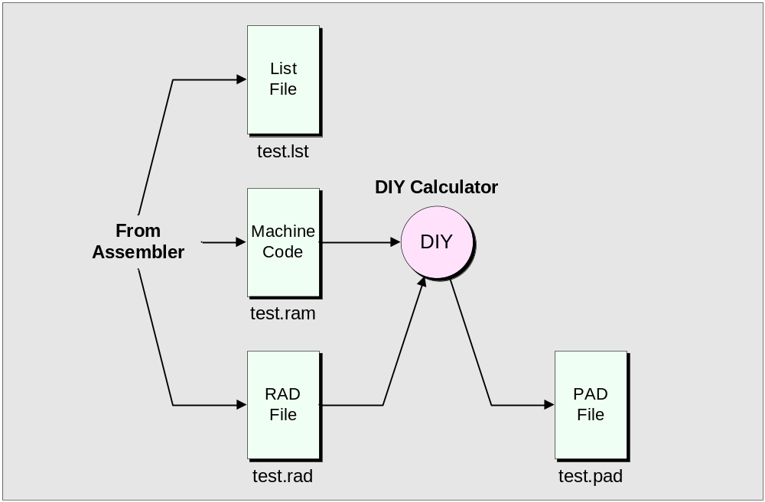
Using the DIY Calculator to generate a *.pad (processed assembly dump) file

Slide 5
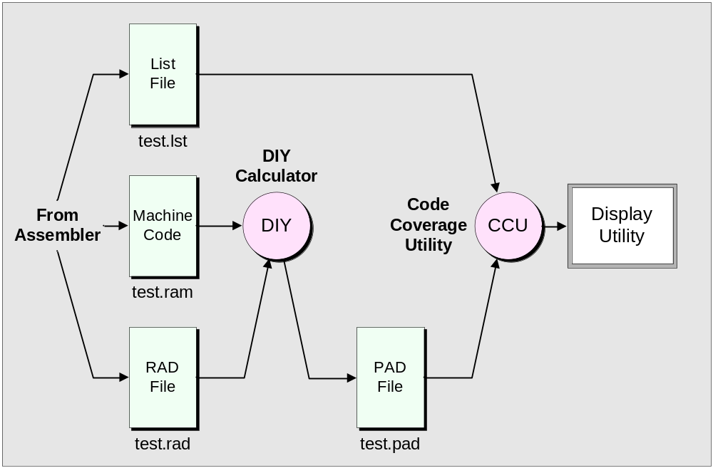
Creating a Code Coverage utility

Slide 6
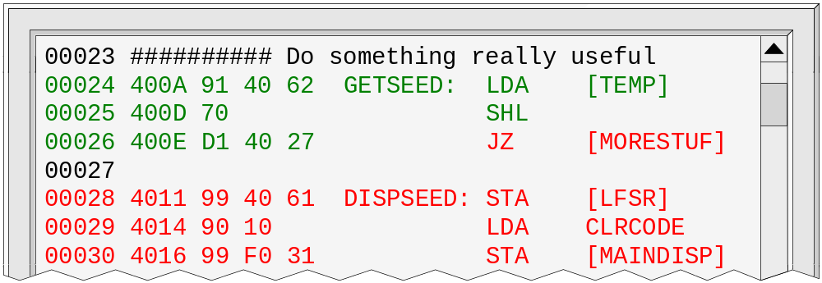
One form of colored text display

Slide 7
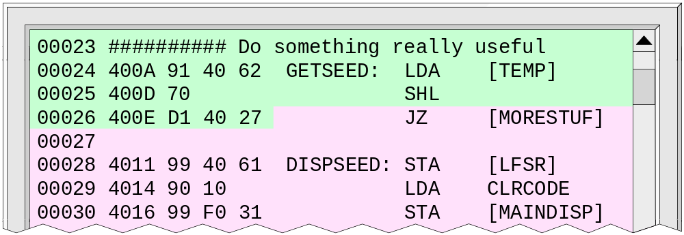
An alternative technique

Slide 8
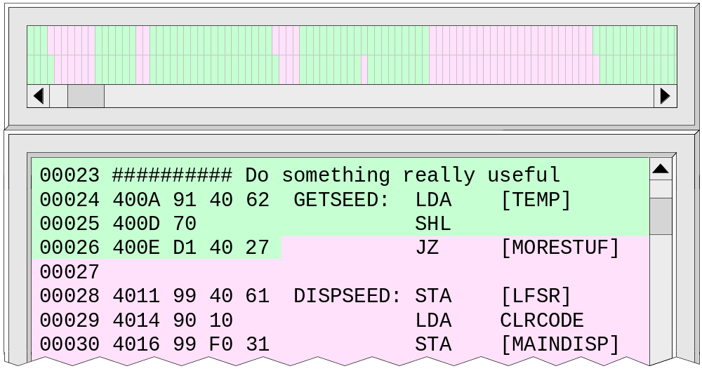
Adding a vertical bar-char type display

Slide 9
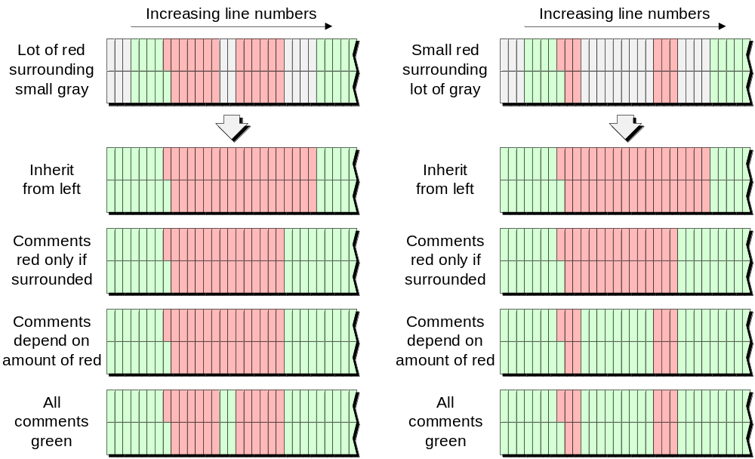
Alternative approaches to coloring comment lines

Slide 10
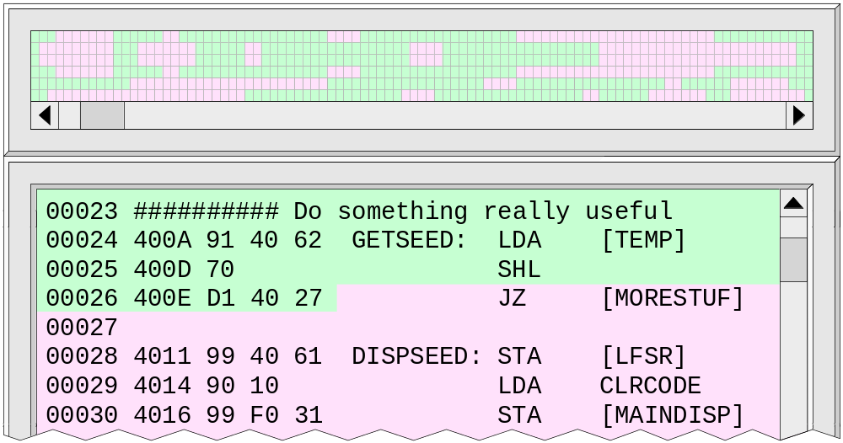
A “bird’s eye” view display

Slide 11
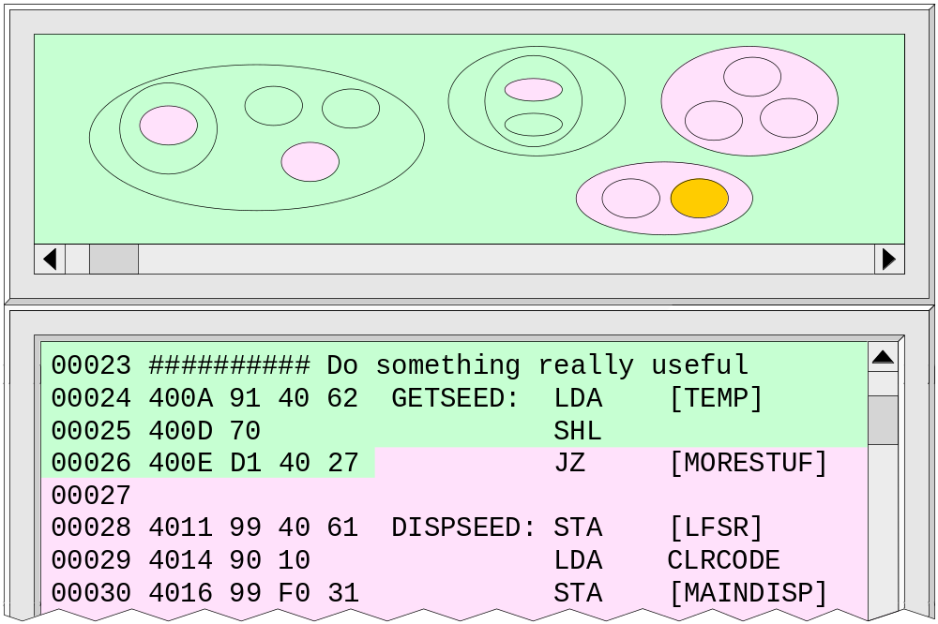
An organic “lava-lamp” type display

