Slide 1
Images From the Code Profiler
Topic On the “More Tools” Page

Slide 2
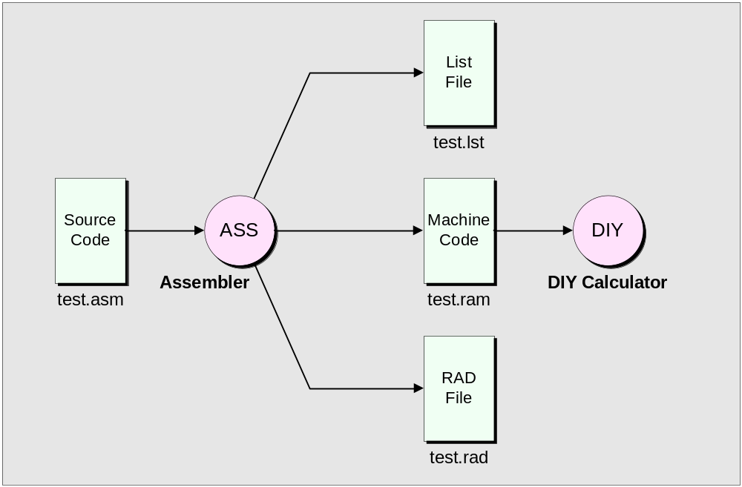
Files generated by the assembler

Slide 3
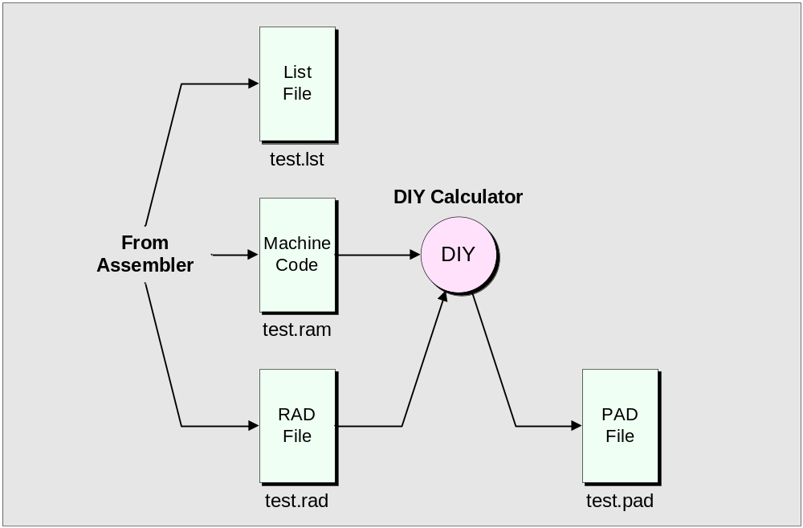
Using the DIY Calculator to generate a *.pad (processed assembly dump) file

Slide 4
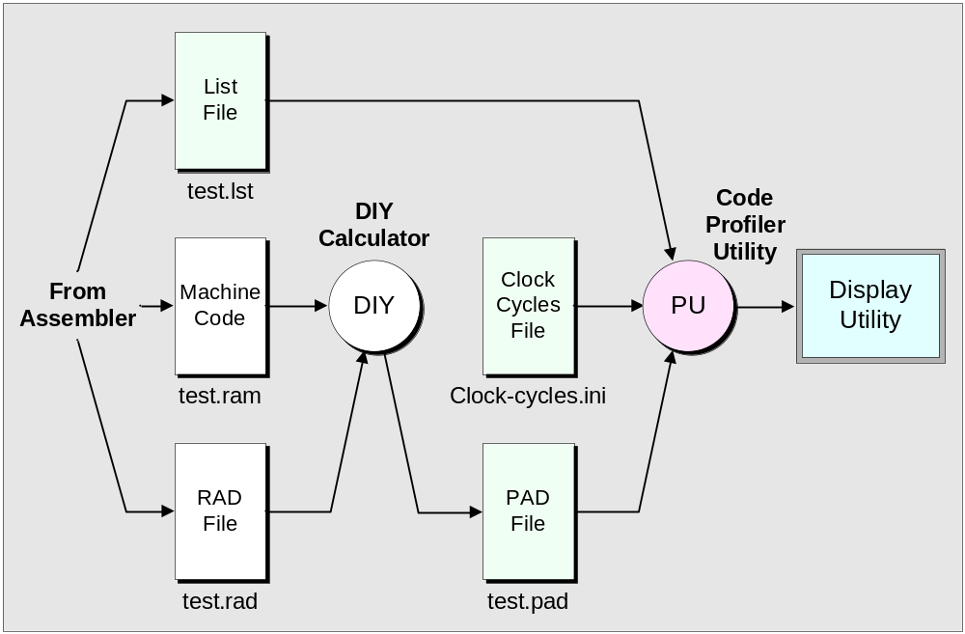
Creating a Code Profiler utility

Slide 5
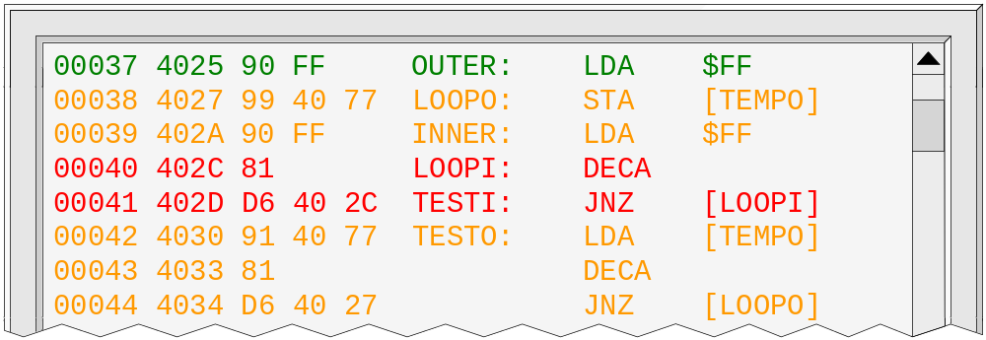
One form of colored text display

Slide 6
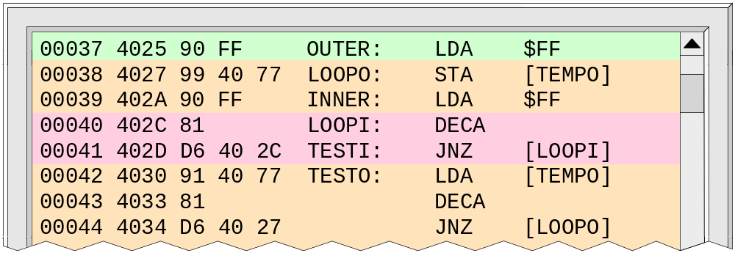
An alternative technique

Slide 7
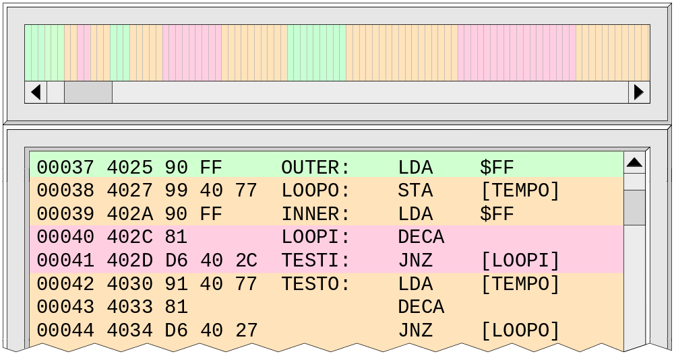
Adding a vertical bar-char type display

Slide 8
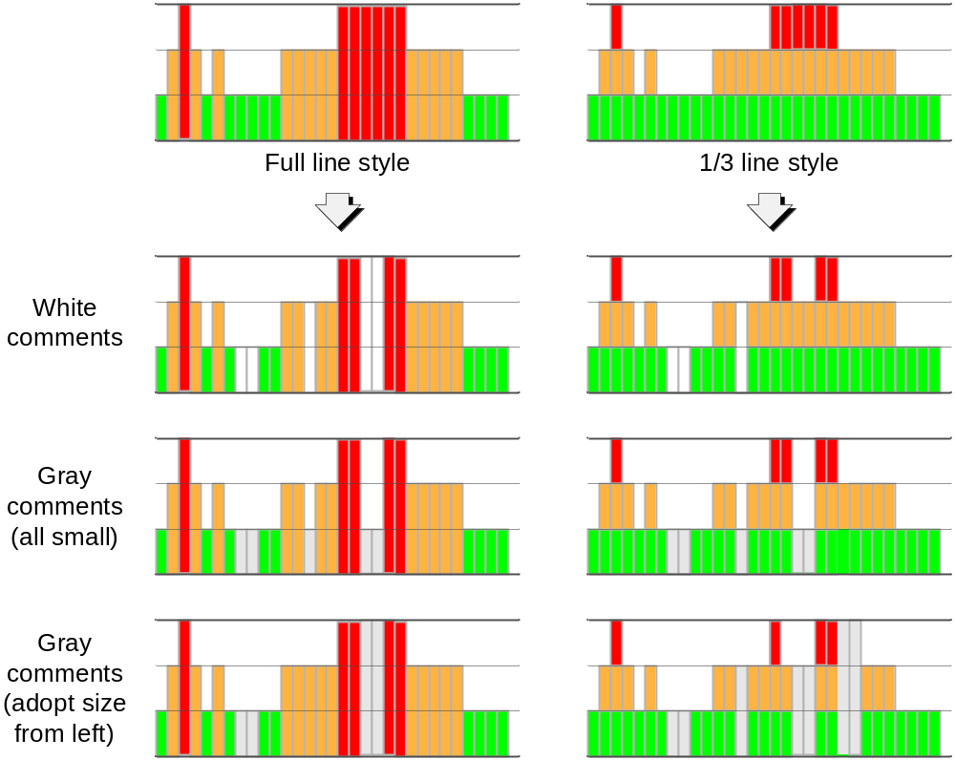
Using height
as well as color

Slide 9
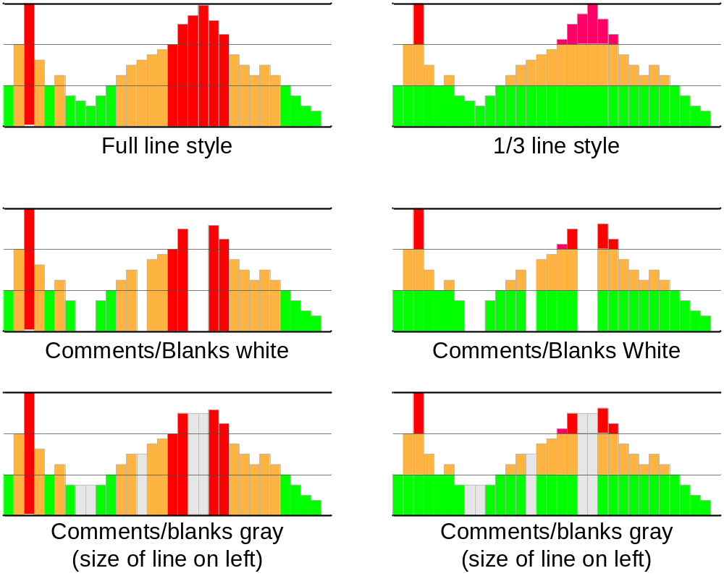
Using height as well as color (continued)

Slide 10
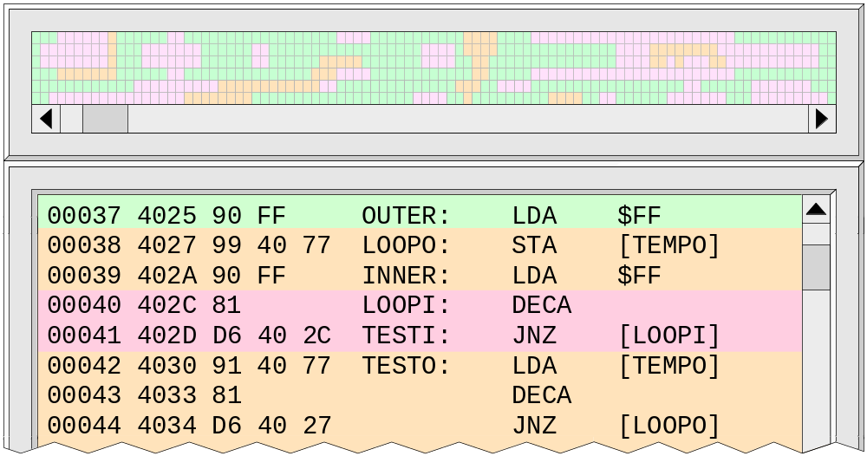
A “bird’s eye” view display

Slide 11
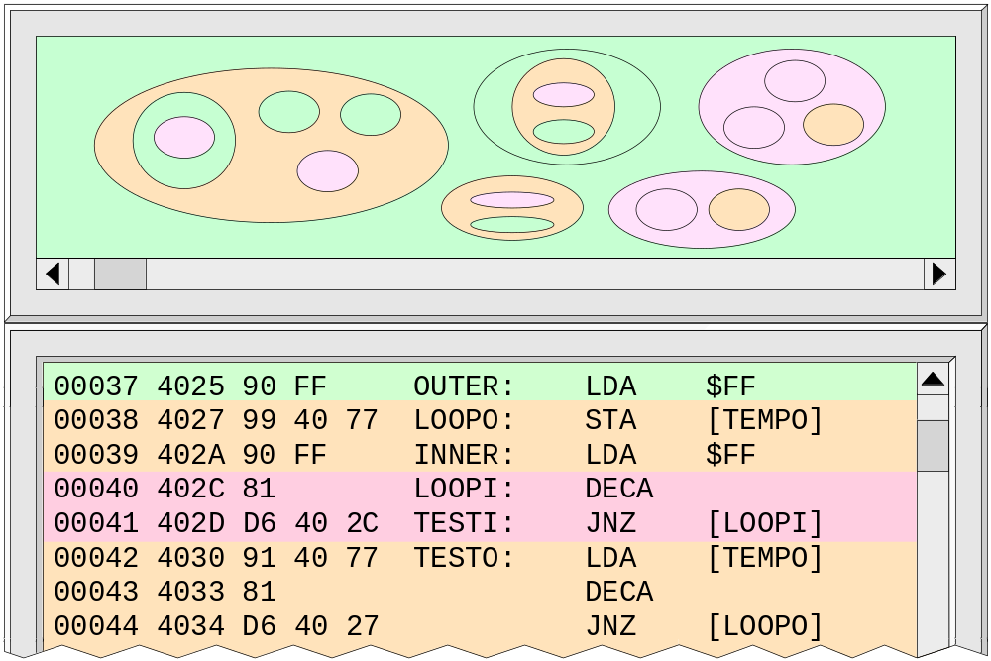
An organic “lava-lamp” type display

