Slide 1
Images From the File Transfer Utility
Topic On the “More Tools” Page

Slide 2
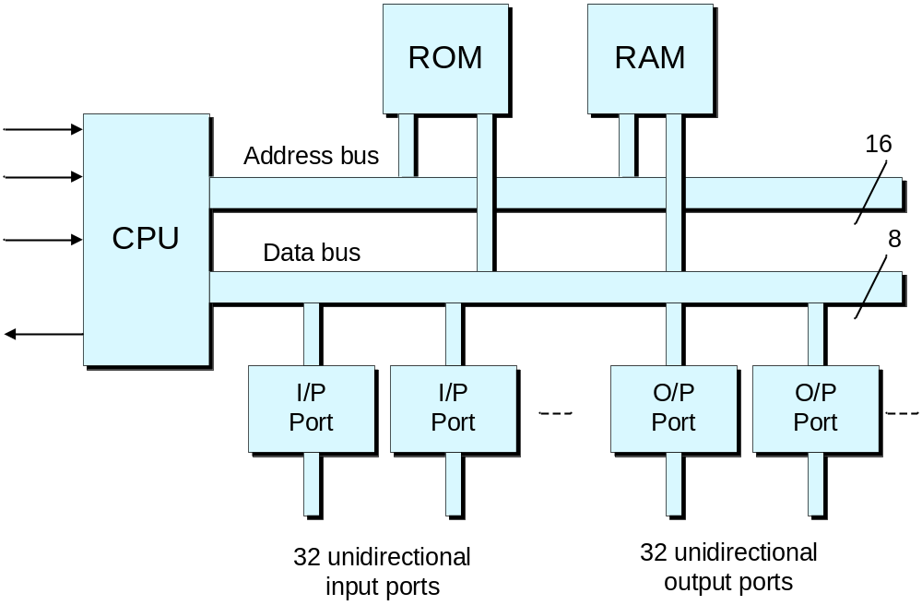
The virtual DIY Calculator is based on a simple microcomputer system

Slide 3
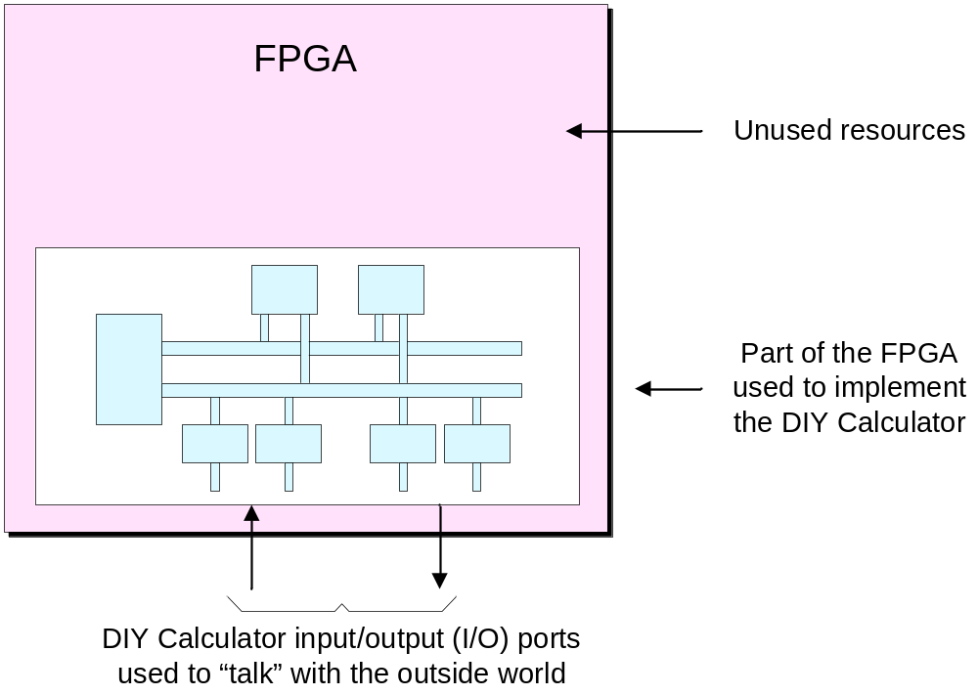
Using an FPGA to implement the DIY Calculator

Slide 4
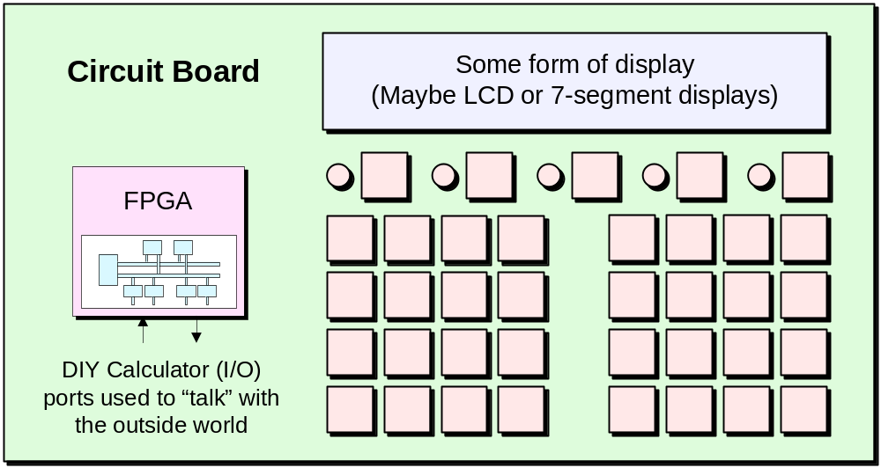
The FPGA in the context of a circuit board

Slide 5
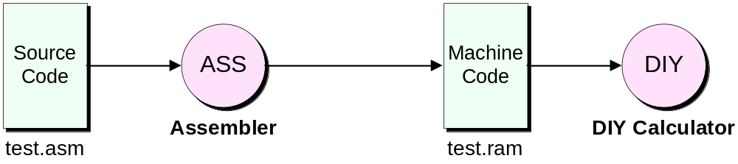
Reminding ourselves how things work in our virtual world

Slide 6
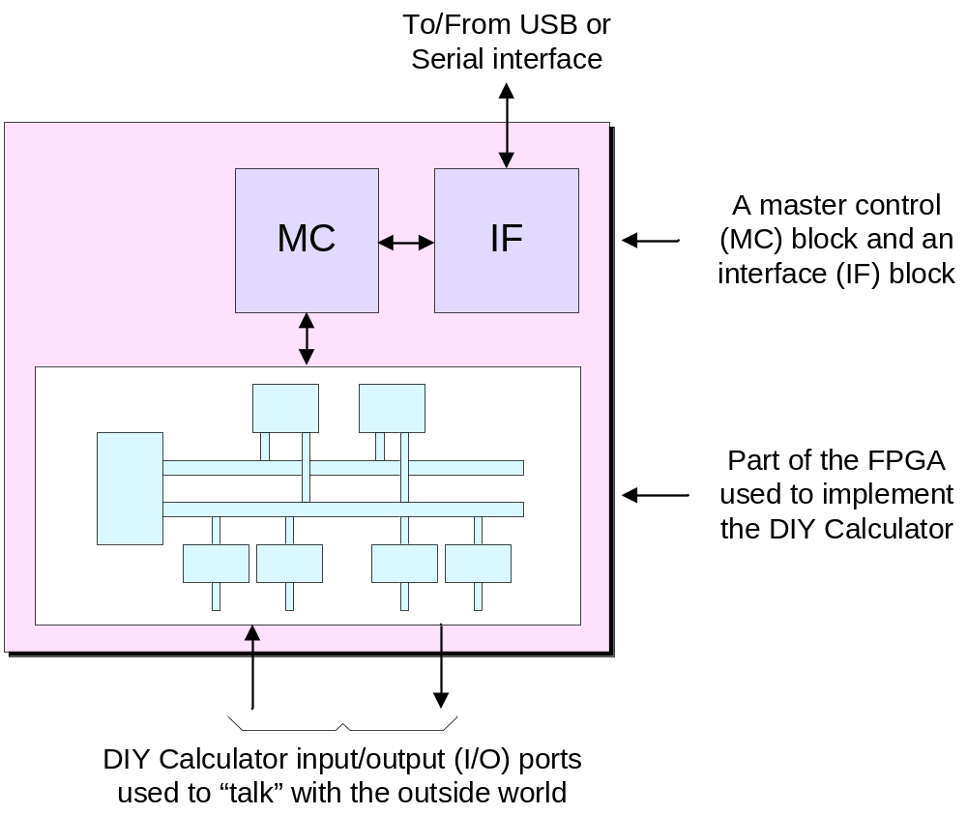
Augmenting the FPGA with master control (MC) and interface (IF) blocks

Slide 7
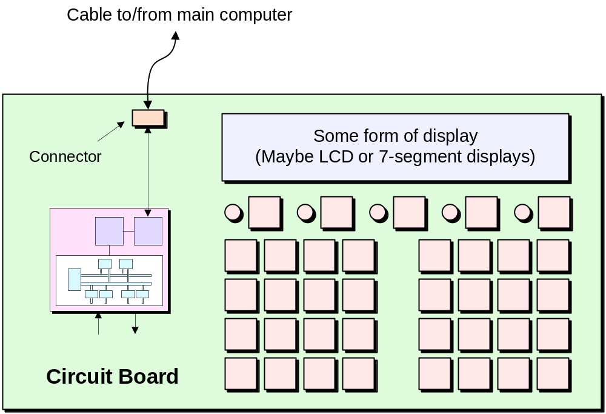
Connecting the physical DIY Calculator to the main computer

Slide 8
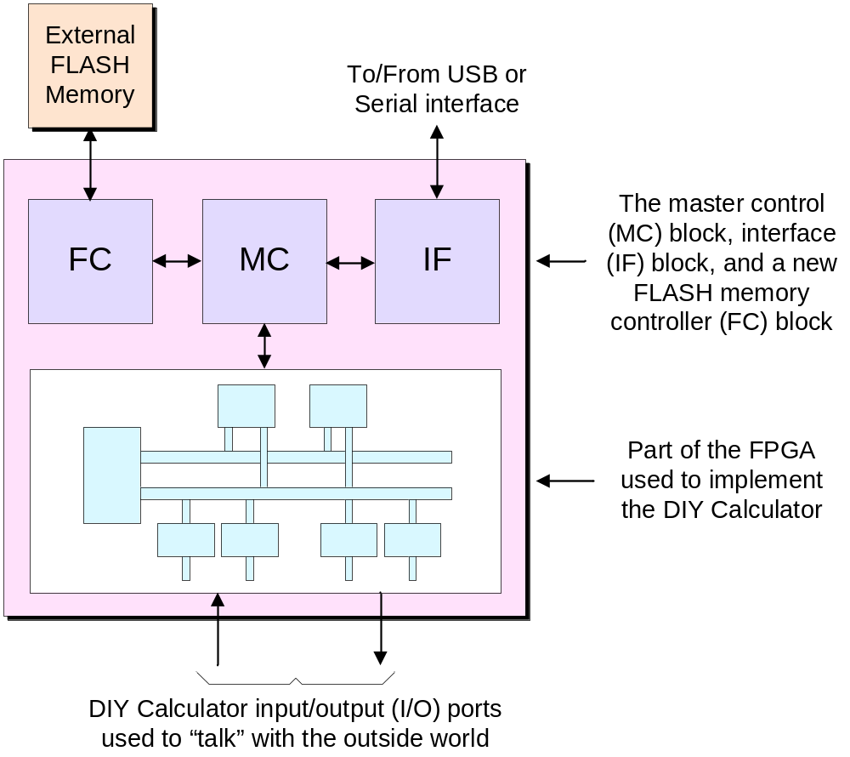
Adding a FLASH controller (FC) block and an external FLASH memory

Slide 9
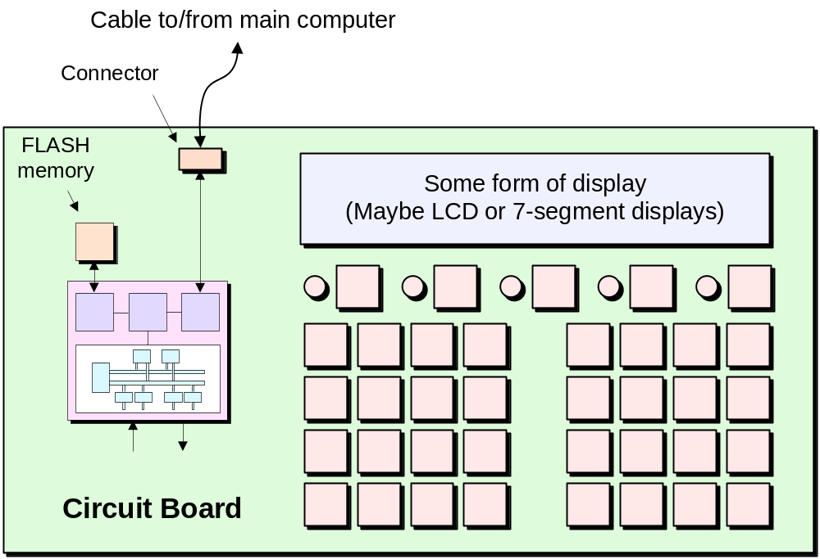
Augmenting the system with a FLASH memory

