Slide 1
PUSHX, POPX, CMPX Subroutines
Images from the PUSHX, POPX,CMPX Subroutines topic on the “Programs & Routines” page of the www.DIYCalculator.com website

Slide 2
#--------- Push a copy of the index (X) reg onto the stack ----------#
########## Doesn't change ACC or X registers
PUSHX: STA [_PU_TACC] # Store temp copy of ACC
########## Retrieve return address from stack and store it
POPA # Retrieve MS byte of return addr
STA [_PU_RADD+0] # ... and store it
POPA # Retrieve LS byte of return addr
STA [_PU_RADD+1] # ... and store it
########## Push copy of X reg onto the stack
BSTX [_PU_TX] # Store temp copy of X reg
LDA [_PU_TX+1] # Load ACC with LS byte of X
PUSHA # ... and push it onto the stack
LDA [_PU_TX+0] # Load ACC with MS byte of X
PUSHA # ... and push it onto the stack
:
{See next slide}
PUSHX (“push index register to stack”) subroutine

Slide 3
{From previous slide}
:
########## Restore return address to the stack
LDA [_PU_RADD+1] # Get temp LS byte of return addr
PUSHA # ... and push it onto the stack
LDA [_PU_RADD+0] # Get temp MS byte of return addr
PUSHA # ... and push it onto the stack
########## Restore original ACC value and exit the subroutine
LDA [_PU_TACC] # Restore original value in ACC
RTS # Return
########## Reserve some local temporary locations to be used by PUSHX
_PU_TACC: .BYTE # 1 byte to store ACC
_PU_TX: .2BYTE # 2 bytes to store X register
_PU_RADD: .2BYTE # 2 bytes to store return address
PUSHX (“push index register to stack”) subroutine (continued)

Slide 4
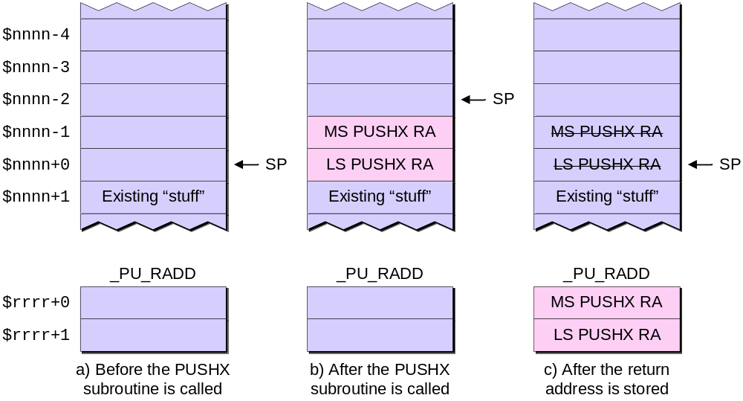
The state of the stack during the PUSHX routine

Slide 5
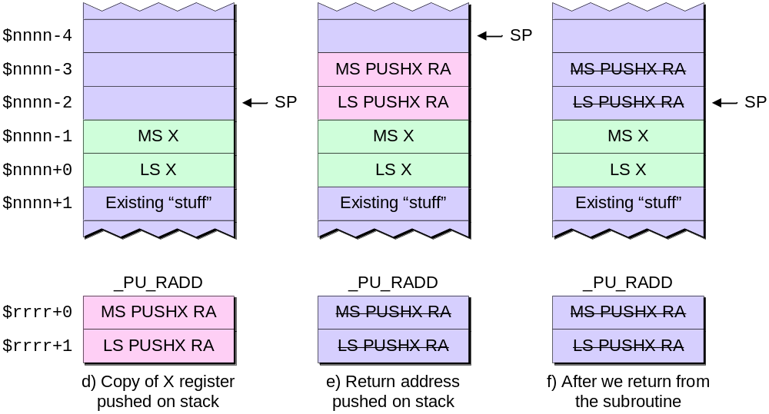
The state of the stack during the PUSHX routine (continued)

Slide 6
#--------- Pop a copy of the index (X) reg off the stack ------------#
########## Changes both ACC and X registers
########## ACC set to 0 if X reg = 0 (thereby setting Z flag)
########## Original ACC stored in _PO_TACC just in case
POPX: STA [_PO_TACC] # Store copy of ACC (just in case)
########## Retrieve return address from stack and store it
POPA # Retrieve MS byte of return addr
STA [_PO_RADD+0] # ... and store it
POPA # Retrieve LS byte of return addr
STA [_PO_RADD+1] # ... and store it
########## Pop copy of X reg off the stack
POPA # Pop MS byte of X reg off stack
STA [_PO_TX+0] # ... and store in in temp location
POPA # Pop LS byte of X reg off stack
STA [_PO_TX+1] # ... and store it in temp location
BLDX [_PO_TX] # Load value from stack into X reg
:
{See next slide}
POPX (“pop index register off stack”) subroutine

Slide 7
{From previous slide}
:
########## Restore return address to the stack
LDA [_PO_RADD+1] # Get temp LS byte of return addr
PUSHA # ... and push it onto the stack
LDA [_PO_RADD+0] # Get temp MS byte of return addr
PUSHA # ... and push it onto the stack
########## Load ACC with TEMPX+0, OR with TEMPX+1, and exit
# Note that this will set the Z flag to 1 if X = $0000
LDA [_PO_TX+0] # Load ACC with MS X
OR [_PO_TX+1] # ... and OR with LS X
RTS # Return
########## Reserve some local temporary locations to be used by POPX
_PO_TACC: .BYTE # 1 byte to store ACC
_PO_TX: .2BYTE # 2 bytes to store X register
_PO_RADD: .2BYTE # 2 bytes to store return address
POPX (“pop index register off stack”) subroutine (continued)

Slide 8
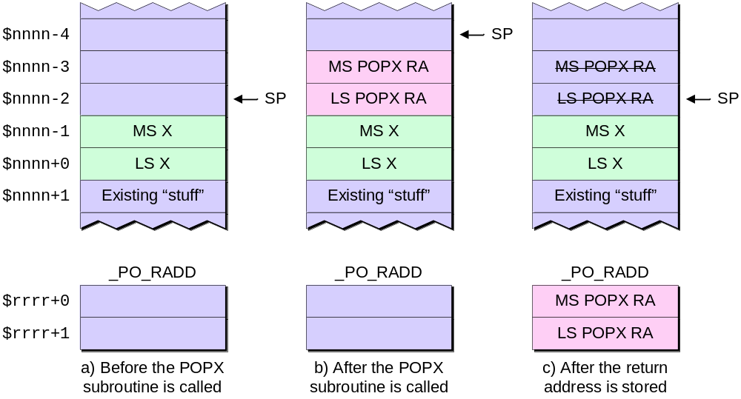
The state of the stack during the POPX routine

Slide 9
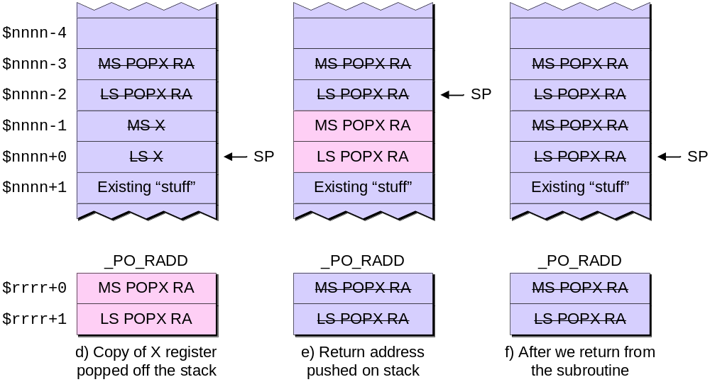
The state of the stack during the POPX routine (continued)

Slide 10
#--------- Compare X reg with another 2-byte value ------------------#
########## Changes ACC, leave X unchanged
########## Assumes X values to be compared are already on the stack
########## ACC set to 0 values are equal (thereby setting Z flag)
########## Original ACC stored in _CX_TACC just in case
CMPX: STA [_CX_TACC] # Store copy of ACC (just in case)
########## Retrieve return address from stack and store it
POPA # Retrieve MS byte of return addr
STA [_CX_RADD+0] # ... and store it
POPA # Retrieve LS byte of return addr
STA [_CX_RADD+1] # ... and store it
########## Pop copy of compare value off the stack
POPA # Pop MS byte of comp val off stack
STA [_CX_CV+0] # ... and store in in temp location
POPA # Pop LS byte of comp val off stack
STA [_CX_CV+1] # ... and store it in temp location
:
{See next slide}
CMPX (“compare index register to 16-bit value”) subroutine

Slide 11
{From previous slide}
:
########## Pop copy of X reg off the stack
POPA # Pop MS byte of X reg off stack
STA [_CX_TX+0] # ... and store in in temp location
POPA # Pop LS byte of X reg off stack
STA [_CX_TX+1] # ... and store it in temp location
########## Restore return address to the stack
LDA [_CX_RADD+1] # Get temp LS byte of return addr
PUSHA # ... and push it onto the stack
LDA [_CX_RADD+0] # Get temp MS byte of return addr
PUSHA # ... and push it onto the stack
########## Restore original value in X register (this is the value
########## that was in the X register before we called this routine)
BLDX [_CX_TX] # Load the X reg from temp location
:
{See next slide}
CMPX (“compare index register to 16-bit value”) subroutine (continued)

Slide 12
{From previous slide}
:
########## Perform the comparison and exit the routine
########## Make C = 1 if X is bigger; Z = 1 if values are the same
## First compare MS bytes
_CX_TMS: LDA [_CX_TX+0] # Load ACC with MS X
CMPA [_CX_CV+0] # Compare to MS compare value
_CX_TZMS: JZ [_CX_TLS] # MS bytes equal, test LS bytes
JMP [_CX_END] # ... else return
## If MS bytes are equal, we have to compare the LS bytes
_CX_TLS: LDA [_CX_TX+1] # Load ACC with LS X
CMPA [_CX_CV+1] # Compare to LS compare value
_CX_END: RTS # Return
########## Reserve some local temporary locations to be used by CMPX
_CX_TACC: .BYTE # 1 byte to store ACC
_CX_CV: .2BYTE # 2 bytes to store compare value
_CX_TX: .2BYTE # 2 bytes to store X register
_CX_RADD: .2BYTE # 2 bytes to store return address
CMPX (“compare index register to 16-bit value”) subroutine (continued)

Slide 13
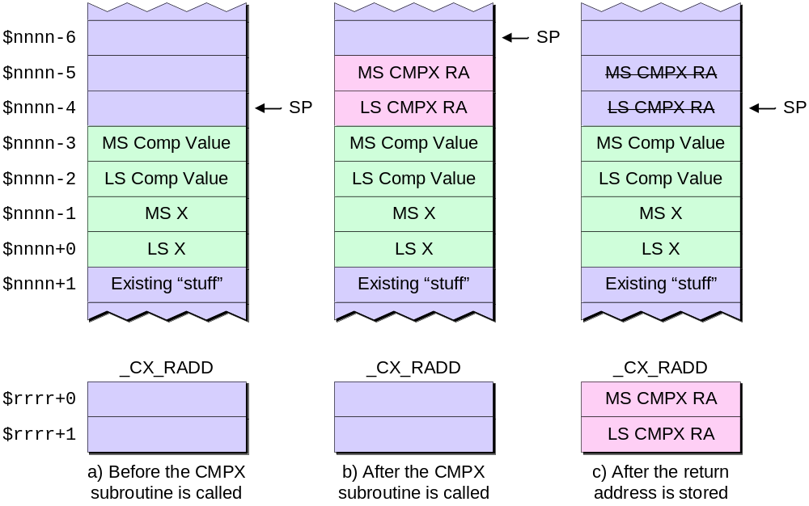
The state of the stack during the CMPX routine

Slide 14
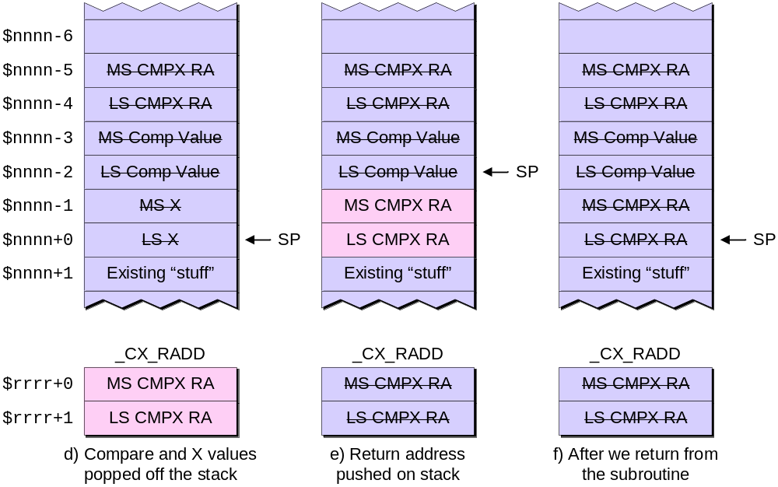
The state of the stack during the CMPX routine (continued)

Slide 15
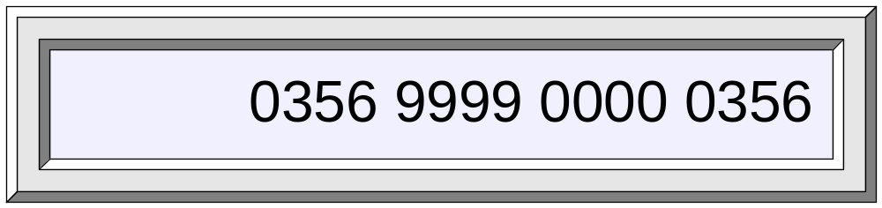
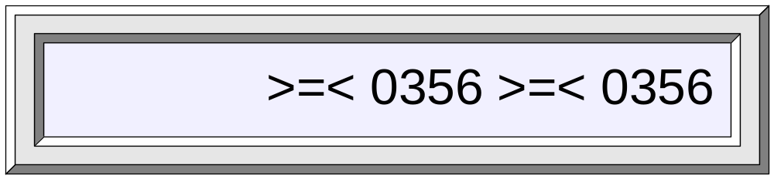
Expected result from test #1
Expected result from test #2
The results expected when running the test program

