Slide 1

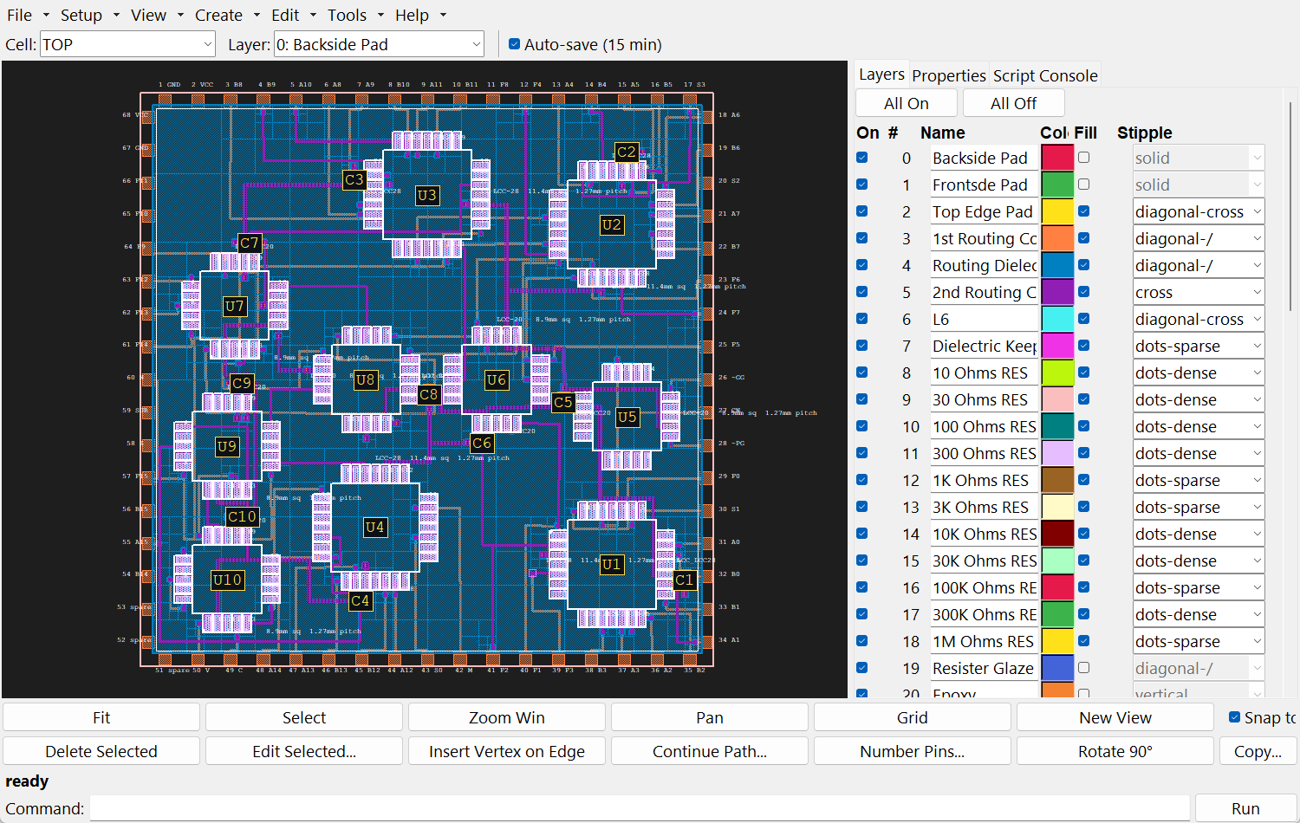
HLayout
Thick-film hybrid layout CAD
From a KiCad schematic to print artwork, bond diagrams, assembly drawings and 3D models — on an open-source toolchain.
Key features overview
Notes:
HLayout is a CAD tool for thick-film hybrid circuits: printed conductors, dielectric, resistor inks and glaze on a ceramic substrate, with packaged parts or bare dies. The screenshot is the ALU16 module from example 2.

Slide 2
Built for hybrids, not PCBs
One GDSII-native design database driven by mouse, commands or Python
64
1 µm
500
3
independent layers, each with colour, fill and name
database unit — external GDSII libraries drop straight in
mm square maximum design area, hierarchical cells
ways to drive it: canvas, command bar, Python / MCP
Thick-film aware: resistor designer and laser-trim simulator, dielectric fill with via windows, wire bonds, chip-and-wire dies, thermal analysis and process-order top views.
HLayout · Thick-film hybrid layout CAD
2
Notes:
Every action is available three ways: click it, type it on the command bar, or script it through the Session object. The MCP server lets Claude drive the same session.

Slide 3
An open-source workflow, end to end
Seven stages; only schematic capture and the machines sit outside HLayout
1
2
3
4
5
6
7
Schematic
Tech & parts
Placement
Nets & bonds
Routing
Verify
Outputs
KiCad Eeschema
Layers, libraries, dies, resistors
Auto Place from the netlist
Net names, wire bonds
Freerouting / hybrid router
DRC, netlist, thermal, trim
CAM, docs, 3D (FreeCAD)
Open-source tool in the loop (KiCad, Freerouting, FreeCAD)
Done inside HLayout
Open formats at every hand-off: KiCad .net · GDSII · Specctra DSN/SES · Gerber RS-274X · DXF · STEP · CSV / KiCad .pos
HLayout · Thick-film hybrid layout CAD
3
Notes:
Freerouting and the hybrid router are called from inside HLayout and their results come straight back into the design as one undo step. HLayout itself is built on open-source Python libraries: gdstk, shapely, numpy and scipy.

Slide 4
Three ways to build a hybrid
Same seven stages; parts, bonds and routing differ
A
Packaged parts, multilayer
B
Chip and wire, two conductors
C
Chip and wire, one conductor
LCC carriers, SMD caps and SOT packages on a two-conductor stack. Freerouting routes both conductors with vias through the dielectric.
Bare dies on die-attach pads, wire-bonded to bond fingers, with printed resistors and chip caps. Fingers laid on the 2nd conductor.
One printed conductor, no dielectric. Wire-bond jumpers carry one track over another; Freerouting single-layer or the hybrid router.
Example 2 — ALU16, ten LCCs
Example 4 — 85 of 85 nets, no shorts or opens
Notch filter example
HLayout · Thick-film hybrid layout CAD
4
Notes:
Pick the path from the parts list and the process before placing anything; it decides which layers carry which pads.

Slide 5
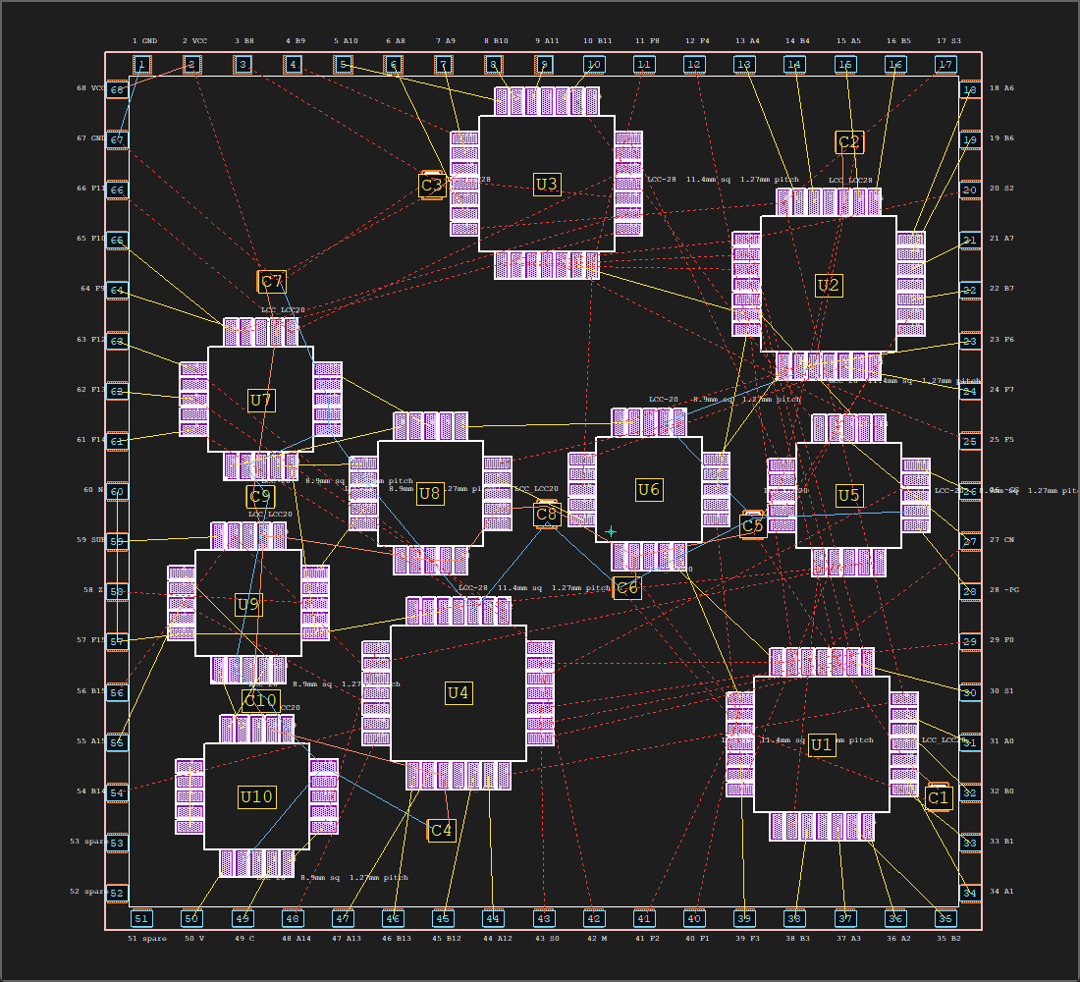
Schematic capture to placement
KiCad netlist in, parts placed for the shortest weighted net length
1
Capture in KiCad
Reference designators, pin or die-pad numbers, VCC/GND nets. Export the .net — or a pad,net CSV or Tango file.
2
Carry HLayout data in the schematic
HL_Family, HL_Cell, HL_Power_mW, HL_Weight, HL_Fixed fields — or an overrides CSV per job.
3
Auto Place
Weighted nets including power and ground, 50 µm grid, thermal term keeps hot parts apart. ALU16: ten LCCs in ~10 s.
4
Straight-line interconnects
Live ratsnest that follows every drag; Unrouted Nets list steps through what is left.
ALU16 placed from its KiCad netlist, SLIs shown
HLayout · Thick-film hybrid layout CAD
5
Notes:
Footprints map to cells automatically: same RefDes, HL_Cell field, saved map, same name, or package letters plus pin count. Printed resistors in the netlist are sized by the Resistor Designer and placed like any other part.

Slide 6
Layout tools made for thick film
Everything a fired-film stack needs, in one editor
Technology setup
Parts libraries
Resistor Designer
Print-order layers, route layers, wire-bond and dielectric-fill rules saved as a reusable tech file.
Attached GDS libraries, Via and Pad Wizards, Chip Wizard for bare dies with numbered pads.
Sizes printed resistors from value, tolerance, power and ink; places them as cells.
Trim Simulator
Dielectric fill
Mask operations
Plunge and L-cut laser trim with live resistance, sensitivity and heat map.
Generated sheet inside the I/O ring with a window at every via.
Oversize, undersize and boolean layer ops, run singly or as saved batches.
HLayout · Thick-film hybrid layout CAD
6
Notes:
All dialogs have command-bar and Python equivalents, and every operation is a single undo step.

Slide 7
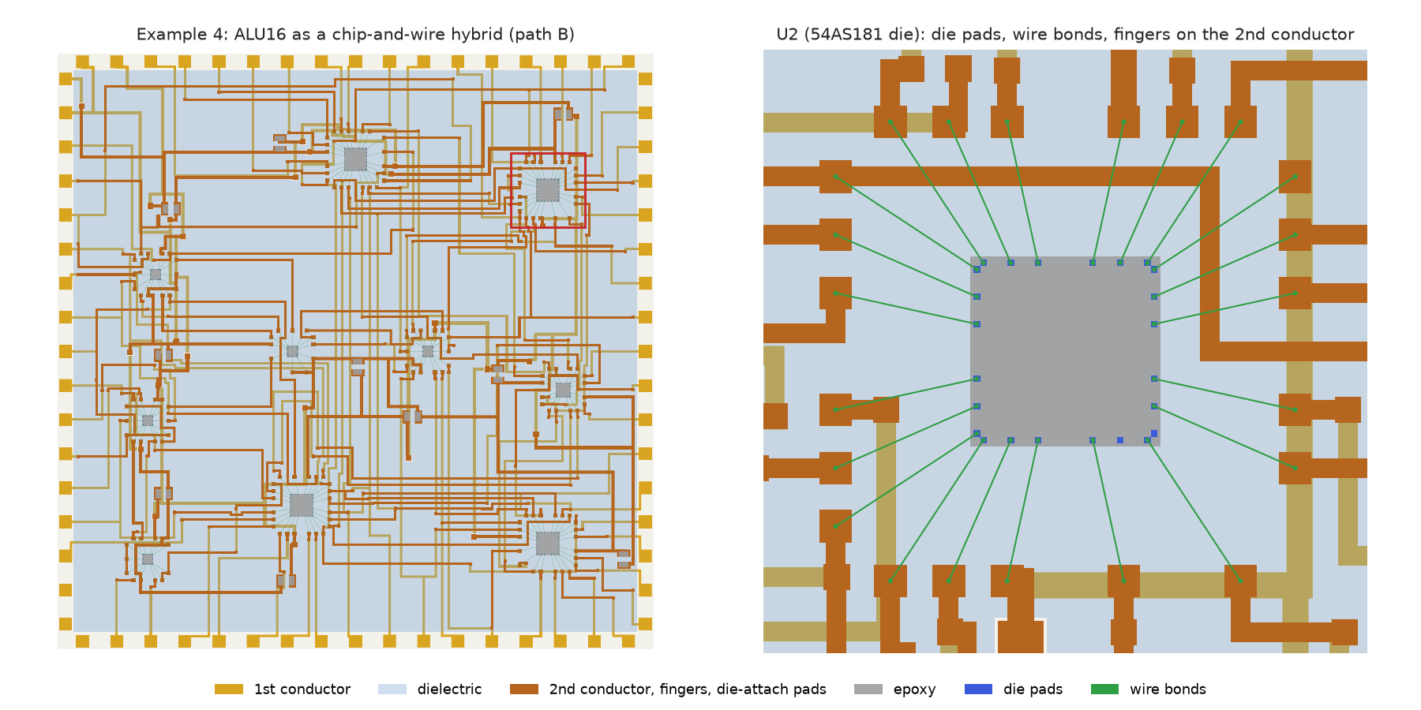
Autorouting with Freerouting
Open-source router for multilayer and chip-and-wire hybrids
85/85
nets routed on the ALU16 chip-and-wire build, no shorts or opens
Your DRC rules set the router’s widths and clearance
Wire-bond landings become bond fingers automatically
Hybrid router: one conductor with wire-bond jumpers
Via optimisation, track shortening, rip-up and reroute
Example 4: die U2 with wire bonds fanning out to bond fingers
HLayout · Thick-film hybrid layout CAD
7
Notes:
HLayout writes a Specctra .dsn, Freerouting routes it and writes a .ses, and HLayout reads tracks and vias back as one undo step, then checks every net. The hybrid router (a Freerouting fork, HybridRouterCli) adds crossovers, jumpers and the bond diagram.

Slide 8
Verify before you print
Rules, connectivity, heat and trim checked in the same tool
DRC
Design Rule Check
Width, area, spacing, enclosure, substrate-edge clearance and wire-bond length and departure angle.
171
NL
Netlist extraction
die-pad bond ends checked on example 4
Rebuilds connectivity from copper and bonds; compares with net names for opens and shorts.
Thermal analysis
33.4°
°C
Steady-state conduction through substrate and films; banded maps and an HTML report.
steepest departure — passes the 45° bond-angle rule
Ω
Trim simulation
Confirms each printed resistor can be trimmed to value.
HLayout · Thick-film hybrid layout CAD
8
Notes:
Thermal analysis is a design-stage estimate: checked against closed-form cases, not yet against FEA or measured hybrids.

Slide 9
CAM outputs for every machine
Each file is made from the checked design and feeds one step of the build
Output | What it holds | Goes to
Gerber RS-274X | One file per print layer | Screens and photo-tools
DXF | Merged as-fired geometry, mm | Laser trim, scribing, mechanical
Pick and place | Centroid + rotation, CSV or KiCad .pos | Placement machine
Bond diagram | Every wire in bonding order, length, angle | Wire bonder
Test netlist | CSV, KiCad or Tango | Bare-substrate and module test
Archive | Design, technology and libraries | Job record
HLayout · Thick-film hybrid layout CAD
9
Notes:
Gerber and DXF export run as named, repeatable export sets. DXF bakes path widths into closed polygons and merges touching shapes, matching the fired film.

Slide 10
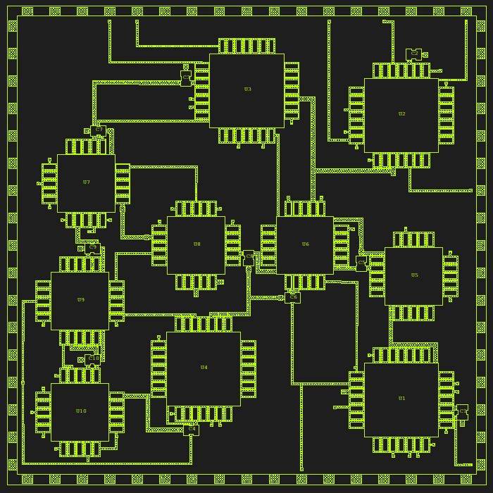
Assembly documentation in one step
Tools → Assembly Drawing builds the whole sheet and rebuilds it on demand
TV
Top view
Hidden-line pictorial view in true process order, scaled 100:1 to 1:10 automatically.
RT
Resistor table
Ref, value, tolerance, aim value and ink in RKM code, read from the Resistor Designer.
PT
Pin and bond tables
Pinout table per package; bond table added for chip-and-wire builds.
SH
ISO drawing sheet
A4 or A3 with a full title block; house style remembered between designs.
Hidden-line top view, conductor hatched
HLayout · Thick-film hybrid layout CAD
10
Notes:
Each part is its own regenerable cell (ASSY_SHEET, ASSY_TOPVIEW, ASSY_PINTABLE, ASSY_RESTABLE). After moving parts or editing resistors, press Build again. Print renders a true-scale HTML/SVG page.

Slide 11
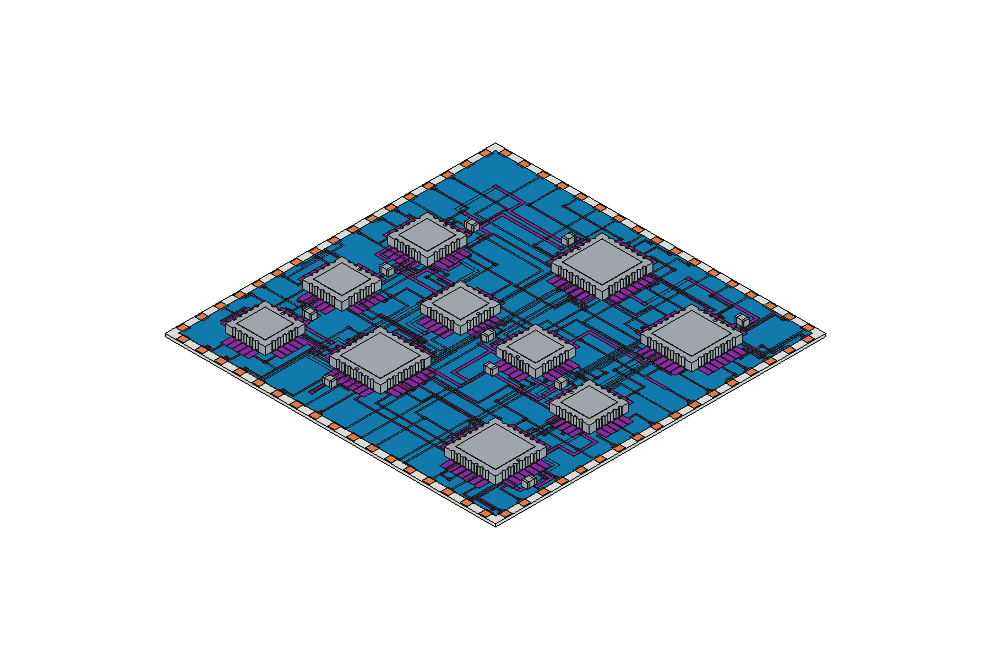
See it in 3D
The fired-film stack and every component, as real solids
FreeCAD macro: one solid per film at its fired thickness; wire bonds as raised loops
STEP library: chip caps 0201–2512, SOT family, LCC, Kovar headers, bare dies — built by script
Auto-match: parts tied to STEP bodies by size code or pad footprint; overrides in the Component Library Manager
SolidCraft: 3D view through its MCP server; writes STEP, 3MF, STL or OBJ
ALU16 rebuilt in FreeCAD from the exported macro
HLayout · Thick-film hybrid layout CAD
11
Notes:
Components rest on whatever film lies under their footprint, so a die sits on its conductor rather than floating. Headers can be referenced to the substrate underside. build_STEP_parts/build_all.py rebuilds every family.

Slide 12
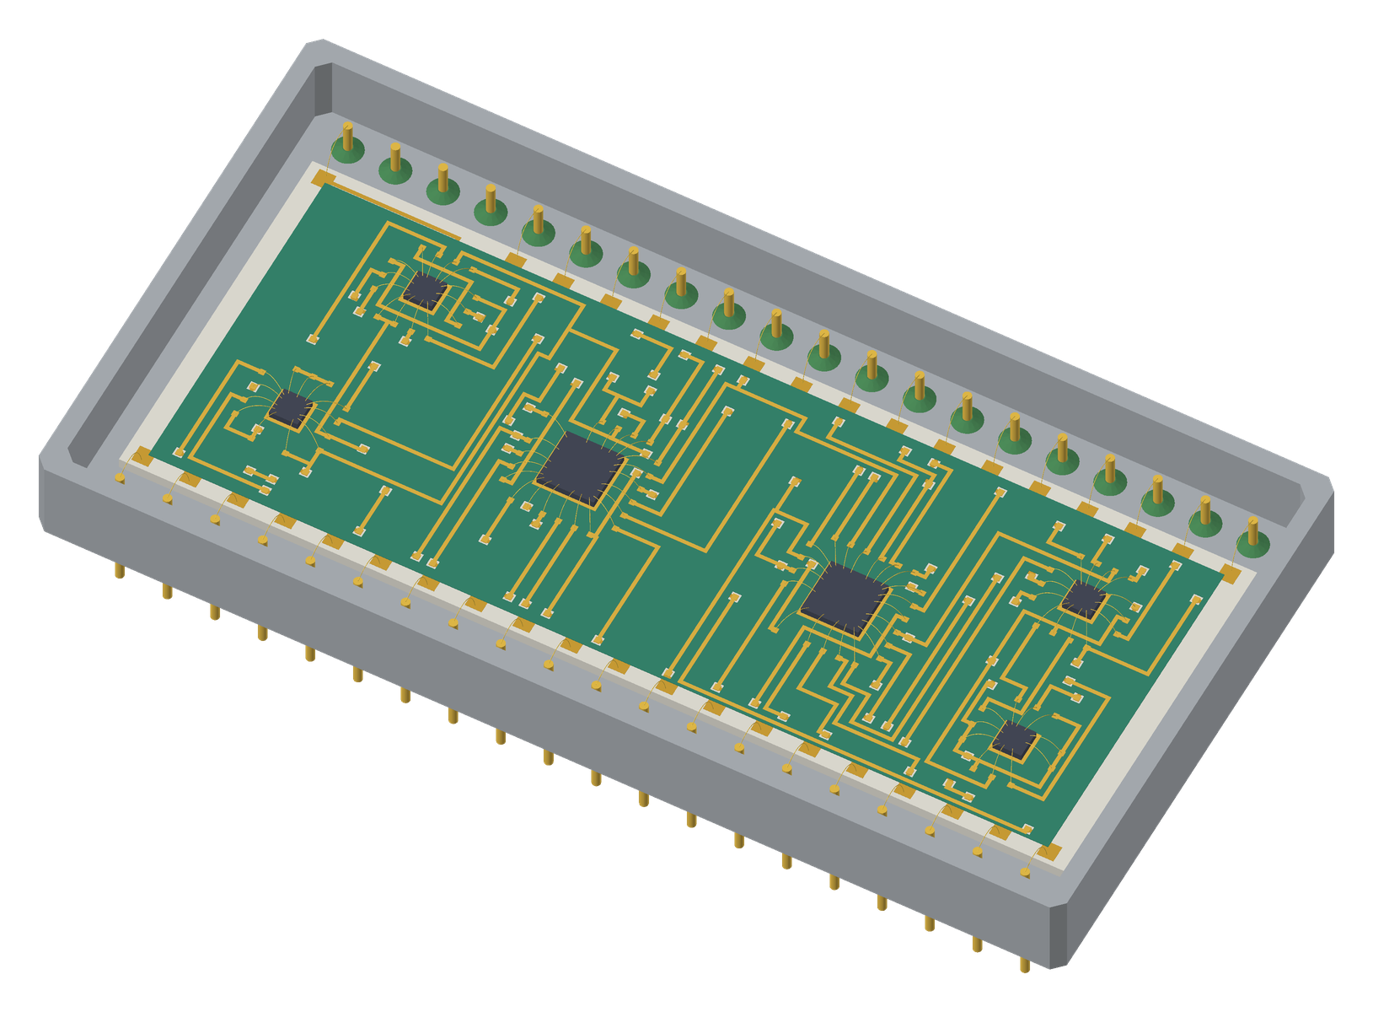
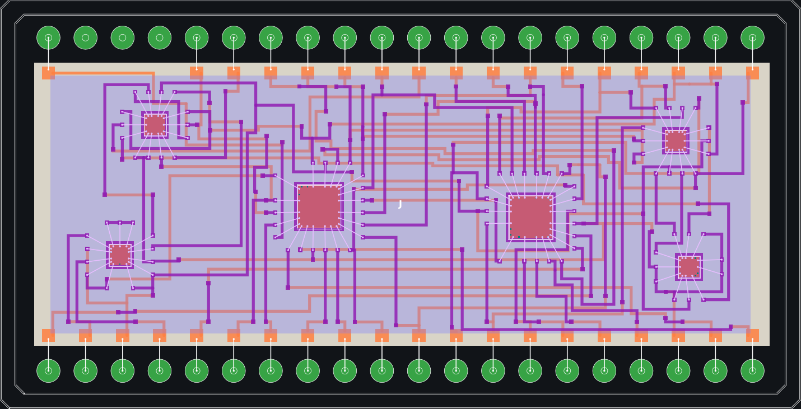
Example 5: ALU8, layout to 3D
Six bare dies wire-bonded on two conductors, sealed in a 40-pin Kovar DIP
Layout: 1st conductor orange, 2nd purple, dies bonded to fingers
The corresponding 3D view, exported to FreeCAD
HLayout · Thick-film hybrid layout CAD
12
Notes:
Example 5 is an 8-bit ALU: two 54AS181 slices and four 54LS gate dies, 46 nets, placed by Auto Place and routed with Freerouting with bond fingers on the 2nd conductor. The 3D view is the same design exported to FreeCAD: fired films at real thickness, dies on attach pads, substrate seated in the Kovar DIP40 with glass-sealed pins.

Slide 13
Scriptable, and Claude-ready
Anything you can click you can type, script or hand to an AI assistant
>_
Command bar
Short AutoCAD-style language: AUTOPLACE, DRC RUN, GERBER, ASSEMBLY, PNP EXPORT.
AUTOPLACE RUN alu16.net effort=1
DRC RUN error=60
GERBER out\alu16
PNP EXPORT alu16.pos
ASSEMBLY size=A3 title="ALU16"
# Python
r = s.generate_assembly_drawing(
size="A3", title="ALU16")
Py
Python Session API
Full scripting of cells, layers, routing, DRC, thermal and export; a tested cookbook in the manual.
AI
MCP server
Claude drives a live window (edits land in its undo history) or a headless session.
HLayout · Thick-film hybrid layout CAD
13
Notes:
The MCP bridge is off until enabled, listens on 127.0.0.1 only, and every request carries a random per-run token.

Slide 14
One design. Every output.
Schematic
Layout
CAM
Docs
3D
KiCad netlist
Placement, routing
Gerber, DXF, PnP, bonds
Assembly drawing
FreeCAD, STEP, SolidCraft
Get started
pip install -r requirements.txt
python hlayout_app.py example2\alu16_MCM.gds
Full guide: docs\HLayout_User_Manual.pdf · Help → Command Reference (F1)
Notes:
Recap: the same design database feeds every downstream output, and the open toolchain (KiCad, Freerouting, FreeCAD) means no proprietary licences in the loop.

