Slide 1
Brain-Controlled Wheelchair
By Roy and Alvin

Slide 2


Slide 3

Technology

Slide 4

Web APIs

Slide 5
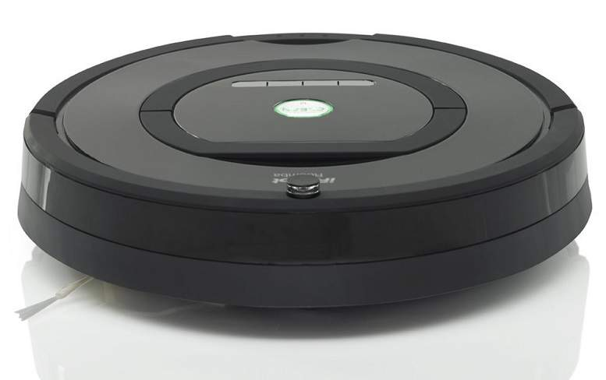
iRobot

Slide 6

Speech Recognition

Slide 7
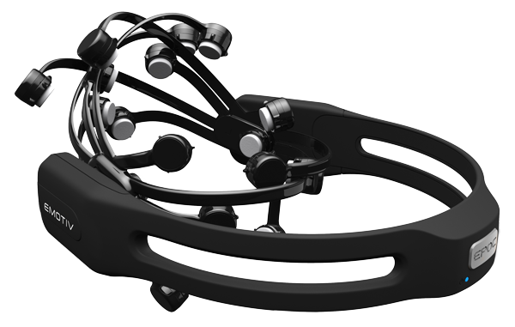
EMOTIV

Slide 8
Video

Slide 9

Implementation

Slide 10
Backbone
EMOTIV
iRobot
Speech Recognition and Web APIs

