Slide 1
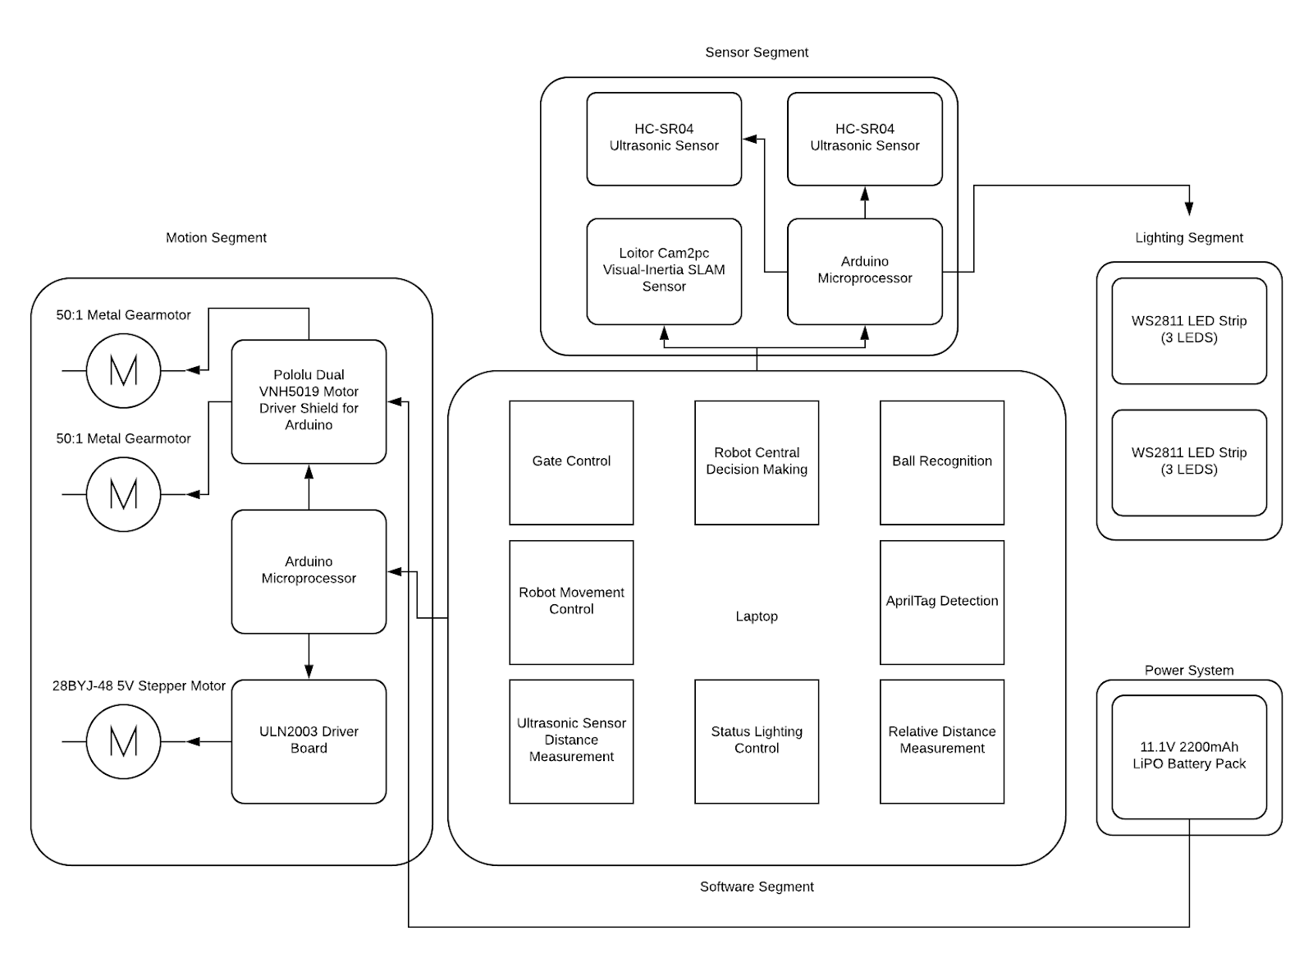



Basketball Retriever (Team B6)
Electrical and Computer Engineering Department
Carnegie Mellon University
Alvin Shi, Wayne Liu, Roy Li
{xiangs1, ruixuanl, tianqil1}@andrew.cmu.edu
Overview
Motivation
This project aims to build an autonomous robot that helps a player retrieve the basketball during shooting practices. The robot should not block the view between the athlete and the basket and it should allow the player to practice at any spot on the court. The robot should start searching for the ball as soon as the basketball has been released by the player, move to the ball, pick the ball up as soon as it can, and bring the ball back to the player. Furthermore, the robot should be smart enough to know whether a ball is in a player’s possession so that it does not interfere with the player’s practice.
When practicing shooting a basketball alone, most of the player’s time is spent retrieving the basketball. In order to maximize practice efficiency, a player can either find someone willing to pick up the basketball after every shot or use a basketball collector. However, neither approach is optimal, as it is difficult to find someone willing to do the menial work and the basketball collector partially blocks the basket. As big fans of the sport, we believe that we can use the advancements in technology to implement a much smarter way of returning the ball back to the player quickly to ensure that the player is getting the most out of the practice session. Hence, the idea of a basketball retriever robot comes to life.
System Architecture
Approach
Evaluation
Specification | Result
Ultrasonic sensor should take at most 2s to determine whether ball is in frame | Time negligible; 0.5s max
The ball recognition module should have 90% accuracy for images taken in ideal conditions | 91.5% accuracy from 200 images
The ball recognition module should be able to process the images at 5 frames per second | Module processes about 10 frames per second
The relative distance module should be accurate within 1m | Accurate within 20cm by estimation
The robot should be able to move at 1m/s in the indoor gym environment | Robot can move at 1.4m/s
The robot should move at an average speed of 0.5m/s towards the basketball or player | Robot can move at 0.6m/s on average after tuning
90% overall success rate in ideal half court. | 75% overall success rate in ideal half court
Additional Information
http://wise.ece.cmu.edu/redmine/projects/safebike/wiki/

