Slide 1
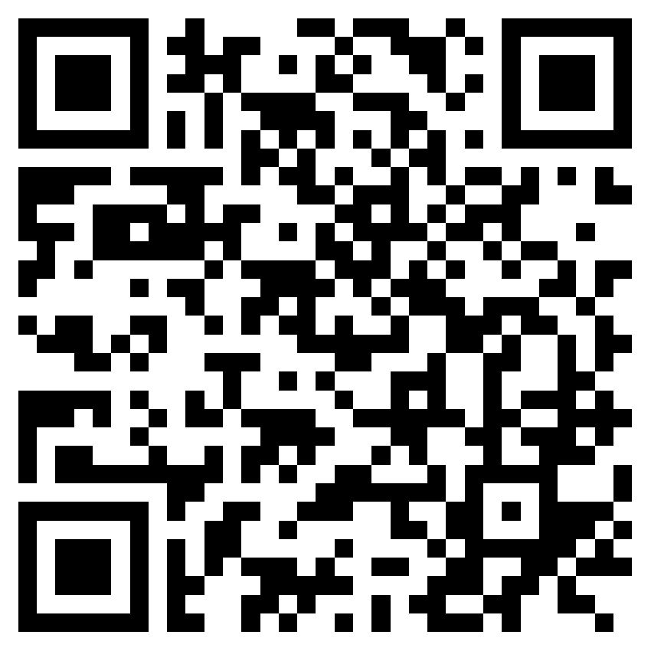


Basketball Retriever (Team B6)
Electrical and Computer Engineering Department
Carnegie Mellon University
Alvin Shi, Wayne Liu, Roy Li
{xiangs1, ruixuanl, tianqil1}@andrew.cmu.edu
Overview
Motivation
System Architecture
Approach
Evaluation
Additional Information
http://wise.ece.cmu.edu/redmine/projects/safebike/wiki/

