Slide 1
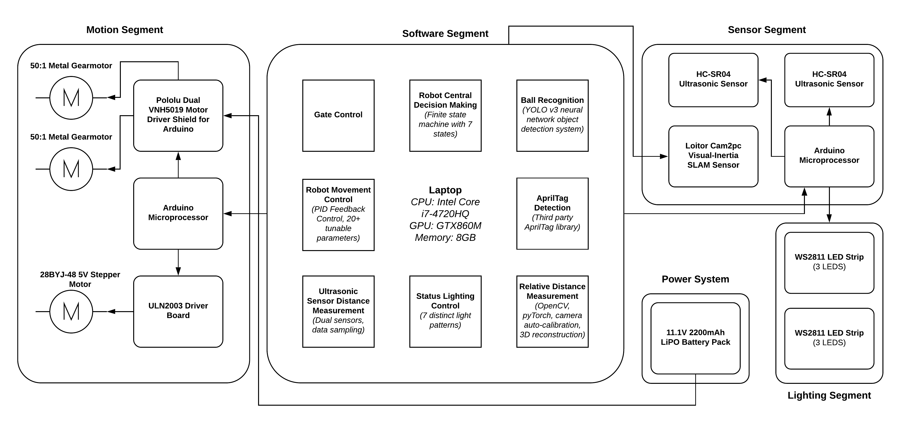
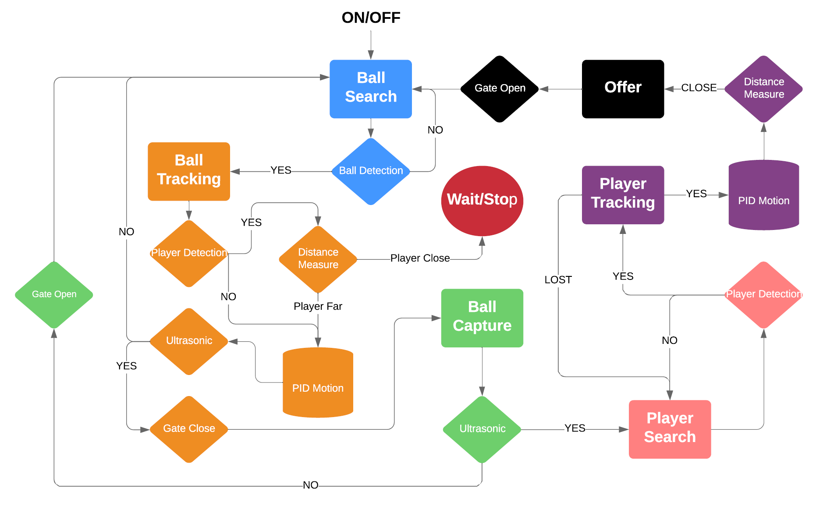



Basketball Retriever (Team B6)
Electrical and Computer Engineering Department
Carnegie Mellon University
Alvin Shi, Wayne Liu, Roy Li
{xiangs1, ruixuanl, tianqil1}@andrew.cmu.edu
Overview
Motivation
This project aims to build an autonomous mobile robot that helps a player to retrieve the basketball during practices. The robot should not block the view between the athlete and the basket and it should allow the player to practice any moves at any spot on the court. The robot should start searching for the ball as soon as the player doesn’t have the ball in control, move to the ball, pick the ball up, and bring the ball back to the player. Furthermore, the robot should be smart enough to know whether a ball is in a player’s possession so that it does not interfere with the player’s practice.
When practicing basketball drills alone, most of the player’s time is spent retrieving the basketball. In order to maximize the practice efficiency, a player can either find a partner or place a basketball collector under the basket. However, neither approach is optimal, as it is difficult to find someone willing to do the menial work and the basketball collector partially blocks the basket. As big fans of the sport, we believe that we can use the advancements in technology to implement a much smarter way of returning the ball back to the player quickly to ensure that the player is getting the most out of the practice session. Hence, the idea of a basketball retriever robot comes to life.
System Architecture
Approach
Evaluation
Specification | Result
Ultrasonic sensor should output a decision within 2s. | Time negligible; 0.5s max.
Ball tracking module should have 90% accuracy. | 91.5% accuracy from 200 images.
Ball tracking module should process at least 5 fps to run in real time. | Module processes at 10 fps.
Stereo vision module should output distance with an error within 1m. | Error within 20cm.
The robot should move at an average speed of 0.5m/s when tracking. | Robot moves at 0.6m/s
90% overall success rate in ideal half court. | 86.7% overall success rate in ideal half court
http://course.ece.cmu.edu/~ece500/projects/s19-teamb6/

