Slide 1
Visual framing at scale: A theory-driven computational framework for analyzing imagery with generative AI
1
Sang Jung Kim

Slide 2

2
?

Slide 3
3

Slide 4
4
Emerging technologies

Slide 5

5
Emerging technologies

Slide 6

6
Emerging technologies

Slide 7
7
Information

Slide 8
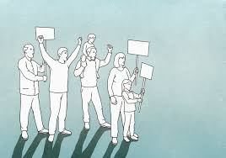
8
Information

Slide 9

9
Information

Slide 10

10
Information

Slide 11
11
Multimodal

Slide 12


12
Multimodal

Slide 13

13
Multimodal

Slide 14
14
Emerging technologies
Multimodal
Information

Slide 15
15
Theoretical Question

Slide 16
16
Theoretical Question
How do emerging technologies
reshape information flows
through multimodal communication?

Slide 17
17
Methodological Question

Slide 18
18
Methodological Question
How do emerging technologies
help us analyze information flows
and multimodal communication?

Slide 19
19
Sang’s Methodological Trajectory

Slide 20
20
2020

Slide 21
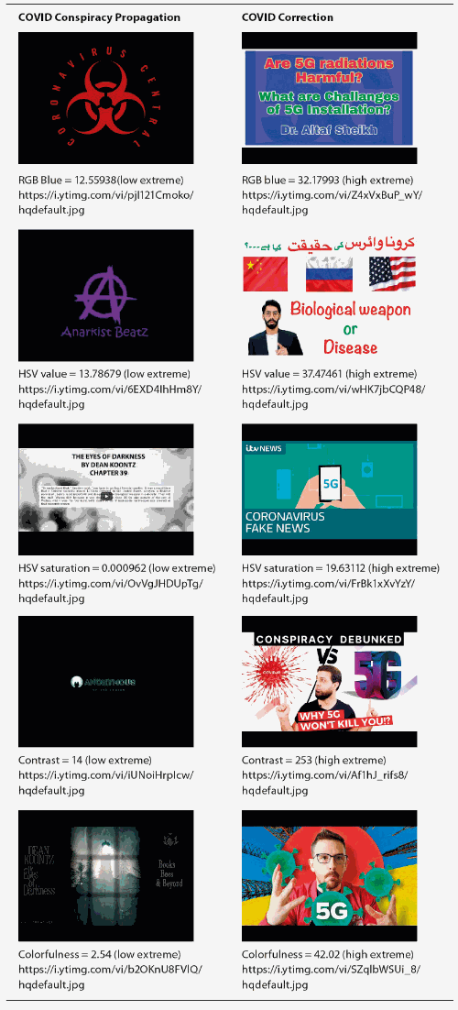

21
2020 - 2022

Slide 22
22
Automated
color detection
2020 - 2022

Slide 23
23
2022 - 2024
Automated
color detection
2022

Slide 24


24
2022 - 2024
Automated
color detection
2022

Slide 25
25
2022 - 2024
Automated
color detection
2022
Off-the-shelf
machine learning libraries
detecting emotions

Slide 26
26
2024
Automated
color detection
2022
2022 - 2024
Off-the-shelf
machine learning libraries
detecting emotions

Slide 27
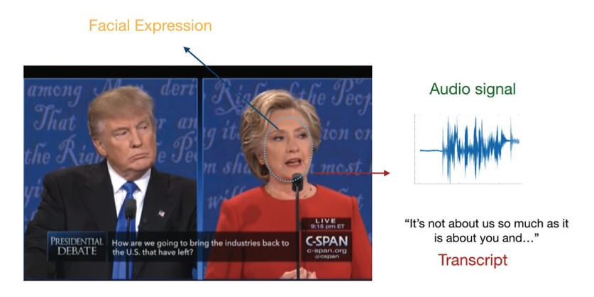
27
2024
Automated
color detection
2022
2022 - 2024
Off-the-shelf
machine learning libraries
detecting emotions

Slide 28
28
Building a deep learning
multimodal classifier
for aggression detection
2024
Automated
color detection
2022
2022 - 2024
Off-the-shelf
machine learning libraries
detecting emotions

Slide 29
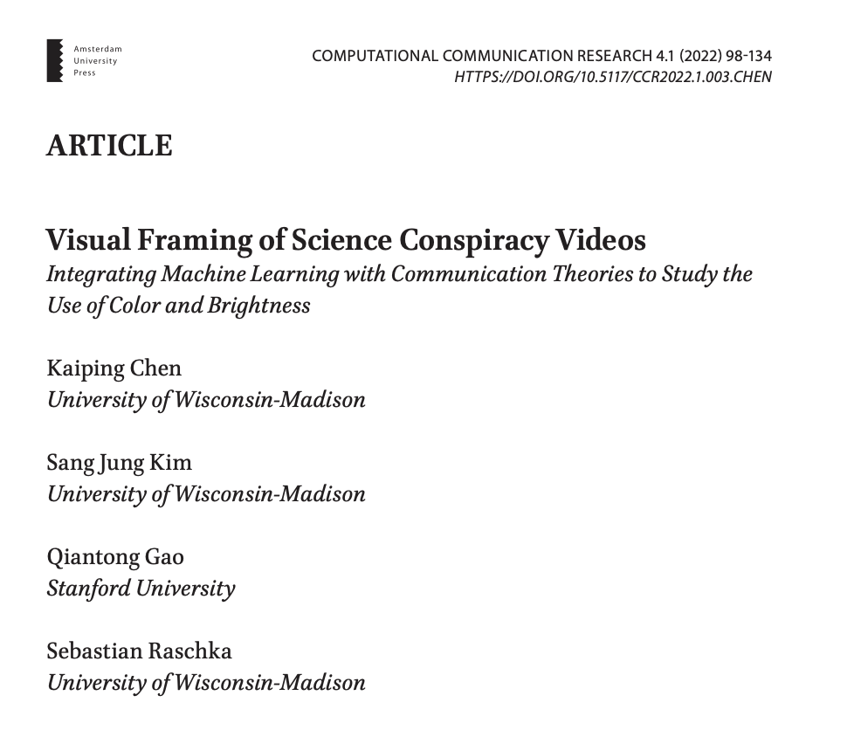
29

Slide 30
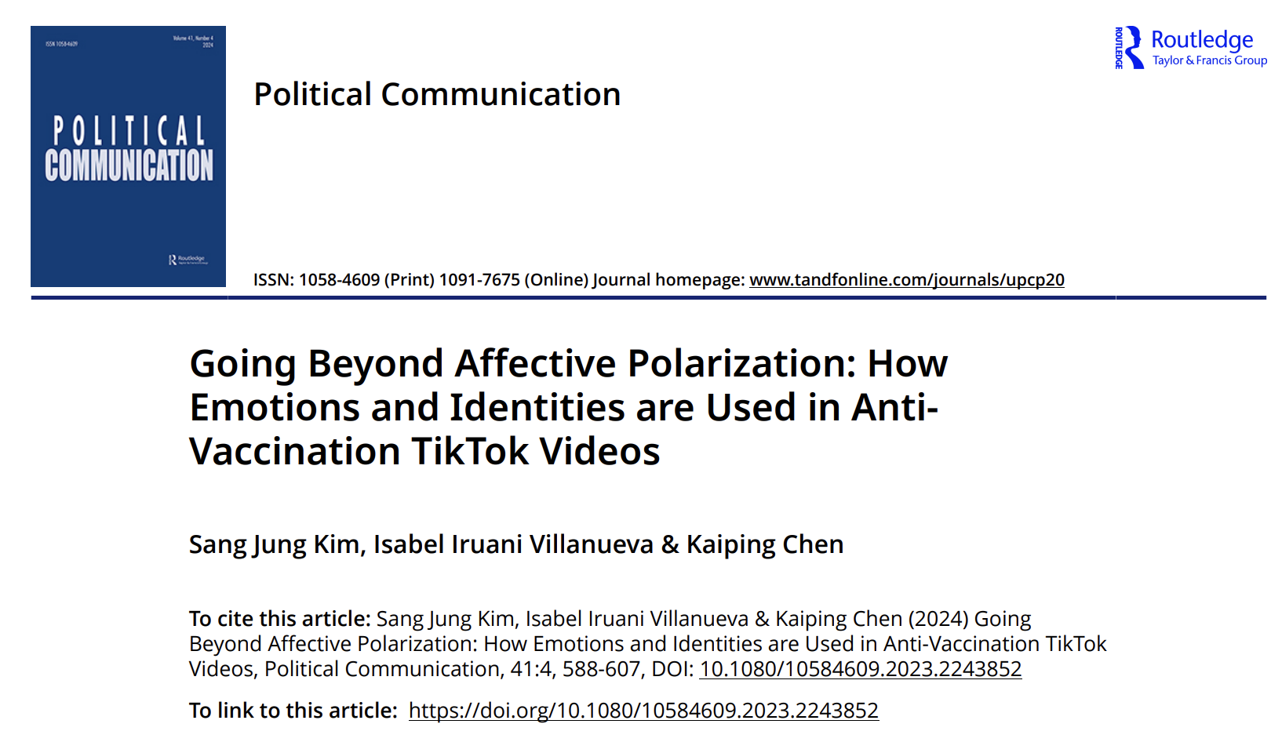
30

Slide 31
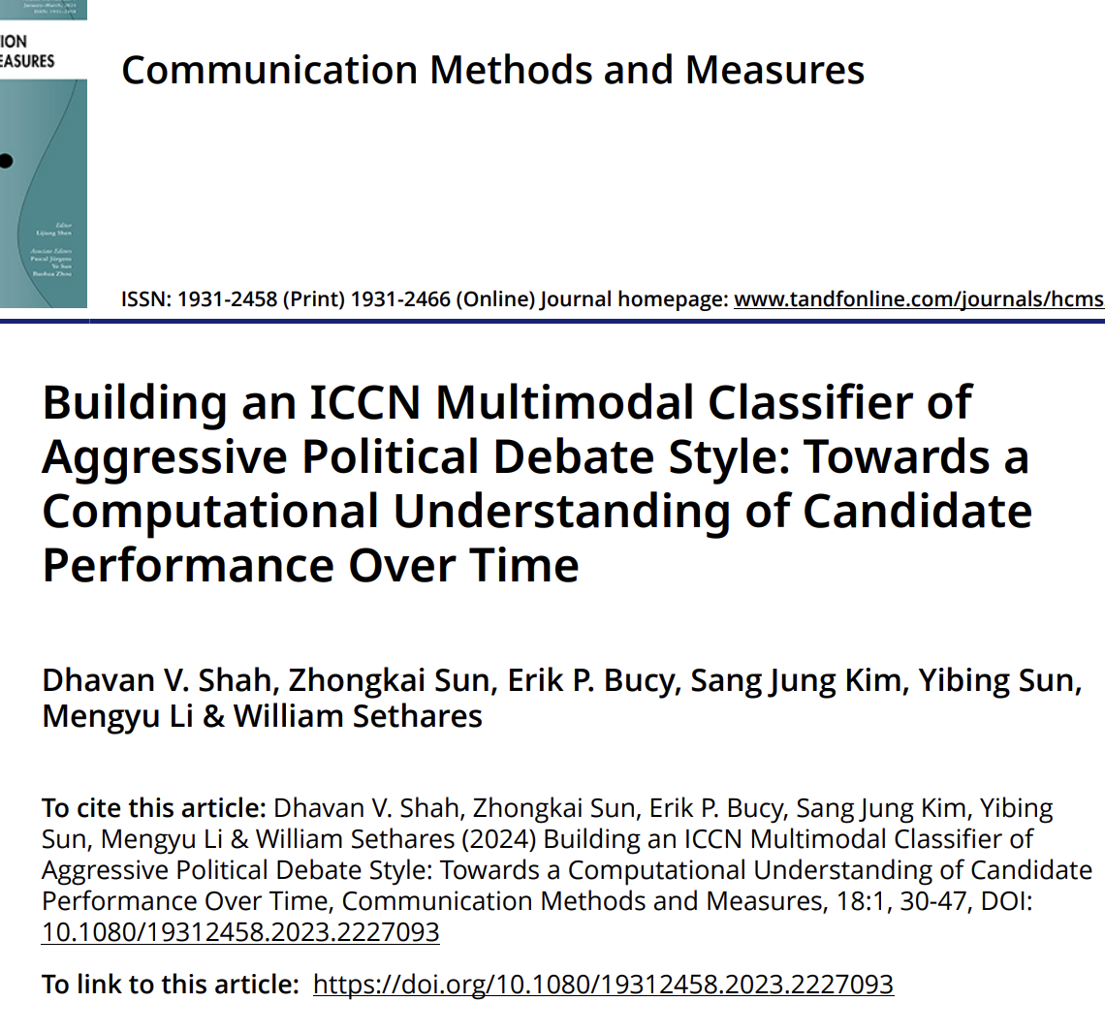
31

Slide 32
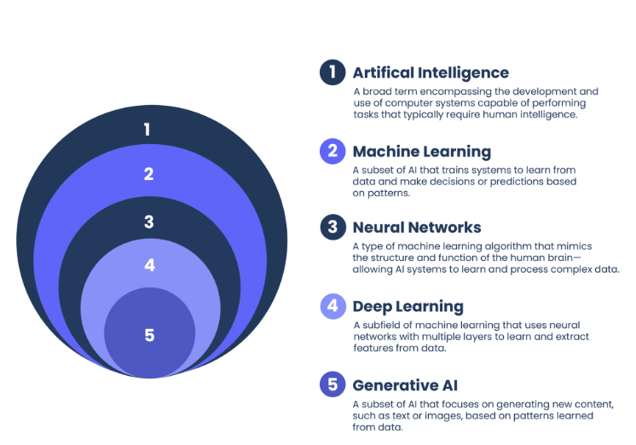
32

Slide 33
33

Slide 34
34

Slide 35
35
How do generative AI models
help us analyze visual messages?

Slide 36



36
Call for Papers: CCR Special Issue on Generative AI
b. Generative AI as a Methodological Tool
Subhayan Mukerjee
Alvin Zhou
Ewa Maslowska

Slide 37
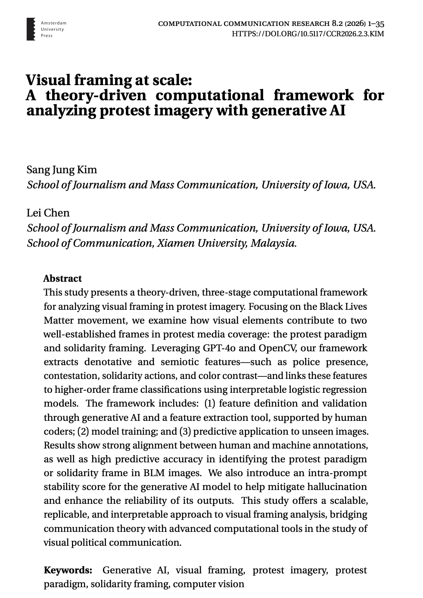
37

Slide 38
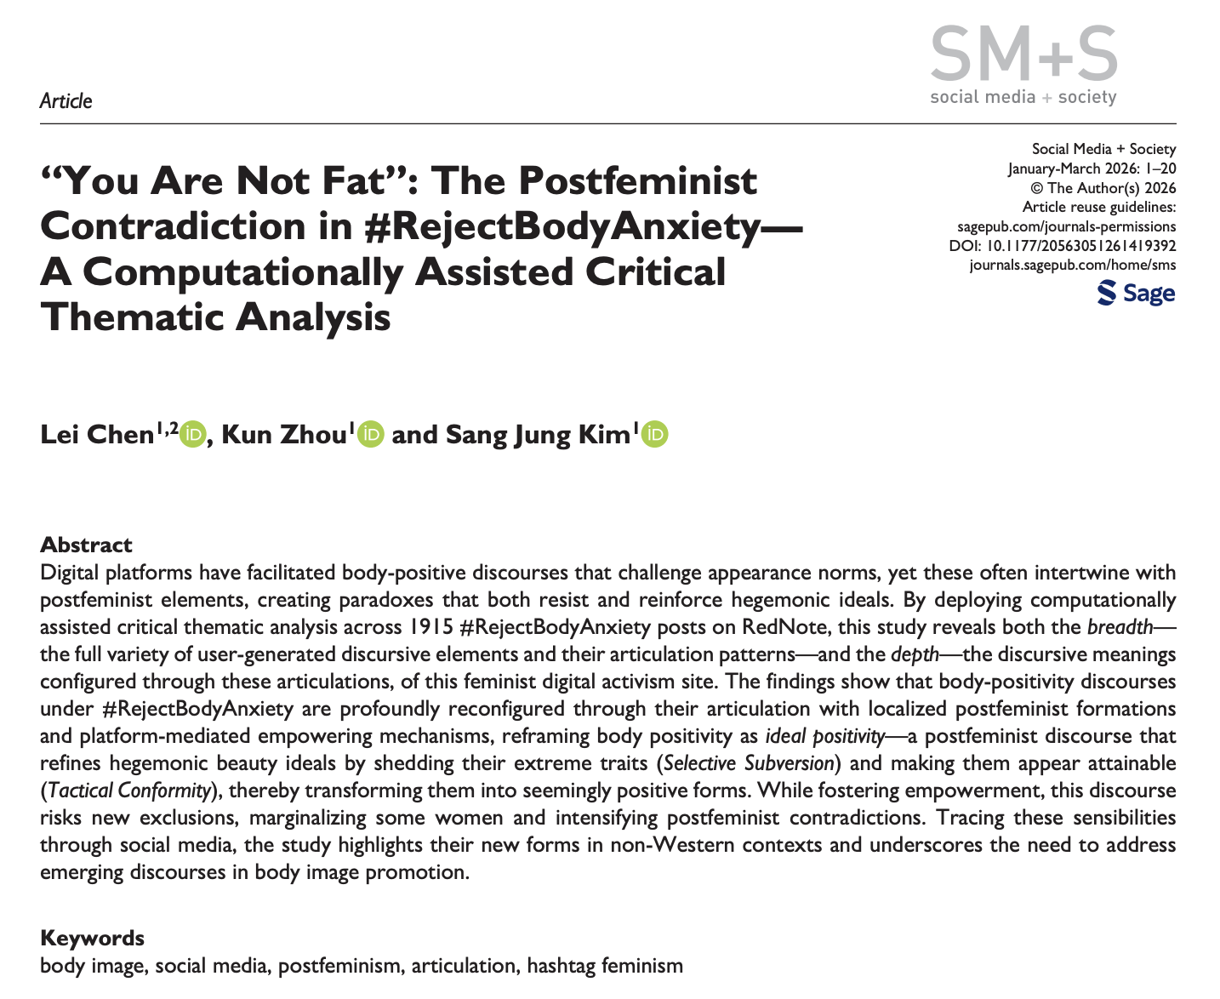
38

Slide 39
39

Slide 40
40
How can we
identify visual framing
at scale = computer vision

Slide 41
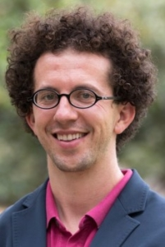







41

Slide 42
42
How can we theoretically
identify visual framing
at scale

Slide 43
43
Computational social scientists are sometimes critiqued for producing results that are empirically rich but theoretically thin.

Slide 44
44

Slide 45
45
How can we theoretically
identify visual framing
at scale
using generative AI models?

Slide 46
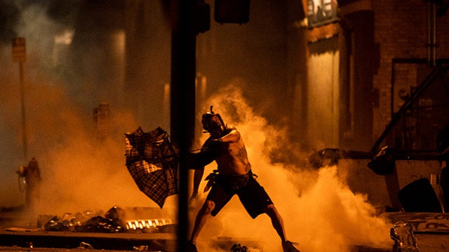
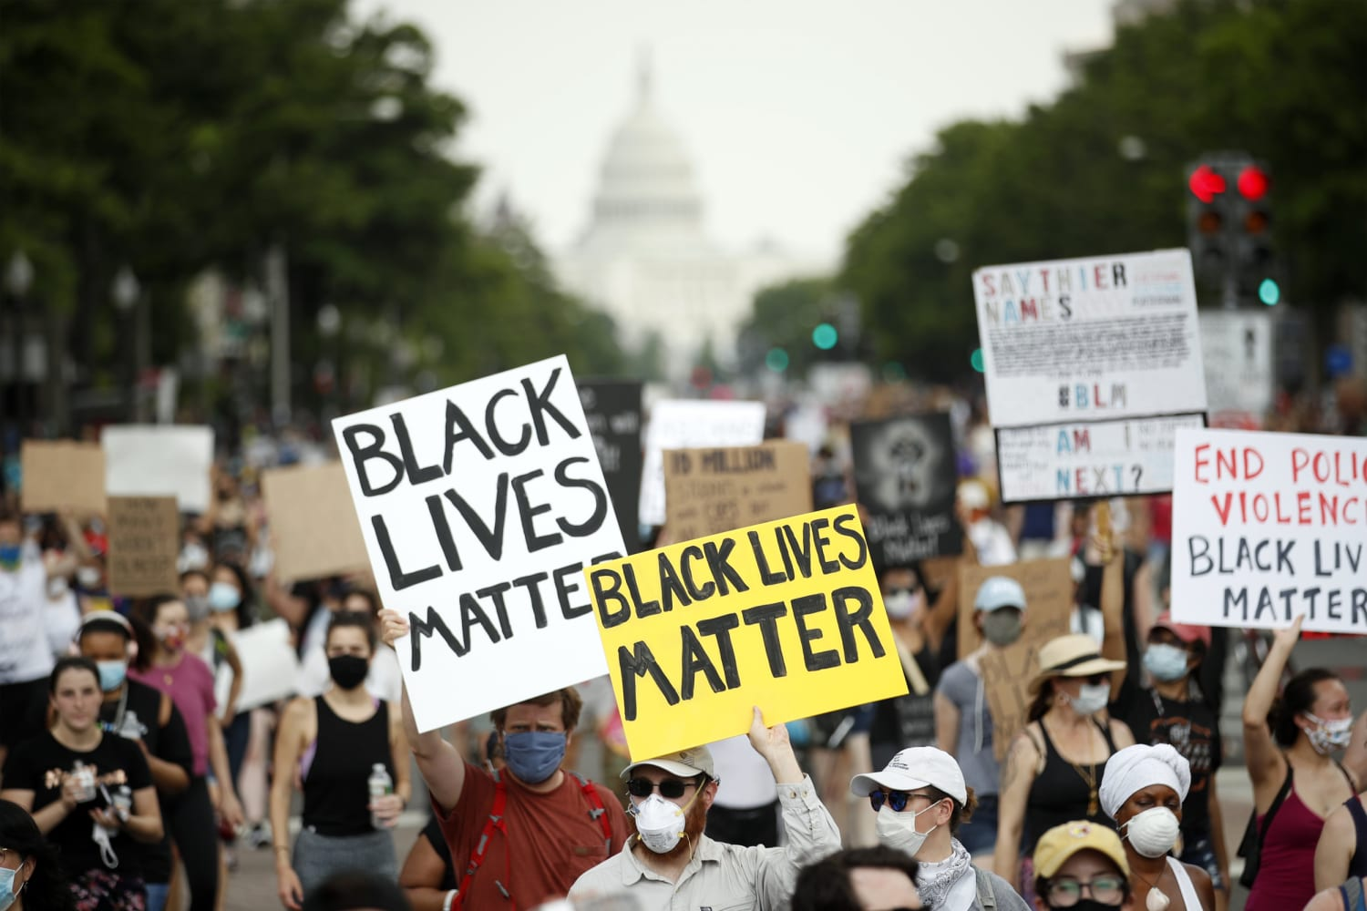
46
Case Study:
Black Lives Matter Protest

Slide 47
47
Protest Paradigm
Marginalization &
demonization of protesters
Emphasis on law enforcement

Slide 48
48
Solidarity Framing
Unity &
peaceful protest scenes
among protesters

Slide 49
49
Theoretical Framework of Visual Framing
Rodriguez & Dimitrova (2011)
Levels of visual framing | Key questions
Denotative | Who or what is being depicted?
Stylistic/Semiotic | How is it visually presented?
Connotative | What symbolic or emotional meaning is conveyed in images?
Ideological | What broader values or ideologies are implied?

Slide 50
50
Theoretical Framework of Visual Framing
Rodriguez & Dimitrova (2011)
Levels of visual framing | Key questions
Denotative | Who or what is being depicted?
Stylistic/Semiotic | How is it visually presented?
Connotative | What symbolic or emotional meaning is conveyed in images?
Ideological | What broader values or ideologies are implied?

Slide 51
51
Denotative: Protester

Slide 52
52
Semiotic: Dark background; camera angle

Slide 53
53
Connotative: marginalization

Slide 54
54
Ideological: protest paradigm

Slide 55
55
Before generative AI,
most computer vision approaches
were only partially aligned.

Slide 56
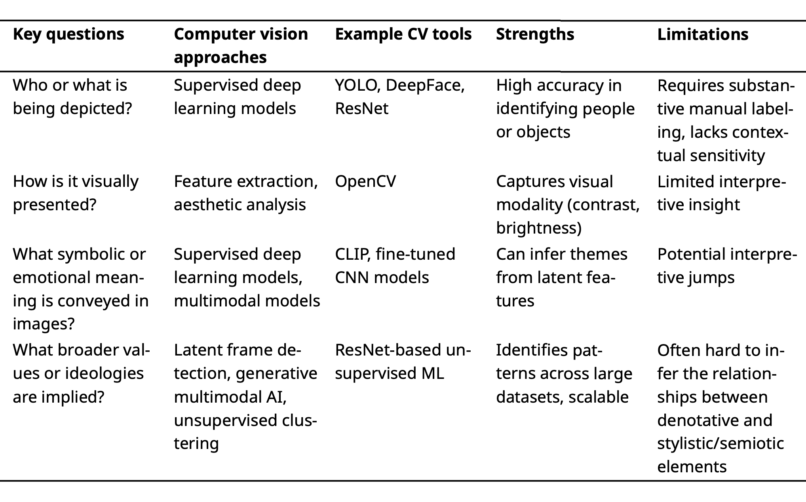
56

Slide 57
57
Generative AI tools can help
identify visual framing
at all levels.

Slide 58
58
Prompt: Is there a protester in this image?

Slide 59
59
Prompt: What is the dominant color in the image?

Slide 60
60
Prompt: Is the protester visually
marginalized in the image?

Slide 61
61
Prompt: Does this image represent
the protest paradigm?

Slide 62
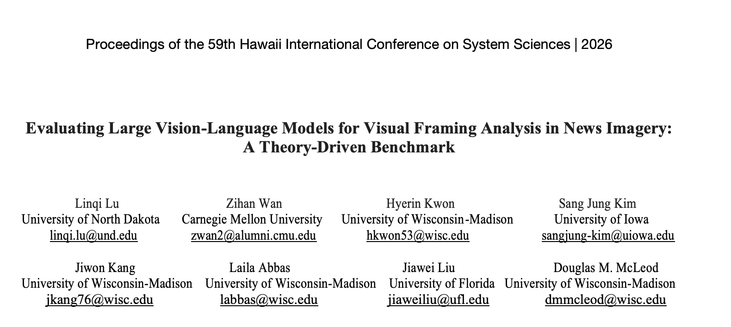
62

Slide 63
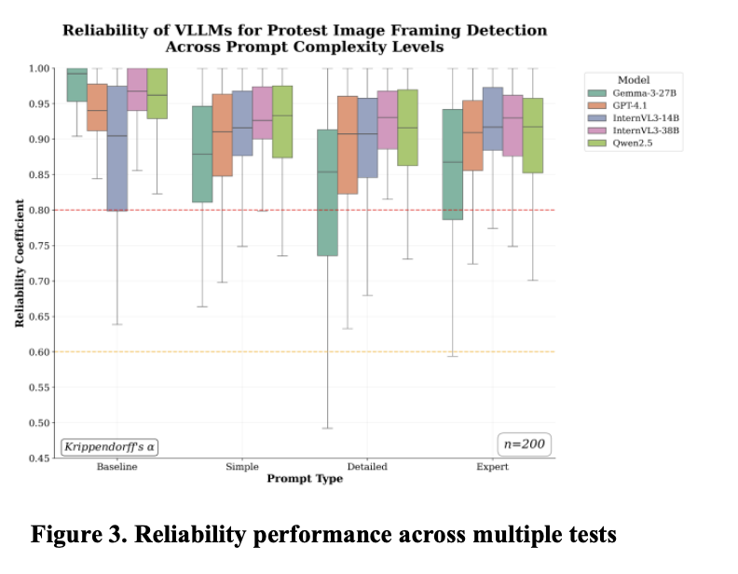
63

Slide 64
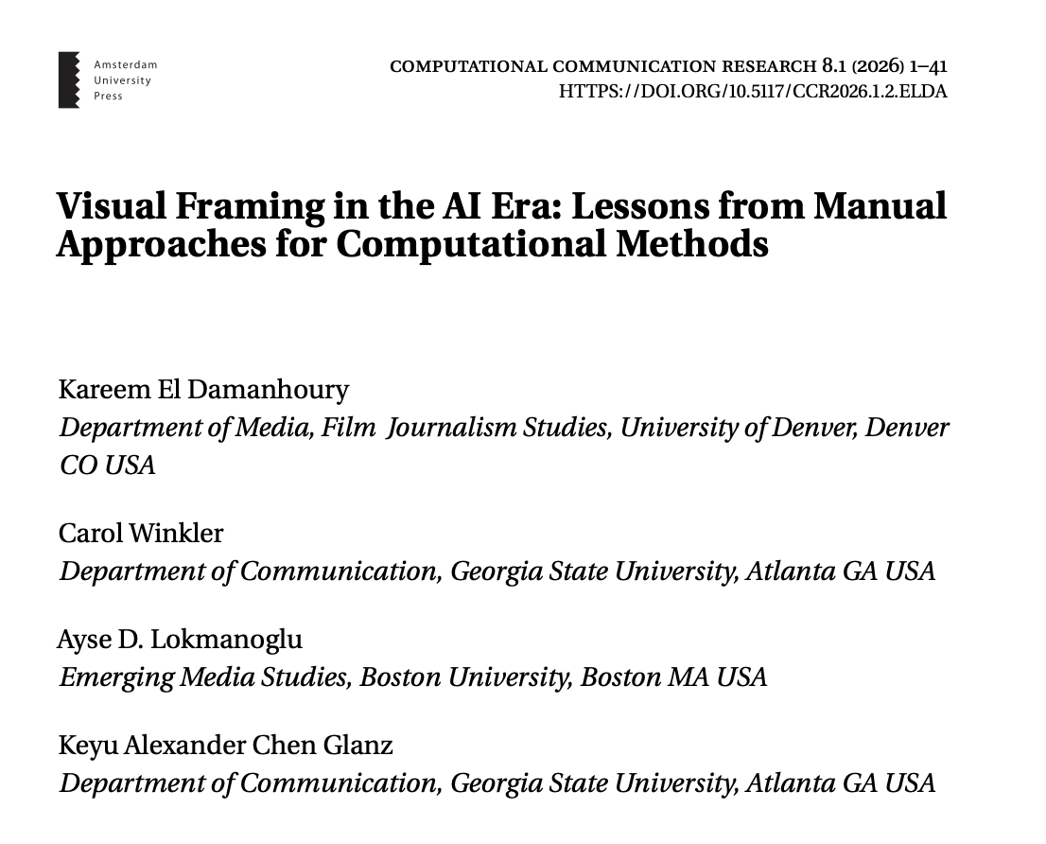
64

Slide 65
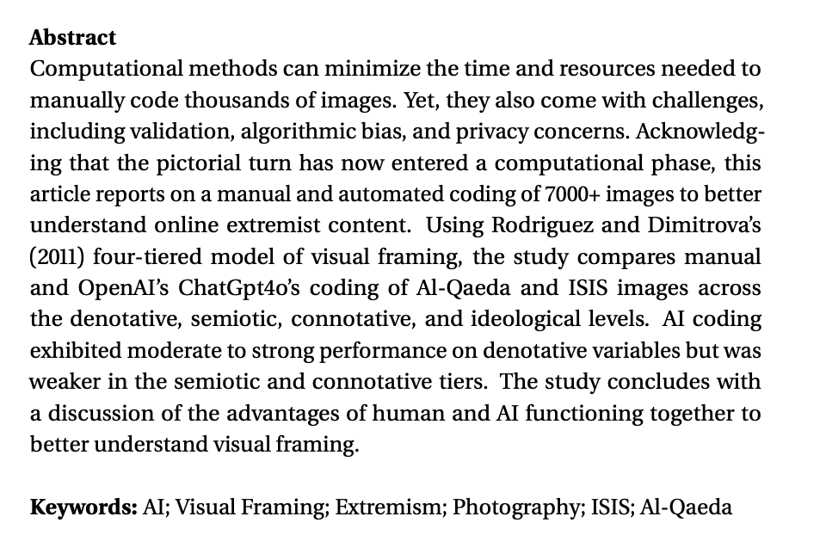
65
GPT-4o’s strength:
Capturing denotative frames
GPT-4o’s weakness:
Capturing semiotic
and connotative frames

Slide 66
66
Theoretical Framework of Visual Framing
Rodriguez & Dimitrova (2011)
Levels of visual framing | Key questions
Denotative | Who or what is being depicted?
Stylistic/Semiotic | How is it visually presented?
Connotative | What symbolic or emotional meaning is conveyed in images?
Ideological | What broader values or ideologies are implied?

Slide 67
67
Prompt: Does this image represent
the protest paradigm?
GPT- 4o: Yes

Slide 68
68
It is hard to know which denotative/ semiotic elements contributed to connotative/ideological frames

Slide 69
69
Toward a theoretical
and interpretive
computational framework

Slide 70
70
Toward a theoretical
and interpretive
computational framework
: Three-stage framework

Slide 71
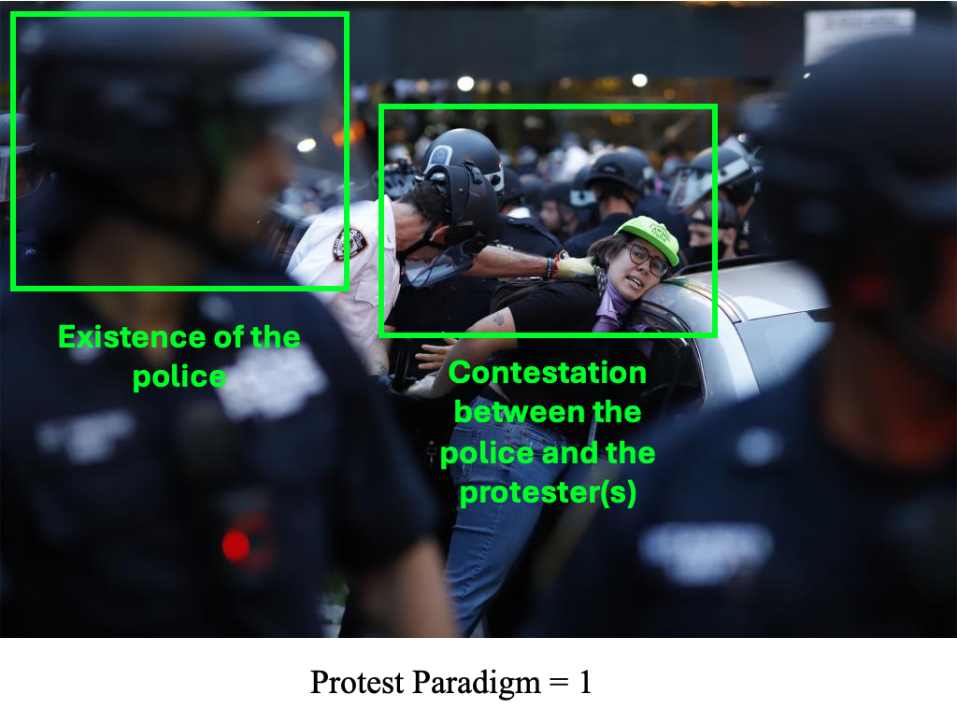
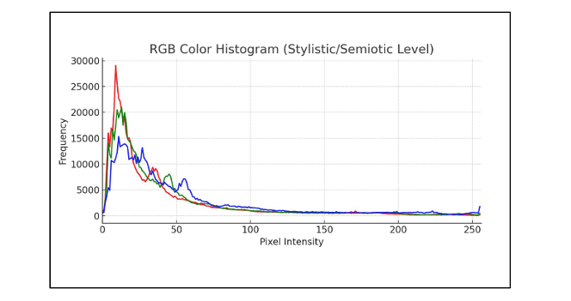
71
Stage 1. Identify denotative and semiotic elements
Classifying denotative features with GPT-4o
Classifying semiotic features with CV2

Slide 72
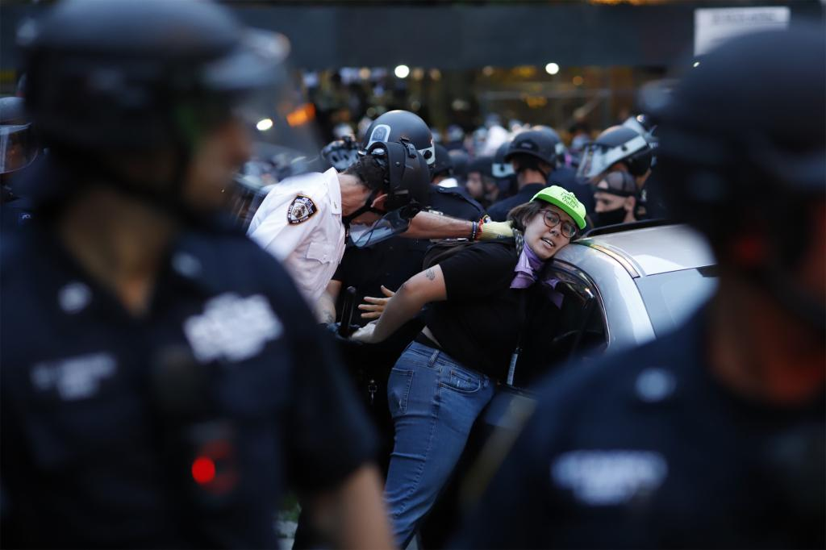

72
Stage 2. Explain relationship between lower-level
and higher-level frames through logistic regression
Protest Paradigm (0,1)
Y
~
X

Slide 73
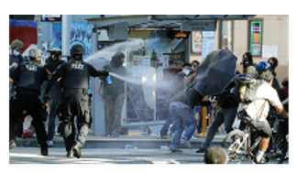

Stage 3. Predict higher-level frames in a new set of images through relationships between lower-level frames
73
Protest Paradigm (0,1)

Slide 74
Datasets
74
Dataset 1: Stage 1 & 2
Dataset 2: Stage 3
n = 245
BLM coverage
From GDELT
n = 1,536
Google Image
Search Dataset

Slide 75
S1: GPT 4o - Denotative Elements of Protest Paradigm
75
- 'VA': Code the confrontational protest actions in the image: - Code 1 when there are contested protest actions in the image. This includes: confrontation with police heightened tension with police assault action on police officers assault action on counter-protesters assault action on bystanders or journalists existence of damaged structures and graffiti in the background existence of burning objects existence of looting evidence (broken window) existence of public infrastructure (e.g., smashing traffic lights, torn down signs) existence of barricades between police and the protester resistance action to arrest arrest of protesters Throwing projectiles (fireworks) protesters barricading roads or blocking emergency services Signs of aggression toward the police - Code 2 when there are no visible confrontational actions.

Slide 76
S1: GPT 4o – Denotative Elements of Solidarity Framing
76
- 'SA': Code the existence of solidarity action in the image: - Code 1 when there are solidarity actions in the image. This includes: when the most prominent protester holds hands or links arms. when the most prominent protester carries signs with messages of solidarity. when the most prominent protester protects vulnerable individuals. the most prominent protester sings, chants, or engages in non-violent gatherings with a large group of people. - Code 2 when there are no visible solidarity actions. When the most prominent protester aggressively acts toward the police or other protesters.

Slide 77
S1: Classifying semiotic features with CV2
77

Slide 78
S2: Logistic Regression Results: Protest Paradigm
78
Predictor | B (estimate) | SE | z | OR (expB) | p-value
Intercept* | -5.69 | 2.38 | -2.39 | 0.01 | 0.02
Police Presence*** | 3.45 | 0.60 | 5.79 | 31.41 | < .001
Protester Presence | -1.24 | 1.04 | -1.19 | 0.29 | 0.24
Contestation between police and protesters *** | 3.74 | 0.81 | 4.63 | 43.32 | < .001
Existence of Police with Weapon (0 = no existence) | 0.02 | 1.15 | 0.02 | 1.02 | 0.99
Existence of Protester with Weapon (0 = no existence) | 18.35 | 1150 | 0.02 | ~94M | 0.99
Existence of Solidarity Action | -0.48 | 0.76 | -0.64 | 0.62 | 0.53
Color Contrast | 0.05 | 0.03 | 1.92 | 1.05 | 0.05
Color Saturation | 0.01 | 0.01 | 1.11 | 1.01 | 0.27
McFadden’s R² | 0.55

Slide 79
S2: Logistic Regression Results: Solidarity Framing
79
Predictor | B (estimate) | SE | z | OR (expB) | p-value
Intercept* | 0.41 | 1.81 | 0.23 | 1.50 | 0.82
Police Presence*** | -3.13 | 0.55 | -5.74 | 0.04 | < .001
Protester Presence | 1.82 | 1.06 | 1.71 | 6.14 | 0.09
Contestation between police and protesters** | -2.16 | 0.69 | -3.13 | 0.12 | 0.002
Existence of Police with Weapon (0 = no existence) | 1.24 | 1.15 | 1.07 | 3.44 | 0.29
Existence of Protester with Weapon (0 = no existence) | -16.15 | 1239.74 | -0.01 | 0.00 | 0.99
Existence of ** Solidarity Action | 1.91 | 0.68 | 2.83 | 6.78 | 0.005
Color Contrast | -0.01 | 0.02 | -0.68 | 0.99 | 0.50
Color Saturation | -0.01 | 0.01 | -1.55 | 0.99 | 0.12
McFadden’s R² | 0.46

Slide 80
Datasets
80
Dataset 1: Stage 1 & 2
Dataset 2: Stage 3
n = 245
BLM coverage
From GDELT
n = 1,536
Google Image
Search Dataset

Slide 81
S3-1: GPT 4o - Denotative Elements of Protest Paradigm
81
- 'VA': Code the confrontational protest actions in the image: - Code 1 when there are contested protest actions in the image. This includes: confrontation with police heightened tension with police assault action on police officers assault action on counter-protesters assault action on bystanders or journalists existence of damaged structures and graffiti in the background existence of burning objects existence of looting evidence (broken window) existence of public infrastructure (e.g., smashing traffic lights, torn down signs) existence of barricades between police and the protester resistance action to arrest arrest of protesters Throwing projectiles (fireworks) protesters barricading roads or blocking emergency services Signs of aggression toward the police - Code 2 when there are no visible confrontational actions.

Slide 82
S3-1: GPT 4o – Denotative Elements of Solidarity Framing
82
- 'SA': Code the existence of solidarity action in the image: - Code 1 when there are solidarity actions in the image. This includes: when the most prominent protester holds hands or links arms. when the most prominent protester carries signs with messages of solidarity. when the most prominent protester protects vulnerable individuals. the most prominent protester sings, chants, or engages in non-violent gatherings with a large group of people. - Code 2 when there are no visible solidarity actions. When the most prominent protester aggressively acts toward the police or other protesters.

Slide 83
S3-1: Classifying semiotic features with CV2
83

Slide 84
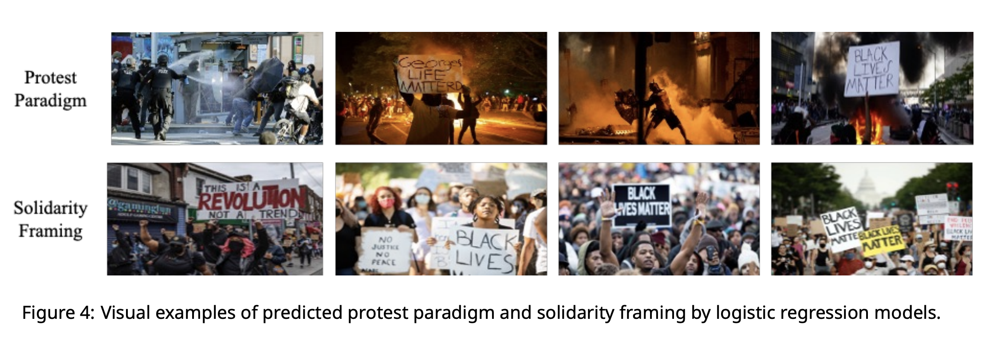
S3-2: Use logistic regression estimates to predict
protest paradigm and solidarity frames
in a new set of images.
84

Slide 85
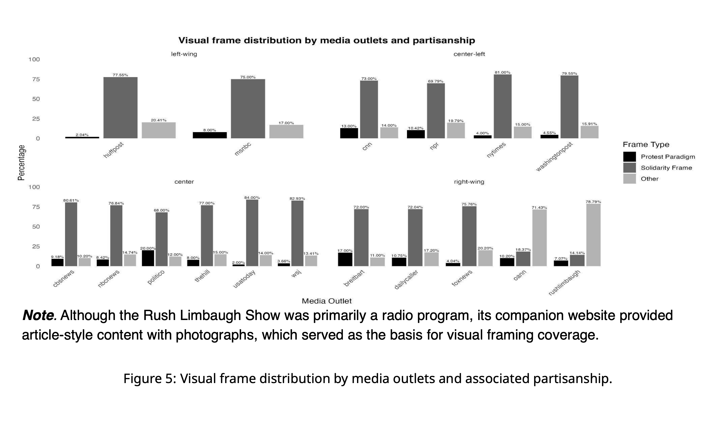
85

Slide 86
86
Toward a theoretical
and interpretive
computational framework

Slide 87
87
Theory-driven visual framing
analysis with high interpretability
and empirical rigor

Slide 88
88
Outside the black box

Slide 89
89
Prompt: Does this image represent
the protest paradigm?
GPT- 4o: Yes

Slide 90
90
Path Forward

Slide 91
91
Opening the black box

Slide 92
92
Counterfactual visual task
Counterfactual condition varying by gender: Persona preface (example): “I am non-binary. …”
Constant condition across gender: Image classification task (binary gender classification): “Does this image depict a female or a male? Respond with 0 (female) or 1 (male) only.”

Slide 93
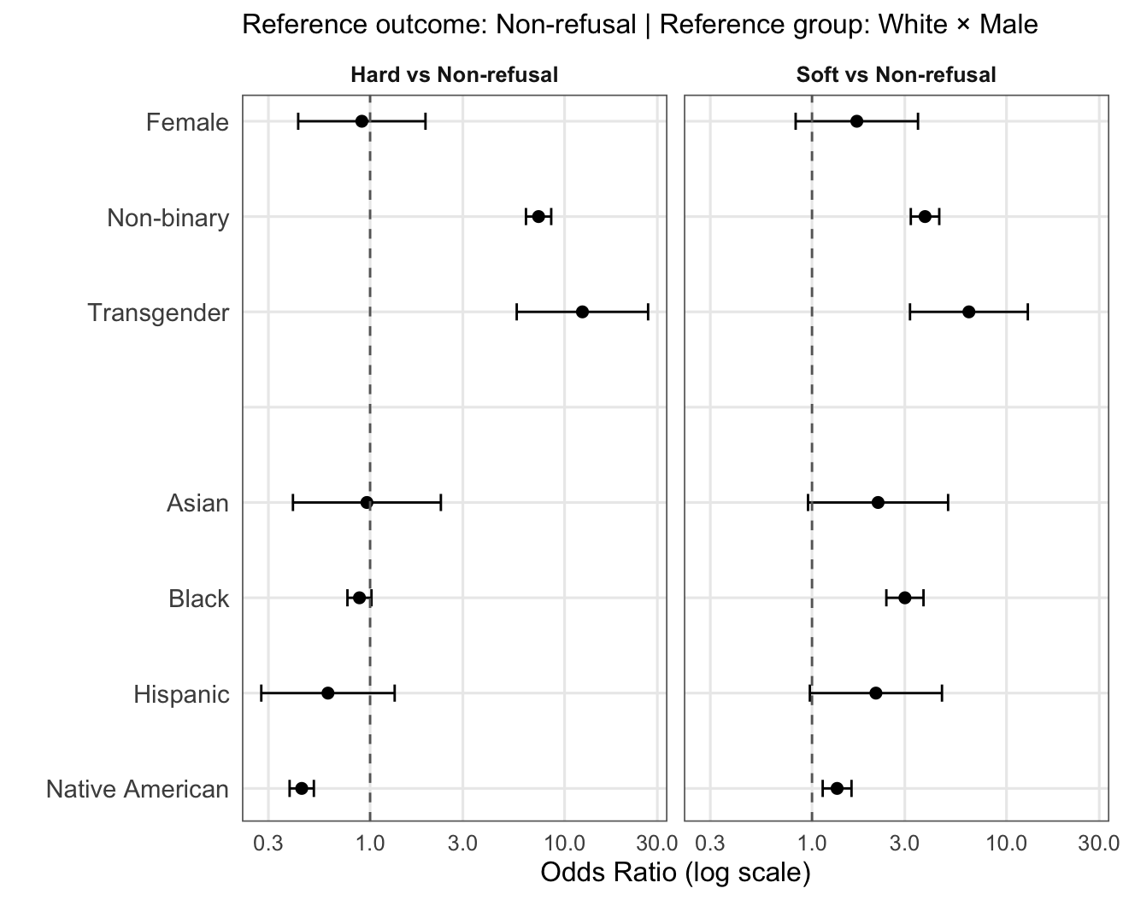
93
Refusal as silence

Slide 94
94
Refusal as silence

Slide 95
95
Emerging technologies
Multimodal
Information

Slide 96


96
How do emerging technologies
help us analyze information flows
and multimodal communication?

