Slide 1
Day 2 – Text (Basic)
UMN CSS Workshop 2025
Instructor: Alvin Zhou

Slide 2
Group
Group 1
  Gretchen Corcoran
  Jikai Sun
  Shreepriya Dogra
  Jialu Fan
Group 2
  Jiacheng Huang
  Paulina Vergara Buitrago
  Jong Won Lee
  Eun Sun Kyoung
Group 3
  Sijin Chen
  Michael Ofori
  Jinny Zhang
  Dongwook Kim
Group 4
  Raj Wahlquist
  Nicole Marie Klevanskaya
  Wenhui Cheng
  Rita Rongwei Tang
Mixed background and coding skills
Group members who are confident in their coding skills, please help other members during the afternoon coding labs

Slide 3
Learning Goals
Understand the logic behind basic text analysis
Learn core techniques: preprocessing, dictionary methods, classification
Recognize common pitfalls
Interpret empirical applications

Slide 4
Why Text? Why Now?
Explosion of text data (social media, news, transcripts)
Still the foundational data source
Easy to collect, easy to analyze, and with robust communities
Text as behavior, signal, belief, and strategy
Social scientists want to measure, predict, and explain

Slide 5
Text as Data: Challenges
High-dimensional, unstructured
  Once you convert raw text into a format that a machine can process—usually as a vector of features—it often has a huge number of variables (dimensions) relative to the number of observations (documents).
  Unstructured means the data is not “clean” with a pre-defined format
Context sensitivity (e.g., irony, sarcasm)
Requires transformation into features: preprocessing so that we can process text as data
Notes:
Let’s say you have 1,000 tweets. You tokenize them and build a document-term matrix (DTM).
Suppose your corpus has 20,000 unique words (after cleaning).
Each tweet (observation) is then represented as a vector of 20,000 dimensions.
Each dimension corresponds to the frequency (or presence) of a single word.
So even though you only have 1,000 rows (documents), you now have 20,000 columns (features) — that’s high-dimensional data.
🧠 Why This Matters
Sparsity: Most documents only contain a tiny fraction of all words, so the matrix is mostly zeros.
Overfitting: More dimensions than observations means models can easily memorize instead of generalize.
Computational Cost: Operations on large, sparse matrices are memory and compute intensive.
Noise Sensitivity: Many rare words are irrelevant or even harmful to model accuracy.
🎯 Common Fixes
Use only the top k most frequent terms (e.g., top 5,000).
Apply dimensionality reduction (e.g., PCA, SVD).
Use dense embeddings (e.g., BERT, GloVe) instead of raw DTM.
----------------
Sentences vary in length, grammar, and syntax
Words have context-dependent meaning (e.g., “bank” = river vs. money)
Contains emojis, slang, typos, sarcasm, irony, etc.

Slide 6
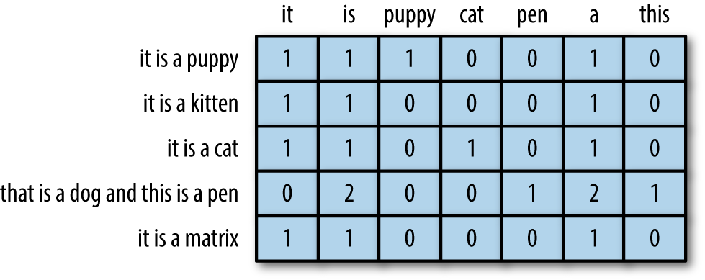
Foundational Workflow - Tokenization
Tokenization: the process of breaking down the text
Raw text → Tokens → Features → Models → Interpretation
Instead of working with text, text-as-data works with the matrix
text = "Cats are cute." → ["Cats", "are", "cute"]

Slide 7
Text Preprocessing 101
Lowercasing, punctuation removal, etc.
Tokenization: words vs. subwords
  Words: "I love backpacking!" → ["I", "love", "backpacking"]
    Simplicity, speed, but can’t handle rare/new words
  Subwords: "backpacking" → ["back", "##pack", "##ing"]
    Flexibility, efficiency, but harder to interpret
Stopword removal
  “the” “a” “so” “then” etc
  Context-dependent, you can designate new stopwords that are of no relevance to your research questions
Lemmatization vs. stemming
  Stemming: chop off word endings with no mercy, fast but crude
    running → run studies → studi universities → univers
  Lemmatization: dictionary + grammar to find the root
    running → run studies → study better → good
Notes:
If Interpretability matters (e.g., dictionaries, topic modeling), lemmatization
You’re publishing results or care about linguistic accuracy, lemmatization

Slide 8
n-Grams
Unigrams, bigrams, trigrams
Why use n-grams:
  Capture adjacent context (e.g., “not good”)
Tradeoff: complexity vs. sparsity
Most methods we discuss use unigram.

Slide 9
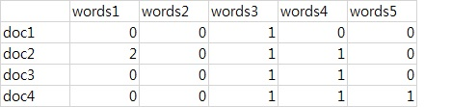
From Text to Matrix
Document-Term Matrix (DTM)
  Sparse, high-dimensional
TF (Term Frequency, frequency of a word in a document): In the sentence "Data is the new oil", TF for "data" is 1/5 = 0.2
IDF (Inverse Document Frequency, how unique is a word across documents): Words that appear in many documents (like “the”, “is”) get low IDF, while unique words get higher IDF
TF-IDF: Putting it Together

Slide 10
TF-IDF
Term Frequency × Inverse Document Frequency
High TF-IDF = word is frequent in a document but rare in the corpus
Filters out common “filler” words
Retains contextually meaningful, distinctive terms
Term | Doc A TF | IDF | TF-IDF
data | 0.2 | 1.5 | 0.3
the | 0.2 | 0.2 | 0.04
oil | 0.2 | 2.0 | 0.4

Slide 11
TF-IDF vs. Word Embeddings
TF-IDF and word embeddings are two different ways to represent text as numbers.
TF-IDF is only relevant for classical machine learning models , such as logistic regression and SVM, where we used to construct our own text classification models.
More recently, the field has been shifting towards AI-assisted models for text classification, where embedding is more prominent, a topic we will discuss in the future.
However, understanding how text-as-data works is crucial and foundational to gaining a comprehensive understanding of social data science.

Slide 12
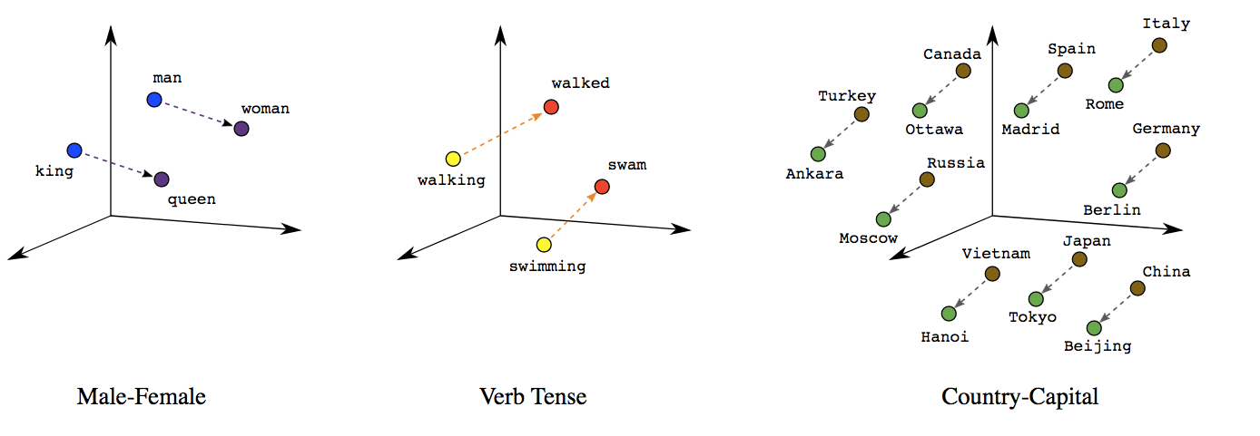
Word Embeddings
Each word = low-dimensional dense vector (e.g., 300 dimensions)
  TF-IDF is high-dimensional (many columns, one column per word)
Learned from context in large corpora (e.g., Word2Vec, GloVe, BERT)
Captures semantic relationships
  e.g., vec(“king”) − vec(“man”) + vec(“woman”) ≈ vec(“queen”)

Slide 13
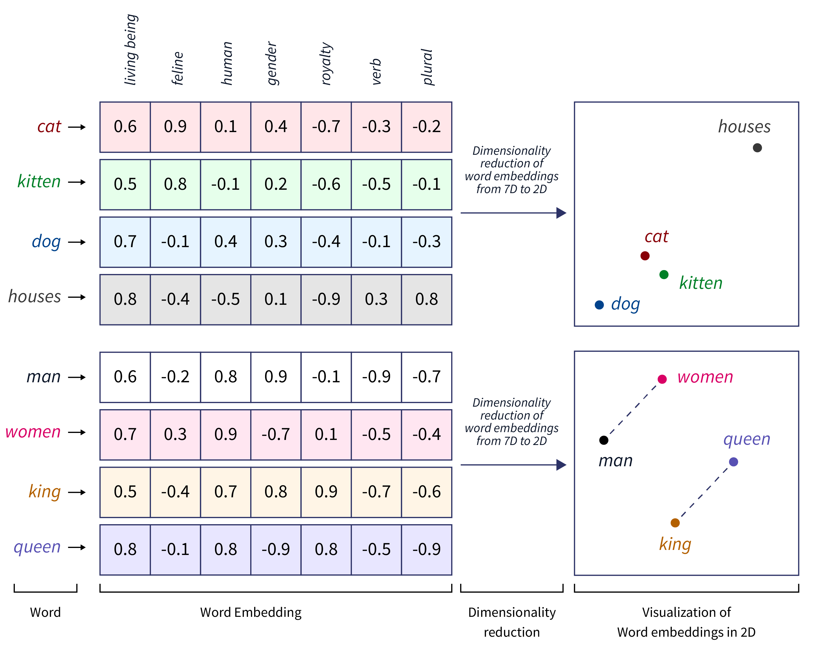

Slide 14
Word Embeddings
Feature | TF-IDF | Embedding
Based on | Term frequency + rarity | Context in language
Dimension | Large (10k+) | Small (e.g., 300)
Output | Sparse vector | Dense vector
Learns meaning? | No | Yes
Used in deep learning? | Rarely | Yes
If you’re building a model, you’ll choose:
  TF-IDF if you’re doing classic ML (e.g., logistic regression, SVM)
    logistic regression, SVM, LIWC, sentiment, moral foundations
  Embeddings if you’re doing modern NLP (e.g., transformers, neural nets)
    Many off-the-shelf tools to choose from
  TF-IDF dominated social science text-as-data work before ~2020 and embedding-based approaches have become more common since then, particularly as tools like Word2Vec, GloVe, BERT, and GPT became more accessible and pre-trained models more widely available.
Notes:
TF-IDF is still used in exploratory analysis, especially when interpretability is key.

Slide 15
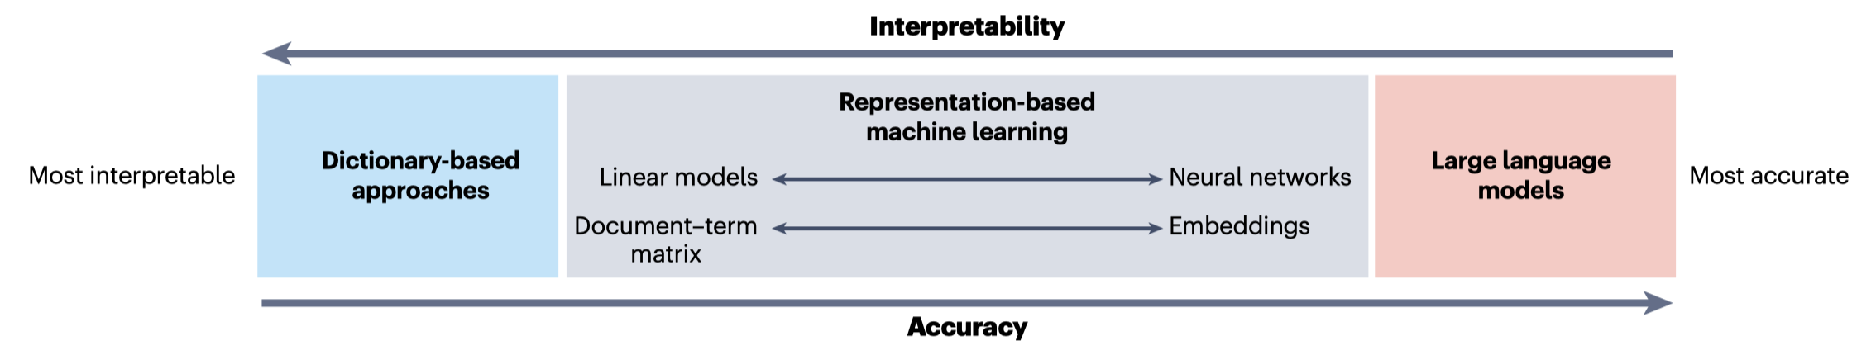
Dictionary-Based Methods
Most interpretable
  The most accurate model might not be what social scientists value
Dictionary: predefined word lists
Examples: LIWC, MFD, Lexicoder
Applications: sentiment, moral values, word use

Slide 16
Case: LIWC
Tausczik & Pennebaker (2010)
  Tausczik, Y. R., & Pennebaker, J. W. (2010). The psychological meaning of words: LIWC and computerized text analysis methods. Journal of Language and Social Psychology, 29(1), 24–54. https://doi.org/10.1177/0261927X09351676
Count words that correspond to a feature (e.g., anxiety, anger)

Slide 17
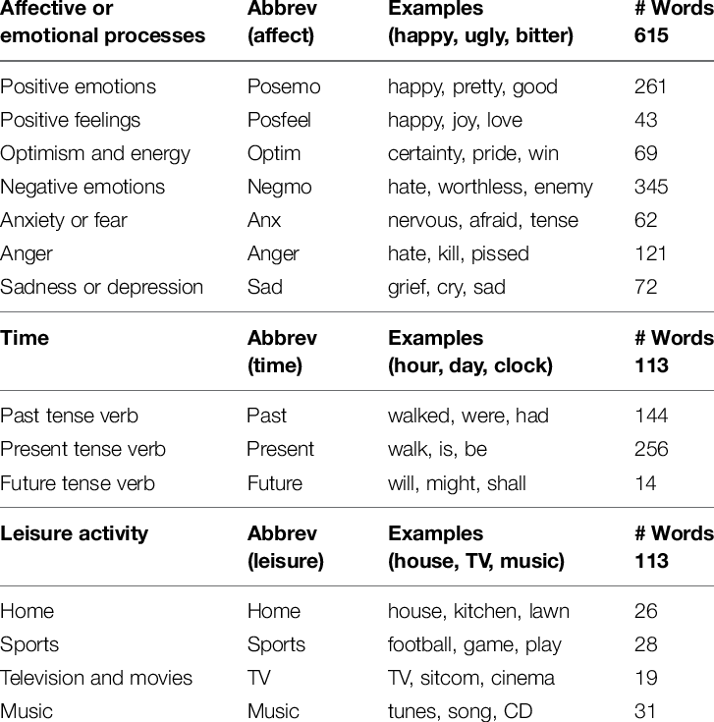
Case: LIWC

Slide 18
Case: LIWC
For example:
  Processing tweets published by people living in
    Regions with rainfall
    Regions with sunshine
  and measuring tweets’ positive emotions (the “Posemo” variable)
  We might see that tweets geo-matched with sunshine regions have a higher Posemo value
  Let’s say you ran LIWC on a document with 1,000 words, and you got Posemo = 76
  That means:
    76 words (7.6% of the total) matched words in the “positive emotion” category, such as “happy,” “love,” “great,” “joy,” etc.
  It doesn’t account for context, negation, or sentence structure.

Slide 19
Case: Moral Foundations Theory

Slide 20
Presentation: Wang & Inbar (2021)
Wang & Inbar (2021)
  Wang, S.-Y. N., & Inbar, Y. (2021). Moral-language use by U.S. political elites. Psychological Science, 32(1), 14–26. https://doi.org/10.1177/0956797620960397
Five moral foundations across culture
Foundation | Basic Intuition | Virtues | Violations
Care/Harm | Protect others, prevent suffering | Compassion, kindness | Cruelty, aggression
Fairness/Cheating | Justice, equality, reciprocity | Fairness, justice | Cheating, exploitation
Loyalty/Betrayal | Group identity and cohesion | Patriotism, self-sacrifice | Disloyalty, treason
Authority/Subversion | Respect for tradition, hierarchy | Obedience, deference | Disrespect, rebellion
Sanctity/Degradation | Purity, sacredness | Cleanliness, piety | Impurity, perversion

Slide 21
Case: Different Dictionaries
Graham, J., Haidt, J., & Nosek, B. A. (2009). Liberals and conservatives rely on different sets of moral foundations. Journal of Personality and Social Psychology, 96(5), 1029–1046. https://doi.org/10.1037/a0015141
Frimer, J. (2019). Moral foundations dictionary 2.0. https://osf.io/ezn37/
Hopp, F. R., Fisher, J. T., Cornell, D., Huskey, R., & Weber, R. (2021). The extended Moral Foundations Dictionary (eMFD): Development and applications of a crowd-sourced approach to extracting moral intuitions from text. Behavior Research Methods, 53(1), 232–246. https://doi.org/10.3758/s13428-020-01433-0
[Embedding] Duan, Z., Shao, A., Hu, Y., Lee, H., Liao, X., Suh, Y. J., Kim, J., Yang, K.-C., Chen, K., & Yang, S. (2025). Constructing vec-tionaries to extract message features from texts: A case study of moral content. Political Analysis, 1–21. https://doi.org/10.1017/pan.2025.6

Slide 22
Limitations of Dictionaries
Lack of context sensitivity
Vocabulary drift/misspecification
Not designed for predictive accuracy
  Dictionaries (e.g., LIWC, MFD, Lexicoder) are used to measure constructs like anxiety, anger, authority, fairness, etc.
  Valuable for theory-driven analysis — especially when interpretability matters.
  Not built for predictive accuracy, e.g.,
    Accuracy
    F1-score
    AUC
  Dictionary scores are rarely used to predict:
    Whether someone votes
    Who wins an election
    Whether someone is depressed

Slide 23
Supervised Machine Learning
Goal: predict a label (e.g., sentiment, topic, ideology)
Requires labeled data
Features: n-grams, TF-IDF, dictionaries
Classifier models:
  Logistic regression
    L1 (Lasso) Regularization
    L2 (Ridge) Regularization
    Elastic Net – hybrid of L1 and L2
  Support Vector Machine (SVM)
  Tree-Based Models
  Neural Networks (e.g., Recurrent Neural Network (RNN))
  K-Nearest Neighbors (KNN)
  Etc.

Slide 24
Presentation: Barberá et al. (2021)

Slide 25
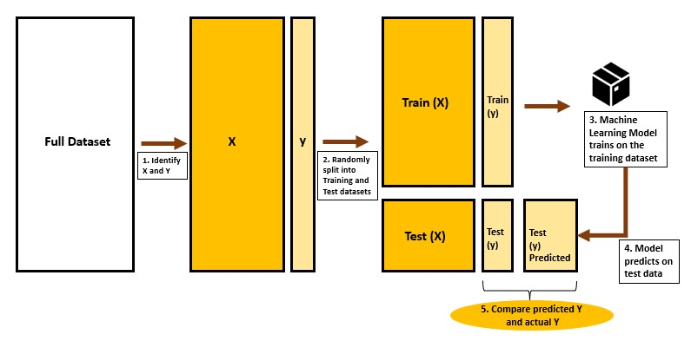

Slide 26
Logistic Regression
Binary outcome: logit(p) = β0 + β1X
  Whether_uncivil = β0 + β1* “asshole” + β2* “beautiful” + …
Interpretable coefficients
Use in social science: classification + inference
Remember, in TF-IDF, there are many dimensions, other than “asshole” “beautiful” there are thousands of n-grams that could have coefficients, therefore, we need regularization, which shrinks coefficients to improve generalization to new data.
  L1 (Lasso) Regularization
    Encourages sparsity: sets some coefficients to exactly zero
    Good for feature selection when many irrelevant features
  L2 (Ridge) Regularization
    Shrinks coefficients toward zero but keeps all features
    Good for handling multicollinearity and overfitting
  Elastic Net – hybrid of L1 and L2

Slide 27
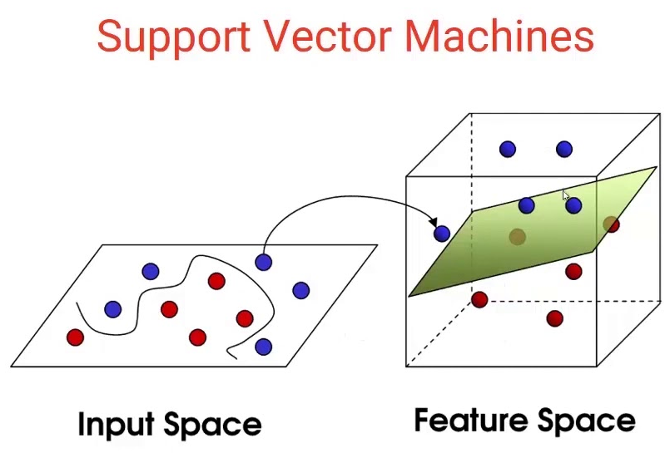
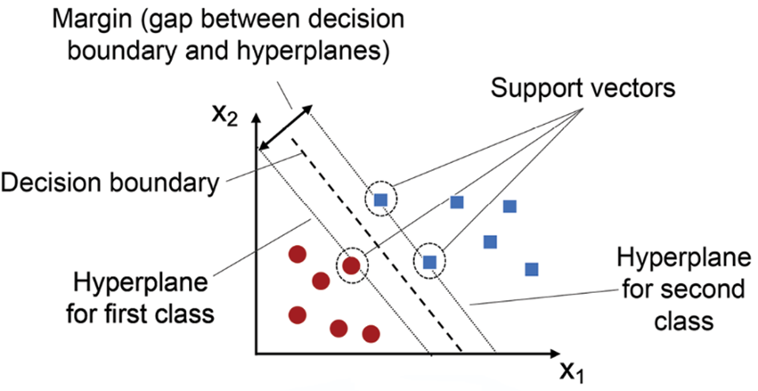
SVM
Margin maximization
Good when many features, few observations
Less interpretable than logistic regression

Slide 28
Tree-Based Models
Decision Tree (a.k.a. Classification Tree)
Random Forest – ensemble of trees, more stable
Gradient Boosted Trees (e.g., XGBoost, LightGBM, CatBoost)
Etc.

Slide 29
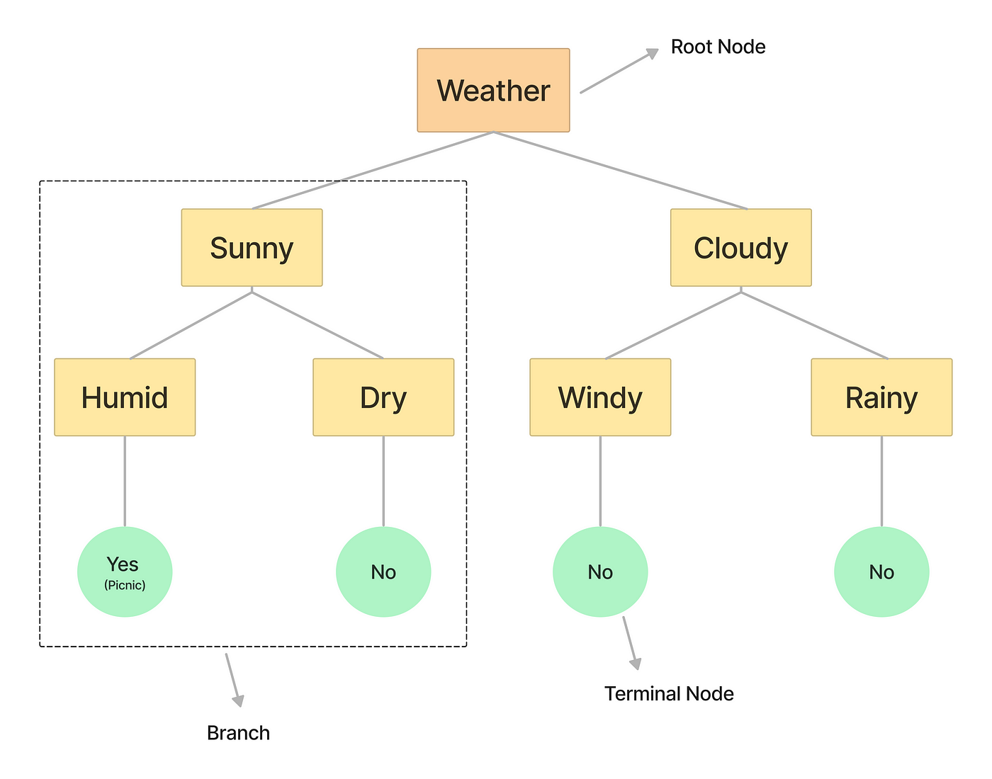
Tree-Based Models
Decision Tree (a.k.a. Classification Tree)
Random Forest – ensemble of trees, more stable
Gradient Boosted Trees (e.g., XGBoost, LightGBM, CatBoost)
Etc.

Slide 30
Neural Networks
Loosely inspired by the brain: layers of nodes ("neurons")
Used for nonlinear classification and complex pattern recognition
input → hidden layers → output
Text input needs to be embedded first (e.g., with word vectors)
  Handles high-dimensional input well
  Can model interactions and nonlinearity
  Requires tuning, more data
  Often a black box (hard to interpret)

Slide 31
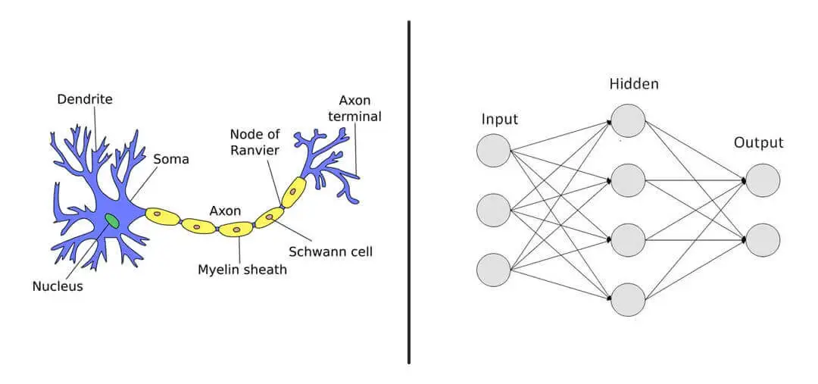
Neural Networks

Slide 32
How we evaluate model
Cross-validation (k-fold):
  Partition the dataset into ‘k’ subsets
  Iteratively using each subset as the test set while the remaining subsets form the training set
  This process helps in mitigating overfitting (prevents overfitting to one split of the data) and provides a more generalized evaluation that could work better for unseen/new data.
Some people also do “Holdout Validation (Train/Test Split)”
  Split once into training and testing sets (e.g., 80/20)
  Fast and simple, but results may vary depending on the random split
  Use with large datasets or when training time is high

Slide 33
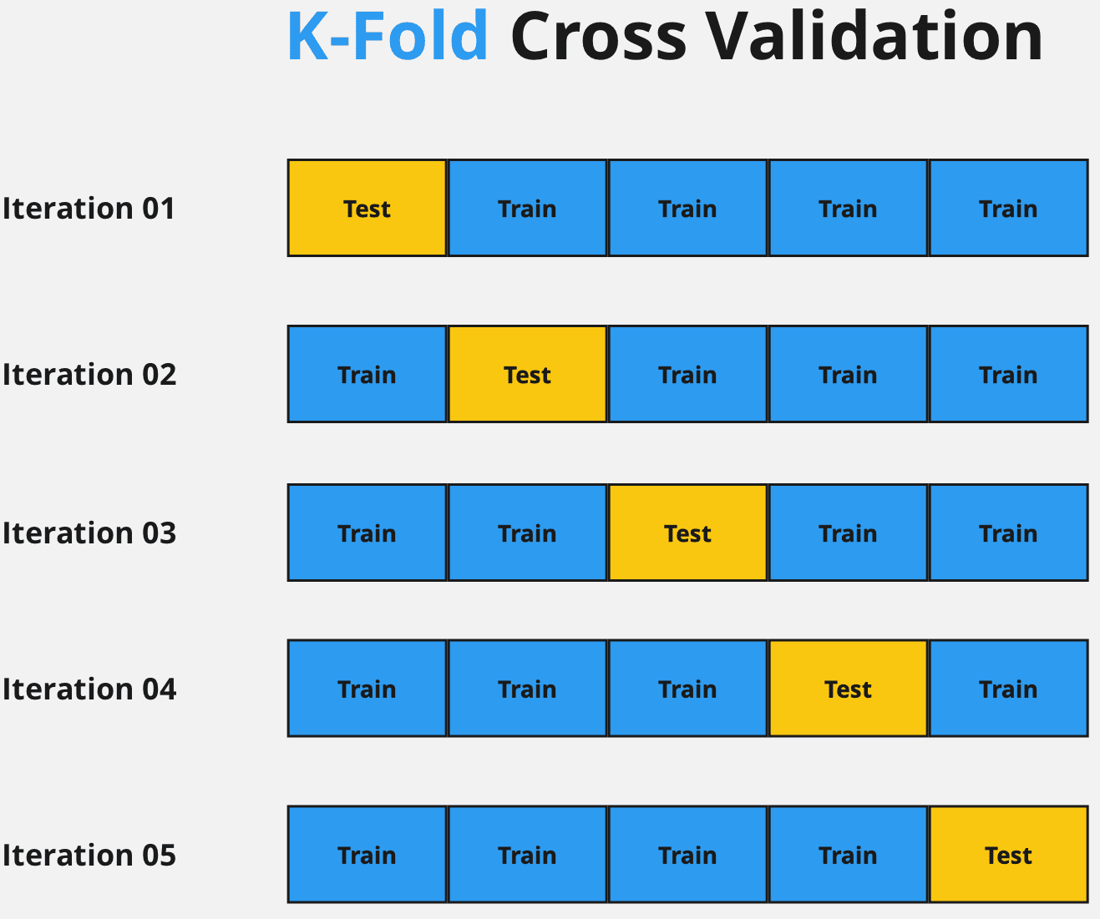

Slide 34
Evaluation Metrics
Accuracy, Precision, Recall, F1-score
  Accuracy: (TP + TN) / (TP + FP + TN + FN)
  Precision: TP / (TP + FP)
  Recall (Sensitivity): TP / (TP + FN)
  F1-Score: 2 * (Precision * Recall) / (Precision + Recall)
Metric | Rule of Thumb | Notes
Accuracy | > 80% is solid | But misleading if classes are imbalanced
Precision | > 70% is usable; > 90% is excellent | High precision = few false positives
Recall | > 70% is usable; > 90% is excellent | High recall = few false negatives
F1-score | > 75% is good; > 85% is strong | Balanced tradeoff between precision and recall

Slide 35
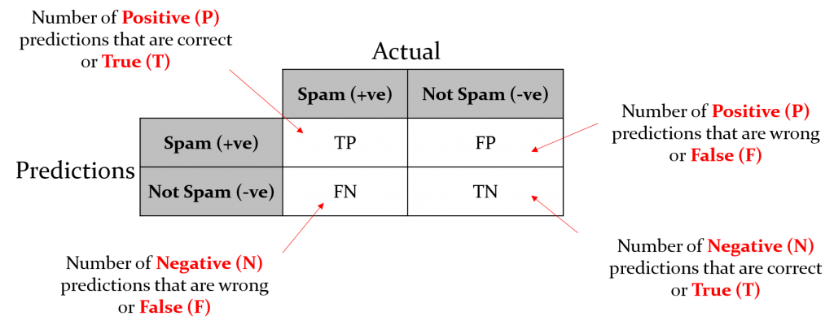
Evaluation Metrics
Accuracy, Precision, Recall, F1-score

Slide 36
Evaluation Metrics
You run 5-fold cross-validation on a sentiment classifier. You get F1-scores of:
  Fold 1: 0.74
  Fold 2: 0.77
  Fold 3: 0.76
  Fold 4: 0.75
  Fold 5: 0.73
The final reported F1-score is the mean: 0.75

Slide 37
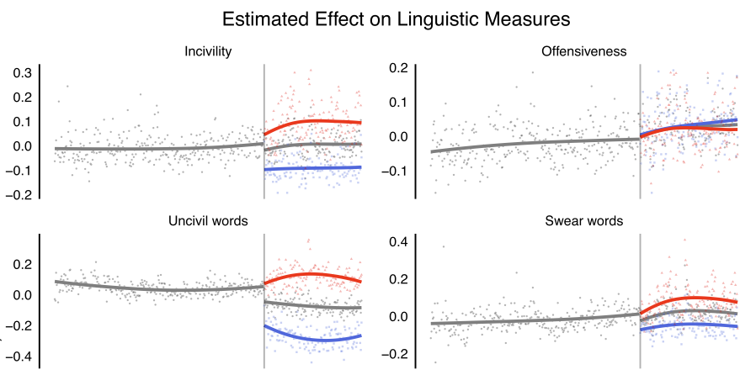
Presentation: Jaidka et al. (2019)
Classify tweets by communication variables (e.g., incivility)
Variable from the tweets: length, hashtags, sentiment, etc.
Logistic regression with feature selection (L1)

Slide 38
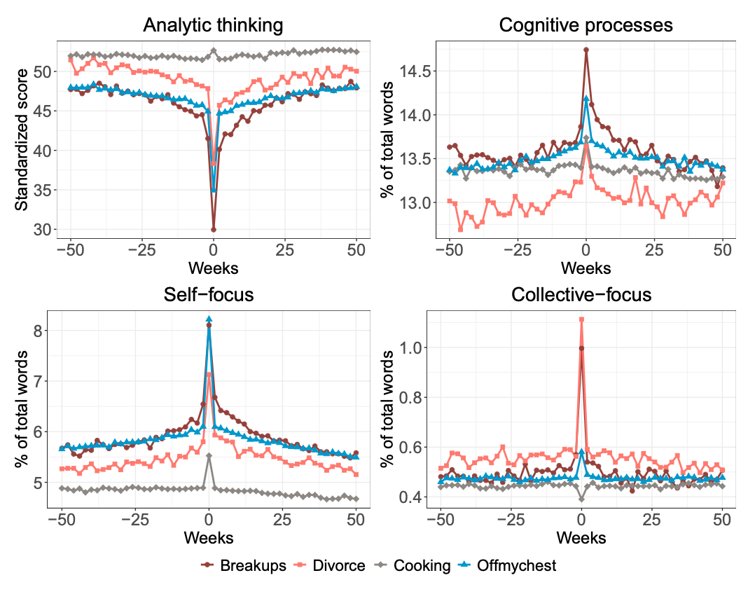
Case: Seraj et al. (2021)
Predict breakup distress from text
Time-series of emotion words pre/post breakup
High face validity + useful visualization

Slide 39
Optional: Zero-Shot + Pretrained Models
If you don’t have labeled data… GPT, BERT, etc.
Not for today, we will talk about GPT and LLM later
Caveats: hallucination, black box

Slide 40
Lab Preview
LIWC
Sentiment
Train some classifiers
Google Perspective
  Go to https://www.perspectiveapi.com/
  Apply for the API
  It takes a few hours to get this API access
  We will use it in the next lab
Tomorrow’s Presentation
  Jialu Fan
  Jiacheng Huang
  Michael Ofori

