Slide 1
Day 2 – Text (Basic)
UMN CSS Workshop 2025
Instructor: Alvin Zhou

Slide 2
Learning Goals
Understand the logic behind basic text analysis
Learn core techniques: preprocessing, dictionary methods, classification
Recognize common pitfalls
Interpret empirical applications

Slide 3
Why Text? Why Now?
Explosion of text data (social media, news, transcripts)
Still the foundational data source
Easy to collect, easy to analyze, and with robust communities
Text as behavior, signal, belief, and strategy
Social scientists want to measure, predict, and explain

Slide 4
Text as Data: Challenges
High-dimensional, unstructured
Once you convert raw text into a format that a machine can process—usually as a vector of features—it often has a huge number of variables (dimensions) relative to the number of observations (documents).
Unstructured means the data is not “clean” with a pre-defined format
Context sensitivity (e.g., irony, sarcasm)
Requires transformation into features: preprocessing so that we can process text as data
Notes:
Let’s say you have 1,000 tweets. You tokenize them and build a document-term matrix (DTM).
Suppose your corpus has 20,000 unique words (after cleaning).
Each tweet (observation) is then represented as a vector of 20,000 dimensions.
Each dimension corresponds to the frequency (or presence) of a single word.
So even though you only have 1,000 rows (documents), you now have 20,000 columns (features) — that’s high-dimensional data.
🧠 Why This Matters
Sparsity: Most documents only contain a tiny fraction of all words, so the matrix is mostly zeros.
Overfitting: More dimensions than observations means models can easily memorize instead of generalize.
Computational Cost: Operations on large, sparse matrices are memory and compute intensive.
Noise Sensitivity: Many rare words are irrelevant or even harmful to model accuracy.
🎯 Common Fixes
Use only the top k most frequent terms (e.g., top 5,000).
Apply dimensionality reduction (e.g., PCA, SVD).
Use dense embeddings (e.g., BERT, GloVe) instead of raw DTM.
----------------
Sentences vary in length, grammar, and syntax
Words have context-dependent meaning (e.g., “bank” = river vs. money)
Contains emojis, slang, typos, sarcasm, irony, etc.

Slide 5
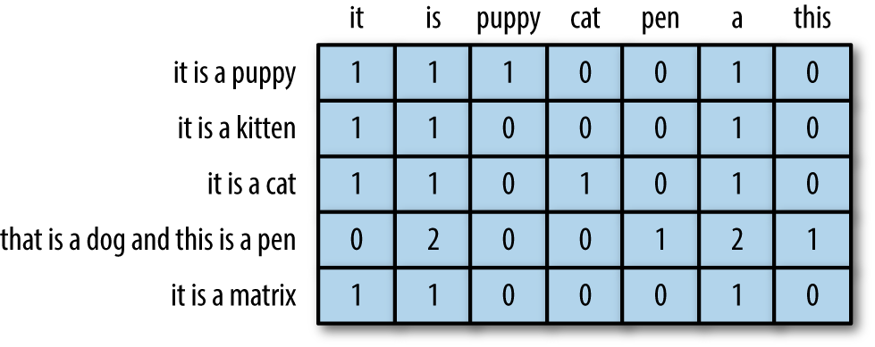
Foundational Workflow - Tokenization
Tokenization: the process of breaking down the text
Raw text → Tokens → Features → Models → Interpretation
Instead of working with text, text-as-data works with the matrix
text = "Cats are cute." → ["Cats", "are", "cute"]

Slide 6
Text Preprocessing 101
Lowercasing, punctuation removal, etc.
Tokenization: words vs. subwords
Words: "I love backpacking!" → ["I", "love", "backpacking"]
Simplicity, speed, but can’t handle rare/new words
Subwords: "backpacking" → ["back", "##pack", "##ing"]
Flexibility, efficiency, but harder to interpret
Stopword removal
“the” “a” “so” “then” etc
Context-dependent, you can designate new stopwords that are of no relevance to your research questions
Lemmatization vs. stemming
Stemming: chop off word endings with no mercy, fast but crude
running → run studies → studi universities → univers
Lemmatization: dictionary + grammar to find the root
running → run studies → study better → good
Notes:
If Interpretability matters (e.g., dictionaries, topic modeling), lemmatization
You’re publishing results or care about linguistic accuracy, lemmatization

Slide 7
n-Grams
Unigrams, bigrams, trigrams
Why use n-grams:
Capture adjacent context (e.g., “not good”)
Tradeoff: complexity vs. sparsity
Most methods we discuss use unigram.

Slide 8
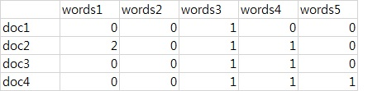
From Text to Matrix
Document-Term Matrix (DTM)
Sparse, high-dimensional
TF (Term Frequency, frequency of a word in a document): In the sentence "Data is the new oil", TF for "data" is 1/5 = 0.2
IDF (Inverse Document Frequency, how unique is a word across documents): Words that appear in many documents (like “the”, “is”) get low IDF, while unique words get higher IDF
TF-IDF: Putting it Together

Slide 9
TF-IDF
Term Frequency × Inverse Document Frequency
High TF-IDF = word is frequent in a document but rare in the corpus
Filters out common “filler” words
Retains contextually meaningful, distinctive terms
Term | Doc A TF | IDF | TF-IDF
data | 0.2 | 1.5 | 0.3
the | 0.2 | 0.2 | 0.04
oil | 0.2 | 2.0 | 0.4

Slide 10
TF-IDF vs. Word Embeddings
TF-IDF and word embeddings are two different ways to represent text as numbers.
TF-IDF is only relevant for classical machine learning models , such as logistic regression and SVM, where we used to construct our own text classification models.
More recently, the field has been shifting towards AI-assisted models for text classification, where embedding is more prominent, a topic we will discuss in the future.
However, understanding how text-as-data works is crucial and foundational to gaining a comprehensive understanding of social data science.

Slide 11
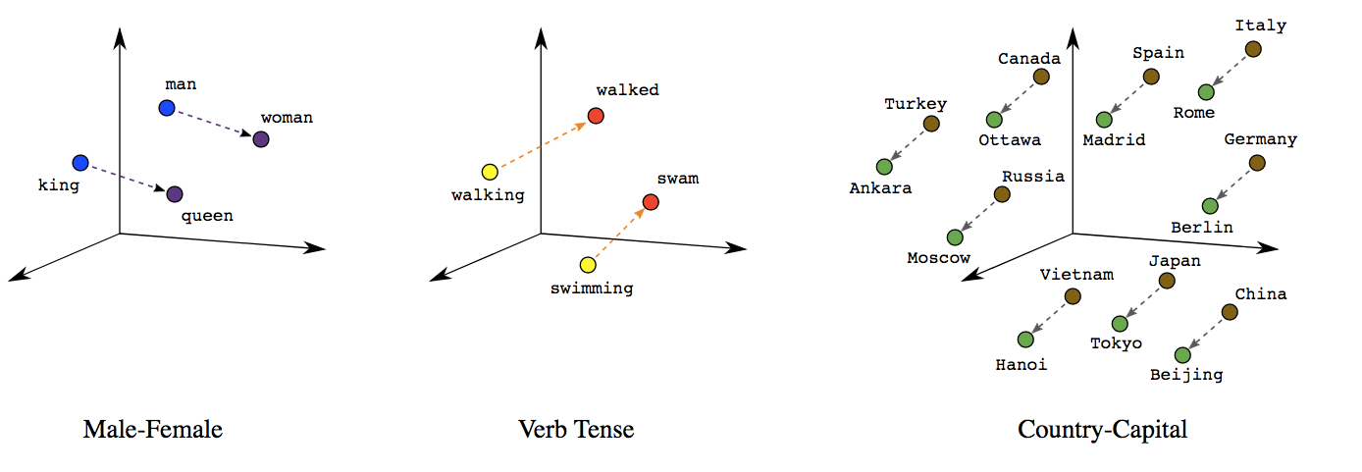
Word Embeddings
Each word = low-dimensional dense vector (e.g., 300 dimensions)
TF-IDF is high-dimensional (many columns, one column per word)
Learned from context in large corpora (e.g., Word2Vec, GloVe, BERT)
Captures semantic relationships
e.g., vec(“king”) − vec(“man”) + vec(“woman”) ≈ vec(“queen”)

Slide 12
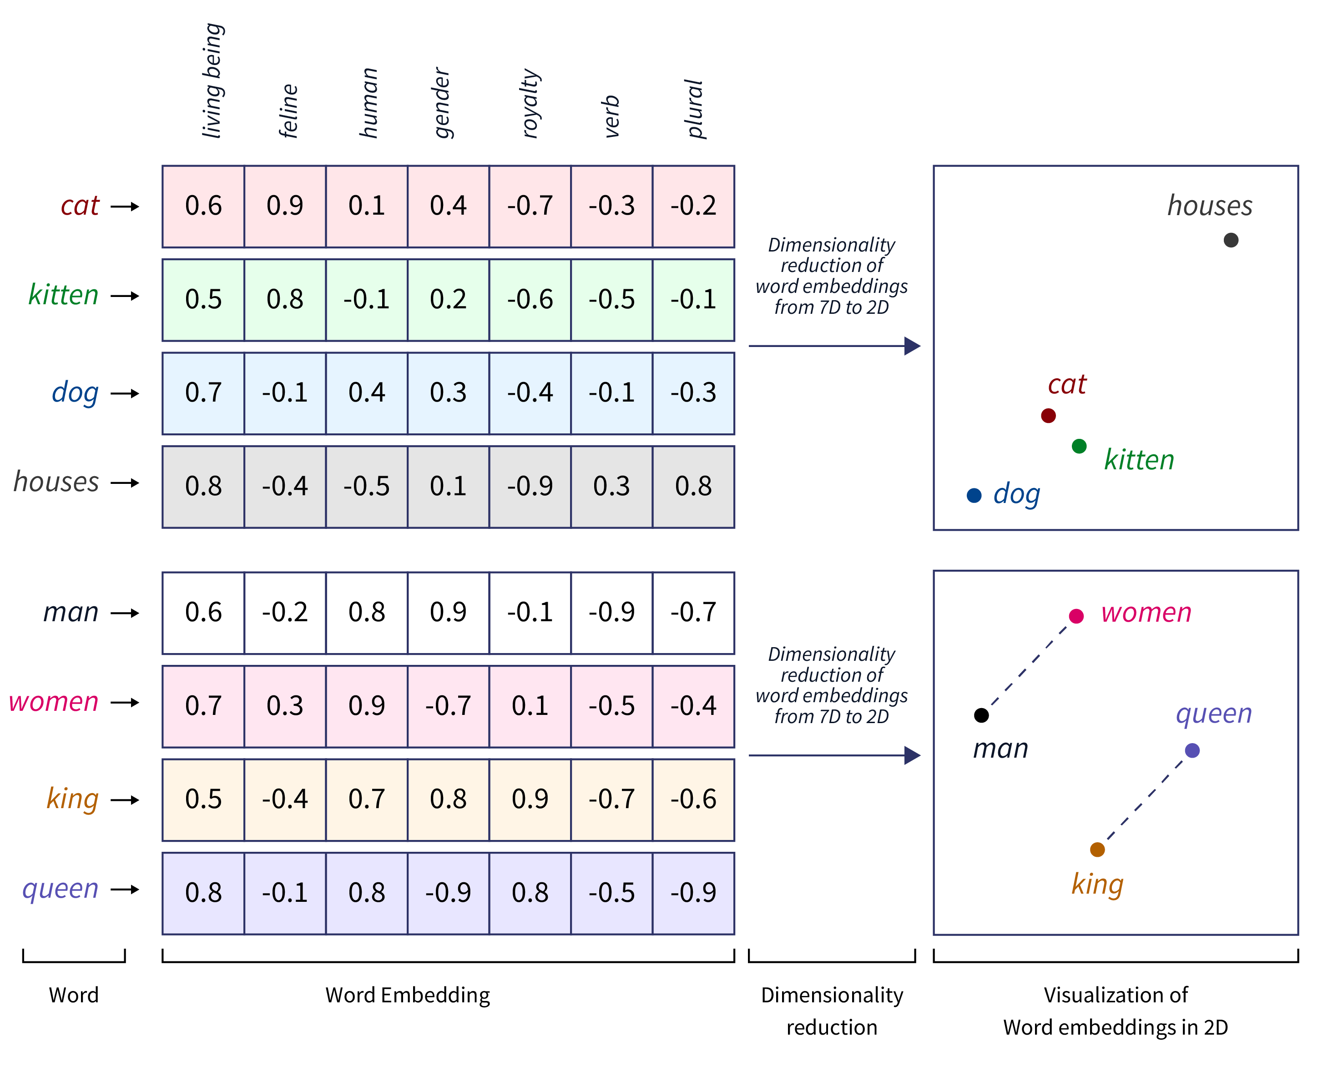

Slide 13
Word Embeddings
Feature | TF-IDF | Embedding
Based on | Term frequency + rarity | Context in language
Dimension | Large (10k+) | Small (e.g., 300)
Output | Sparse vector | Dense vector
Learns meaning? | No | Yes
Used in deep learning? | Rarely | Yes
If you’re building a model, you’ll choose:
TF-IDF if you’re doing classic ML (e.g., logistic regression, SVM)
logistic regression, SVM, LIWC, sentiment, moral foundations
Embeddings if you’re doing modern NLP (e.g., transformers, neural nets)
Many off-the-shelf tools to choose from
TF-IDF dominated social science text-as-data work before ~2020 and embedding-based approaches have become more common since then, particularly as tools like Word2Vec, GloVe, BERT, and GPT became more accessible and pre-trained models more widely available.
Notes:
TF-IDF is still used in exploratory analysis, especially when interpretability is key.

Slide 14
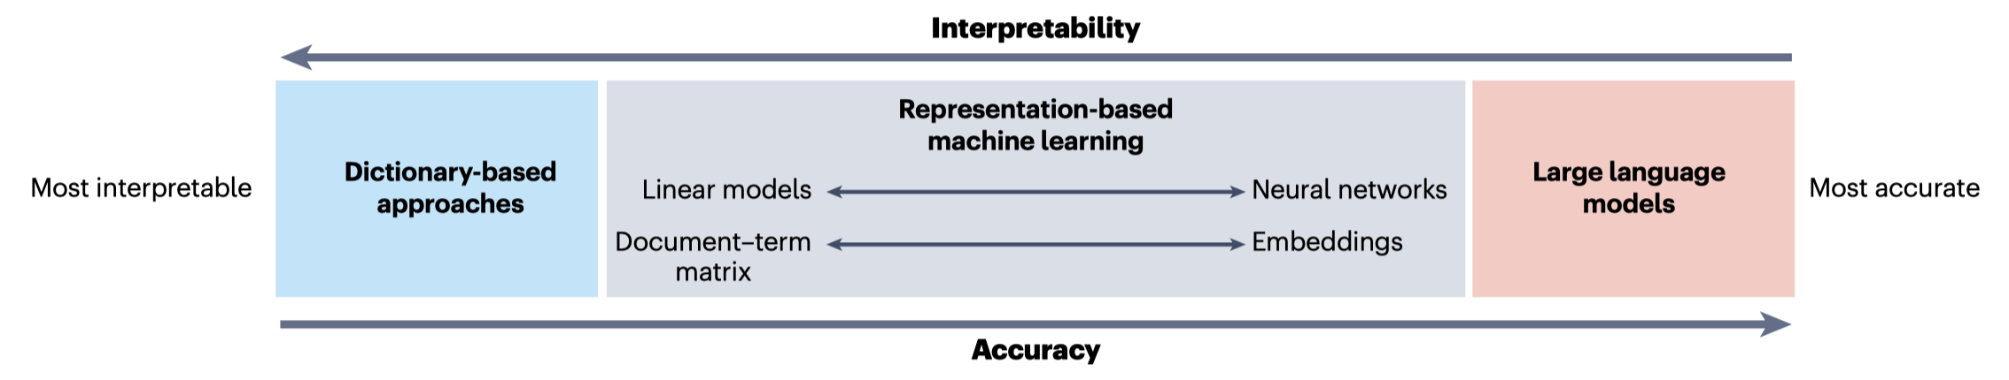
Dictionary-Based Methods
Most interpretable
The most accurate model might not be what social scientists value
Dictionary: predefined word lists
Examples: LIWC, MFD, Lexicoder
Applications: sentiment, moral values, word use

Slide 15
Case: LIWC
Tausczik & Pennebaker (2010)
Tausczik, Y. R., & Pennebaker, J. W. (2010). The psychological meaning of words: LIWC and computerized text analysis methods. Journal of Language and Social Psychology, 29(1), 24–54. https://doi.org/10.1177/0261927X09351676
Count words that correspond to a feature (e.g., anxiety, anger)

Slide 16
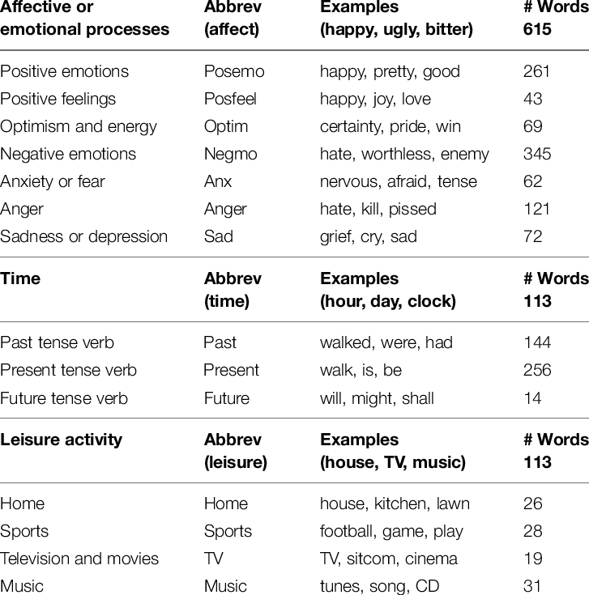
Case: LIWC

Slide 17
Case: LIWC
For example:
Processing tweets published by people living in
Regions with rainfall
Regions with sunshine
and measuring tweets’ positive emotions (the “Posemo” variable)
We might see that tweets geo-matched with sunshine regions have a higher Posemo value
Let’s say you ran LIWC on a document with 1,000 words, and you got Posemo = 76
That means:
76 words (7.6% of the total) matched words in the “positive emotion” category, such as “happy,” “love,” “great,” “joy,” etc.
It doesn’t account for context, negation, or sentence structure.

Slide 18
Case: Moral Foundations Theory
Wang & Inbar (2021)
Wang, S.-Y. N., & Inbar, Y. (2021). Moral-language use by U.S. political elites. Psychological Science, 32(1), 14–26. https://doi.org/10.1177/0956797620960397
Five moral foundations across culture
Foundation | Basic Intuition | Virtues | Violations
Care/Harm | Protect others, prevent suffering | Compassion, kindness | Cruelty, aggression
Fairness/Cheating | Justice, equality, reciprocity | Fairness, justice | Cheating, exploitation
Loyalty/Betrayal | Group identity and cohesion | Patriotism, self-sacrifice | Disloyalty, treason
Authority/Subversion | Respect for tradition, hierarchy | Obedience, deference | Disrespect, rebellion
Sanctity/Degradation | Purity, sacredness | Cleanliness, piety | Impurity, perversion

Slide 19
Case: Different Dictionaries
Graham, J., Haidt, J., & Nosek, B. A. (2009). Liberals and conservatives rely on different sets of moral foundations. Journal of Personality and Social Psychology, 96(5), 1029–1046. https://doi.org/10.1037/a0015141
Frimer, J. (2019). Moral foundations dictionary 2.0. https://osf.io/ezn37/
Hopp, F. R., Fisher, J. T., Cornell, D., Huskey, R., & Weber, R. (2021). The extended Moral Foundations Dictionary (eMFD): Development and applications of a crowd-sourced approach to extracting moral intuitions from text. Behavior Research Methods, 53(1), 232–246. https://doi.org/10.3758/s13428-020-01433-0
[Embedding] Duan, Z., Shao, A., Hu, Y., Lee, H., Liao, X., Suh, Y. J., Kim, J., Yang, K.-C., Chen, K., & Yang, S. (2025). Constructing vec-tionaries to extract message features from texts: A case study of moral content. Political Analysis, 1–21. https://doi.org/10.1017/pan.2025.6

Slide 20
Limitations of Dictionaries
Lack of context sensitivity
Vocabulary drift/misspecification
Not designed for predictive accuracy
Dictionaries (e.g., LIWC, MFD, Lexicoder) are used to measure constructs like anxiety, anger, authority, fairness, etc.
Valuable for theory-driven analysis — especially when interpretability matters.
Not built for predictive accuracy, e.g.,
Accuracy
F1-score
AUC
Dictionary scores are rarely used to predict:
Whether someone votes
Who wins an election
Whether someone is depressed

Slide 21
Supervised Machine Learning
Goal: predict a label (e.g., sentiment, topic, ideology)
Requires labeled data
Features: n-grams, TF-IDF, dictionaries
Classifier models:
Logistic regression
L1 (Lasso) Regularization
L2 (Ridge) Regularization
Elastic Net – hybrid of L1 and L2
Support Vector Machine (SVM)
Tree-Based Models
Neural Networks (e.g., Recurrent Neural Network (RNN))
K-Nearest Neighbors (KNN)
Etc.

Slide 22
Logistic Regression
Binary outcome: logit(p) = β0 + β1X
Whether_uncivil = β0 + β1* “asshole” + β2* “beautiful” + …
Interpretable coefficients
Use in social science: classification + inference
Remember, in TF-IDF, there are many dimensions, other than “asshole” “beautiful” there are thousands of n-grams that could have coefficients, therefore, we need regularization, which shrinks coefficients to improve generalization to new data.
L1 (Lasso) Regularization
Encourages sparsity: sets some coefficients to exactly zero
Good for feature selection when many irrelevant features
L2 (Ridge) Regularization
Shrinks coefficients toward zero but keeps all features
Good for handling multicollinearity and overfitting
Elastic Net – hybrid of L1 and L2

Slide 23
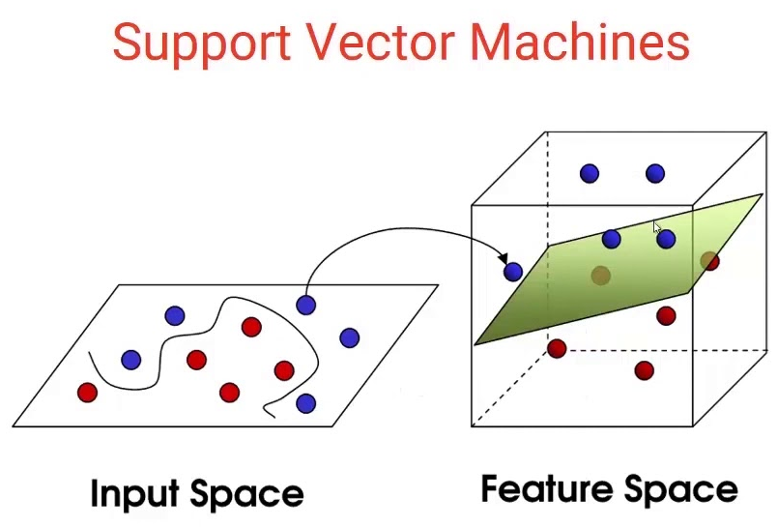
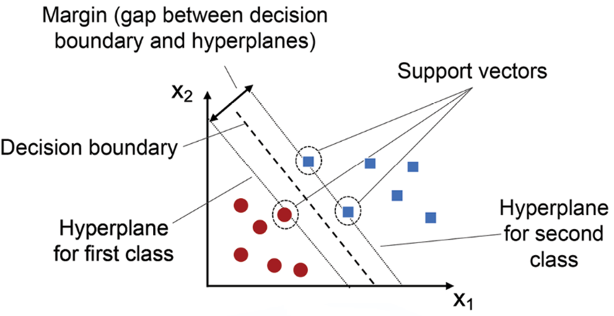
SVM
Margin maximization
Good when many features, few observations
Less interpretable than logistic regression

Slide 24
Tree-Based Models
Decision Tree (a.k.a. Classification Tree)
Random Forest – ensemble of trees, more stable
Gradient Boosted Trees (e.g., XGBoost, LightGBM, CatBoost)
Etc.

Slide 25
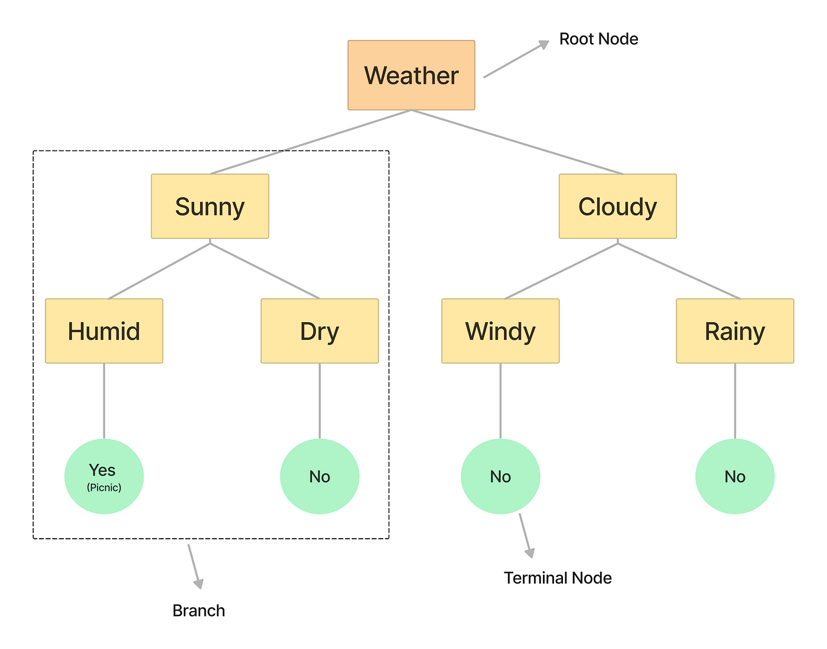
Tree-Based Models
Decision Tree (a.k.a. Classification Tree)
Random Forest – ensemble of trees, more stable
Gradient Boosted Trees (e.g., XGBoost, LightGBM, CatBoost)
Etc.

Slide 26
Neural Networks
Loosely inspired by the brain: layers of nodes ("neurons")
Used for nonlinear classification and complex pattern recognition
input → hidden layers → output
Text input needs to be embedded first (e.g., with word vectors)
Handles high-dimensional input well
Can model interactions and nonlinearity
Requires tuning, more data
Often a black box (hard to interpret)

Slide 27
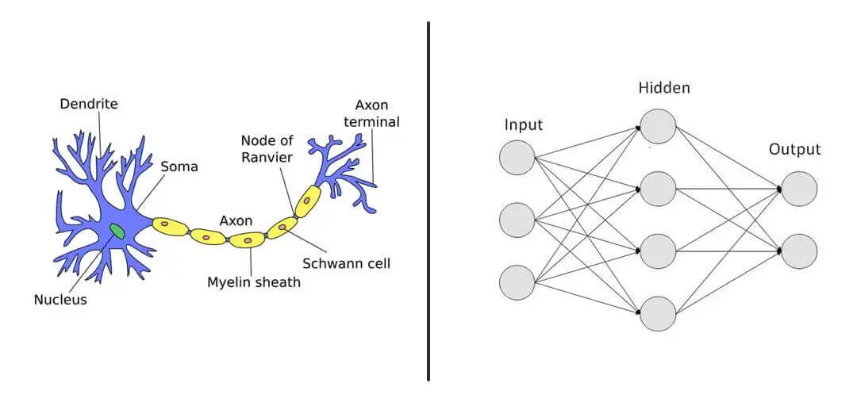
Neural Networks

Slide 28
How we evaluate model
Cross-validation (k-fold):
Partition the dataset into ‘k’ subsets
Iteratively using each subset as the test set while the remaining subsets form the training set
This process helps in mitigating overfitting (prevents overfitting to one split of the data) and provides a more generalized evaluation that could work better for unseen/new data.
Some people also do “Holdout Validation (Train/Test Split)”
Split once into training and testing sets (e.g., 80/20)
Fast and simple, but results may vary depending on the random split
Use with large datasets or when training time is high

Slide 29
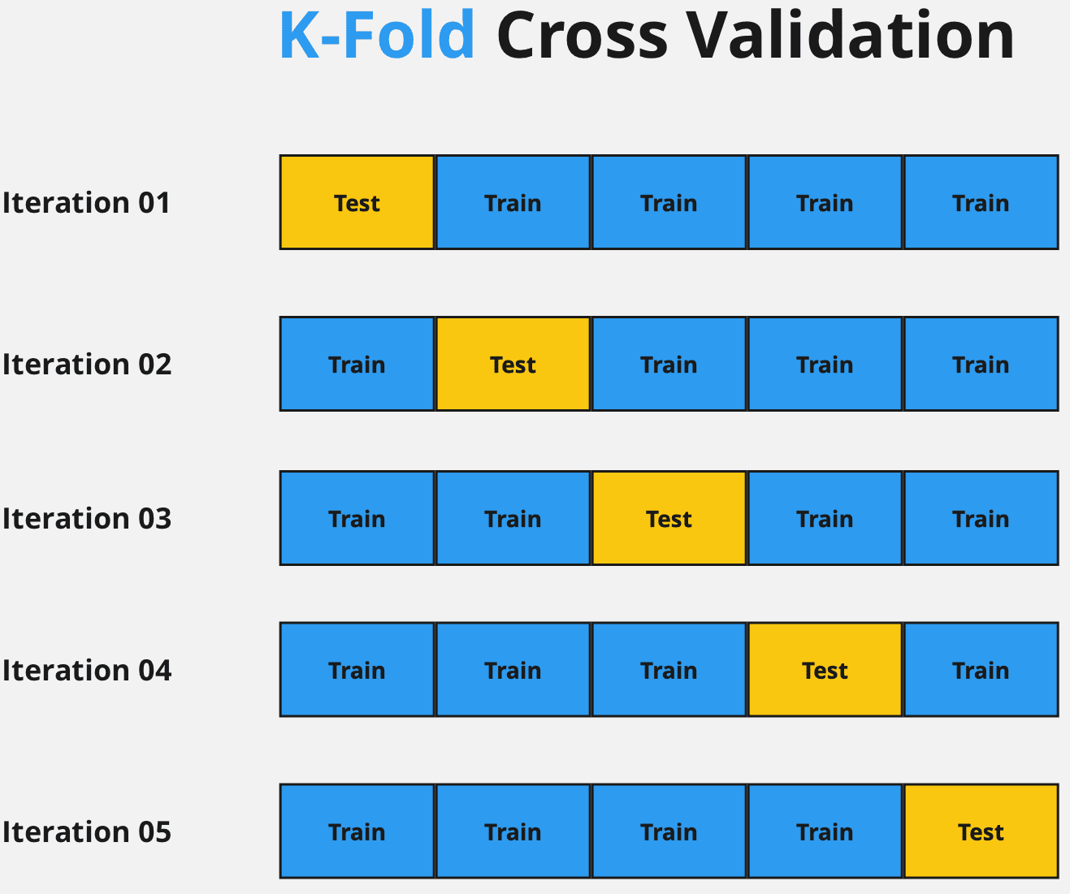

Slide 30
Evaluation Metrics
Accuracy, Precision, Recall, F1-score
Accuracy: (TP + TN) / (TP + FP + TN + FN)
Precision: TP / (TP + FP)
Recall (Sensitivity): TP / (TP + FN)
F1-Score: 2 * (Precision * Recall) / (Precision + Recall)
Metric | Rule of Thumb | Notes
Accuracy | > 80% is solid | But misleading if classes are imbalanced
Precision | > 70% is usable; > 90% is excellent | High precision = few false positives
Recall | > 70% is usable; > 90% is excellent | High recall = few false negatives
F1-score | > 75% is good; > 85% is strong | Balanced tradeoff between precision and recall

Slide 31
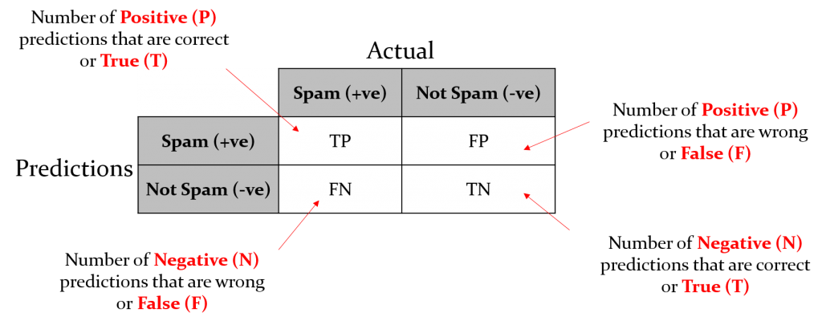
Evaluation Metrics
Accuracy, Precision, Recall, F1-score

Slide 32
Evaluation Metrics
You run 5-fold cross-validation on a sentiment classifier. You get F1-scores of:
Fold 1: 0.74
Fold 2: 0.77
Fold 3: 0.76
Fold 4: 0.75
Fold 5: 0.73
The final reported F1-score is the mean: 0.75

Slide 33
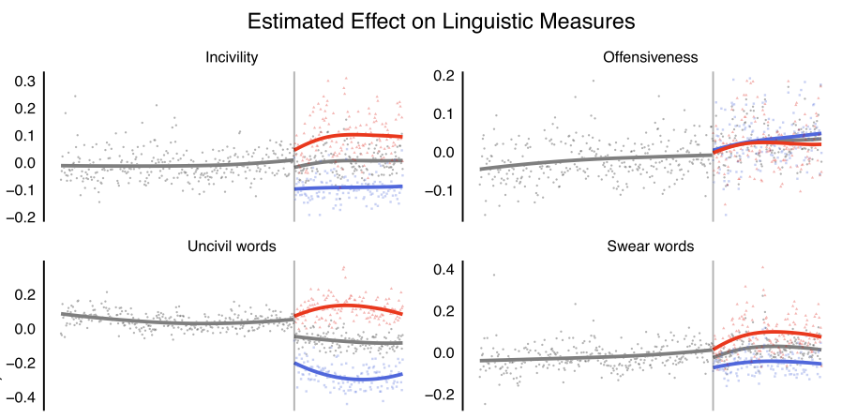
Case: Jaidka et al. (2019)
Classify tweets by communication variables (e.g., incivility)
Variable from the tweets: length, hashtags, sentiment, etc.
Logistic regression with feature selection (L1)

Slide 34
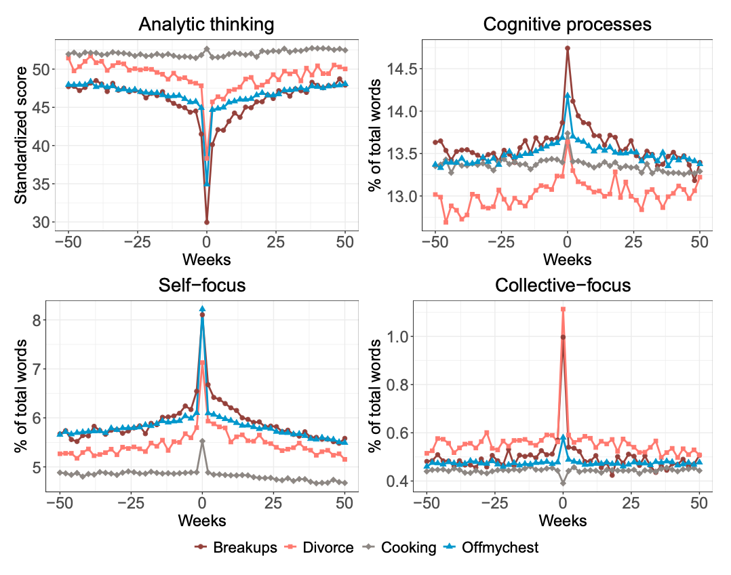
Case: Seraj et al. (2021)
Predict breakup distress from text
Time-series of emotion words pre/post breakup
High face validity + useful visualization

Slide 35
Optional: Zero-Shot + Pretrained Models
If you don’t have labeled data… GPT, BERT, etc.
Not for today, we will talk about GPT and LLM later
Caveats: hallucination, black box

Slide 36
Lab Preview
LIWC
Sentiment
Moral Foundations
Google Perspective
Go to https://www.perspectiveapi.com/
Apply for the API
It takes a few hours to get this API access
We will use it in the next lab

