Slide 1
Day 3 - Text (Advanced)
UMN CSS Workshop 2025
Instructor: Alvin Zhou

Slide 2
Learning Goals
Learn word embedding
Understand topic modeling and its use in social science
Explore creative uses of computational text methods
Practice using external text APIs and topic modeling

Slide 3
Last Class
Dictionary-Based Methods
Traditional Classifier (pre-2020)
Create features (independent variables) from text: n-grams (bag of words), metadata (emoji, length), TF-IDF, dictionaries (LIWC, MFD)
For example, the text “I love data science! 🧪” can have these features
"I": 1, "love": 1, "data": 1, "science": 1, “🧪”: 1
No. of Characters: 22
Punctuation Count: 1
"PRP (personal pronoun)": 1, "VBP (verb)": 1, "NN (noun)": 2, "SYM (symbol)”: 1
The Y (dependent variable) is binary (uncivil/civil; relevant/irrelevant, etc.)
Fit different models (e.g., logistic regression with regularization) with training data
Evaluate how the model performs
Apply the model to the remaining dataset

Slide 4
Limitations of Traditional Features
Bag of Words and TF-IDF are sparse and high-dimensional
Vocabulary is rigid: struggles with new/rare words
Ignores word meaning and semantic similarity
“happy” and “joyful” are treated as unrelated
Doesn’t capture context: “good” ≠ “not good”
Performance plateaus in many classification tasks

Slide 5
Word Embedding
Each word is represented by a vector
Words with similar meanings are close in vector space
Captures semantic and syntactic similarity
“king” – “man” + “woman” ≈ “queen”
“love” and “like” have similar embeddings
The “GloVe 6B 300-dimensional” model from Stanford
trained on Wikipedia + Gigaword, in which:
"man" → [ 0.20217, 0.12963, -0.17952, -0.00857, 0.05105, -0.32036, 0.18403, 0.39143, 0.46551, -0.22903, ... ]
cosine_similarity("man", "woman") ≈ high

Slide 6
Why Use Word Embeddings? (post-2020)
Low-dimensional: ~100–300 dimensions vs. 10,000s for BoW
Generalizes across similar terms (e.g., “happy”, “joyful”)
Pretrained models available (Word2Vec, GloVe, BERT) – simply download to your computer and you are good to go
Reduces need for manual feature engineering (e.g., L1/L2 regularization)
Improved performance in many areas of NLP

Slide 7
How Embeddings Are Used in Practice
Average word vectors for each document, so that one document is represented by a vector. If
“man” is [1, 0, 1]
“and” is [1, 0, 0]
“woman” is [1, 1, 1]
A document with “man and woman” is represented as [1, 0.333, 0.666]
TF-IDF–weighted average
If “man” appears too many times in the document, its influence on “averaging word vectors for each document” decreases
Sentence or document embeddings (e.g., Sentence-BERT)
Feed into any classifier (logistic, SVM, NN)

Slide 8
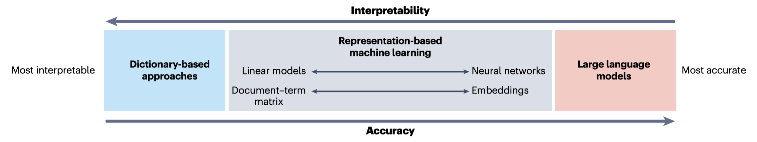
TF-IDF vs. Word Embedding
Feature Type | TF-IDF | Word Embedding
Sparse/Dense | Sparse | Dense
Dimensionality | High | Low
Handles Synonyms? | No | Yes
Context-Aware? | No | Sometimes (if BERT)
Pretrained? | Not really | Yes (Word2Vec, GloVe, BERT)
Model Input | Classic ML | ML + DL
Notes:
TF-IDF easier to understand, so still quite used in social sciences.
Remember, not the best methods will win you a paper, it is the story that the method enables you to tell.

Slide 9
Presentation: Toubia et al. (2021)

Slide 10
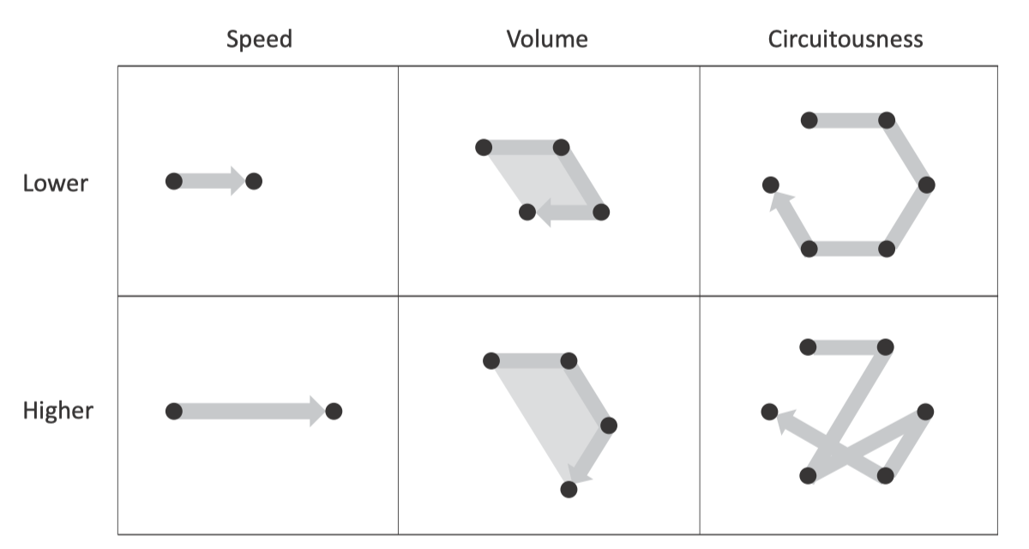
Presentation: Toubia et al. (2021)
How quantifying the shape of stories predicts success
Track emotional arc over time using NLP
Shape features predict box office revenue
Social science application: narrative structure & diffusion

Slide 11
You can fine-tune embeddings for your study
TF-IDF studies usually “start from scratch”
But studies using embeddings usually grab an existing model and fine-tune it with new data
“Fine-tuning” means continuing to train a pretrained model on a new, domain-specific corpus, so it adapts to the language and meaning specific to your data.

Slide 12
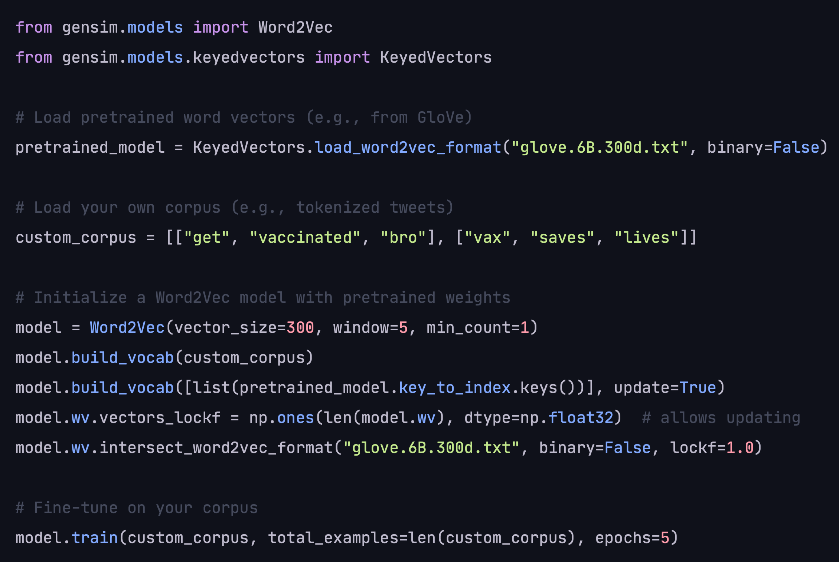
For Example
Fine-Tuning GloVe on Social Media
Let’s say you’re studying vaccine discourse on Twitter. You start with GloVe (trained on news/Wikipedia), but you want to adapt it to Twitter slang + COVID-specific terms.
In Python (conceptually):

Slide 13
For Example
You get an embedding model that understands “vax,” “jabbed,” “anti-vaxxer” as used in your data, but still retains core semantic structure from GloVe.
https://pmc.ncbi.nlm.nih.gov/articles/PMC9578521/
Our study investigated and compared public sentiment related to COVID-19 vaccines expressed on 2 popular social media platforms—Reddit and Twitter—harvested from January 1, 2020, to March 1, 2022.
To accomplish this task, we created a fine-tuned DistilRoBERTa model to predict the sentiments of approximately 9.5 million tweets and 70 thousand Reddit comments. To fine-tune our model, our team manually labeled the sentiment of 3600 tweets and then augmented our data set through back-translation. Text sentiment for each social media platform was then classified with our fine-tuned model using Python programming language and the Hugging Face sentiment analysis pipeline.

Slide 14
You can definitely train it from scratch
Presentation: Kozlowski et al. (2019)

Slide 15
Presentation: Kozlowski et al. (2019)
Trained custom Word2Vec embeddings on Google Books Ngram data from each decade (1900–1999)
Downloaded the Google Books Ngram corpus, stratified by decade (1900–1999).
Trained separate Word2Vec models for each decade.
Used these decade-specific embeddings to:
Measure how meanings of cultural terms shifted across time.
Project words into latent dimensions (e.g., class, gender, affluence) defined by antonym word pairs (e.g., rich vs. poor).

Slide 16
Other Text-Based Methods
Choose methods to answer your questions!
Named entity recognition
PoS Tagging
Topic models

Slide 17
Presentation: Knight (2022)

Slide 18
Presentation: Knight (2022)
The New York Times (1890−1934) and Wall Street Journal (1905−1934)
OCR, 400,000+ articles
Analyzed “agentic talk” — linguistic indicators that describe corporations as intentional actors (e.g., “decided,” “believed”)
Named entity recognition (NER) to identify organizations
Standard Named Entity Recognizer
Authors’ own + manual cleaning
Parsing
“nsubj” - the active subject in a sentence
Stanford Tagger + manual cleaning
Dictionary for Verbs
Harvard General Inquirer database
“cognitive orientation” and “communicating”
STM

Slide 19
Topic Models
An unsupervised method to discover hidden thematic structure
“what do these documents/text talk about?”
Useful for exploratory analysis when labels aren't available
Widely popular in social sciences

Slide 20
Basic Logic of Topic Modeling
Three Levels:
Documents
Topics
Words
Documents are composed of multiple topics, with weights
Each topic is described by a set of words, with weights

Slide 21
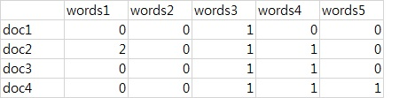
Basic Logic of Topic Modeling
Early/Most topic models based on TF-IDF
Newer models based on word embedding
If two words (word 1 and word 2) always co-occur, the computer understands that they might belong to the same topic

Slide 22
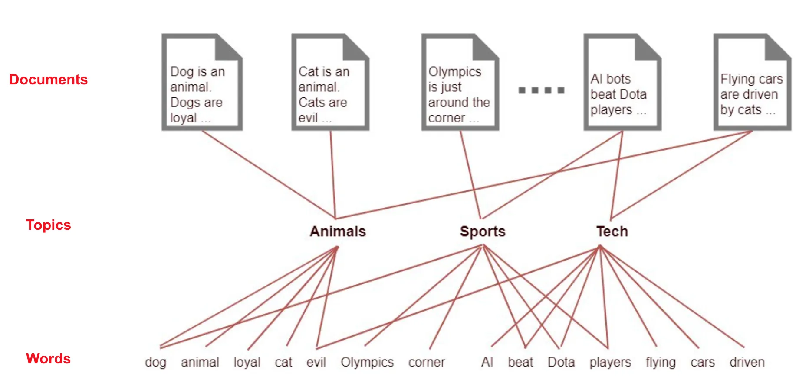
Basic Logic of Topic Modeling

Slide 23
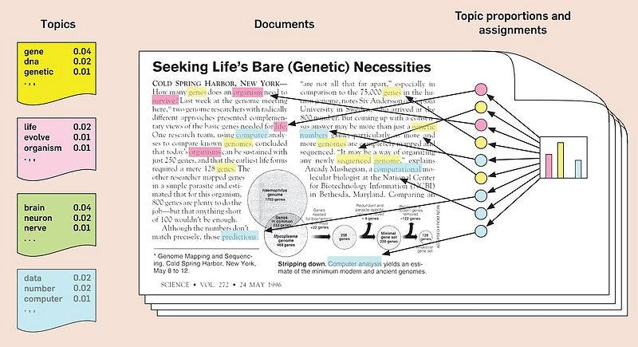
Basic Logic of Topic Modeling

Slide 24
Latent Dirichlet Allocation (LDA)
Introduced by Blei, Ng, and Jordan (2003)
Assumption
Each document is a mixture of topics
Each topic is a mixture of words
Both mixtures are drawn from Dirichlet distributions
Widely used, but with limitations:
Cannot integrating metadata
Doesn’t work well with short text

Slide 25
Structural Topic Modeling (STM)
Extends LDA by incorporating document-level metadata/covariate
Year
Political Party
Before/After Treatment
Instead of assuming Dirichlet distributions, it uses logistic-normal prior (has a normal distribution in log-space)
Don’t ask me what they mean ☺
Allows topic prevalence and content to vary by covariates
Excellent for theory-testing in social science
Implemented in R using stm package

Slide 26
LDA/STM Output Example
You get:
A list of topics (top words per topic)
Topic 1’s top words: animal, cat, dog, cow, farm, …
Topic 2’s top words: work, employ, farm, rice…
…
Document-topic proportions
This document consists of 50% Topic 1, 25% Topic 2, 15% Topic 3, and 10% Topic 4
Specific to STM:
Topic correlations across all documents
How likely Topic 1 and Topic 2 can co-occur (i.e., a network)
Covariate effect (e.g., topic prevalence by party/time/treatment)

Slide 27
Topic Modeling Does Not Give You Labels
You get:
A list of topics (top words per topic)
Topic 1’s top words: animal, cat, dog, cow, farm, …
Topic 2’s top words: work, employ, farm, rice…
…
But they never tell you what the topics are, the computer only knows that these words seem to co-occur here
No labels like “animal,” “farming,” or “climate change” / “terrorism” etc
Labels are interpretive, researcher-assigned summaries
Needs researchers’ substantial expertise to cover research areas
You must:
Inspect top words
Read exemplar documents for each topic
Assign a topic label and discuss with co-authors

Slide 28
Topic Modeling Does Not Give You Labels
Topic modeling is a discovery tool, not a labeling machine.
It helps uncover patterns — you provide the meaning.
A topic with top words like “children,” “school,” “teacher,” “lunch,” “bus” might sound like it’s about “Education”
But since I am aware that the documents I have are all NY Times articles mentioning “gun,” I should know that it’s mostly about “school shootings.”
If I did the search about “poverty,” then I should label it “childhood hunger.”
Reading top representative documents is also helpful.

Slide 29
Specify the No. of Topics (K) (LDA/STM)
There is no “correct” K, as much art as science
It’s a modeling choice, not a ground truth
Too few topics → overgeneralized, mixed themes
Too many topics → fragmented, redundant, hard to interpret
Need to find a balanced K with human interpretation
Model diagnosis does help
Held-out likelihood (predictive performance)
Semantic coherence (do top words make sense together?)
Exclusivity (are top words unique to topics?)
But most important: Interpretability (read top documents, qualitative)
Tip
Plot “Exclusivity vs. Semantic Coherence” to find a sweet spot
Favor interpretability over statistical fit for most social science audiences
Be transparent and communicate the transparency (in appendix)

Slide 30
Limitations of LDA/STM
Bag-of-words assumption: no word order
Topics can be hard to interpret
Sensitive to preprocessing choices
STM assumes linear effects of covariates

Slide 31
What Comes After STM?
BERTopic: combines transformer embeddings with clustering
No need to specify topic count in advance
More coherent topics via sentence-level context
Better for short texts (e.g., tweets)
Not always good
You might get 15 topics, but your theory posits 6 dimensions
So when social scientists use BERTopic (which typically returns more topics than they want), they have to do post-hoc merging
Merge topics 3, 8, and 14 because they all relate to “government surveillance.”
This is defensible but might come off weird in eyes of reviewers
Instead, use STM, run various K models, and pick the consensus

Slide 32
Topic Modeling Summary
Use LDA to explore topics of long documents
Use STM when you have metadata and theory-driven questions
Use BERTopic for modern, contextual embeddings + better clustering
All topic models are tools — interpret with care

Slide 33
Case: Zhou et al. (2023)
Exploring PR research topics via topic modeling
Use STM to identify topics and clusters
Compare topic distributions across journals and time
Network simulation to test inter-cluster dynamics

Slide 34
RQ & Findings
What topics do public relations scholars study?
What clusters/themes emerge?
Do these clusters/themes intersect with each other?

Slide 35
RQ & Findings
What topics do public relations scholars study?
What clusters/themes emerge?
Do these clusters/themes intersect with each other?
Identify 65 topics
These 65 topics cluster into 9 subfields
These subfields do not talk to each other

Slide 36
Data and Methods
Web Scraping Data
Time: from 2010 to 2020
Journals:
Public Relations Review (PRR)
Journal of Public Relations Research (JPRR)
1093 papers from PRR and 200 from JPRR
7,400,685 words

Slide 37
Data and Methods
Method 1: Structural Topic Modeling
We identified 65 topics, such as
“Twitter” “Facebook”
“Relationship management” “Nonprofit Management”
“Image Repair” “Situational Crisis Communication Theory”

Slide 38
Data and Methods
Method 1: Structural Topic Modeling
We identified 65 topics, such as
“Twitter” “Facebook” --- “Digital Media”
“Relationship management” “Nonprofit Management” --- “Strategic Management”
“Image Repair” “Situational Crisis Communication Theory” --- “Crisis Comm”

Slide 39
Data and Methods
Method 1: Structural Topic Modeling
We identified 65 topics, such as
“Twitter” “Facebook” --- “Digital Media”
“Relationship management” “Nonprofit Management” --- “Strategic Management”
“Image Repair” “Situational Crisis Communication Theory” --- “Crisis Comm”
<Like, comment, and share on Facebook: How each behavior differs from the other> is detected to have:
Digital Media (73.7%)
Strategic Management (18.7%)
Public Relations Professionalism (0.1%), Crisis Communication (2.3%), Internal Communication (0.8%), Global Public Relations (0.0%), Rhetoric and Philosophy (0.1%), Media Relations (0.2%), Critical Studies (0.0%)

Slide 40
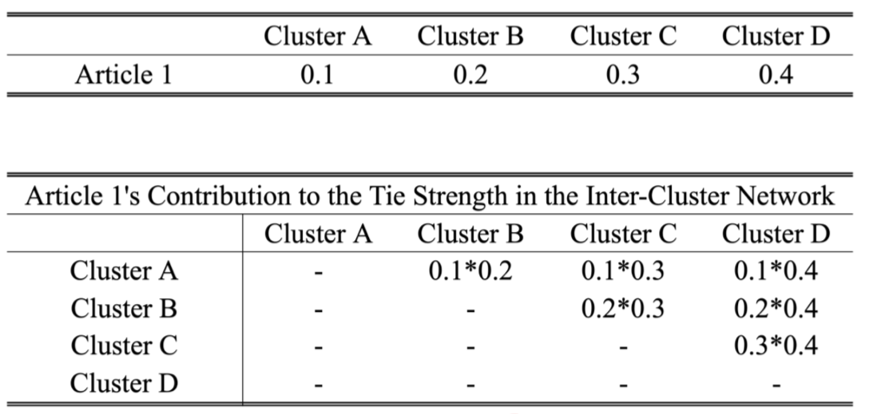
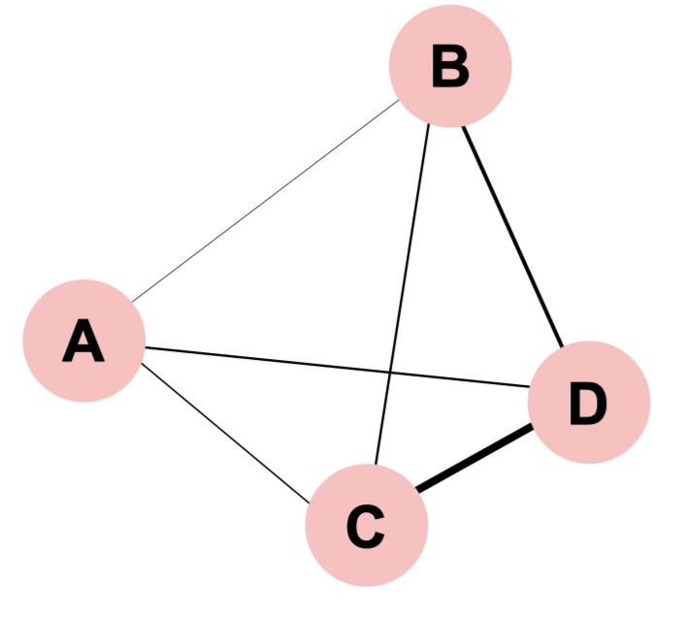
Data and Methods
Method 2: Inter-Cluster Network Analysis

Slide 41
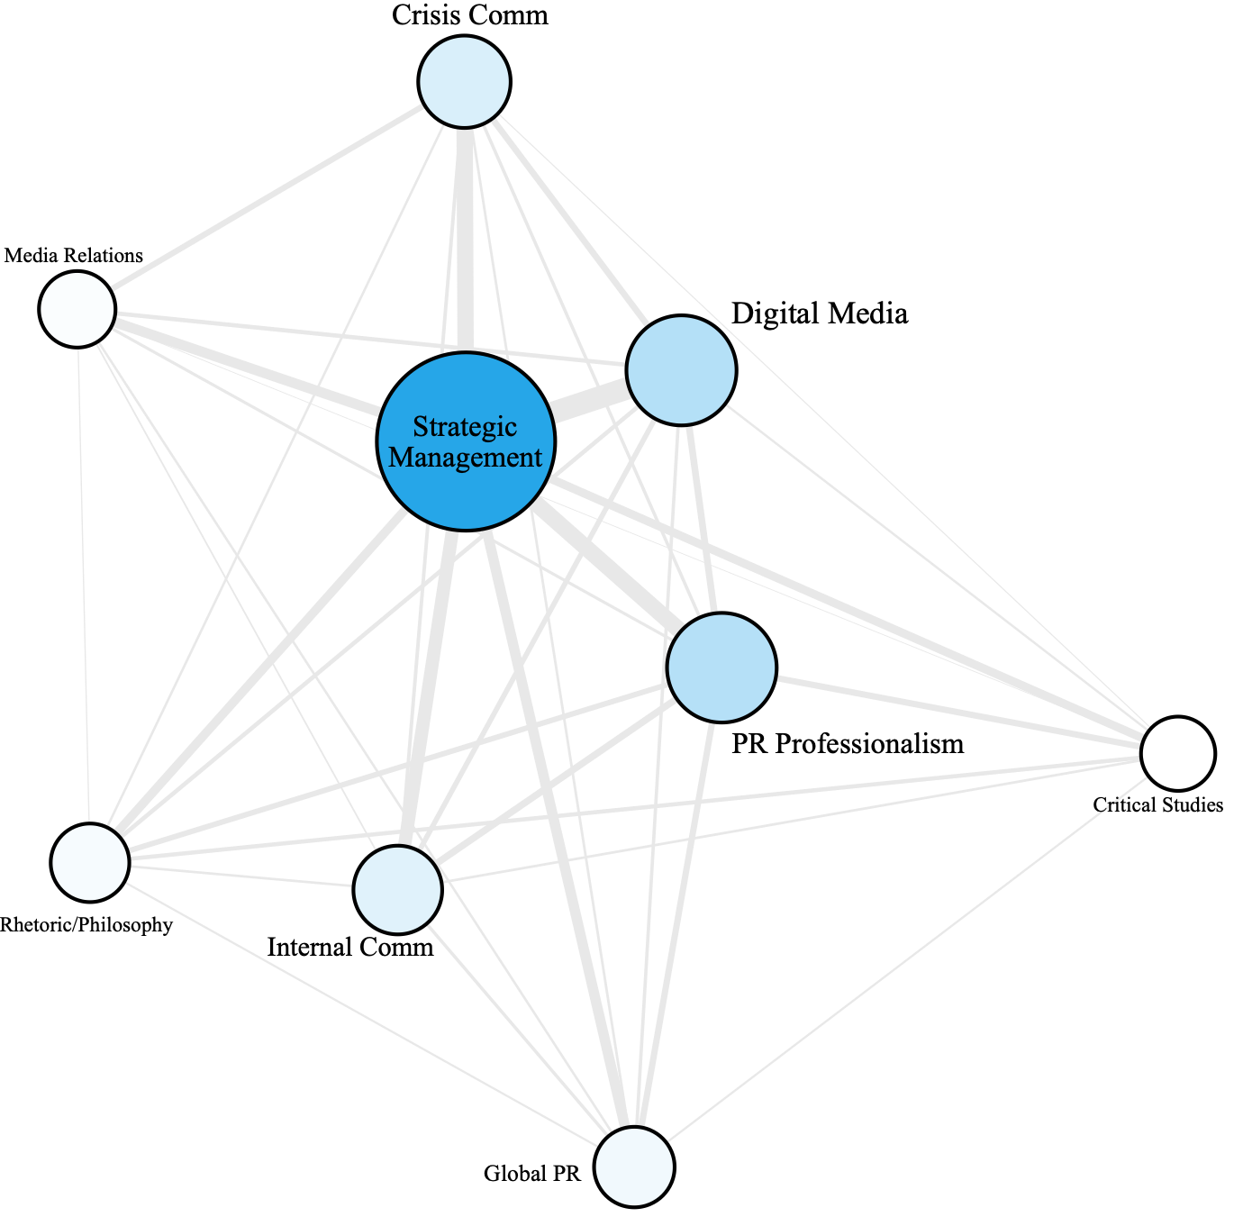
Data and Methods
Method 2: Inter-Cluster Network Analysis

Slide 42
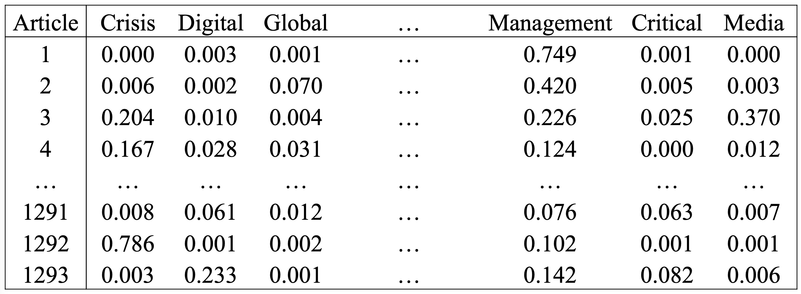
Data and Methods
Method 3: Network Simulation

Slide 43
Data and Methods
Method 3: Network Simulation
For each article, cluster proportions add up to 100%
For each cluster, its proportion across all articles remains the same
 | Cluster 1 | Cluster 2 | Cluster 3 | Cluster 4 | … | Cluster 7 | Cluster 8 | Cluster 9
Paper 1
Paper 2
Paper 3
…
Paper 1292
Paper 1293

Slide 44
Data and Methods
Method 3: Network Simulation
For each article, cluster proportions add up to 100%
For each cluster, its proportion across all articles remains the same
 | Cluster 1 | Cluster 2 | Cluster 3 | Cluster 4 | … | Cluster 7 | Cluster 8 | Cluster 9
Paper 1
Paper 2
Paper 3
…
Paper 1292
Paper 1293

Slide 45
Data and Methods
Method 3: Network Simulation
For each article, cluster proportions add up to 100%
For each cluster, its proportion across all articles remains the same
 | Cluster 1 | Cluster 2 | Cluster 3 | Cluster 4 | … | Cluster 7 | Cluster 8 | Cluster 9
Paper 1
Paper 2
Paper 3 |  |  | [i₁, j₁] |  |  | [i₁, j₂]
…
Paper 1292 |  |  | [i₂, j₁] |  |  | [i₂, j₂]
Paper 1293

Slide 46
Data and Methods
Method 3: Network Simulation
For each article, cluster proportions add up to 100%
For each cluster, its proportion across all articles remains the same
 | Cluster 1 | Cluster 2 | Cluster 3 | Cluster 4 | … | Cluster 7 | Cluster 8 | Cluster 9
Paper 1
Paper 2
Paper 3 |  |  | [i₁, j₁] - ∆ |  |  | [i₁, j₂] + ∆
…
Paper 1292 |  |  | [i₂, j₁] + ∆ |  |  | [i₂, j₂] - ∆
Paper 1293

Slide 47
Data and Methods
Method 3: Network Simulation
For each article, cluster proportions add up to 100%
For each cluster, its proportion across all articles remains the same
1000 Simulated Networks / Alternative Universes/Timelines
95%/5% upper/lower bound as the confidence interval for tie strengths
We simulated “what the field’s interconnection could have been”.

Slide 48
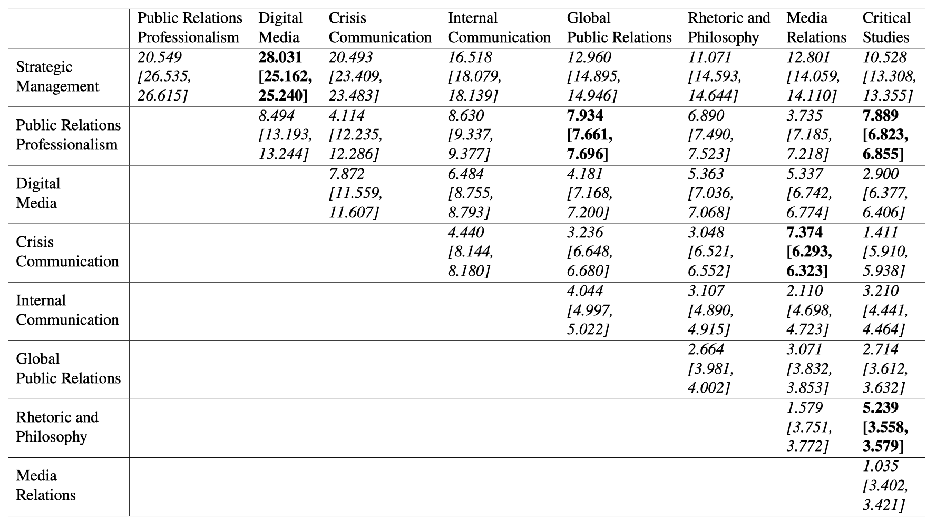
Data and Methods
Method 3: Network Simulation

Slide 49
Lab Preview
Explore semantic similarity using word embedding
Practice Google Perspective API
Run STM with presidential speech corpus and metadata
Pick K, generate the model, label topics
Explore covariates’ effects on topical proportion
Visualize topic correlations
Download and Install Gephi
https://gephi.org
We will use it next class

