Slide 1

ALL IS WELL
- DON'T BE STRESSED!
BioHack UCalgary 2025
Competitive track
Prompt 2: Mental Health
Alvish
Predicting Stress Levels Using Machine Learning

Slide 2

Inspiration
Understanding how stress impacts individuals differently is Important for improving mental health strategies.
Many factors, including demographics, lifestyle, and external burdens, contribute to varying stress levels.
My goal is to build a predictive model that helps identify individuals at risk based on these factors.
BIOHACKS UCALGARY 2025
All is well

Slide 3

What it does
My project uses machine learning to predict an individual’s stress level based on personal and lifestyle factors.
The model analyzes data such as age, employment status, physical activity, mental health history, and other key indicators to classify stress levels.
I also conducted a Power BI analysis to identify significant trends and Influencing factors to stress.
BIOHACKS UCALGARY 2025
All is well

Slide 4
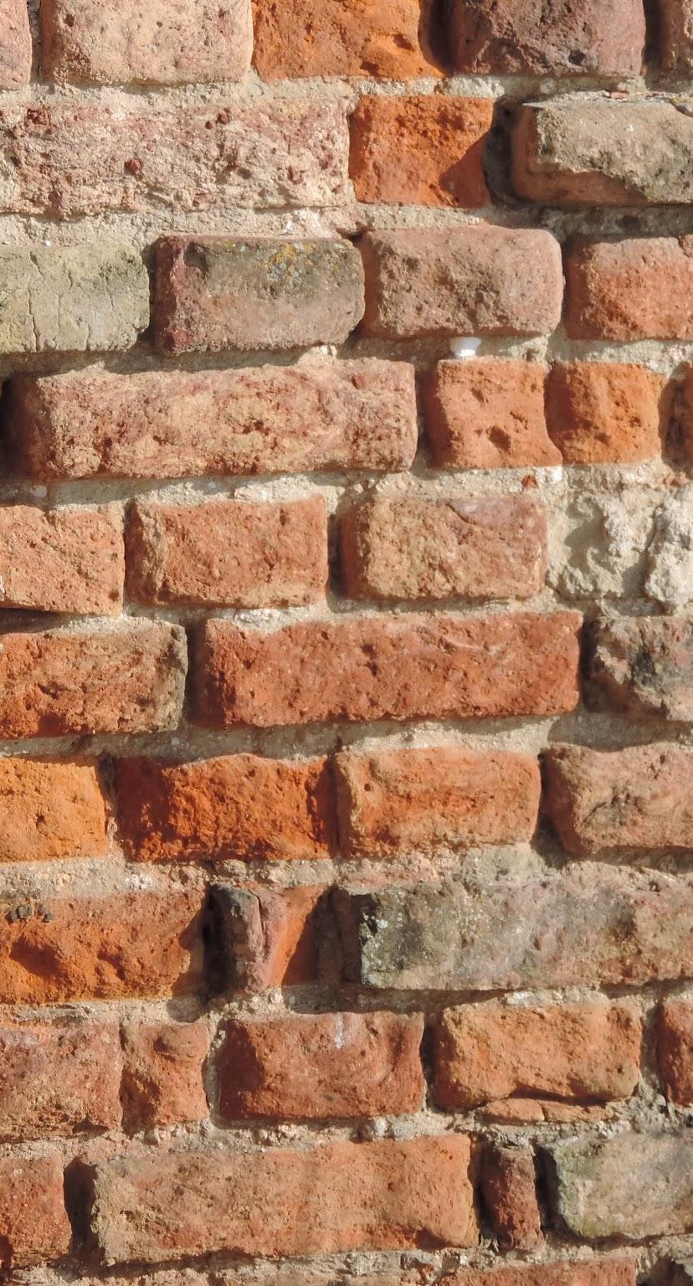
How we build it
Dataset: Kaggle stress-level dataset (link).
Data Preprocessing:
Cleaned and preprocessed data using Pandas and NumPy.
Handled missing values and encoded categorical variables.
Normalized numerical features.
Machine Learning Model:
Built using Scikit-learn.
Tested multiple classifiers: Decision Trees, Random Forests, and Ensemble Model.
Initial accuracy: 60% → After tuning: 78%.
Web Application:
Developed with Django to allow users to input data and get predictions.
Power BI Analysis:
Conducted trend analysis to identify significant correlations
BIOHACKS UCALGARY 2025
All is well

Slide 5
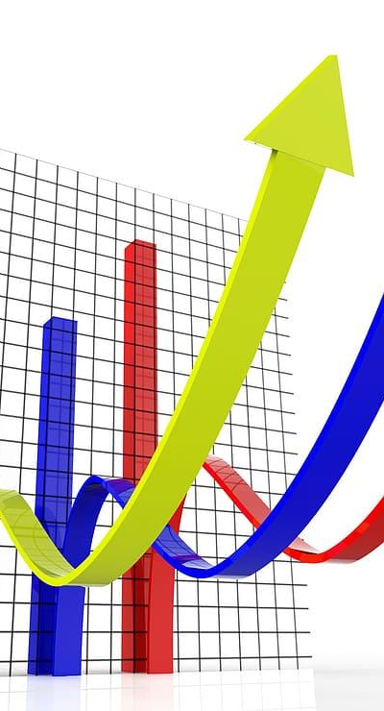
Key Influencing Features
I analyzed the dataset and identified the following key factors influencing stress levels:
Biggest factor: Cholesterol level is the biggest factor that influence stress followed by alcohol intake and amount of social interactions.
Smallest factors: Physical activity, meditation and caffeine intake are among the lowest influencing factors meaning doing those results in low stress.
Surprising facts: more sleep time is in the higher quadrant
BIOHACKS UCALGARY 2025
All is well

Slide 6

Model and performance
I implemented a Random Forest Classifier and fine-tuned it using GridSearchCV. Initially, the model had an accuracy of 60%, but with parameter tuning, we improved it to 78% accuracy.
Model Evaluation:
Best Parameters Identified: Fine-tuned using GridSearchCV.
Final Accuracy: 78%.
Insights: The model showed that sleep patterns, income levels, and mental health history had the highest correlation with stress levels.
BIOHACKS UCALGARY 2025
All is well

Slide 7
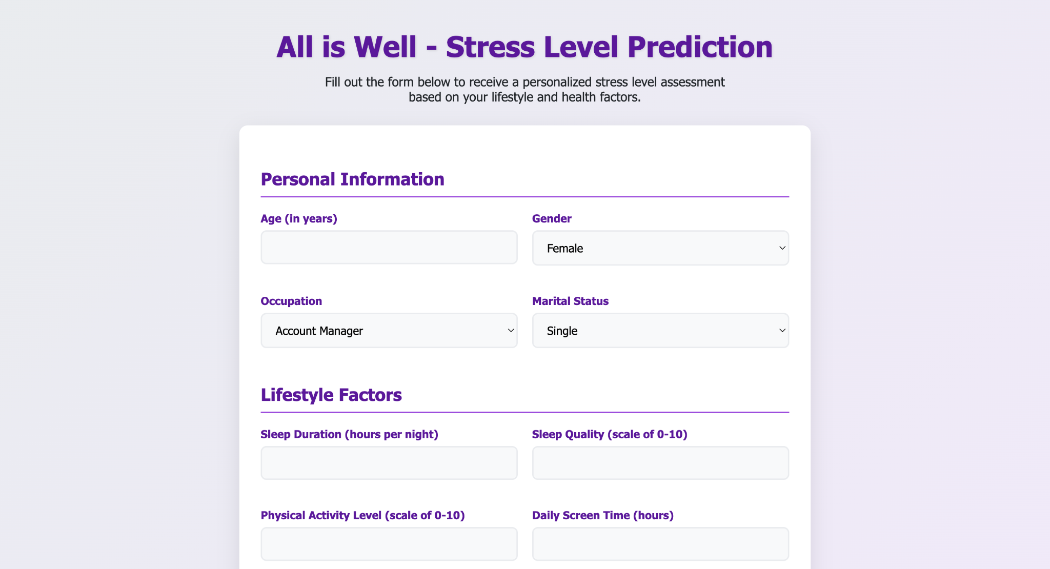

Working model
BIOHACKS UCALGARY 2025
All is well

Slide 8
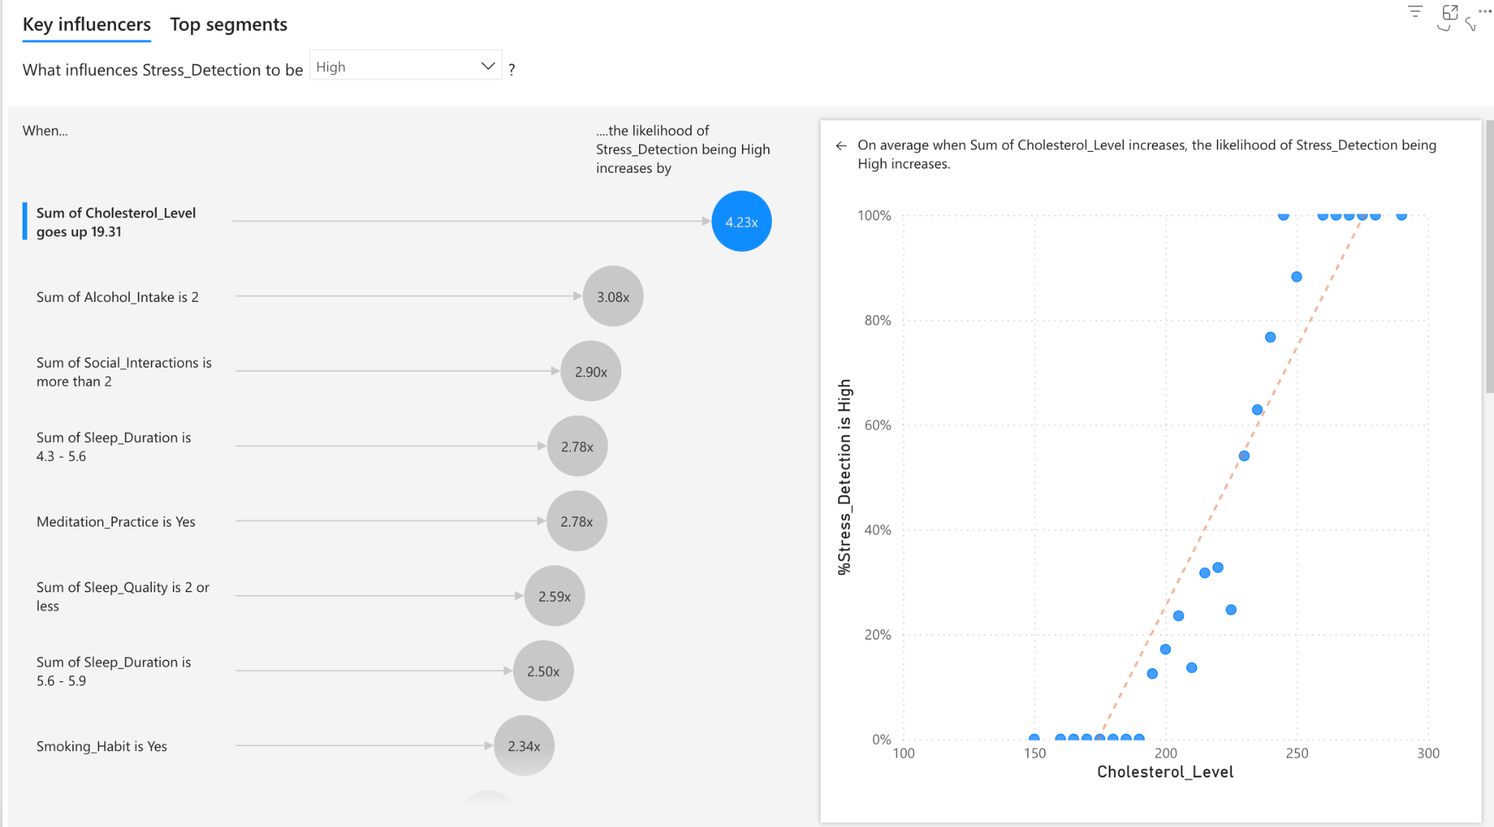

Power BI Analysis
BIOHACKS UCALGARY 2025
All is well

Slide 9

Whats Next?
Further Model Optimization: Exploring deep learning models to improve accuracy.
Feature Expansion: Incorporating real-time stress tracking using wearable data.
Personalized Recommendations: Suggesting stress management techniques based on predictions.
Mobile App Development: Extending functionality to mobile users.
Community Engagement: Partnering with healthcare organizations to implement AI-driven stress management.
BIOHACKS UCALGARY 2025
All is well

Slide 10
THANK
YOU

