Slide 1
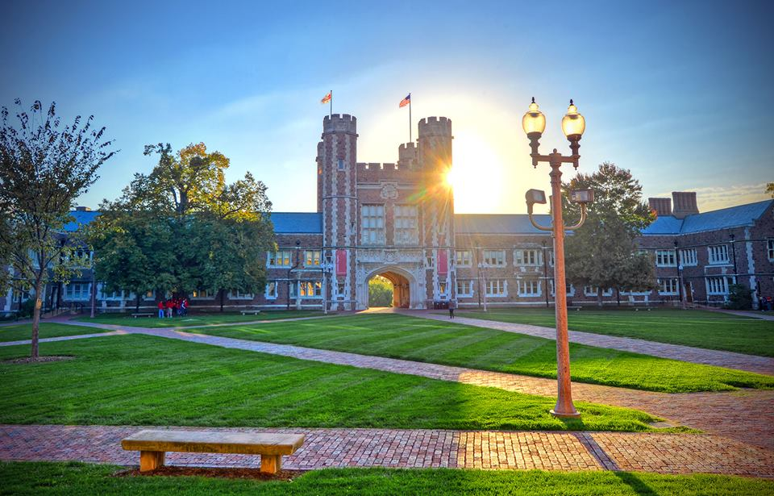

Vision, Visualization, Graphics, and Interaction: Solved Problems, Trends, and Challenges
Alvitta Ottley
Visualization Interaction and Behavior Exploration
http://visualdata.wustl.edu/

Slide 2
Vision, Visualization, Graphics, and Interaction: Solved Problems, Trends, and Challenges
Alvitta Ottley
Visualization Interaction and Behavior Exploration
http://visualdata.wustl.edu/

Slide 3
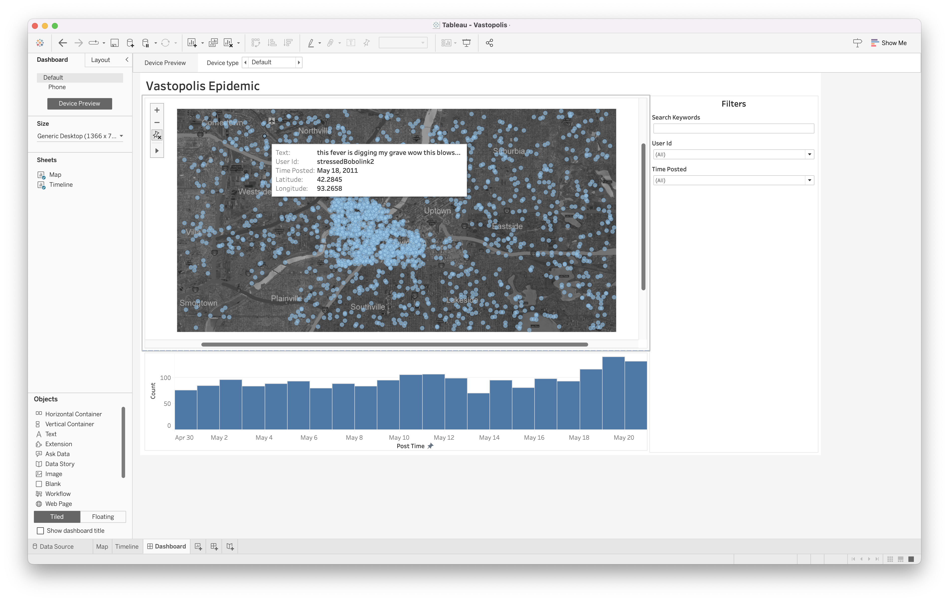
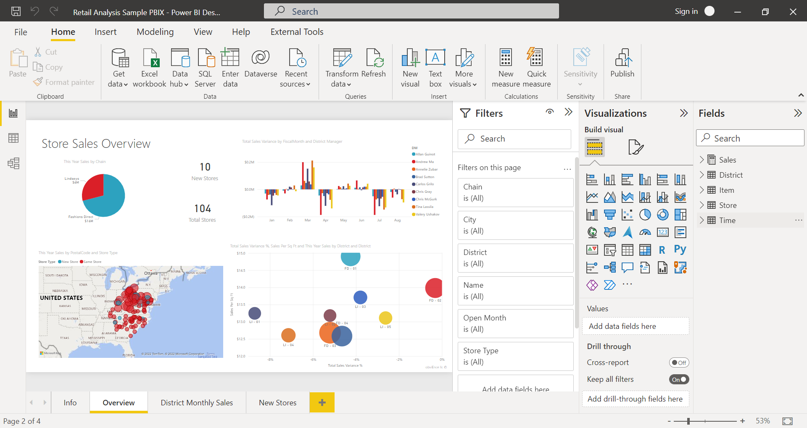
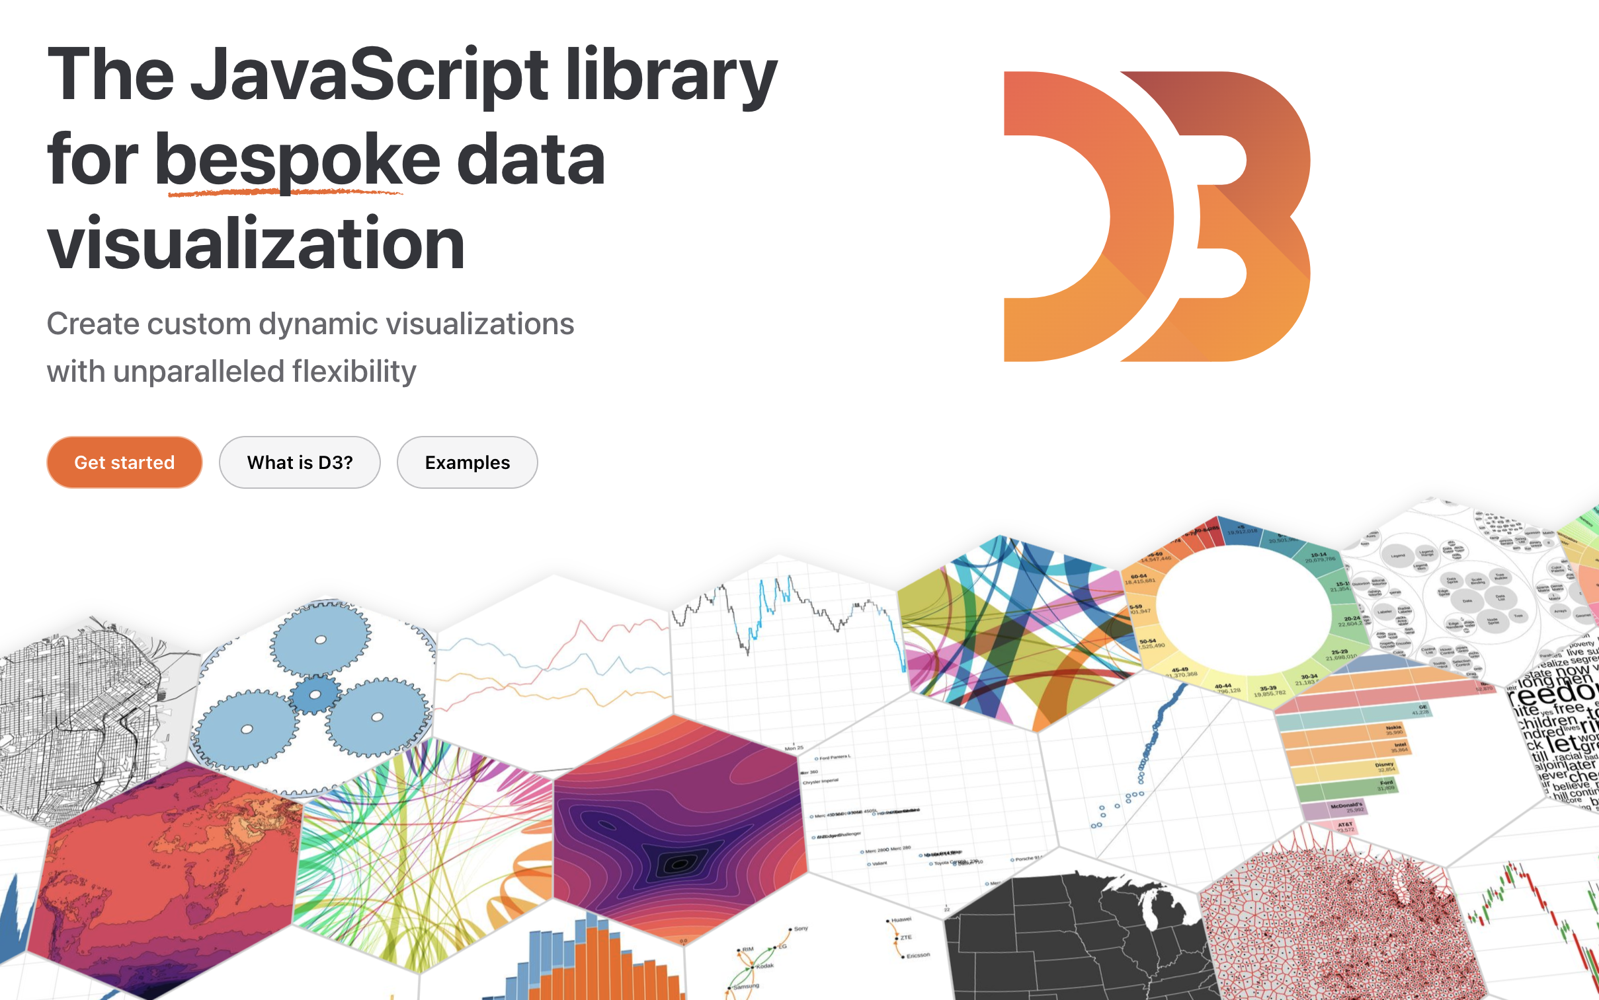
Better software, making it easy to create visualizations.
Better hardware (e.g., GPUs), leading to immersive and interactive visualizations.
Notes:
Tableau, Power BI, and custom visualization tools.

Slide 4
Anyone can create a visualization!

Slide 5
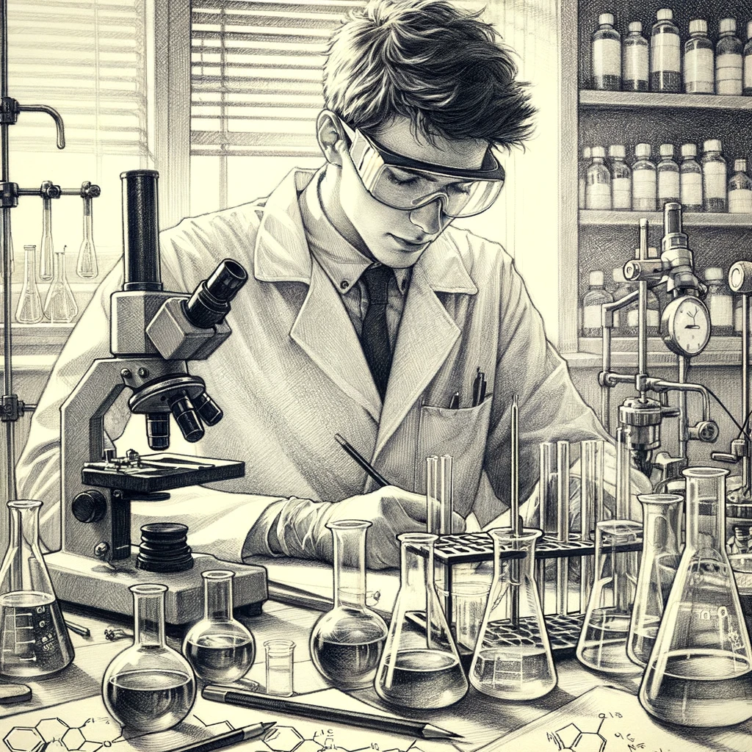
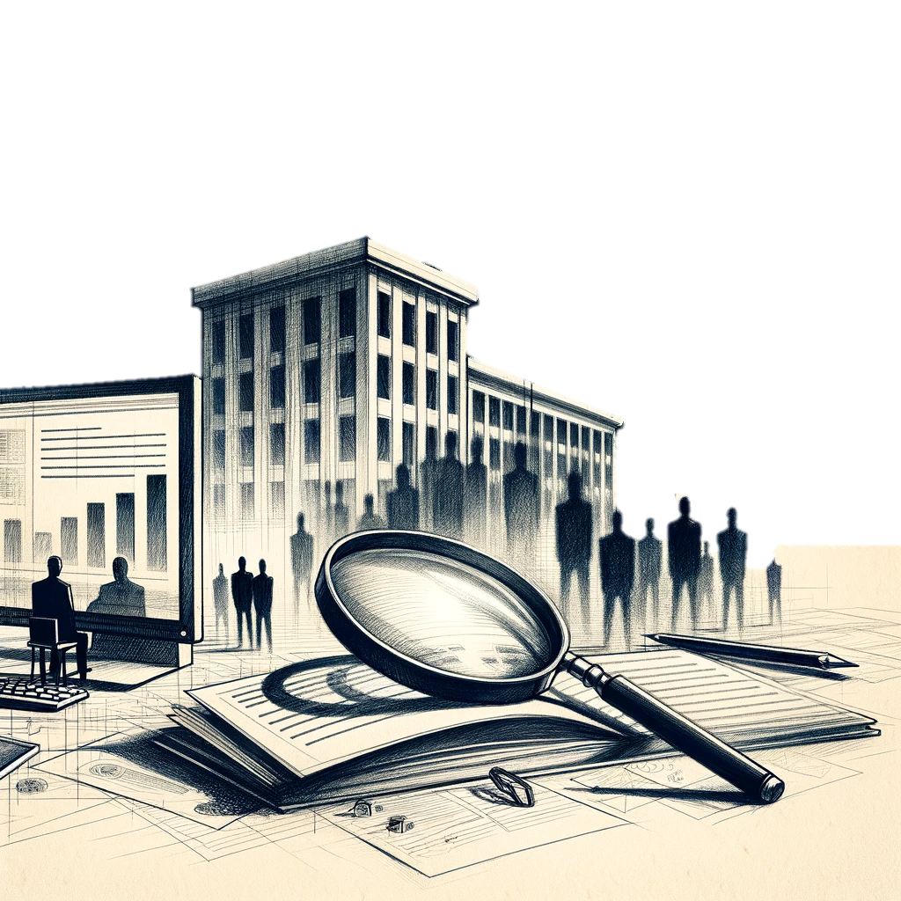
Our users are no primarily longer scientific experts or business and government officials.
Notes:
This methodology has made significant impacts
In many domains, such as business, government for intelligence analysis, and scientific discovery.
Many of these accomplishment are made possible by platforms such as

Slide 6
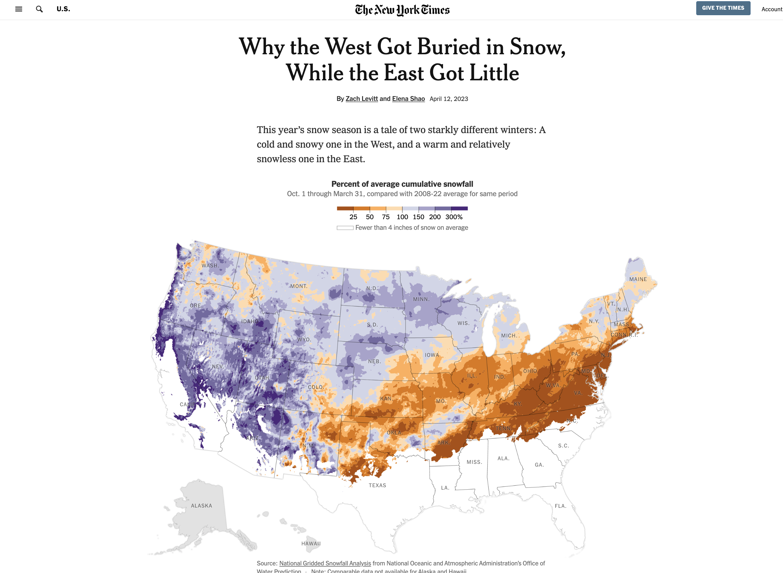
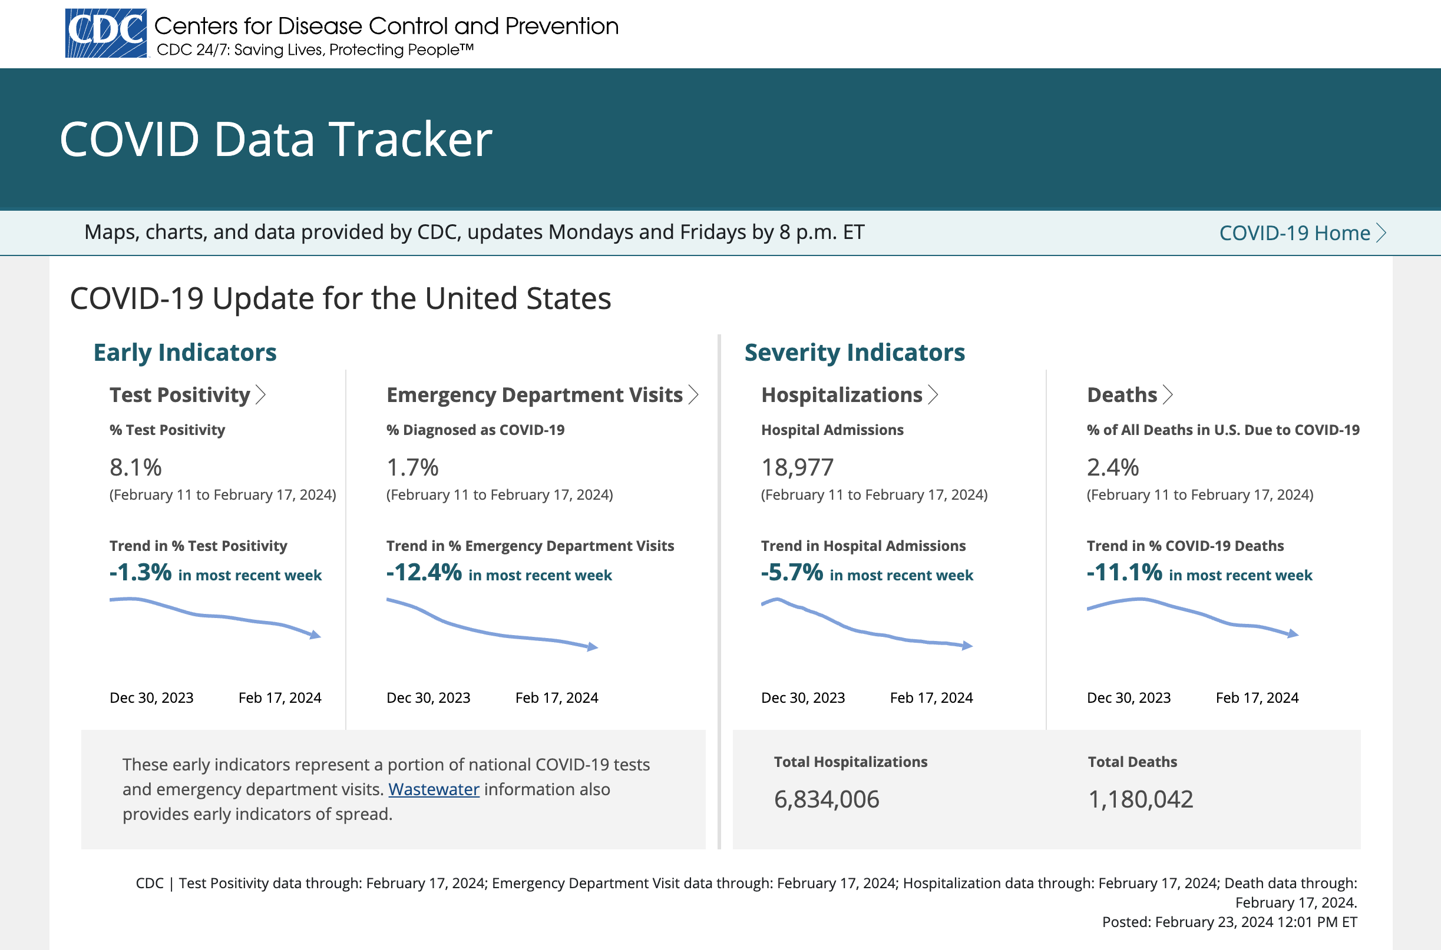
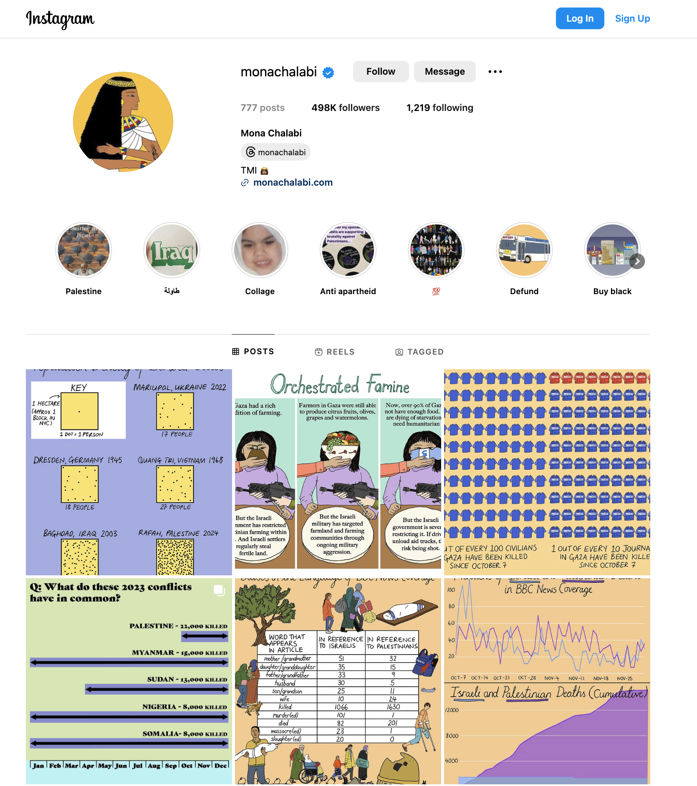
Visualization is now ever-present in the news, the health community, and social interactions.

Slide 7
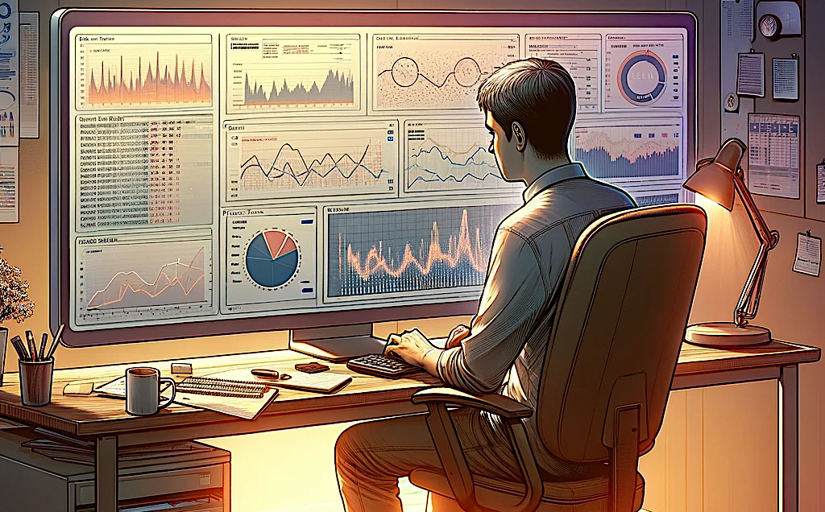
We have seen significant strides in data science and visual analytics.

Slide 8
Big Data
High-Dimensional Data

Slide 9

Big Data
High-Dimensional Data
AI and ML Integration

Slide 10
Anyone can create a visualization!
Notes:
As visualization's power to inform and persuade has become more widely recognized, there's been a growing discussion around ethics, including concerns about misleading visualizations and the responsibility of designers to present data accurately and fairly.

Slide 11
Challenges
Misinformation
Responsibility of designers to present data accurately and fairly

Slide 12
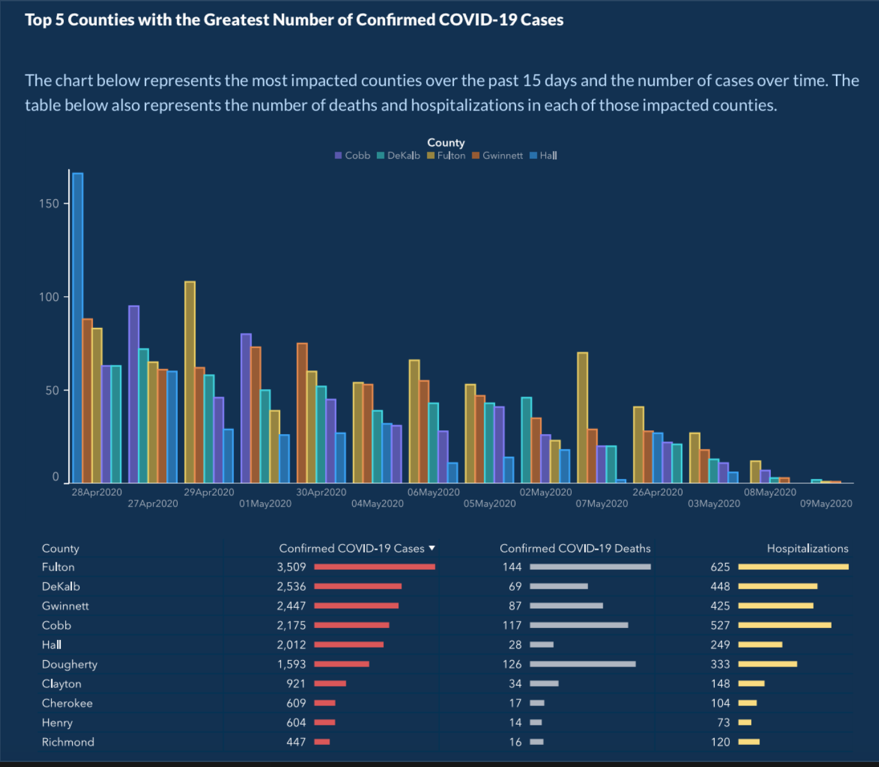
Challenges
Misinformation
Responsibility of designers to present data accurately and fairly

Slide 13
Challenges
Misinformation
Responsibility of designers to present data accurately and fairly

Slide 14
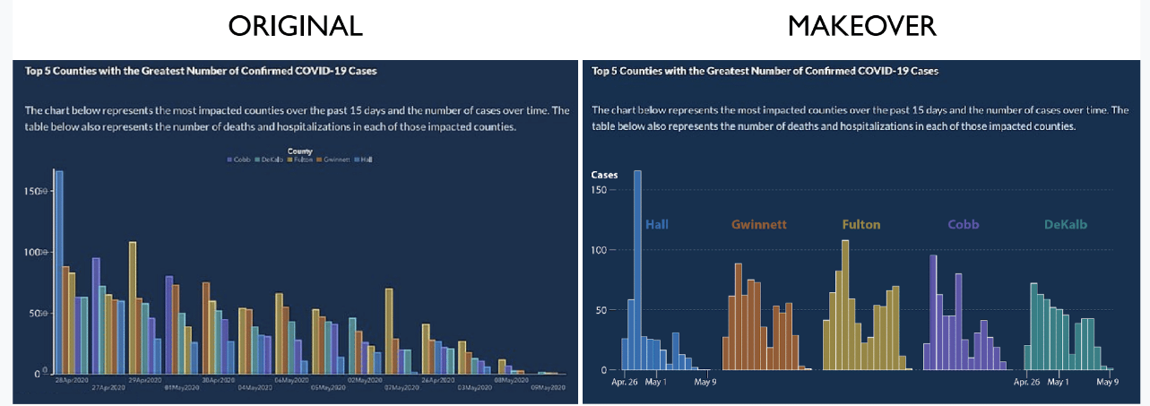

Slide 15
Now that visualizations are used to communicate vital information to the general public…
Notes:
It’s now apparent that….

Slide 16
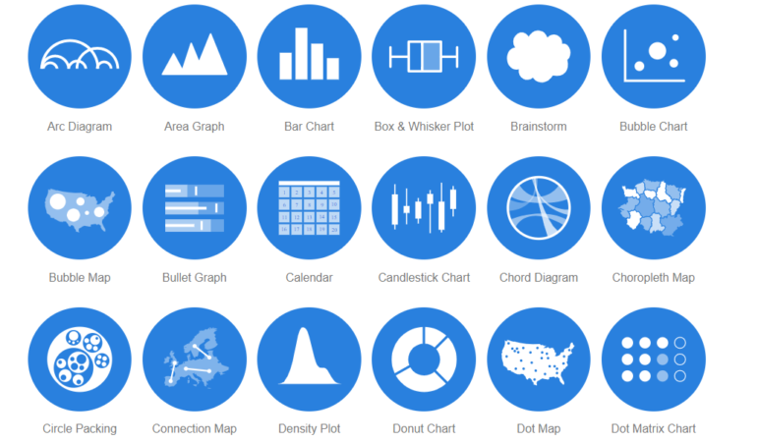
Many people do not know how to read visualizations.
How do we improve data and visualization literacy?
How to make visualizations more intuitive, engaging, and effective for ALL users.
How do we help viewers recognize when a visualization is misleading?

Slide 17
Now that AI can perform some tasks as effectively or even more efficiently than humans...

Slide 18
Challenges
How do we increase communication bandwidth between the analyst and the AI?
How do we merge models of human-human collaborative problem-solving with AI distributed problem-solving approaches?

Slide 19
In summary
Ethical Visualizations: Ensuring that visualizations do not mislead or misrepresent the data is a critical challenge.
Visualization Education: Create a data and visualization literate society and broaden access to “data-poor” and underserved populations.
Data Analytics + AI: What does it mean for AI to collaborate with humans? How to explain model decisions, uncertainty, and biases in the data or model.
Notes:
Addressing these challenges requires a multidisciplinary approach that combines skills in computer science, graphic design, user experience design, and domain-specific knowledge.

Slide 20
Vision, Visualization, Graphics, and Interaction: Solved Problems, Trends, and Challenges
Alvitta Ottley
Visualization Interaction and Behavior Exploration
http://visualdata.wustl.edu/
Notes:
I look forward to an exciting discussion

