Slide 1
Where to start a new tapas restaurant in Seville
Applied Data Sciece Capstone
Álvaro Romero Muñiz
28 June 2021

Slide 2
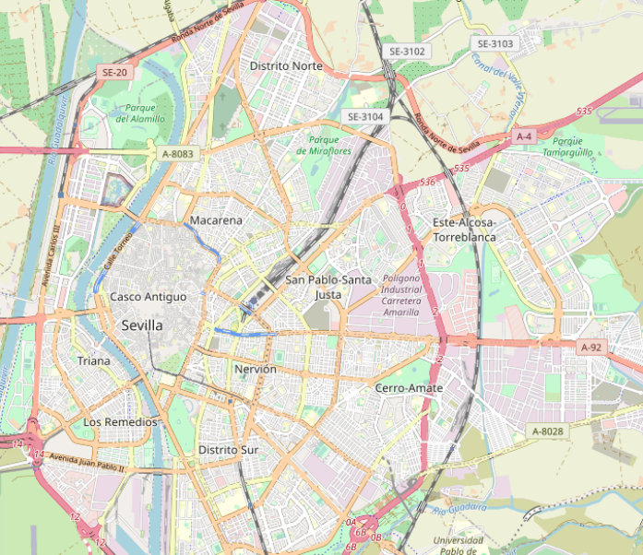
INTRODUCTION
Most of the city is on the east side of the river, while Triana, La Cartuja and Los Remedios are on the west side. Triana is the oldest neighbourhood of the west bank of the river and it is very different from the Ancient District
The owner of a restaurant in Triana wants to start another business in the Casco Antiguo (Acinet Districton) on the other side of the river, but does not know which area may be the best. “The more similar it is, the easier it will be for my restaurant to succeed”

Slide 3
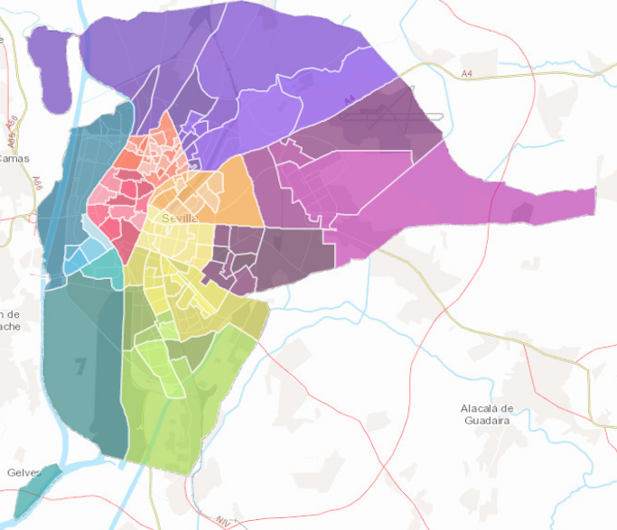
DATA SOURCE
The Seville city hall has digital resources of their spatial planning (urbanismosevilla.org)
A .kml file can be downloaded with the districts and neighbourhoods of the city, that should be transformed into points (centroids of polygons) to get the coordinates of each one
There are 108 different areas, some of them contain industrial parks or farmlands and they will not be considered in the study

Slide 4
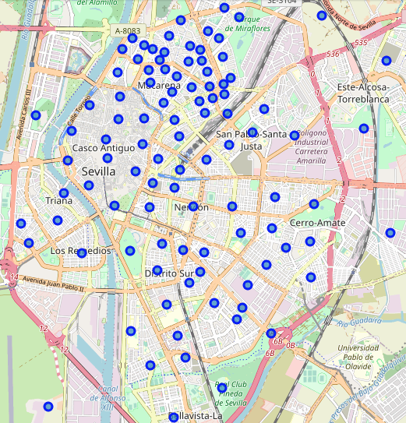
DATA CLEANING
The archive with the polygons is converted to a .shp file and the centroids of the neighborhoods are obtained using the method centroid of the GeoPandas Python library
The venues in each area are gotten using foursquare
There are 908 results with 136 different categories, but only 55 neighborhoods have five or more venues
A dataframe is creaed with the 55 neighborhoods of the sample and the most common venues. It is transformed using dummy variables instead of the feature name

Slide 5
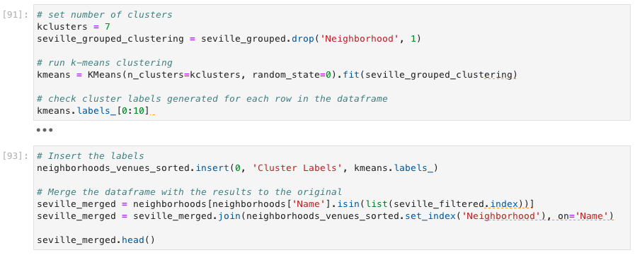
MODEL
The algorithm of k-means clustering is run the dataframe of dummy variables and different number of clusters
Classify the different neighborhoods without additional information. With more than seven clusters some remain empty
The most accurate classification is that of kcluster = 7

Slide 6
RESULTS
Name | 1st Most Common Venue | 2nd Most Common Venue | 3rd Most Common Venue | 4th Most Common Venue | 5th Most Common Venue | 6th Most Common Venue | 7th Most Common Venue | 8th Most Common Venue | 9th Most Common Venue | 10th Most Common Venue
Retiro Obrero | Coffee Shop | Tapas Restaurant | Lounge | Ice Cream Shop | Spanish Restaurant | Wine Bar | Farmers Market | Food | Fish Market | Fish & Chips Shop
El Porvenir | Tapas Restaurant | Spanish Restaurant | Restaurant | Gym / Fitness Center | Grocery Store | Mexican Restaurant | Tennis Court | Ice Cream Shop | Bar | Café
Doctor Barraquer, G. Renfe, Policlínico | Tapas Restaurant | Supermarket | Sandwich Place | Beer Garden | Pub | Spanish Restaurant | Event Space | Fish Market | Fish & Chips Shop | Fast Food Restaurant
Macarena 3 Huertas, Macarena 5 | Tapas Restaurant | Coffee Shop | Fast Food Restaurant | Spanish Restaurant | Café | Wine Bar | Event Space | Food | Fish Market | Fish & Chips Shop
Triana Casco Antiguo | Tapas Restaurant | Spanish Restaurant | Restaurant | Bar | Brewery | Deli / Bodega | Lounge | Market | Fish & Chips Shop | Snack Place
San Lorenzo | Tapas Restaurant | Gay Bar | Spanish Restaurant | Gym, Fitness Center | Mexican Restaurant | Hotel | Café | Indian Restaurant | Bar | Nightclub
Triana Este | Tapas Restaurant | Seafood Restaurant | Gastropub | Chinese Restaurant | Spanish Restaurant | Pub | Fish Market | Fish & Chips Shop | Fast Food Restaurant | Farmers Market
León XIII, Los Naranjos | Tapas Restaurant | Coffee Shop | Spanish Restaurant | Café | Wine Bar | Event Space | Food | Fish Market | Fish & Chips Shop | Fast Food Restaurant
Huerta del Pilar | Tapas Restaurant | Spanish Restaurant | Park | Beer Bar | Mediterranean Restaurant | Restaurant | Pub | South American Restaurant | Bar | Mexican Restaurant

Slide 7
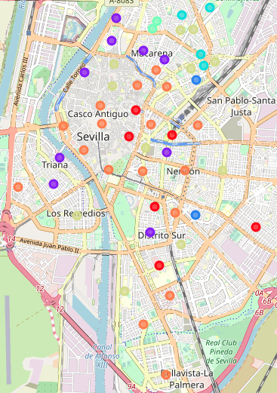
CONCLUSION
The districts of Triana and Casco Antiguo are very different. In the second one, the vast majority of neighborhoods belong to a different group
The distribution shows that the orange ones are more tourist areas, the green ones are new or remodeled residential areas and the purple ones are traditional residential neighborhoods
The study shows that there is only one similar location to open the new bar. It is in the cluster that contains Triana and is inside the Ancient District: San Lorenzo. So this area will be the best to search commercial premises for rent

