Slide 1
AI ENGINEERING PORTFOLIO · 2026
A self-hosted LLM agent,
running on a 4GB laptop GPU.
RAG, fine-tuning, tool calling, and JWT auth — all local, MIT-licensed.
RTX 3050 4GB
qwen2.5:3b
Unsloth LoRA
Ollama + Qdrant
93 tests
Alvaro · Madrid · github.com/alvrooperez/LLM-agent

Slide 2
CONTENTS
What's inside
01
The project
02
Architecture
What I built, why, and the constraints
Browser · FastAPI · Agent loop · Ollama · Qdrant
03
RAG pipeline
04
Fine-tuning
Vector search over AI engineering docs (+83% relevance)
Unsloth LoRA, 230 examples, honest evaluation
05
Tool-calling agent
06
Performance
6 tools, 80-line loop, multi-tool chaining
Load test, capacity, RAG latency, fixes
07
Authentication
08
What this demonstrates
JWT login, scrypt, rate limiting, security
Engineering under real constraints
02

Slide 3
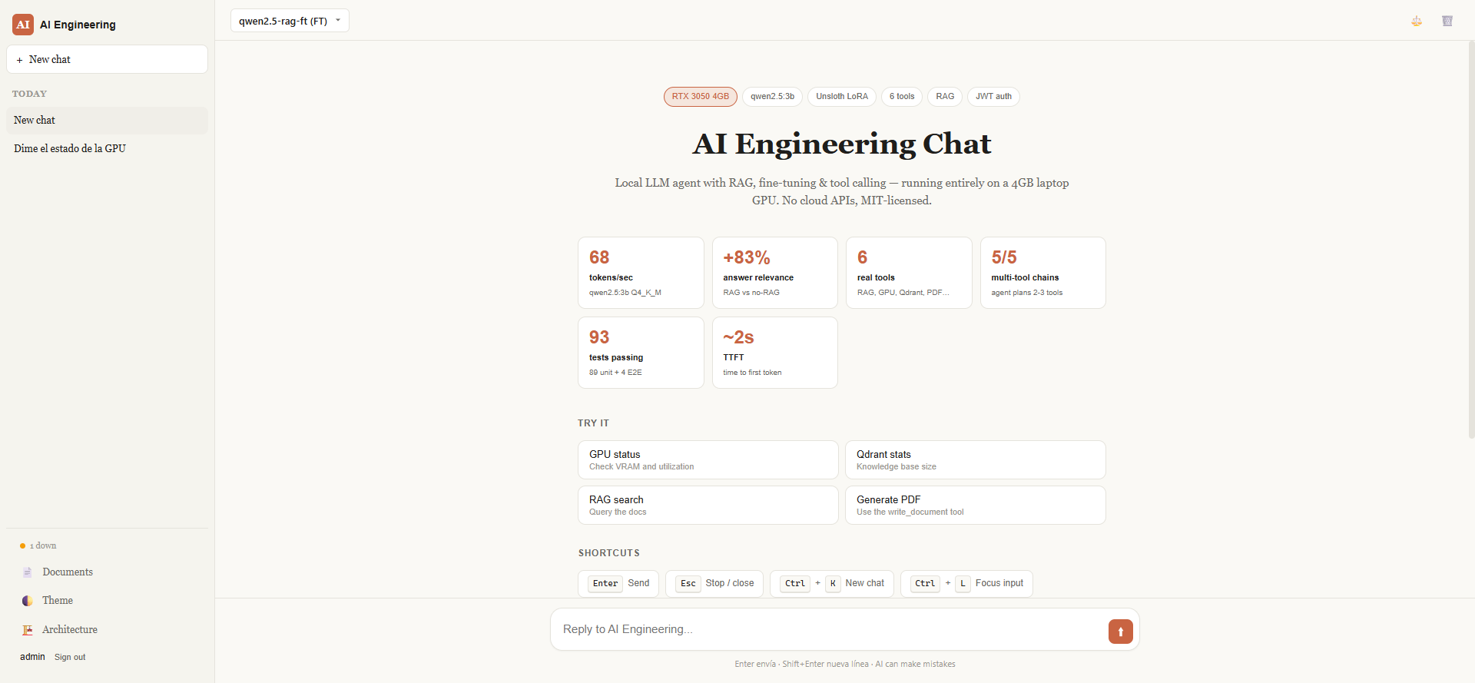
THE PROJECT
A local LLM agent that runs entirely on a laptop GPU.
Inference
Ollama serves qwen2.5:3b at 68 tok/s, Q4_K_M quantized to 1.9 GB.
RAG
Qdrant vector DB + sentence-transformers. +83% answer relevance vs no-RAG.
Fine-tuning
Unsloth LoRA on 230 tool-calling examples. GGUF Q4_K_M export, no quality regression.
Agent
80-line tool-calling loop, 6 real tools, multi-tool chaining, native Ollama tool calling.
Chat welcome screen — login required, JWT auth
03

Slide 4
ARCHITECTURE
Five services, one browser tab.
Browser
Vanilla JS SPA · dark/light
Chat App
:8090
FastAPI + SSE streaming
Agent loop
Ollama
RAG API
Qdrant
:11434
:8000
:6333
80 lines
qwen2.5:3b FT
FastAPI + ST
62 chunks, dim 384
All services containerized. Bind mounts in dev, images in prod. No cloud APIs.
04

Slide 5
RAG PIPELINE
Retrieval-Augmented Generation over 62 doc chunks.
1
2
3
4
5
Embed
Store
Query
Augment
Generate
sentence-transformers/all-MiniLM-L6-v2 · 384 dim
Qdrant cosine similarity · 62 chunks ingested
Top-3 docs by cosine similarity
Inject context into the prompt
Ollama answers using retrieved context
Why it matters
A 3B model hallucinates specifics. Grounding its answers in retrieved docs (Ollama, Qdrant, Unsloth, LlamaIndex) cuts hallucinations and lets me ask 'how do I configure X?' without it guessing.
05

Slide 6
RAG EVALUATION
What retrieval actually buys you.
+83%
relevance improvement
judge model 1-5 scale
62
doc chunks indexed
AI engineering knowledge
~2.5s
retrieval overhead
embed + Qdrant search
100%
local & private
no doc leaves the laptop
06

Slide 7
FINE-TUNING
Unsloth LoRA on tool-calling examples.
1
Generate dataset
~10 min
230 train / 15 held-out test. Tool-call pairs in JSONL.
2
Train with Unsloth
28 min
LoRA r=16, 2 epochs, batch=2, grad_accum=4. ~28 min on RTX 3050.
3
Merge to GGUF
~3 min
CPU merge, then llama.cpp Q4_K_M quantization. Final model: 1.93 GB.
4
Register in Ollama
<1 min
Modelfile + system prompt. Hot-load with `ollama create`.
07

Slide 8
FINE-TUNING RESULTS
What 230 examples actually did.
Metric | Base qwen2.5:3b | Fine-tuned | Delta
Tool call rate | 7% | 7% | no change
Iterations / task | 2.2 | 2.0 | −9%
Response length | 315 chars | 279 chars | −11%
RAG relevance | baseline | baseline | no change
HONEST FINDING
The base model already knew tool-calling format.
LoRA didn't add new capability — it shortened responses and reduced iteration count. Zero regression.
This is the right outcome to report. Inflating 'capability gains' would be lying about the data.
08

Slide 9
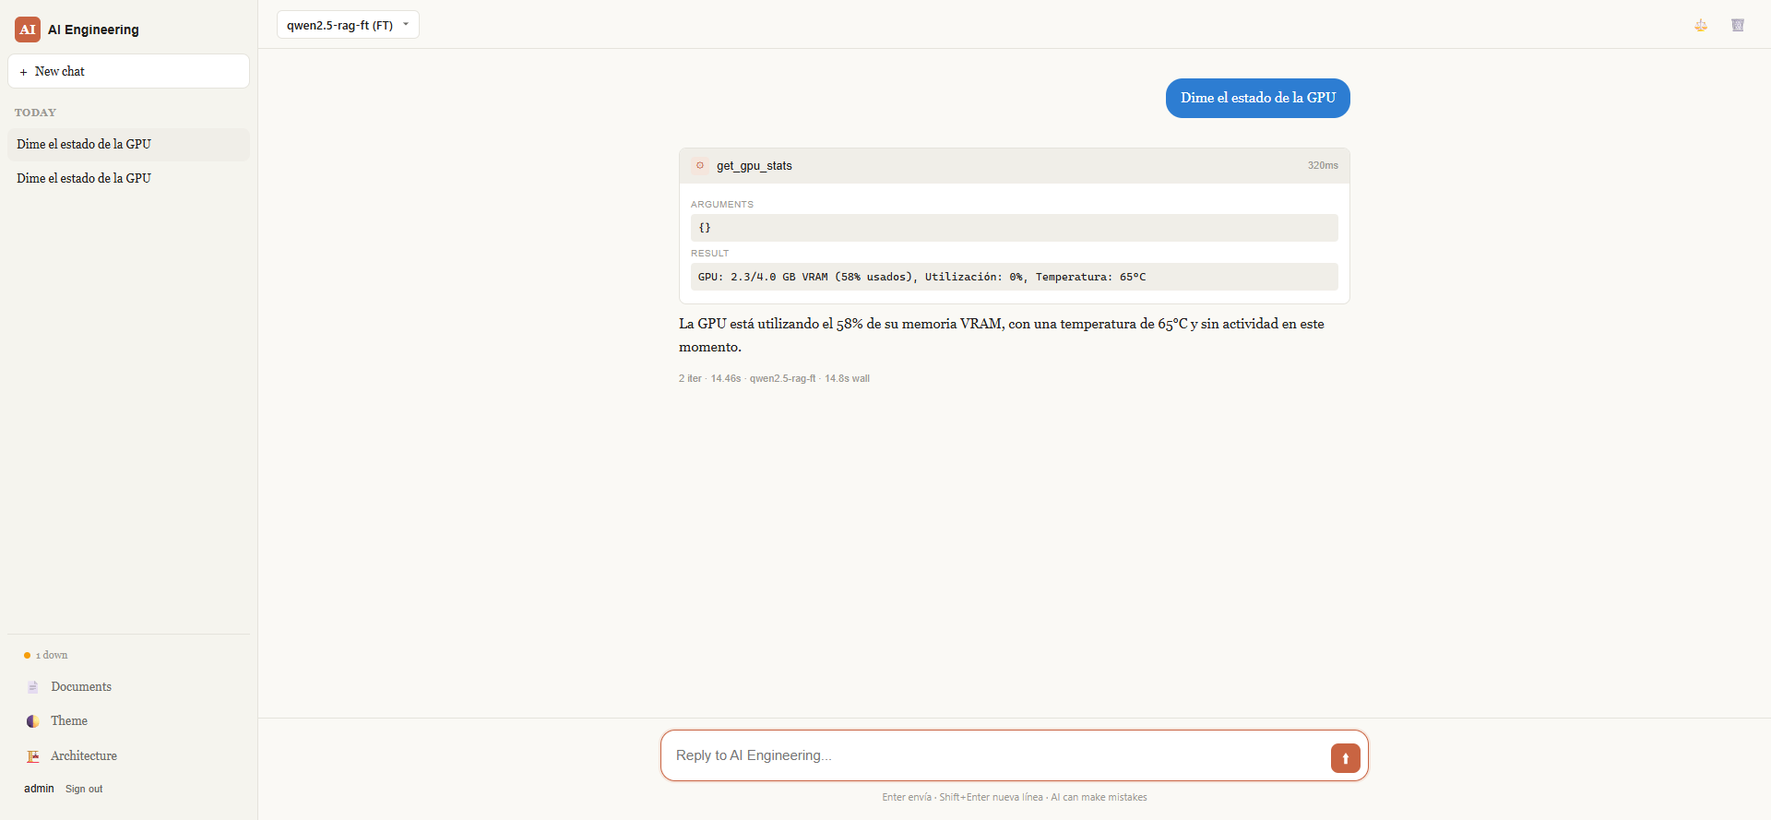
TOOL-CALLING AGENT
6 tools. 80-line loop. No LangChain.
search_docs()
list_models()
RAG over docs
Ollama inventory
get_gpu_stats()
get_collection_info()
VRAM / util
Qdrant metadata
plot_metric()
write_document()
matplotlib chart
PDF report
Multi-tool chaining: 5/5 PASS
Agent plans 2-3 tool calls in a single turn when the task spans them.
Live tool call: get_gpu_stats() → result → answer
09

Slide 10
PERFORMANCE
Bottleneck, capacity, and one big fix.
69s → 20s
RAG query latency fix
Agent loop was oscillating on RAG. Early-stop when 2 iterations call the same tools.
4 concurrent
Max users before p50 > 60s
GPU inference is the bottleneck, not the software stack. Scaling needs more GPUs or batching.
10

Slide 11
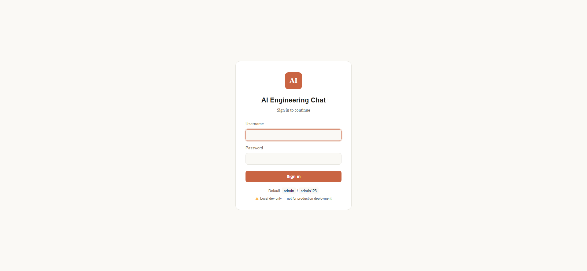
AUTHENTICATION
JWT login with scrypt-hashed passwords.
Stack
User storage
data/users.json · scrypt$n=2^14, r=8, p=1
Password verify
constant-time compare, ~50ms per attempt
Token
JWT HS256 · 24h expiry · sessionStorage
Endpoint guard
FastAPI dependency on every route except /health
Rate limit
10 login/min per IP (anti brute-force)
Login screen — full-screen gate before the chat loads
11

Slide 12
THANK YOU
12
Engineering under real constraints.
4GB VRAM, no cloud APIs, 93 tests, MIT-licensed.
Defensible decisions
Honest reporting
Production patterns
Every choice has a tested 'why'. A/B evals, held-out tests, load profiles.
Fine-tuning didn't add new capability. The base model already knew. I wrote that down.
JWT auth, rate limiting, scanner block, contextvars, regression runner — from day 1.
Demo
Source
Default login
http://localhost:8090
github.com/alvrooperez/LLM-agent
admin / admin123

