Slide 1
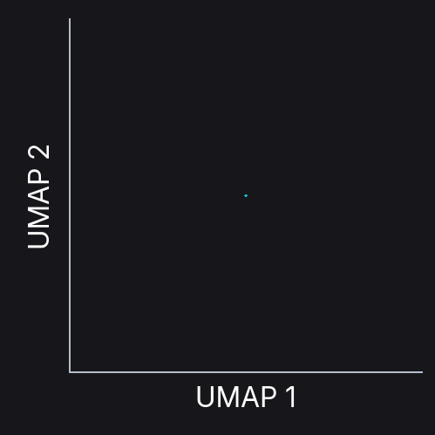
Mammary gland
Sigmoid colon
Cortex
GTEx
Liver
Lung
Normal human
tissues
Stomach
Pancreas
Ovary
Adrenal
Testis
Notes:
Design preview only; confirm event playback specifications before final delivery. Click video to play. Identity-matched interpolation between independently fitted UMAP layouts; motion is illustrative, not a measured trajectory. Each gene/context point averages all 20 samples in its context. Layouts centered and uniformly scaled for display. L0 residuals are zero by construction.

