Slide 1
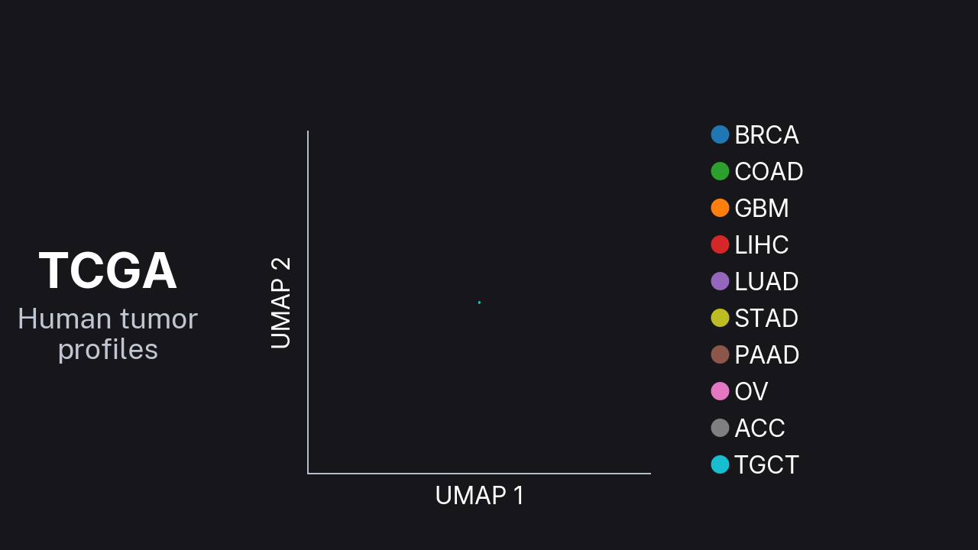
Notes:
Design preview only; confirm event playback specifications before final delivery. Click video to play. Identity-matched interpolation between independently fitted UMAP layouts; motion is illustrative, not a measured trajectory. Each gene/context point averages all 20 samples in its context. Layouts centered and uniformly scaled for display. L0 residuals are zero by construction. Colors match the corresponding normal organ. Cortex/GBM is approximate; organ matching is not patient or cell-type matching.

