Slide 1
What is a Job Worth?

Slide 2
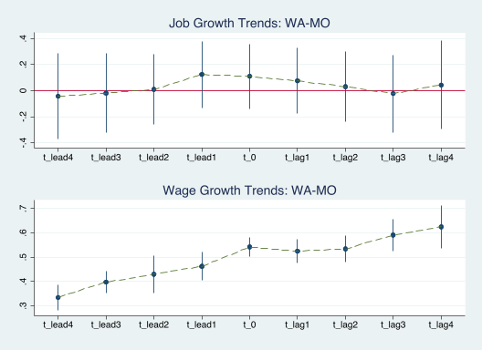
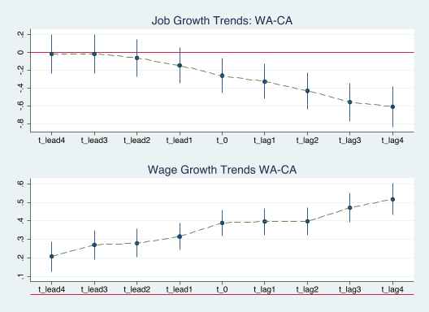
DID with WA/MO and WA/CA

Slide 3
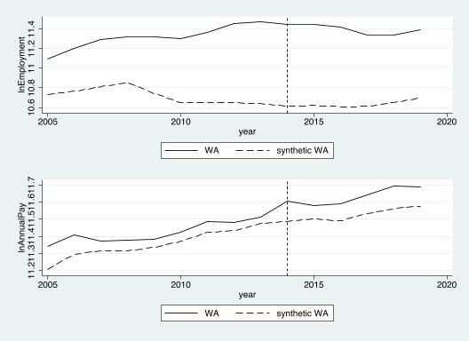
Synthetic Control

Slide 4
Code, Data, Plots
Gitlab Repo: Econ672_Winter2022/tree/main/ResearchPaper

