Slide 1
Simplified Gravity Model
Jon Holder

Slide 2
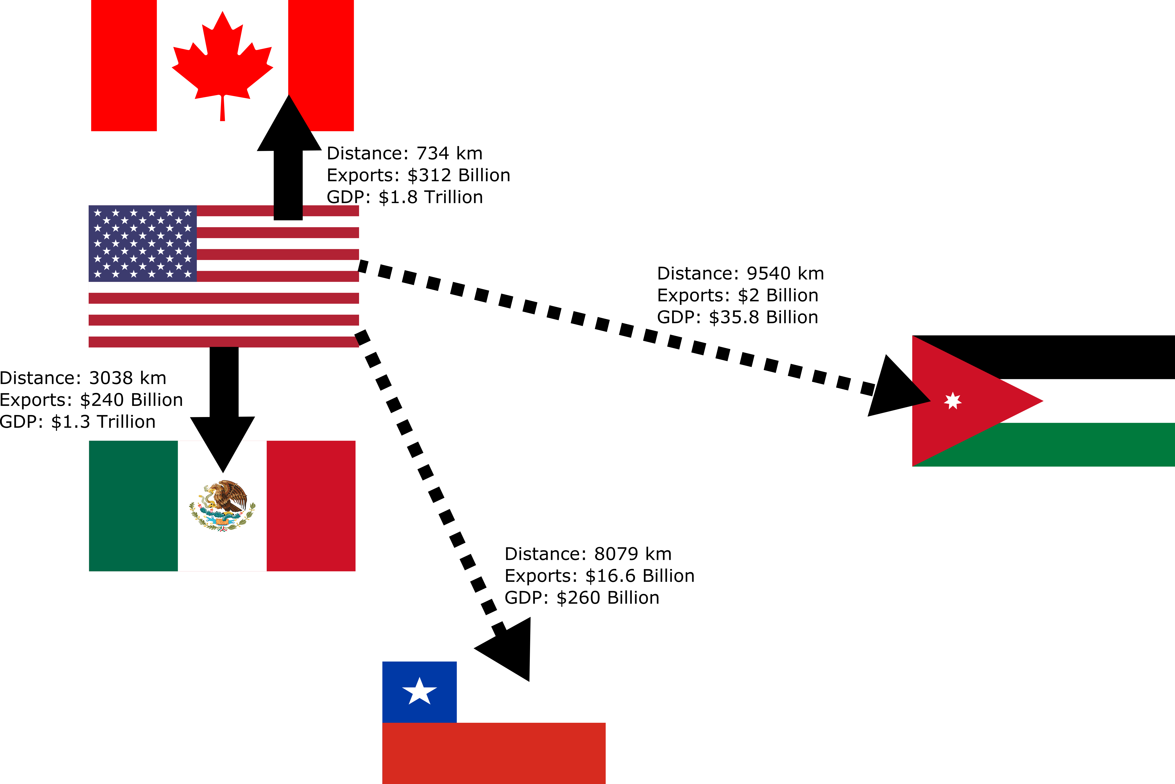
About Gravity Model
Gravity model estimates the “force” of trade relationship between countries as function of country size and trade friction.
A country will trade more with partners with lower trade costs, ie geographically closer, shared language, favorable trade terms.
A country will trade more with partners with more goods to trade, ie larger GDP .

Slide 3
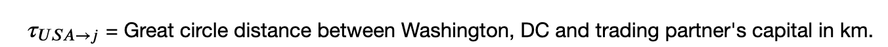
Modified Gravity Model
$ln\left(X_{USA→j}\right)=β_{0}+δ_{0}common_{l}ang+δ_{1}sharedBorder+$ $β_{1}ln\left(GDP_{j}\right)+β_{2}ln\left(τ_{USA→j}\right)$
$$+ δ_{2}\left(common_lang\#ln\left(τ_{USA→j}\right)\right)+e_{USA→j}$$
Expect that sharing a common language and sharing a common border would reduce the trade cost.

Slide 4
Descriptive Statistics
Variable | # Obs | Mean | Std. dev. | Min | Max
usExp | 219 | 7.41E+09 | 2.92E+10 | 4364 | 3.12E+11
gdp | 190 | 3.20E+11 | 9.88E+11 | 1.17E+08 | 1.05E+13
distanceKm | 209 | 8718.804 | 3701.592 | 733.894 | 16834.42
29 Countries in the US Export data are missing GDP data. Reasons include:
Active civil war in 2014
Overseas territories identified as countries in the US Export data
Country GDP data not reported data
common_lang | Frequency | Percent
0=Not English | 182 | 83.11
1=English | 37 | 16.89
Totals | 219 | 100.00

Slide 5
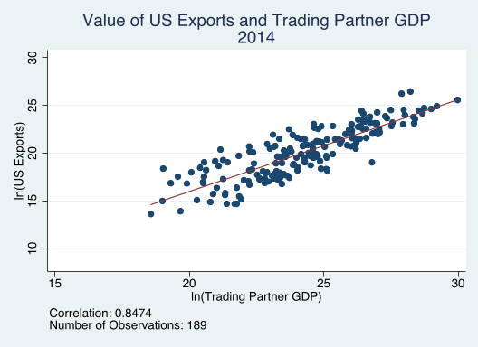
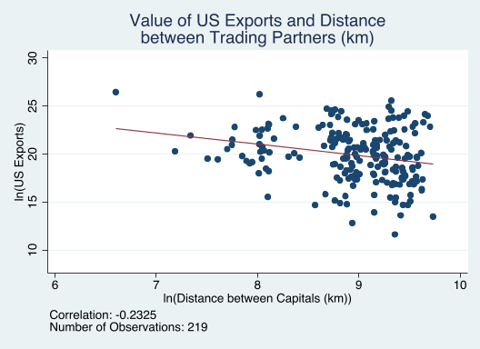
Correlation between primary parameters
Scatter plots follow theory:
Trade increases proportionally to the size of the economy increase
Trade decreases proportionally to the distance between economies

Slide 6
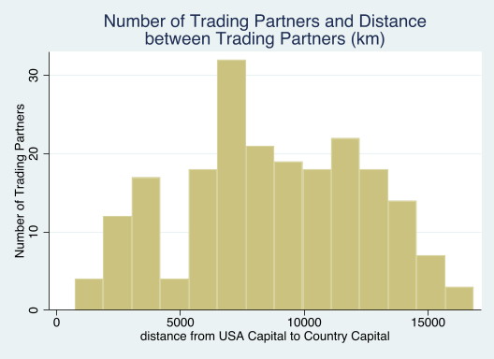
USA Exports higher values to nearer most countries
USA Exports most goods by value to closer countries.
32 Trading Partners less than 4000 km ($21 billion mean exports)
187 Trading Partners more than 4000 km ($5.49 billion mean exports)

Slide 7
How do trade agreements influence US exports?
Jordan:
Distance: 9,540 km
GDP: $35.8 billion
US Exports: $2 billion
Jordan Free Trade Agreement (2001)
Almost all Jordanian goods enter US duty free.
Contributed to increase in textile imports from Jordan.
Chile:
Distance: 8,079 km
GDP: $260 billion
US Exports: $16.6 billion
Chile Free Trade Agreement (2004)
90 % of tariffs on US goods entering Chile eliminated.
Almost all Chilean goods enter US duty free.

Slide 8
Estimates
 | lUsExp (1) | lUsExp (2) | lUsExp (3)
lGdp | 0.960 | 0.957 | 0.954
 | (0.040)** | (0.039)** | (0.039)**
ldist | -1.211 | -1.266 | -1.272
 | (0.223)** | (0.178)** | (0.177)**
1.common_lang | 1.329
 | (3.434)
1.sharedBorder | 0.286
 | (1.000)
1.common_lang#c.ldist | -0.090
 | (0.381)
1.tradeAgreement#c.ldist |  |  | 0.074
 |  |  | (10.694)
1.tradeAgreement |  |  | 0.866
 |  |  | (97.107)
_cons | 7.592 | 8.250 | 8.365
 | (2.209)** | (1.867)** | (1.864)**
R² | 0.78 | 0.78 | 0.78
N | 189 | 189 | 189
GDP is significant (1% level): 1% increase in trading partner’s GDP results in almost 1% increase in US exports to that country.
Distance is significant (1% level): 1% increase in distance results in a 1.2 - 1.3% decrease in US Exports to that country.
Common language: Some impact resulting in increase trade but not enough evidence to support that it is important
Common Border: Not enough evidence to support that it is important. Note: US shares land border with only 2 countries and does not have any other near-water borders. Most trading partners are far away.
Trade agreements: Decreased the distance effect and increase the overall level of US xxports but not at statistically significantly levels.
* p<0.05; ** p<0.01

Slide 9
Bias in the Estimates
 | lUsExp (1) | lUsExp (2) | lUsExp (3)
lGdp | 0.960 | 0.957 | 0.954
 | (0.040)** | (0.039)** | (0.039)**
ldist | -1.211 | -1.266 | -1.272
 | (0.223)** | (0.178)** | (0.177)**
1.common_lang | 1.329
 | (3.434)
1.sharedBorder | 0.286
 | (1.000)
1.common_lang#c.ldist | -0.090
 | (0.381)
1.tradeAgreement#c.ldist |  |  | 0.074
 |  |  | (10.694)
1.tradeAgreement |  |  | 0.866
 |  |  | (97.107)
_cons | 7.592 | 8.250 | 8.365
 | (2.209)** | (1.867)** | (1.864)**
R² | 0.78 | 0.78 | 0.78
N | 189 | 189 | 189
Estimate of lGdp is biased higher in lUsExp(1)
GDP importance on exports may be overstated.
Estimate of ldist is biased lower in lUsExp(1)
Distance may have an overall larger negative effect than estimated.
* p<0.05; ** p<0.01

Slide 10
Summary
Exports from the US will increase:
GDP of trading partner is larger rather than smaller
Countries have fewer trade barriers
Closer in distance
Bilateral agreements may have a positive impact on US exports but not at a statistically significant level

