Slide 1
RDBMS IA-2
Name : Aditi Paretkar
Roll no : 1911034
Batch : A3

Slide 2
How it was done
Procedure for implementation:
First we have created a node for each station , for each line , for 2 kinds of amenity – Bicycle parking and Car parking and 3 services – Accessible Washrooms , Step free access to trains and step free access to platforms.
Then we have linked the lines passing through each specific station by carrying out queries by creating PASSES_THROUGH relation.
Then we have linked the stations to the specific services they have by carrying out queries that link the service to the station using HAS_ A relation.
The database so created is then run through a few queries to obtain specific results.

Slide 3
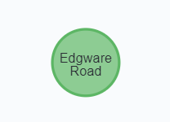
Creation of nodes
Output:
Code for creation of node:
CREATE (n:Station {name: 'Edgware Road', s_id: 112})
Similarly , we have created nodes for all stations, 2 types of amenities and three types of services.
This creates a single node with the given name

Slide 4
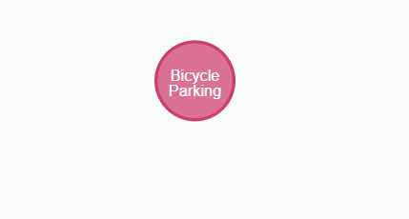
Example- Amenity node

Slide 5
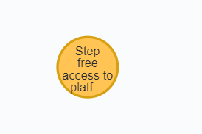
Example – service node

Slide 6
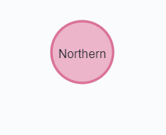
Example- Line Node

Slide 7
Creation of Relations
For example we create all relations for node ‘Edgware Road’ created earlier that shows the lines passing through the station , the amenities and services at the station
1. MATCH
(a:Line),
(b:Station)
WHERE a.name = 'Circle' AND b.name = 'Edgware Road'
CREATE (a)-[r:PASSES_THROUGH]->(b)
RETURN type(r)
2. MATCH
(a:Line),
(b:Station)
WHERE a.name = 'Hammersmith' AND b.name = 'Edgware Road'
CREATE (a)-[r:PASSES_THROUGH]->(b)
RETURN type(r)
3. MATCH
(a:Line),
(b:Station)
WHERE a.name = 'District' AND b.name = 'Edgware Road'
CREATE (a)-[r:PASSES_THROUGH]->(b)
RETURN type(r)
4. MATCH
(a:Station),
(b:Service)
WHERE a.name = 'Edgware Road' AND b.name = 'Step free access to train'
CREATE (a)-[r:HAS]->(b)
RETURN type(r)

Slide 8
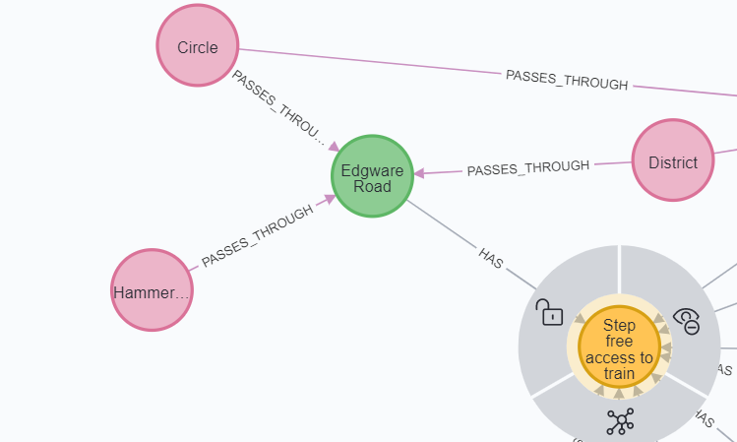
Output

Slide 9
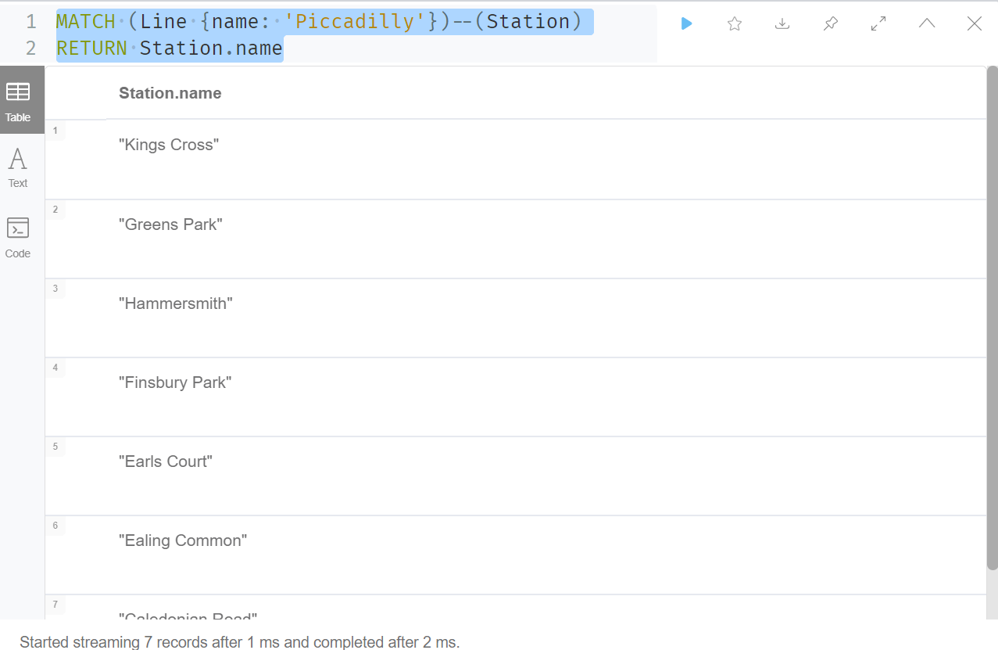
Running a few queries through the created database.
Return all nodes attached to a particular node- example : return all stations that the piccadilly line passes through
Code :
MATCH (Line {name: 'Piccadilly'})--(Station)
RETURN Station.name
. Output

Slide 10
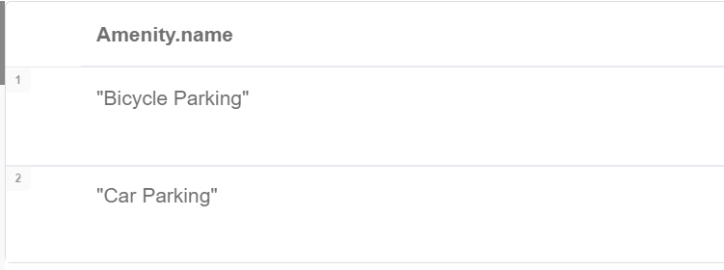
Return all amenities at a particular station – Example King’s Cross
Output
MATCH (:Station {name: 'Kings Cross'})--(Amenity: Amenity)
RETURN Amenity.name

Slide 11
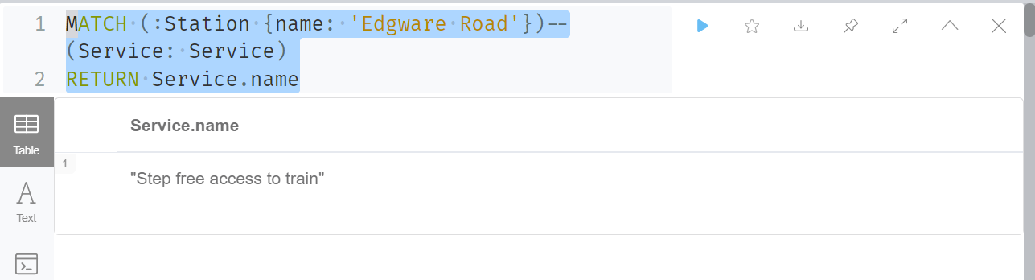
Return all services attached to a particular node , example Edgware road
Output
MATCH (:Station {name: 'Edgware Road'})--(Service: Service)
RETURN Service.name

Slide 12
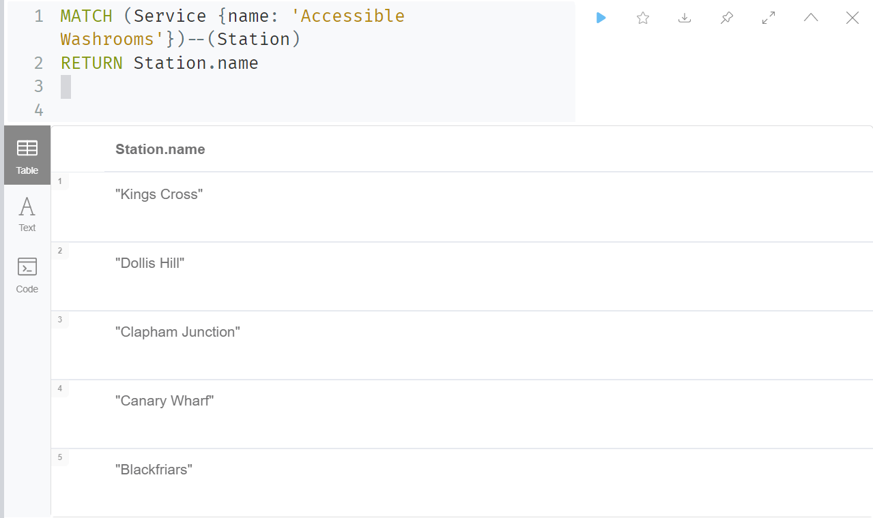
Return which all stations have a particular service – example accessible washrooms
MATCH (Service {name: 'Accessible Washrooms'})--(Station)
RETURN Station.name

Slide 13
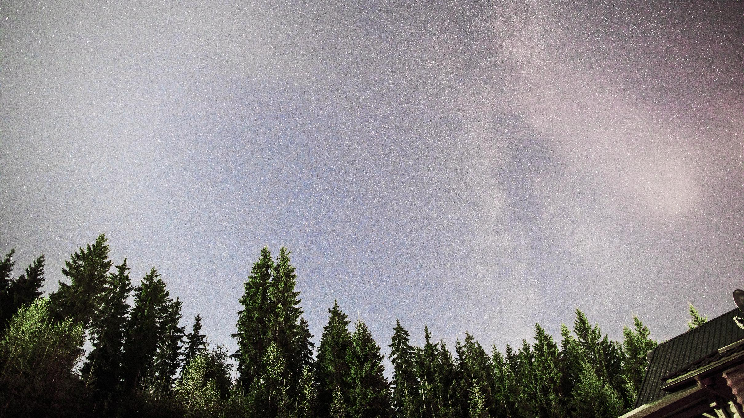
Thank You!

