Slide 1

Programming and Data Structures
Debasis Samanta
Computer Science & Engineering
Indian Institute of Technology Kharagpur
Spring-2017

Slide 2
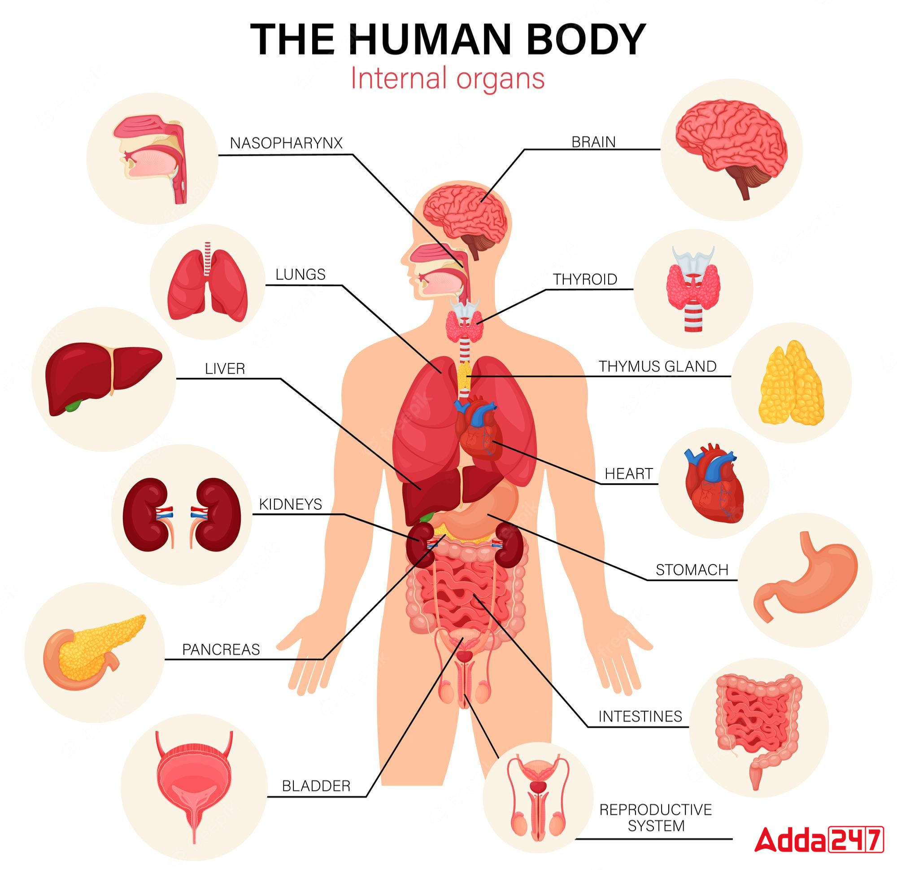

Slide 3
Today’s discussion…
Scope of variables
Parameter passing techniques
Categories of Function based on Return values and Arguments
Macro definition in C
Storage class of variables
Recursive Function
Concepts of functions in C
Definition
Properties
Benefits
Different types of functions
Built-in functions
User-defined functions
Components of Functions

Slide 4
Concepts of Functions in C

Slide 5
Introduction
The C language is termed as function-oriented programming
Every C program consists of one or more functions.
The concept is based on the “divide-and conquer” policy
A large program can be decomposed into a number of relatively smaller segments
Easy to code, debug, maintain, etc.
In C, there is no limit on the number of such functions in a program.
In C programs, any function can call any other function, as many time as it may be.
One of these functions, there shall be one must be called “main”.
Execution of a program always begins by carrying out the instructions in “main”.

Slide 6
Properties of C Functions
Definition
A self-contained program segment that carries out some specific, well-defined task.
A function will carry out its intended action whenever it is called or invoked.
In general, a function will process information that is passed to it from the calling portion of the program, and returns a single value.
Information is passed to the function via special identifiers called arguments or parameters.
The value is returned by the “return” statement.
Some functions may not return anything.
Return data type specified as “void”.

Slide 7
Example
y = n!
#include <stdio.h>
int factorial (int m)
{
int i, temp=1;
for (i=1; i<=m; i++)
temp = temp * i;
return (temp);
}
main()
{
int n;
for (n=1; n<=10; n++)
printf (“%d! = %d \n”, n, factorial (n) );
}
Output!
1! = 1
2! = 2
3! = 6
……..
upto 10!
Whether this factorial(n) works, if it is called with parameter value n = 0?

Slide 8
Why Functions?
Allows one to develop a program in a modular fashion.
Divide-and-conquer approach.
All variables declared inside functions are local variables.
Known only in function defined.
There are exceptions (to be discussed later).
Parameters
Communicate information between functions.
They also become local variables.

Slide 9
Illustration …
#include <stdio.h>
int count;
int factorial (int m)
{
int i, temp=1;
for (i=1; i<=m; i++) {
temp = temp * i; count++;
}
return (temp);
}
main()
{
int n;
for (n=1; n<=10; n++) {
count = 0;
printf (“%d! = %d \n”,n, factorial (n) );
printf(“Number of multiplications is %d”, count);
}
}

Slide 10
Benefits
Divide and conquer
Manageable program development.
Construct a program from small pieces or components.
Software reusability
Use existing functions as building blocks for new programs.
Abstraction: hide internal details (library functions).

Slide 11
Functions in C
First let us discuss on built-in functions

Slide 12
Built-in Functions in C

Slide 13
Built-in Functions
Many functions are already there in C language
These are defined by the C developer
These are called standard library
Standard library
<assert.h> <float.h> <math.h> <stdarg.h> <stdlib.h>
<ctype.h> <limits.h> <setjmp.h> <stddef.h> <string.h>
<errno.h> <locale.h> <signal.h> <stdio.h> <time.h>
In all these header files, functions, type and macros are declared and defined

Slide 14
Header Files
Standard header files
A header file can be accessed by
#include <headerFileName.h>
A header must be included outside of any external declaration.
A programmer can include as many as headers they need in his program.
Headers may be included in any order.
Custom header files
Create file(s) with function definitions.
Save as filename.h (say).
Load in other files with #include “filename.h”
Reuse functions.

Slide 15
Input and Output Functions
Many functions dealing with input and output to-and-from programs
#include <stdio.h>
For file operation
To write and read from an external files (stored in secondary memory)
(We shall study about it in details in a later class.)
For formatted output
int printf(char *format, ….);
int sprintf(char *s, char *format, ….);
For formatted input
int scanf(char *format, ….);
int sscanf(char *s, char *format, ….);

Slide 16
Formatted Output Functions
printf (…) function
The printf(…) function is unusual in that it can take a variable number of parameters.
The function take at least one parameter : a string literal
This argument contains text and may contain many placeholders
Number of arguments is decided by the number of placeholders
Examples
printf(“Hello World”);
printf(“Hi %s darling! %d years\n”, name, age);

Slide 17
Formatted Output Functions
printf (…) conversion character
Conversion format | Meaning
c | Printed as a single character
d | Printed as a signed decimal integer
e | Printed as a floating-point value with an exponent
f | Printed as a floating-point value without an exponent
g | Printed as a floating-point value with e- or f-type; trailing zero or trailing decimal point will not be printed
i | Printed as a decimal, hexadecimal or octal integer
o | Printed as an octal integer, without a leading zero
s | Printed as a string
u | Printed as an unsigned decimal integer
x | Printed as a hexadecimal integer, without leading 0x

Slide 18
Formatted Output Functions
sprintf (…) function
The sprintf(…) is the same as the printf(…) except that the output is written into the string s terminated with ‘\0’.
s must be big enough to hold the result
The return value is the number of characters written into the string s
The return count does not include the ‘\0’.
Examples
sprintf(date, “%d-%d-%d”, dd, mm, yy);

Slide 19
Formatted Input Functions
scanf (…) function
The scanf(…) function is the input analog of printf(…).
This argument contains text and may contain many placeholders
Number of arguments is decided by the number of placeholders
The argument for each placeholder must be a pointer, indicating where the corresponding converted input should be stored
Examples
scanf(“Enter name = %s and age = %d”, name, &age);
scanf(“%d%d%d”, &x, &y, &z);

Slide 20
Formatted Input Functions
scanf (…) conversion character
Conversion format | Meaning
c | Read as a single character
d | Read as a signed decimal integer
e | Read as a floating-point value with an exponent
f | Read as a floating-point value without an exponent
g | Read as a floating-point value with e- or f-type; trailing zero or trailing decimal point will not be read
h | Read as a short integer
i | Read as a decimal, hexadecimal, or octal integer
o | Read as an octal integer
s | Read as a string followed by a whitespace character, the null character ‘\0’ will automatically be added at the end
u | Read as an unsigned decimal integer
x | Read as a hexadecimal integer
[…] | Read as a string, which may include whitespace characters

Slide 21
Formatted Output Functions
sscanf (…) function
The sscanf(…) reads from a string instead of the standard input.
It sscanf(char *s, char *format, ..);
It scans the string s according to the format in format (i.e., the conversion specifications) and stores the resulting values through arg1, arg2, …
These arguments must be pointers.
Examples
sscanf(date, “%d-%d-%d”, &dd, &mm, &yy);
scanf(biodata,”%s%s%d”, &fName, &lName, &age);

Slide 22
Other Input and Output Functions
Function | Meaning
int fgetc(); | Returns the character (converted to an int), which is typed on the keyboard
int getchar(); | Returns the character (converted to an int), which is typed on the keyboard
int putc(int c); | Writes the character c (converted to an unsigned char); it returns the character return or EOF for an error.
Int putchar(int c); | Writes the character c (converted to an unsigned char); it returns the character return or EOF for an error.
char *gets(char *s, int n); | Reads an input line into the array s; it replaces the terminating newline with ‘\0’. It returns s or NULL, if an error occurs
int puts(char *s); | Writes the string s and a newline to stdout; It returns EOF, if an error occurs

Slide 23
Strings Functions
The C library functions <string.h> for manipulating strings
It is required to add the line.
#include <string.h>
char *strcpy (s1, s2);
char *strncpy(s1, s2, n);
char *strcat(s1, s2);
char *strncat(s1, s2, n);
char *strcmp (s1, s2);
char *strncmp(s1, s2, n);
char *strchr(s1, c);
char *strrchr(s1, c);

Slide 24
Strings Functions
char *strstr (s1, s2);
char *strpbrk(s1, s2);
char *strerror(n);
char *strtok(s1, s2);
int strspn (s1, s2);
int strcspn(s1, s2, n);
int strlen(s1);

Slide 25
Math Library Functions
Math library functions
perform common mathematical calculations
#include <math.h>
Format for calling functions
FunctionName (argument);
If multiple arguments, use comma-separated list
printf ("%f", sqrt(900.0));
Calls function sqrt, which returns the square root of its argument.
All math functions return data type double.
Arguments may be constants, variables, or expressions.

Slide 26
Math Library Functions
double acos(double x) – Compute arc cosine of x.
double asin(double x) – Compute arc sine of x.
double atan(double x) – Compute arc tangent of x.
double atan2(double y, double x) – Compute arc tangent of y/x.
double cos(double x) – Compute cosine of angle in radians.
double cosh(double x) – Compute the hyperbolic cosine of x.
double sin(double x) – Compute sine of angle in radians.
double sinh(double x) – Compute the hyperbolic sine of x.
double tan(double x) – Compute tangent of angle in radians.
double tanh(double x) – Compute the hyperbolic tangent of x.

Slide 27
Math Library Functions
double ceil(double x) – Get smallest integral value that exceeds x.
double floor(double x) – Get largest integral value less than x.
double exp(double x) – Compute exponential of x.
double fabs (double x ) – Compute absolute value of x.
double log(double x) – Compute log to the base e of x.
double log10 (double x ) – Compute log to the base 10 of x.
double pow (double x, double y) – Compute x raised to the power y.
double sqrt(double x) – Compute the square root of x.

Slide 28
User-Defined Functions in C

Slide 29
Components of Functions
Function Declaration or Prototype
Function Definition
Accessing/ Calling a function
Function Parameters
Return Statement

Slide 30
Function Prototypes
Way 1
Usually, a function is defined before it is called.
main() is the last function in the program.
Easy for the compiler to identify function definitions in a single scan through the file.
Way 2
However, many programmers prefer a top-down approach, where the functions follow main().
Must be some way to tell the compiler.
Function prototypes are used for this purpose.
Only needed if function definition comes after use.

Slide 31
Function Prototypes

Slide 32
Function Prototypes
Function prototypes are usually written at the beginning of a program, ahead of any functions (including main()).
Examples
int gcd (int A, int B);
void div7 (int number);
Note the semicolon at the end of the line.
The argument names can be different; but it is a good practice to use the same names as in the function definition.

Slide 33
Defining a Function
A function definition has two parts:
The first line.
The body of the function.
return-value-type function-name ( parameter-list )
{ declarations
…
statements …
return (…);
}

Slide 34
Function: First Line
The first line contains the return-value-type, the function name, and optionally a set of comma-separated arguments enclosed in parentheses.
Each argument has an associated type declaration.
The arguments are called formal arguments or formal parameters.
Example
int gcd (int A, int B)
Theoretically, there is no limit on the number of formal parameters in C functions
Function name should adhered to the declaration of identifiers in C.

Slide 35
Function: Body
The body of the function is actually a compound statement that defines the action to be taken by the function.
int gcd (int A, int B)
{
int temp;
while ((B % A) != 0)
{
temp = B % A;
B = A;
A = temp;
}
return (A);
}
BODY

Slide 36
Function: Call
When a function is called from some other function, the corresponding arguments in the function call are called actual arguments or actual parameters.
The formal and actual arguments must match in their data types.
The notion of positional parameters is important
Note
The identifiers used as formal arguments are “local”.
Not recognized outside the function.
Names of formal and actual arguments may differ.

Slide 37
Function Not Returning Any Value
Example:
A function which prints if a number is divisible by 7 or not.
void div7 (int n)
{
if ((n % 7) == 0)
printf (“%d is divisible by 7”, n);
else
printf (“%d is not divisible by 7”, n);
return;
}
If nothing is returned
return;
or, until reaches right parenthesis
If something returned
return expression; For example, return(0);
OPTIONAL

Slide 38
Some Points
A function cannot be defined within another function.
All function definitions must be disjoint.
Nested function calls are allowed.
A calls B, B calls C, C calls D, etc.
The function called last will be the first to return.
A function can also call itself, either directly or in a cycle.
A calls B, B calls C, C calls back A.
Called recursive call or recursion.

Slide 39
Example: Nested Calls
#include <stdio.h>
int ncr (int n, int r);
int fact (int n);
main()
{
int i, m, n, sum=0;
scanf (“%d %d”, &m, &n);
for (i=1; i<=m; i+=2)
sum = sum + ncr(n, i);
printf (“Result: %d \n”, sum);
}
int ncr (int n, int r)
{
return (fact(n)/fact(r)/fact(n-r));
}
int fact (int n)
{
int i, temp=1;
for (i=1; i<=n; i++)
temp *= i;
return (temp);
}

Slide 40
Example: Random Number Generation
Function generating random number
Prototype defined in <stdlib.h>
Follows PRNG (Pseudo-Random Number Generator) algorithm
rand( ) function
Returns "random" number between 0 and RAND_MAX
i = rand();
To get a random number between x and y
x + (rand() % y )
srand( ) function
Seeds the random number generator used by the function rand()
Takes an unsigned integer value as a seed.
srand (seed);

Slide 41
Example: Randomizing die-rolling program
#include <stdio.h>
#include <stdlib.h>
#include <time.h>
void main()
{
int i, t;
time_t t;
unsigned seed;
/* Initialize random number generator */
srand((unsigned)time(&t));
/* Print 10 random numbers between 1 and 6 */
for(i=1;i<=10;i++)
{
printf(“%d”,1+rand()%6);
if (i%5 == 0)printf(“\n”);
}
return 0;
}
Output
6 1 4 6 2
1 6 1 6 4

Slide 42
Scope of Variables in C

Slide 43
Scope of Variables
#include <stdio.h>
int A;
void myProc()
{ int A = 2;
while( A==2 )
{
int A = 3;
printf ( "A = %d\n", A);
break;
}
printf ( "A = %d\n", A);
}
void main()
{
int A = 1;
myProc();
printf ( "A = %d\n", A);
}
Output!
A = 3
A = 2
A = 1

Slide 44
Scope of Variables
#include <stdio.h>
int A;
void myProc()
{ int A = 2;
while( A==2 )
{
int A = 3;
printf ( "A = %d\n", A);
break;
}
printf ( "A = %d\n", A);
}
void main()
{
myProc();
printf ( "A = %d\n", A);
}
Output!
A = 3
A = 2
A = 1

Slide 45
Scope of a Variable : Illustration
Temp
#include<stdio.h>
void print(int a)
{
printf("3.1 in function value of a: %d\n",a);
a+=23;
printf("3.2 in function value of a: %d\n",a);
}
void main()
{
int a=10,i=0;
printf("1. value of a: %d\n",a);
while(i<1)
{
int a;
a=20;
printf("2. value of a: %d\n",a);
i++;
}
printf("3. value of a: %d\n",a);
print(a);
printf("4. VALUE of a: %d\n",a);
}
3.1 in function value of a: 10
3.2 in function value of a: 33
1. value of a: 10
2. value of a: 20
3. value of a: 10
4. value of a: 10

Slide 46
Parameter Passing Techniques in C

Slide 47
Parameter Passing Techniques
Used when invoking functions.
Technique 1: Call by value
Passes the value of the argument to the function.
Execution of the function does not affect the original.
Used when function does not need to modify argument.
Avoids accidental changes.
Technique 2: Call by reference
Passes the reference to the original argument.
Execution of the function may affect the original.
Not directly supported in C – can be effected by using pointers

Slide 48
Example: Call by Value
#include <stdio.h>
void swap (int x, int y)
{
x = x + y;
y = x – y;
x = x – y;
return;
}
void main()
{
int a, b;
scanf (“a = %d, b = %d”, &a, &b);
swap(a, b);
printf (“a = %d, b = %d”, a, b);
}

Slide 49
Example: Call by Reference
#include <stdio.h>
void swap (int *x, int *y)
{
*x = *x + *y;
*y = *x – *y;
*x = *x – *y;
return;
}
void main()
{
int a, b;
scanf (“a = %d, b = %d”, &a, &b);
swap(&a, &b);
printf (“a = %d, b = %d”, a, b);
}

Slide 50
Passing Arrays to a Function
An array name can be used as an argument to a function.
Permits the entire array to be passed to the function.
Array name is passed as the parameter, which is effectively the address of the first element.
Rules:
The array name must appear by itself as argument, without brackets or subscripts.
The corresponding formal argument is written in the same manner.
Declared by writing the array name with a pair of empty brackets.
Dimension or required number of elements to be passed as a separate parameter.

Slide 51
Example: Minimum of a Set of Numbers
#include <stdio.h>
int minimum (int x[], int size)
{
int i, min = 99999;
for (i=0; i<size; i++)
if (min > x[i])
min = x[i];
return (min);
}
void main()
{
int a[100], i, n;
scanf (“%d”, &n);
for (i=0; i<n; i++)
scanf (“%d”, &a[i]);
printf (“\n Minimum is %d”,minimum(a,n);
}
We can also write
int x[100];
But the way the
function is written
makes it general; it
works with arrays
of any size.

Slide 52
Categories of Functions
void greet() {
printf("Hello, World!\n");
}
Based on Return Values:
Functions with no return value (void).
Functions with a return value.
Based on Arguments:
Functions with no arguments.
Functions with arguments.
Combination of Both:
Functions can have both return values and arguments.
int add(int a, int b) {
return a + b;
}
int getRandomNumber() {
return rand();
}
float divide(float a, float b) {
printf(“%f” , a/b);
}

Slide 53
Macro Definition in C

Slide 54
#define: Macro Definition
Pre-processor directive in the following form:
#define string1 string2
Replaces string1 by string2 wherever it occurs before compilation.
For example:-
#define PI 3.1415926

Slide 55
#define: Macro Definition
Use #define at the header section
It treats as global declaration
#include <stdio.h>
#define PI 3.1415926
main()
{
float r = 4.0, area;
area = PI*r*r;
}
#include <stdio.h>
main()
{
float r = 4.0, area;
area = 3.1415926*r*r;
}

Slide 56
#define Macro with Arguments
#define statement may be used with arguments.
Example:
#define sqr(x) x*x
r = sqr(a) + sqr(30); r = a*a + 30*30;
r = sqr(2+5); r = 2+5*2+5;
Best Practices for Using Macros with parenthesis
#define sqr(x) (x)*(x)
r = sqr(a+b); r = (a+b)*(a+b);
Another Example:
#define MAX(a, b) ((a) > (b) ? (a) : (b))
int maxVal = MAX(10, 20); // maxVal = 20

Slide 57
C Storage Classes

Slide 58
Storage Class of Variables
It refers to the permanence of a variable, and its scope within a program.
Four storage class specifications in C
Automatic: auto
External: extern
Static: static
Register: register

Slide 59
Automatic Variables
These are always declared within a function and are local to the function in which they are declared.
Scope is confined to that function.
This is the default storage class specification.
All variables are considered as auto unless explicitly specified otherwise.
The keyword auto is optional.
An automatic variable does not retain its value once control is transferred out of its defining function.

Slide 60
Example: Auto
#include <stdio.h>
int factorial(int m)
{
auto int i;
auto int temp = 1;
for (i=1; i<=m; i++)
temp = temp * i;
return (temp);
}
void main()
{
auto int n;
for (n=1; n<=10; n++)
printf (“%d! = %d \n”,n, factorial (n));
}

Slide 61
Static Variables
Static variables are defined within individual functions and have the same scope as automatic variables.
Unlike automatic variables, static variables retain their values throughout the life of the program.
If a function is exited and re-entered at a later time, the static variables defined within that function will retain their previous values.
Initial values can be included in the static variable declaration.
Will be initialized only once.
An example of using static variable:
Count number of times a function is called.

Slide 62
Example: Static
#include <stdio.h>
void print()
{
int count = 0;
printf("Hello World!! ");
count++;
printf("is printing %d times.\n",count);
}
int main()
{
int i = 0;
while(i<10)
{
print();
i++;
}
return 0;
}
Output
Hello World!! is printing 1 times.
Hello World!! is printing 1 times.
Hello World!! is printing 1 times.
Hello World!! is printing 1 times.
Hello World!! is printing 1 times.
Hello World!! is printing 1 times.
Hello World!! is printing 1 times.
Hello World!! is printing 1 times.
Hello World!! is printing 1 times.
Hello World!! is printing 1 times.

Slide 63
Example: Static
#include <stdio.h>
void print()
{
static int count = 0;
printf("Hello World!! ");
count++;
printf("is printing %d times.\n",count);
}
int main()
{
int i=0;
while(i<10)
{
print();
i++;
}
return 0;
}
Output!
Hello World!! is printing 1 times.
Hello World!! is printing 2 times.
Hello World!! is printing 3 times.
Hello World!! is printing 4 times.
Hello World!! is printing 5 times.
Hello World!! is printing 6 times.
Hello World!! is printing 7 times.
Hello World!! is printing 8 times.
Hello World!! is printing 9 times.
Hello World!! is printing 10 times.

Slide 64
External Variables
They are not confined to single functions.
Declare them outside the function, at the beginning.
Their scope extends from the point of definition through the remainder of the program.
They may span more than one functions.
Also called global variables.
Alternate way of declaring global variables.

Slide 65
Example: Global
#include <stdio.h>
extern int count = 0;
void print()
{
printf("Hello World!! ");
count++;
}
int main()
{
int i=0;
while(i<10)
{
print();
i++;
printf("is printing %d times.\n",count);
}
return 0;
}
Output!
Hello World!! is printing 1 times.
Hello World!! is printing 2 times.
Hello World!! is printing 3 times.
Hello World!! is printing 4 times.
Hello World!! is printing 5 times.
Hello World!! is printing 6 times.
Hello World!! is printing 7 times.
Hello World!! is printing 8 times.
Hello World!! is printing 9 times.
Hello World!! is printing 10 times.

Slide 66
Static versus Extern
#include <stdio.h>
void print()
{
static int count=0;
printf("Hello World!! ");
count++;
printf("is printing %d
times.\n",count);
}
int main()
{
int i=0;
while(i<10)
{
print();
i++;
}
return 0;
}
#include <stdio.h>
extern int count=0;
void print()
{
printf("Hello World!! ");
count++;
}
int main()
{
int i=0;
while(i<10)
{
print();
i++;
printf("is printing %d
times.\n",count);
}
return 0;
}

Slide 67
Register Variables
These variables are stored in high-speed registers within the CPU.
Commonly used variables like loop variables/counters may be declared as register variables.
Results in increase in execution speed.
User can suggest, but the allocation is done by the compiler.

Slide 68
Example Register Variables
#include<stdio.h>
int main()
{
int sum;
register int count;
for(count=0;count<20;count++)
sum=sum+count;
printf("\nSum of Numbers:%d", sum);
return(0);
}

Slide 69
Recursion
A recursion in programming is a technique for defining a problem in terms of one more smaller version of the same problem. The solution of the problem is built on the results from the smaller versions.
Eg: 4!= 4*3!
3!= 3*2!
2!= 2*1!
1!=1

Slide 70
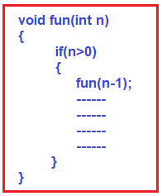
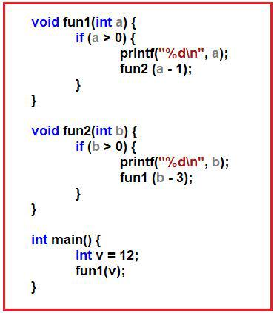
Recursive Function
A function that calls itself directly or indirectly.
Used to solve problems that can be broken down into smaller, similar sub problems.

Slide 71
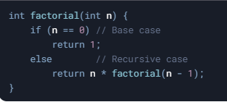
Base Case and Recursive Case
Base Case:
The simplest instance of the problem.
Stops the recursion to prevent infinite loops.
Example
if (n == 0) return 1;
Recursive Case:
Breaks the problem into smaller sub problems.
Calls the function itself with modified arguments.
Example
return n * factorial(n - 1);

Slide 72
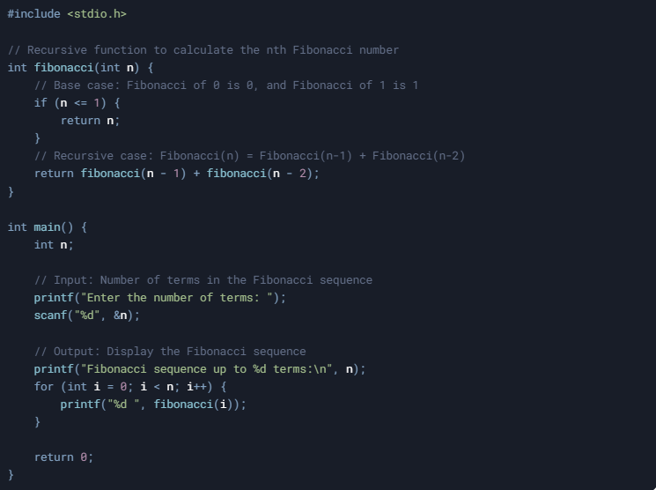
Example: Fibonacci Sequence

Slide 73
Advantages/Disadvantages of Recursion
Advantages:
Simplifies Code:
Breaks complex problems into smaller, manageable parts.
Elegant Solutions:
Ideal for problems with recursive structures (e.g., trees, graphs).
Readability:
Often easier to understand than iterative solutions.
Disadvantages:
Performance Overhead:
Each recursive call adds a new frame to the call stack, consuming memory.
Stack Overflow:
Deep recursion can exhaust the call stack, leading to crashes.
Difficulty in Debugging:
Tracing recursive calls can be challenging.

Slide 74
Tail Recursion
A special case of recursion where the recursive call is the last operation in the function.
int factorial(int n, int result) {
if (n == 0) // Base case
return result;
else // Tail recursive case
return factorial(n - 1, n * result);
}

Slide 75
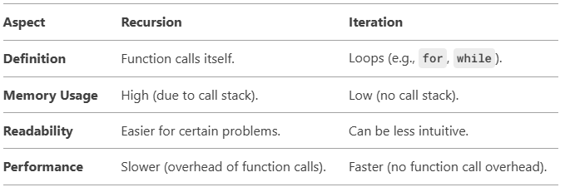
Recursion vs Iteration
When to Use Recursion
Problems with Recursive Structure/nature:
Trees, graphs, divide-and-conquer algorithms.
Mathematical Problems:
Factorials, Fibonacci, Tower of Hanoi.
When Readability is Important:
Recursive solutions are often more intuitive.

Slide 76

Any question?
You may post your question(s) at the “Discussion Forum” maintained in the course Web page.

Slide 77
Problems for Ponder…
Explain what is likely to happen when the following situations are ther in any C program
Actual arguments are less than the formal arguments in a function.
Data type of one of the actual arguments does not match with the type of the corresponding formal argument.
The type of the expression in return(expr); does no match with the type of the function.
The same variable name is declared in two different functions
Reference to a variable name, which is not declared in anywhere in the program
State whether the following statements are true or false.
Functions should be arranged in the order in which they are called.
A function can return only one value.
We can pass nay number of arguments to a function.
A function in C should have at least one argument.
A function always returns an integer values.
A function ca call itself.
Every function should have a return statement.

Slide 78
Problems for Ponder…
Which of the following function definitions are invalid? Why?
average(x, y, z);
sqrt(int n);
Rand();
power (int x, int n)
double minimum(float x; float y);
The following is the function prototype to retune the value of x/y.
double divide(x, y)
float x; float y;
{
return (x/y);
}
What will be the value of the following function calls
divide (10, 2);
divide (4.5, 1.0);
divide (1, 0);

Slide 79
Problems for Ponder…
Determine the output of the following program.
#include <stdio.h>
int p, q;
int producr(int i, int j);
void main () {
int x = 10, y = 20;
p = product(x, y);
q = product(p, product(x,2));
printf(“%d %d \n”, p, q);
}
int producr(int a, int b){
return(a*b);
}
What will be the output of the following programs given that s = “d%samanta”;
printf(s);
printf(“%s”, s);

Slide 80
Problems for Ponder…
Is printf(…) function returns anything? If so, what it returns?
What is the format for printing a number in hexadecimal format?
Is scanf(…) function returns anything? If so, what it returns?
How using scanf(…) function one can read the string “Debasis Samanta” typed on the keyboard?
What the following printf statements will print?
printf( );
printf(“\n \n”);
printf(“%d”, 6789);
printf(“%6d”, 6789);
printf(“%2d”, 6789);
printf(“%-6d”, 6789);
printf(“%.6d”, 6789);
printf(“%7.4d”, 6789);
printf(“%2.2f”, 456.789);

Slide 81
Problems for Ponder…
What the following program segments will print?
int d = 65;
printf(“%c \n”,d);
char c = ‘\t’;
printf(“%d \n”,c);
In response to the input statement
scanf(“%4d %c %f”, &x, &y, &z);
The following data is keyed in
05011964
What values does the computer assigns to the variable x, y and z?

Slide 82
Problems for Practice…
You can check the Moodle course management system for a set of problems for your own practice.
Login to the Moodle system at http://cse.iitkgp.ac.in/
Select “PDS Spring-2017 (Theory) in the link “My Courses”
Go to Topic 5: Practice Sheet #05 : Functions in C
Solutions to the problems in Practice Sheet #05 will be uploaded in due time.

Slide 83
If you try to solve problems yourself, then you will learn many things automatically.
Spend few minutes and then enjoy the study.

