Slide 1
Unit 6: Data Structures
Struct
Union
Bit Field
DMA
Linked List

Slide 2
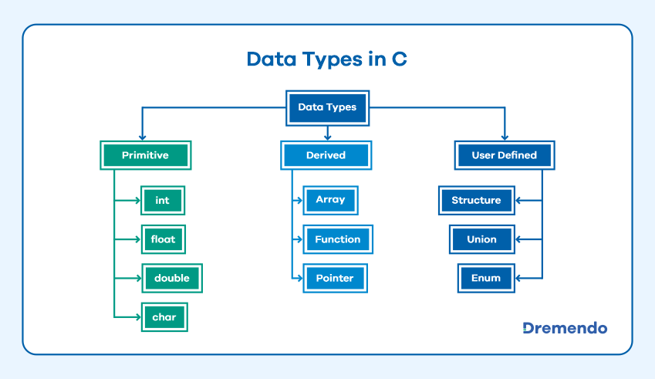

Slide 3
User Defined Data types- typedef, enum
“type definition” allows user to define variable of existing data type.
Example.
typedef float marks ;
marks m1,m2,m3;
(in above example marks is used as float data type)

Slide 4
Enumerated data type:
It is mainly used to assign names to integral constants, the names make a program easy to read and maintain.
enum day { Mon , Tue ,wed ,Thu ,Fri ,Sat , Sun }
enum day today;
today=Thu

Slide 5
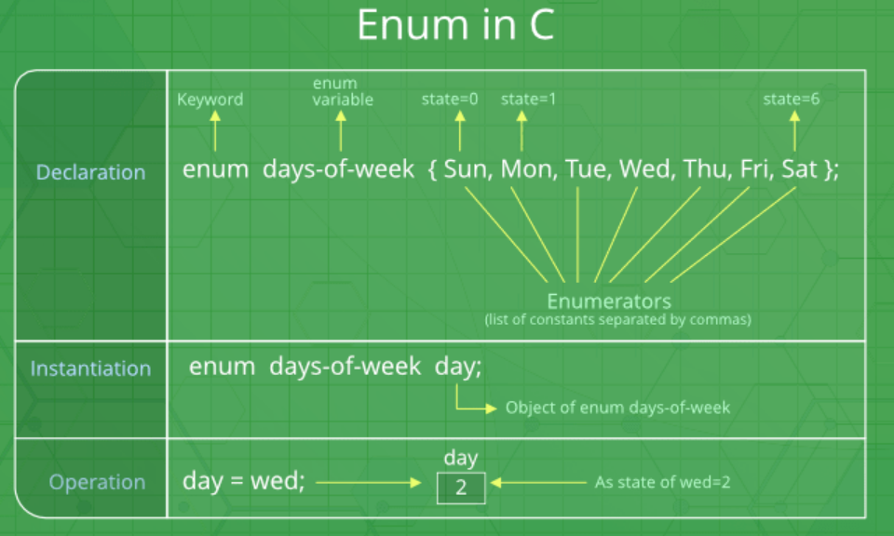
find mistake.

Slide 6
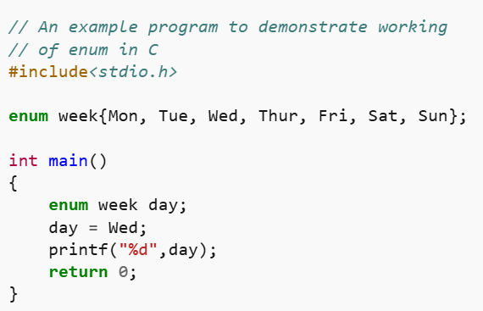

Slide 7
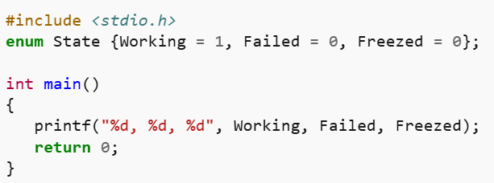
Two enum names can have same value.
If we do not explicitly assign values to enum names, the compiler by default assigns values starting from 0.
Values can be assigned in any order.

Slide 8
Derived data types- Array
Array:
It is collection of homogeneous data type elements stored in contiguous memory locations.
E.g.
int a[5];
Element of array is accessed with a[i] where “a” is the array and “i” is the index .
a[0] | a[1] | a[2] | a[3] | a[4]

Slide 9
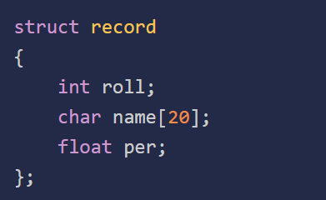
Structure (Struct) in C
created to store different types of values under a single variable. Defining a Structure Syntax:
struct structure_name {
data_type member_name1;
data_type member_name1;
....
....
};

Slide 10
Creating Structure Variable
After structure definition, we have to create variable of that structure to use it. It is similar to the any other type of variable declaration:
struct strcuture_name var;
We can also declare structure variables with structure definition.
struct structure_name {
…
}var1, var2….;

Slide 11
Structures—sometimes referred to as aggregates—are collections of related variables under one name.
Structures may contain variables of many different data types—
in contrast to arrays, which contain only elements of the same data type.

Slide 12
To access or modify members of a structure, we use the ( . ) dot operator. structure_name . member1;
strcuture_name . member2; E.g. struct stud { int char name[35]; int roll_no; char addr[50] }s;
s.Name //access the name field
In the case where we have a pointer to the structure, we can also use the arrow operator to access the members.
structure_ptr -> member1
structure_ptr -> member2

Slide 13
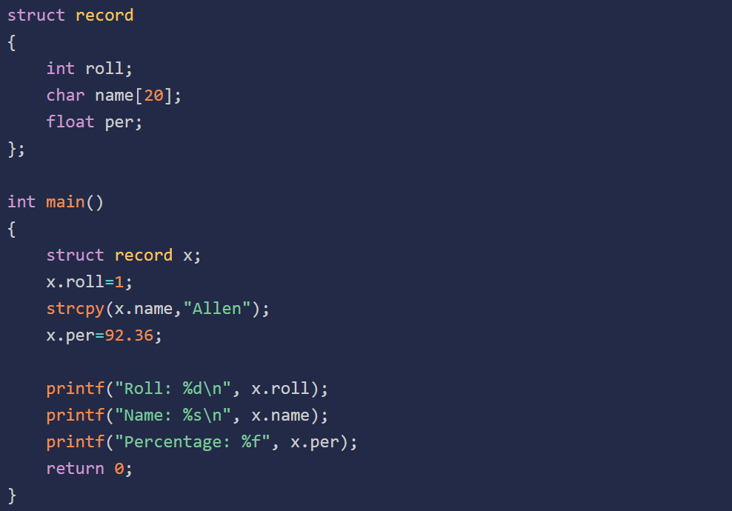
n

Slide 14
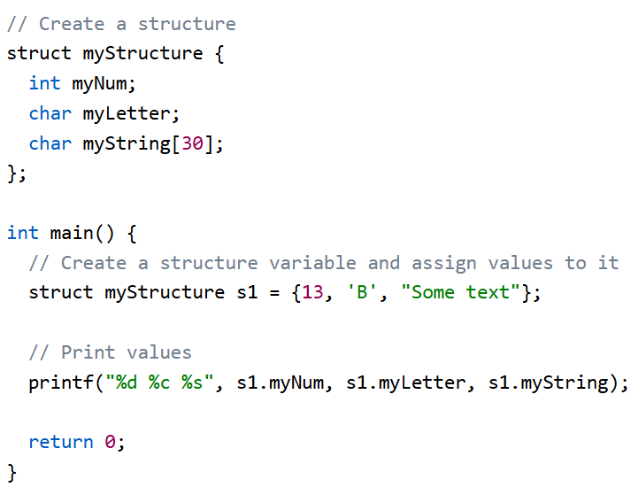
Example:

Slide 15
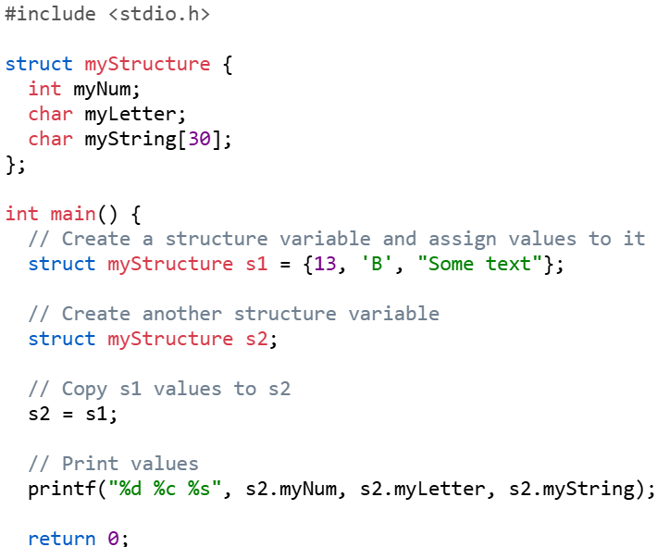
Copy structure

Slide 16
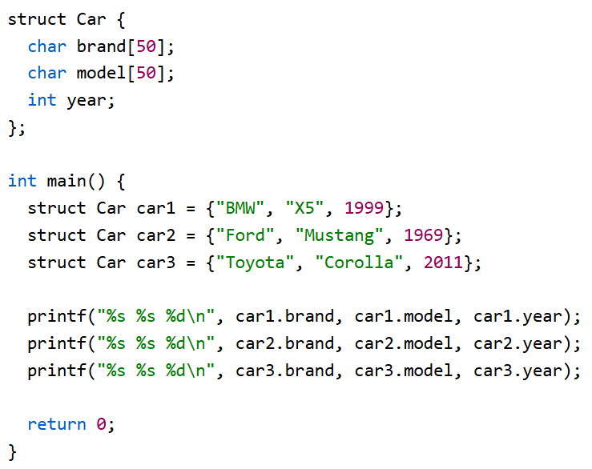
Real-Life Example

Slide 17
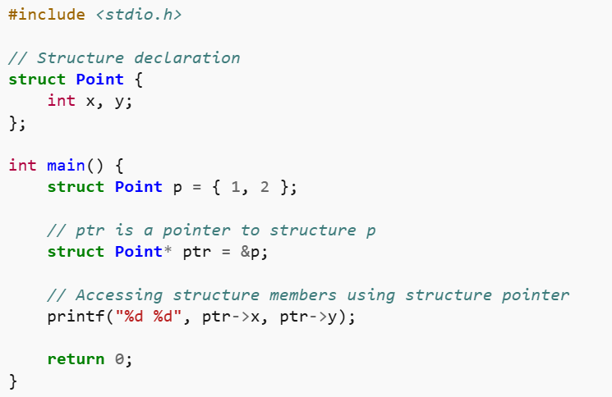
Structure Pointer

Slide 18
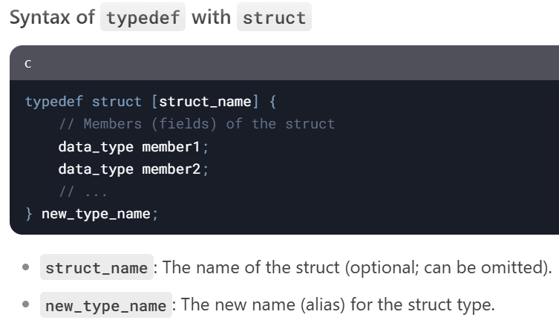

Slide 19
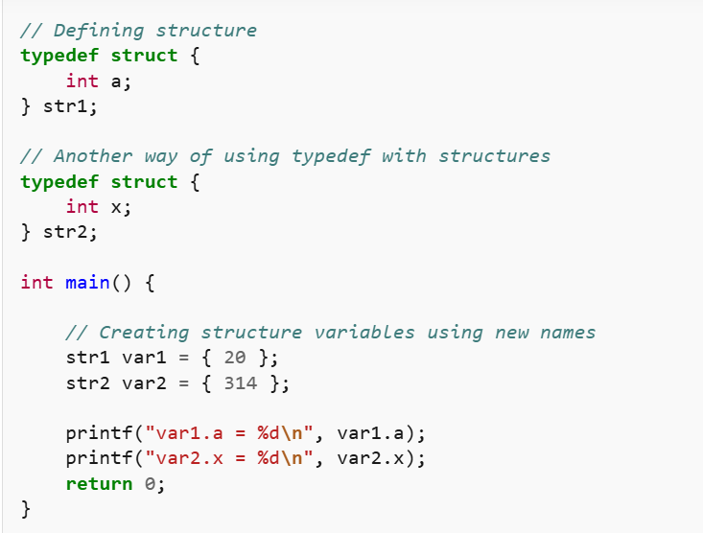
struct st_name { int x; }; typedef st_name str2;

Slide 20
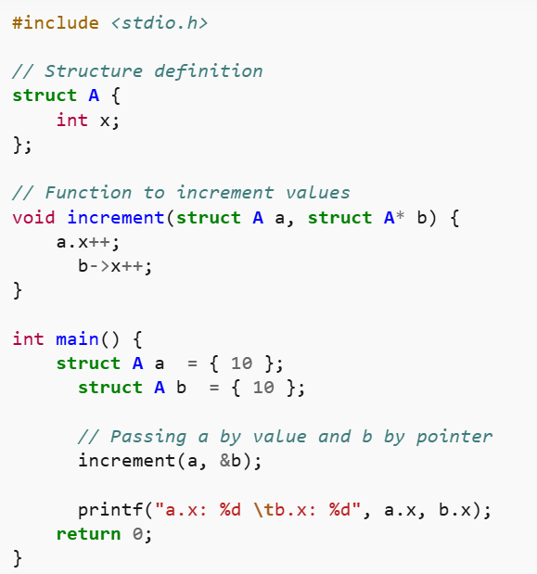
Passing Structure to Functions

Slide 21
Nested Structures
Nested structure refers to a structure that contains another structure as one of its members.
Two ways:
Embedded Structure Nesting: The structure being nested is also declared inside the parent structure.
Separate Structure Nesting: Two structures are declared separately and then the member structure is nested inside the parent structure.

Slide 22
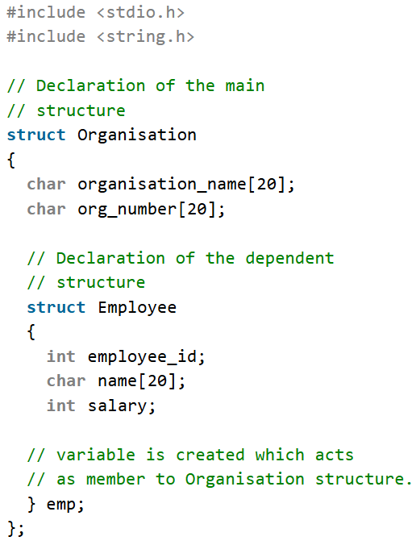
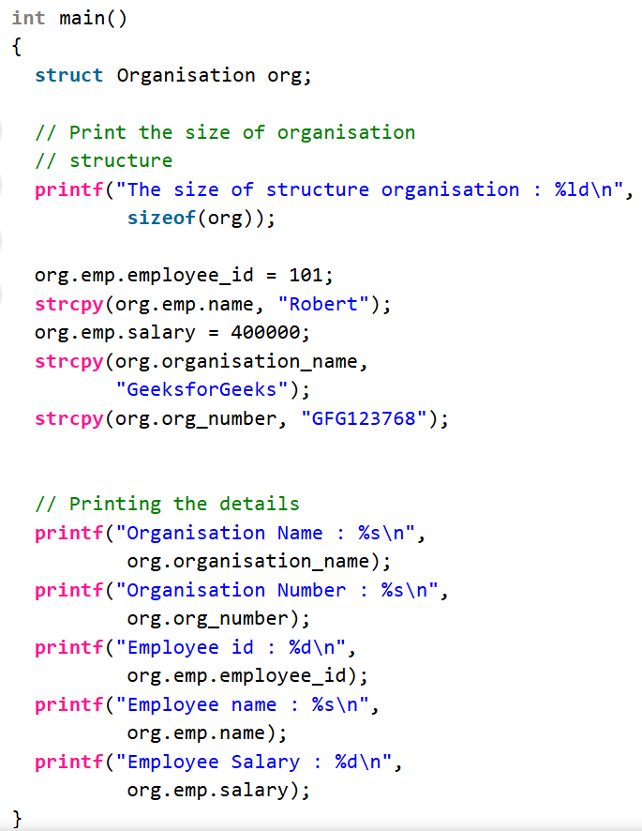

Slide 23
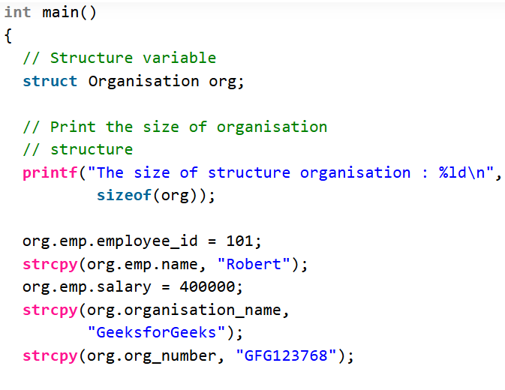
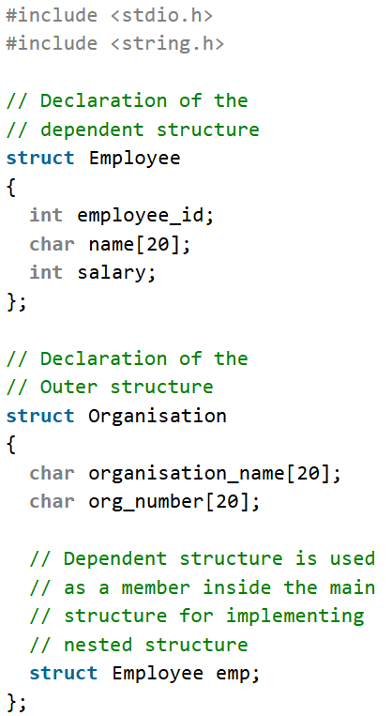
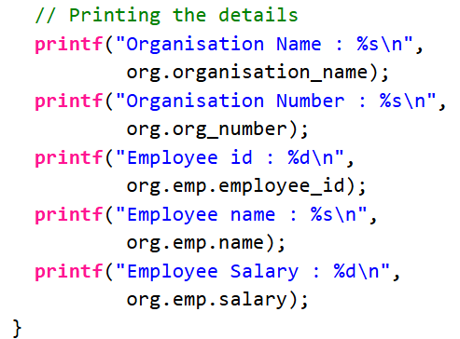

Slide 24
Union
It is similar to structure data type .
Difference between structure and union is that in structure every data member has its own storage where members of union shares same memory locations.
Elements of union can be accessed using dot(.) operator
Total memory allocated is equivalent to the size of the largest member.
E.g
union item
{
int m[5]; //20 bytes
float z; //4 bytes
char c; //1 byte
}u;
u.m //access m field

Slide 25
BIT Field
Can specify the size (in bits) of the structure and union members.
to use memory efficiently when we know that the value of a field or group of fields will never exceed a limit or is within a small range.
C Bit fields are used when the storage of our program is limited.
Syntax
struct {
type [member_name] : width;
};

Slide 26
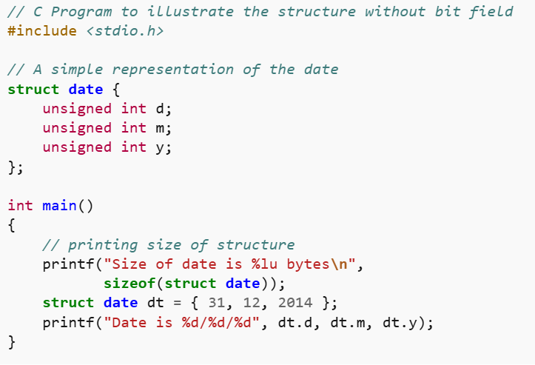
Size of structure without Bit Field

Slide 27
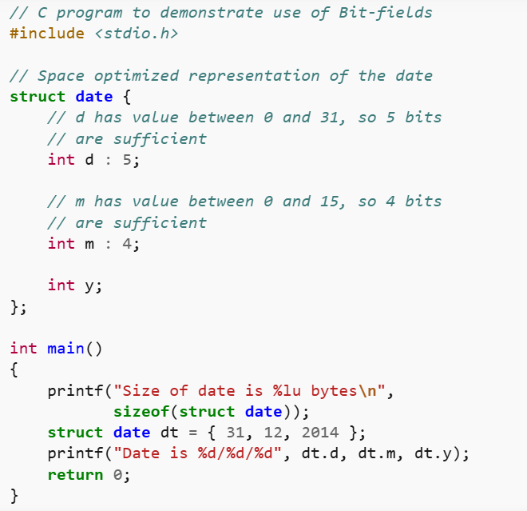
Size of structure with Bit Field

Slide 28
Dynamic Memory Allocation
Process of allocating memory at runtime (during program execution) rather than at compile time.
Allows programs to request memory from the operating system as needed and release it when it is no longer required.
Used when size is not known in advance, such as arrays, linked lists, trees, and more.

Slide 29
key functions in stdlib.h
malloc: Allocates a block of memory of a specified size.
calloc: Allocates a block of memory for an array of elements and initializes all bytes to zero.
realloc: Resizes a previously allocated block of memory.
free: Deallocates a block of memory, making it available for future use.

Slide 30
1. malloc (Memory Allocation)
Allocates a block of memory of a specified size in bytes.
The memory is not initialized (contains garbage values).
Returns a pointer to the first byte of the allocated memory.
If the allocation fails, it returns NULL.
Syntax
void* malloc(size_t size);

Slide 31
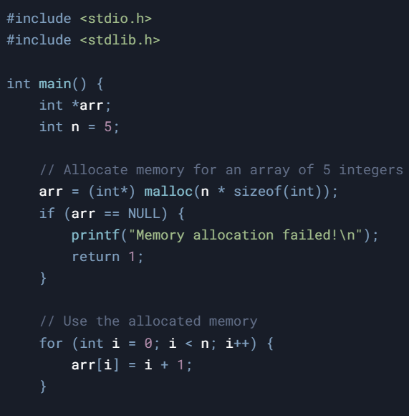
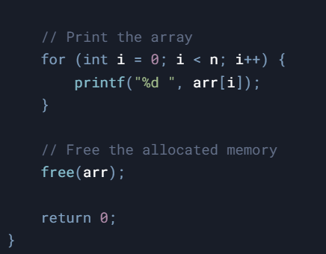

Slide 32
2. calloc (Contiguous Allocation)
Allocates memory for an array of elements and initializes all bytes to zero.
Takes two arguments: the number of elements and the size of each element.
Returns a pointer to the first byte of the allocated memory.
If the allocation fails, it returns NULL.
Syntax
void* calloc(size_t num, size_t size);

Slide 33
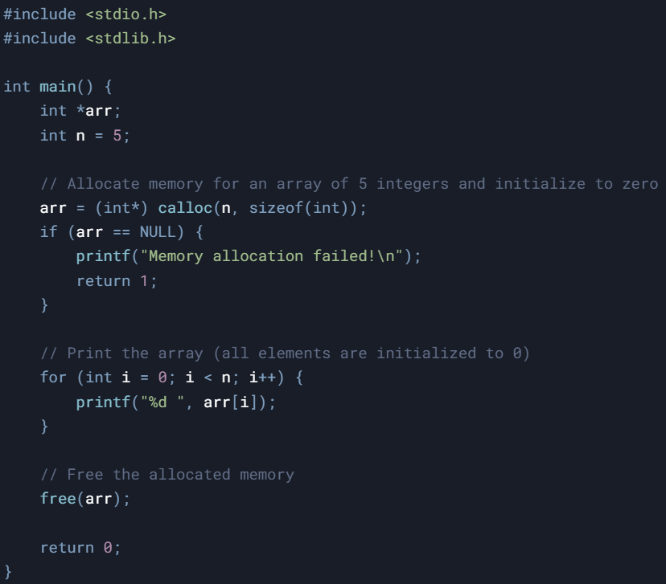

Slide 34
3. realloc (Reallocation)
Resizes a previously allocated block of memory.
Takes two arguments: a pointer to the previously allocated memory and the new size.
If the new size is larger, the additional memory is uninitialized.
If the new size is smaller, the excess memory is deallocated.
Returns a pointer to the resized memory block.
If the allocation fails, it returns NULL, and the original block remains unchanged.
Syntax
void* realloc(void* ptr, size_t size);

Slide 35
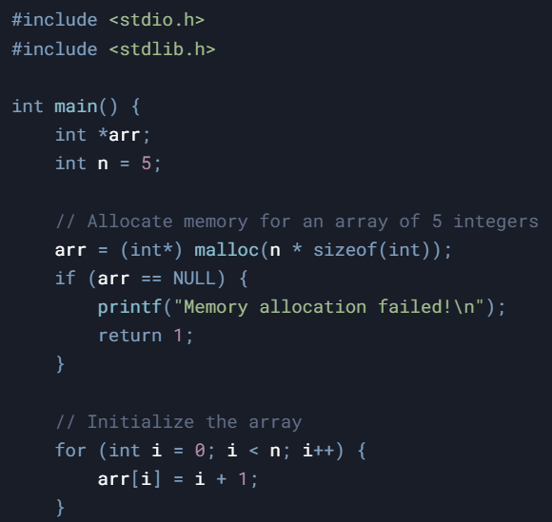
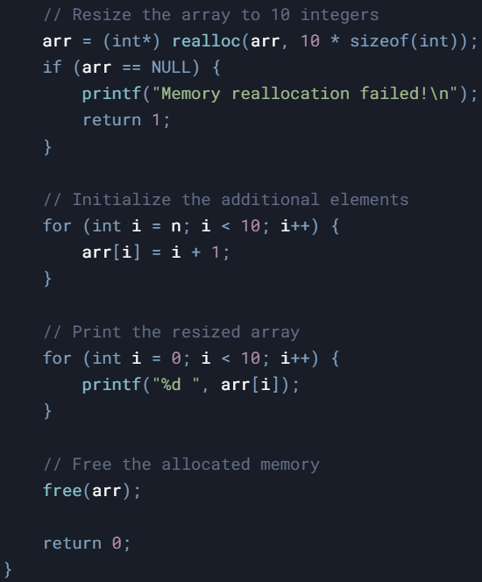

Slide 36
4. free (Deallocation)
Releases a block of memory previously allocated by malloc, calloc, or realloc.
The pointer passed to free must be the same pointer returned by the allocation function.
After calling free, the pointer should not be used (it becomes a dangling pointer).
Syntax
void free(void* ptr);

Slide 37
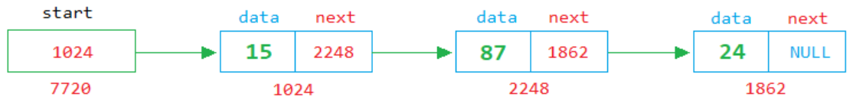
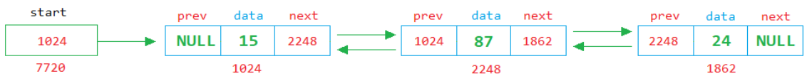
Linked List(Singly, Doubly, Circular)

Slide 38
Linked List
LL is a linear data structure in which elements are stored in nodes, and each node points to the next node in the sequence.
LL do not require contiguous memory allocation.
Each node in a linked list contains two parts:
Data: The value or information stored in the node.
Pointer: A reference (or link) to the next node in the list.
The last node in the list typically points to NULL, indicating the end of the list.

Slide 39
Array VS linked List
 | Array | Linked List
Data Structure | Contigious | Non-Contigious
Memory Allocation | allocated to whole arrary | allocated to individual element
Insertion/ Deletion | Inefficient | Efficient
Access | Random | Sequantial

Slide 40
Operations on Singly Linked List
Traversal
Searching
Length
Insertion:
Insert at the beginning
Insert at the end
Insert at a specific position
Deletion:
Delete from the beginning
Delete from the end
Delete a specific node

Slide 41
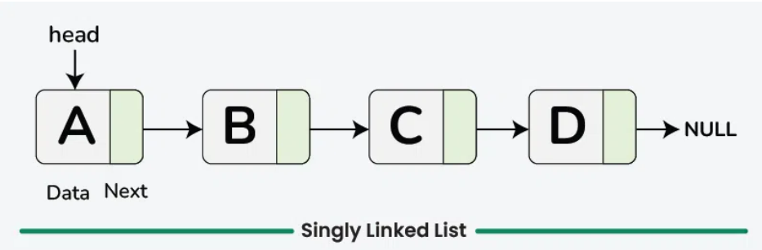
Singly Linked List
// Definition of a Node in a singly linked list
struct Node {
int data;
struct Node* next;
};
// Function to create a new Node
struct Node* newNode(int data) {
struct Node* temp =
(struct Node*)malloc(sizeof(struct Node));
temp->data = data;
temp->next = NULL;
return temp;
}

Slide 42
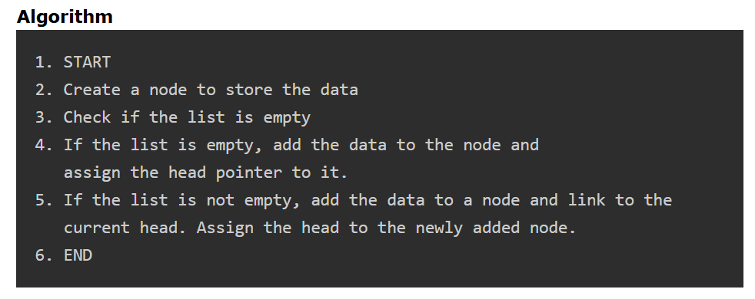
Insertion at Beginning

