Slide 1
Unit 6: Data Structures
Struct
Union
Bit Field
DMA
Linked List

Slide 2
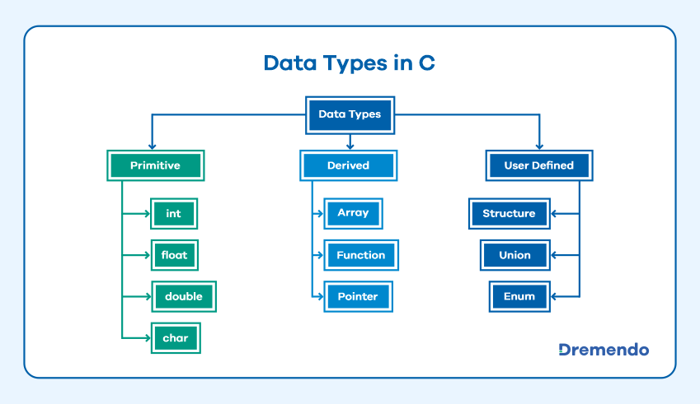

Slide 3
User Defined Data types- typedef, enum
“type definition” allows user to define variable of existing data type.
Example.
typedef float marks ;
marks m1,m2,m3;
(in above example marks is used as float data type)

Slide 4
Enumerated data type:
It is mainly used to assign names to integral constants, the names make a program easy to read and maintain.
enum day(Mon , Tue ,wed ,Thu ,Fri ,Sat , Sun)
enum day today;
today=Thu

Slide 5
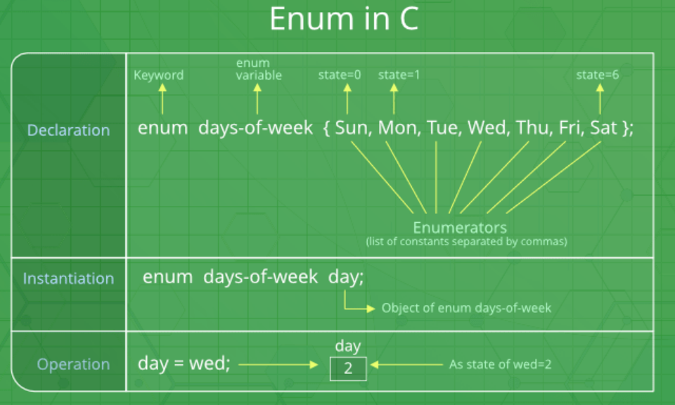

Slide 6
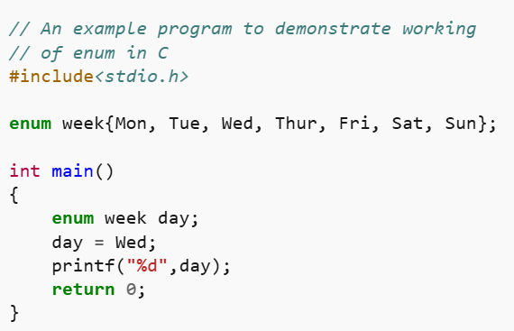

Slide 7
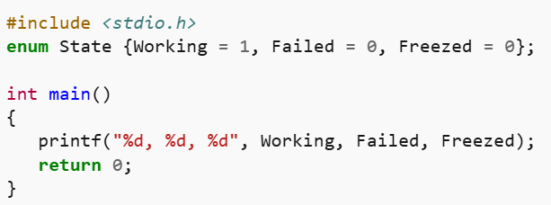
Two enum names can have same value.
If we do not explicitly assign values to enum names, the compiler by default assigns values starting from 0.
Values can be assigned in any order.

Slide 8
Derived data types- Array
Array:
It is collection of homogeneous data type elements stored in contiguous memory locations.
E.g.
int a[5];
Element of array is accessed with a[i] where “a” is the array and “i” is the index .
a[0] | a[1] | a[2] | a[3] | a[4]

Slide 9
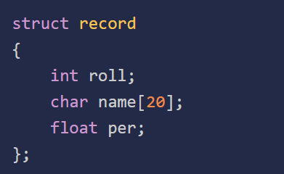
Structure (Struct) in C
created to store different types of values under a single variable. Defining a Structure Syntax:
struct structure_name {
data_type member_name1;
data_type member_name1;
....
....
};

Slide 10
Creating Structure Variable
After structure definition, we have to create variable of that structure to use it. It is similar to the any other type of variable declaration:
struct strcuture_name var;
We can also declare structure variables with structure definition.
struct structure_name {
…
}var1, var2….;

Slide 11
Structures—sometimes referred to as aggregates—are collections of related variables under one name.
Structures may contain variables of many different data types—
in contrast to arrays, which contain only elements of the same data type.

Slide 12
To access or modify members of a structure, we use the ( . ) dot operator. structure_name . member1;
strcuture_name . member2; E.g. struct stud { int char name[35]; int roll_no; char addr[50] }s;
s.Name //access the name field
In the case where we have a pointer to the structure, we can also use the arrow operator to access the members.
structure_ptr -> member1
structure_ptr -> member2

Slide 13
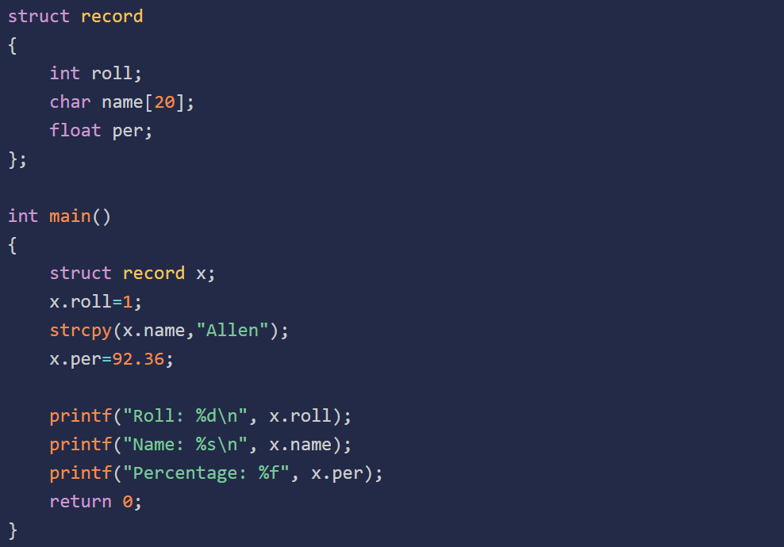
n

Slide 14
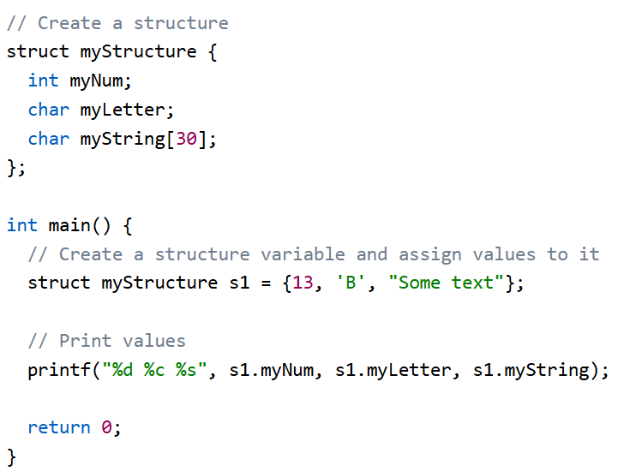
Example:

Slide 15
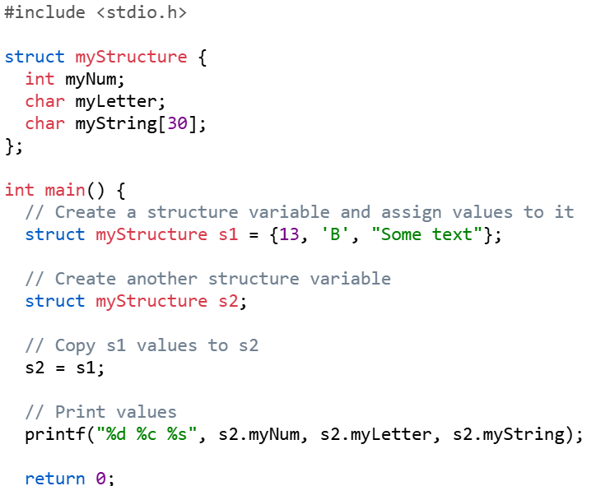
Copy structure

Slide 16
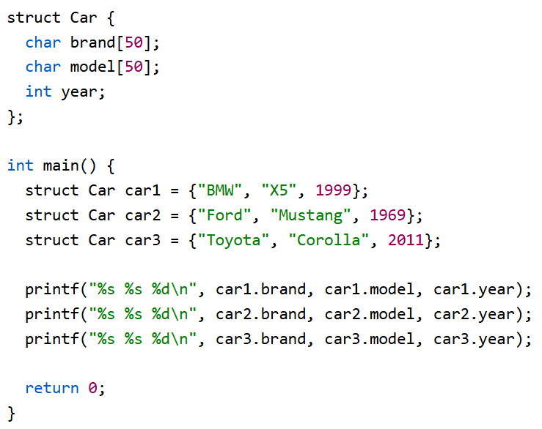
Real-Life Example

Slide 17
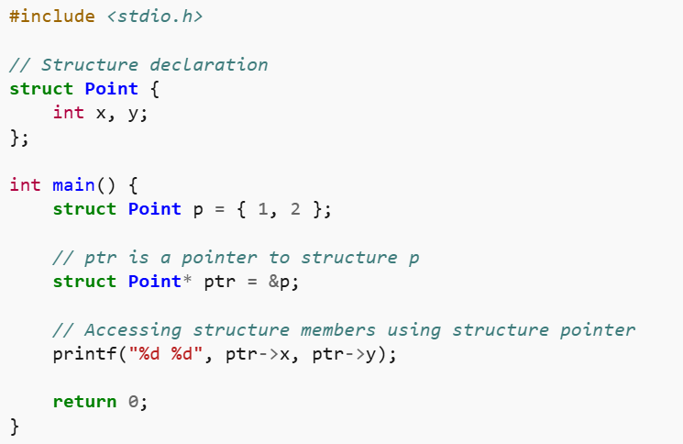
Structure Pointer

Slide 18
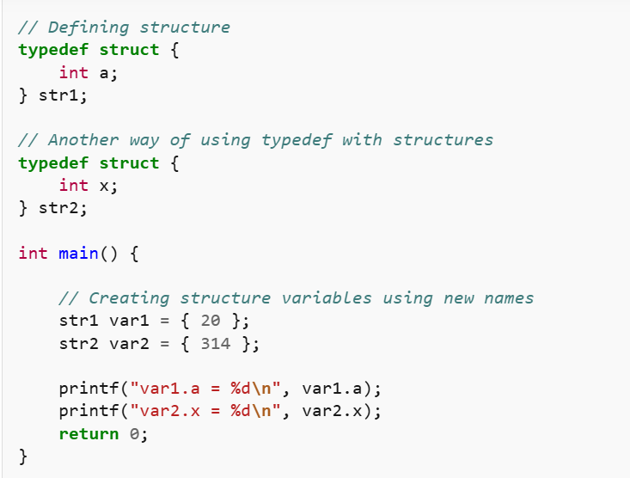
typedef for Structures

Slide 19
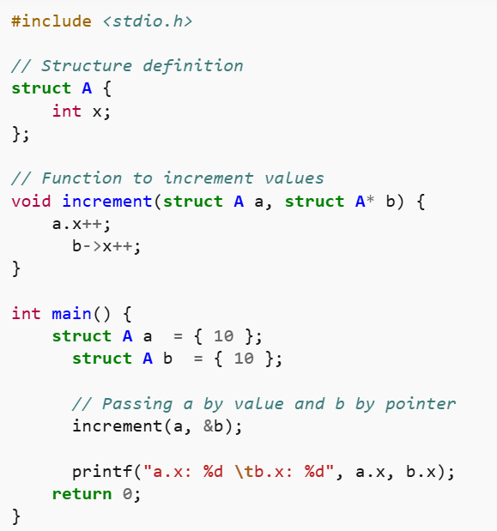
Passing Structure to Functions

Slide 20
Nested Structures
Nested structure refers to a structure that contains another structure as one of its members.
Two ways:
Embedded Structure Nesting: The structure being nested is also declared inside the parent structure.
Separate Structure Nesting: Two structures are declared separately and then the member structure is nested inside the parent structure.

Slide 21
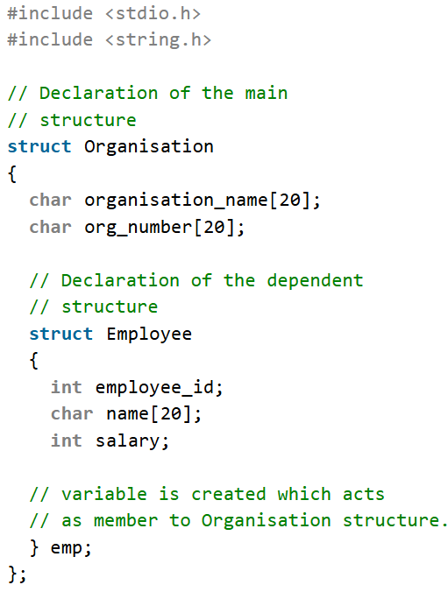
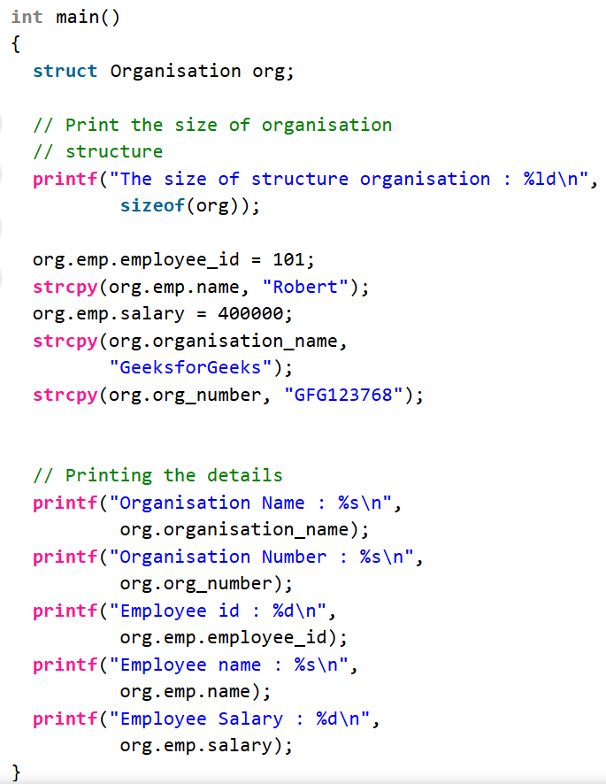

Slide 22
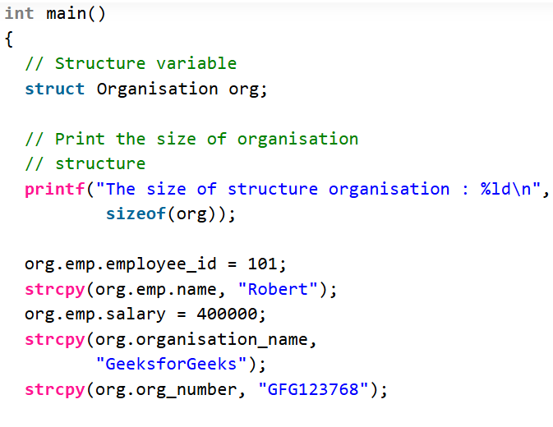
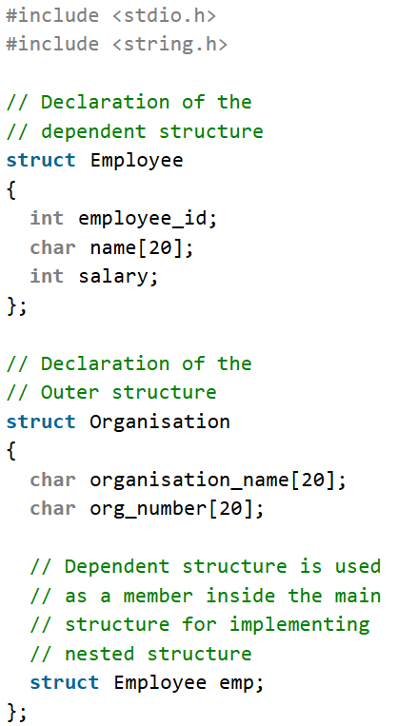
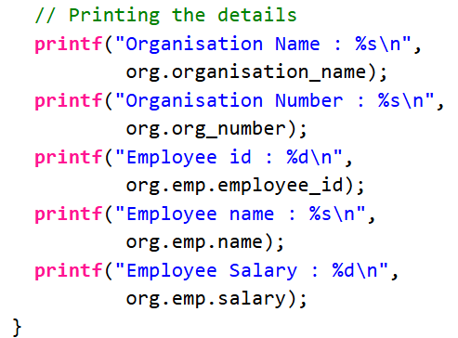

Slide 23
Union
It is similar to structure data type .
Difference between structure and union is that in structure every data member has its own storage where members of union shares same memory locations.
Elements of union can be accessed using dot(.) operator
Storage for below union is 4bytes
E.g
union item
{
int m; //2byte
float z; //4 byte
char c; //1 byte
}u;
u.m //access m field

Slide 24
BIT Field
Can specify the size (in bits) of the structure and union members.
to use memory efficiently when we know that the value of a field or group of fields will never exceed a limit or is within a small range.
C Bit fields are used when the storage of our program is limited.

Slide 25
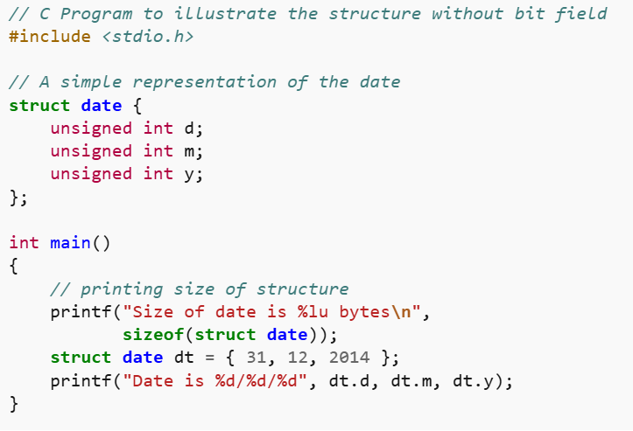
Size without Bit Field

Slide 26
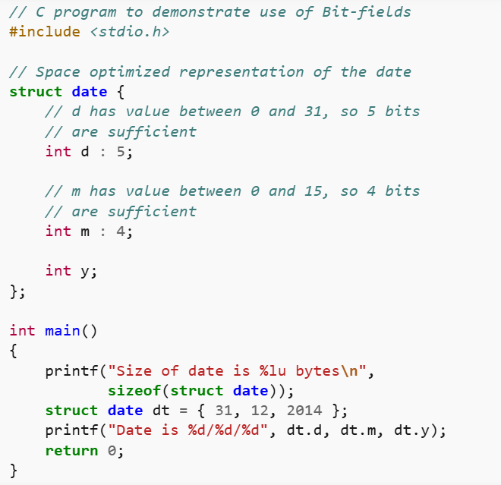
Size with Bit Field

