Slide 1

SMART INDIA HACKATHON 2026
TITLE PAGE
Problem Statement ID – 26228
Problem Statement Title- Trustworthy Computer Vision Integrity Assurance for Data, Models and Inference Outputs in Multi-Contributor Pipelines
Theme - Blockchain & Cybersecurity
PS Category- Software
Team ID – SNPSU0279
Team Name - WHOCODES

Slide 2
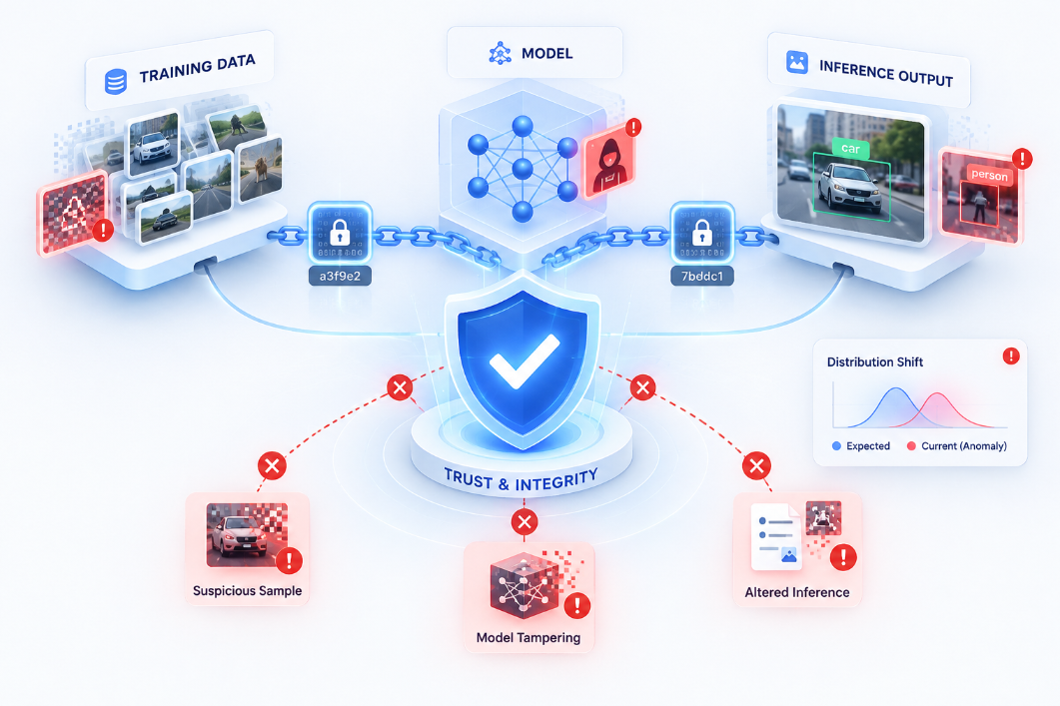
Trustworthy Computer Vision Integrity Assurance for Data, Models and Inference Outputs in Multi-Contributor Pipelines CV-INTEGRITY AI is an intelligent computer vision model trust and dataset quality evaluation platform. It automatically evaluates how dataset quality degradation affects models reliability, robustness and trustworthiness. “Building Trustworthy Computer Vision for a Self-Reliant Bharat”
Whocodes
It trains YOLOv8 models on GOOD, BAD, and WORST quality datasets to measure performance degradation.
Uncovers hidden data flaws (blur, wrong labels, duplicates) that silently degrade model accuracy.
Prevents unreliable CV models from being deployed in critical domains like healthcare, autonomous vehicles, manufacturing, and security.
It prioritizes dataset quality over just model architecture tuning.
A weighted combination of dataset quality, performance, robustness, and stability.
It works with YOLO and can be extended to other CV models; supports custom datasets.

Slide 3
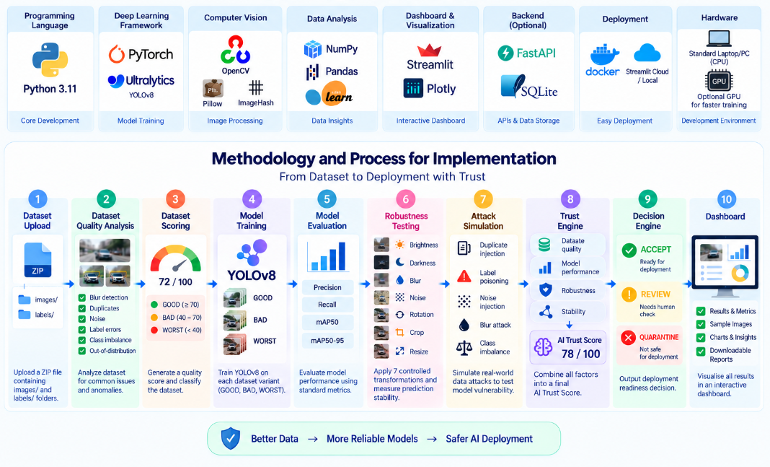
TECHNICAL APPROACH Proposed Solution: Trust + Atmanirbhar Bharat + reliability
Whocodes

Slide 4
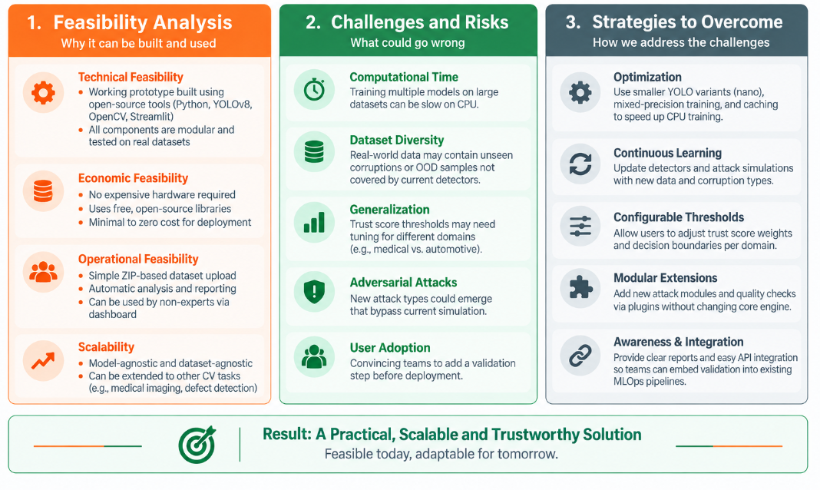
FEASIBILITY AND VIABILITY “Prototype already demonstrates feasibility; next steps focus on scaling and domain adaptation.”
Whocodes

Slide 5
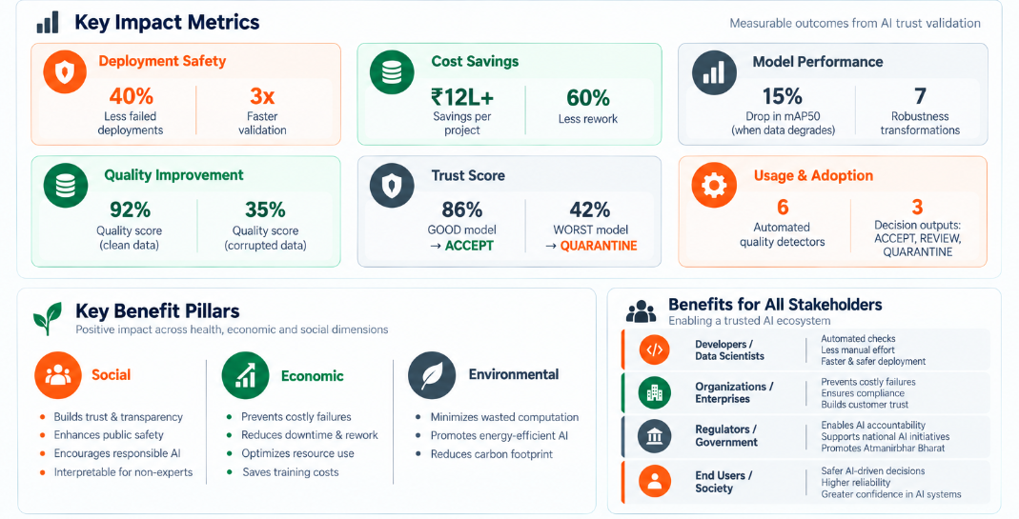
IMPACT AND BENEFITS
Whocodes

Slide 6
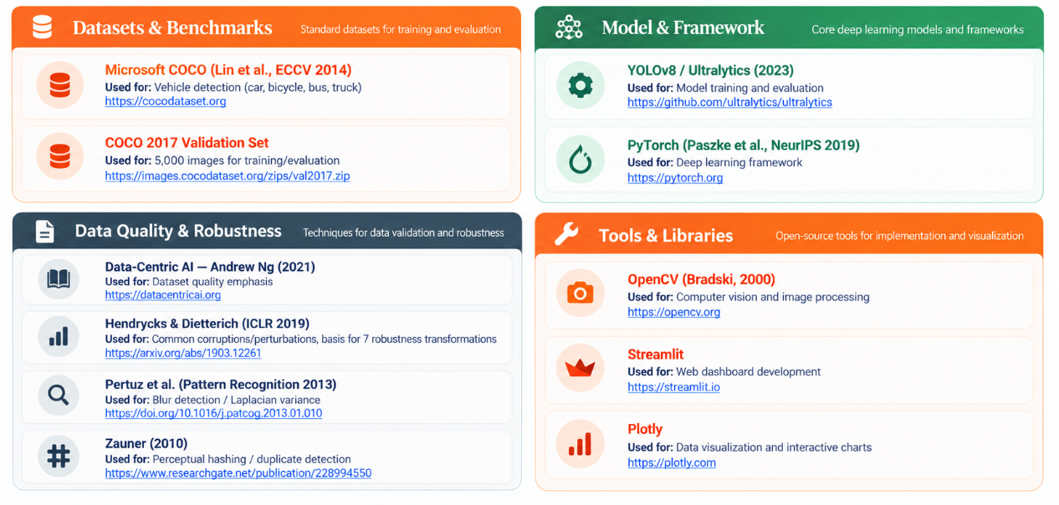
RESEARCH AND REFERENCES
Whocodes

