Slide 1
CPE 301 Project Presentation
Kyle Butler
Email: butlerk2@unlv.nevada.edu

Slide 2
AIM & ACCOMPLISHMENT
AIM:
PID Speed Control of DC Motor with Encoder + PCThe goal of the project will be to control the speed of the supplied DC motor with encoder. The required speed and current speed should be input and displayed from the PC terminal. The speed of the motor should be regulated/controlled using PID algorithm.
Option 2: On a press of a switch the motor should do a soft stop within the time period.
ACCOMPLISHMENT
The motor does a soft stop when switch pressed. I was not able to get the encoder feedback properly sorted for PID control.

Slide 3
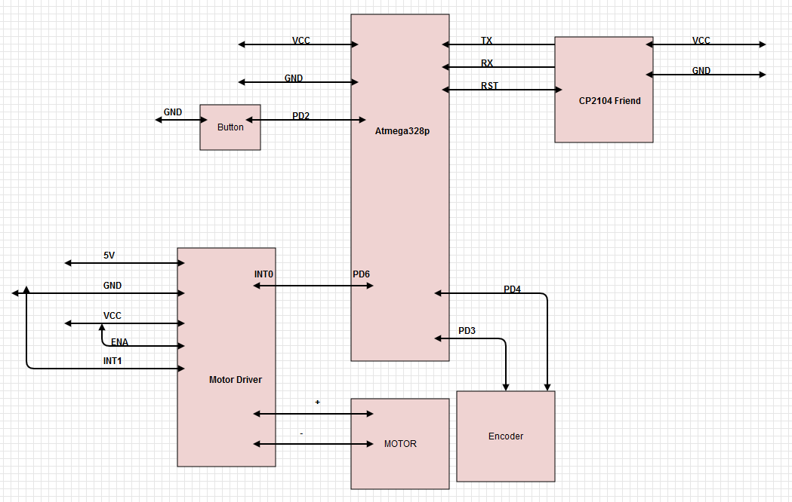
SCHEMATICS
Complete schematics

Slide 4
DESIGN STAGES
Components
AVR ATMEGA328p
ADAFRUIT Friendly FTDI CP2104
6V DC Motor
L293D motor driver
Hall Effect Sensor Encoders
Interfaces
Atmega328p – FTDI using USART for speed request

Slide 5
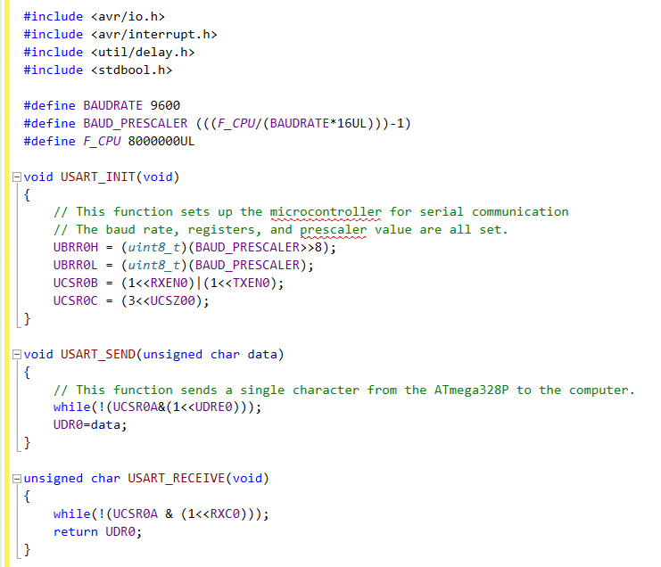
CODE DEVELOPMENT
Initialization

Slide 6
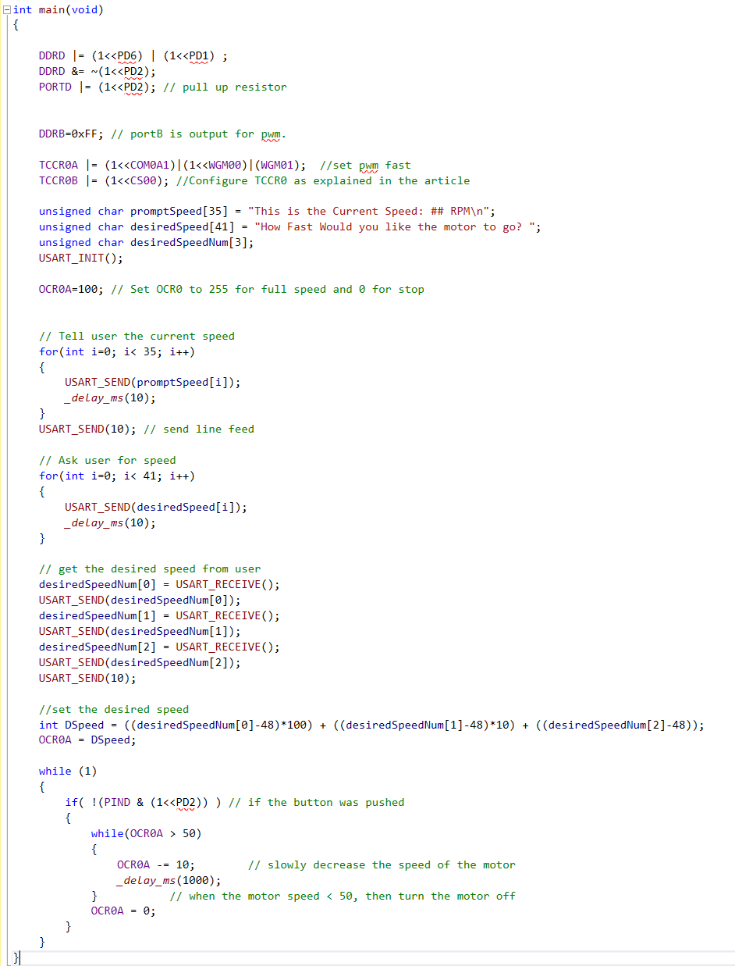
CODE DEVELOPMENT
●Main

Slide 7
DEMO SNAPSHOT/VIDEO
https://www.youtube.com/watch?v=Rc9YwFjyqfc

