Slide 1



ECE MINI-PROJECT
Class : C1 Year : E2-S1
PROJECT TITLE: ACCIDENT PREVENTION USING LDR CIRCUIT
under the supervision of :
Sravanthi madam
Presented By:
A.Jayesh (B220128)
K.Nithish (B221384)
E.Nithin (B221689)

Slide 2
INTRODUCTION
This project demonstrates a simple and cost-effective method for vehicle detection using light interruption
A laser beam continuously illuminates an LDR placed on the opposite side
When a vehicle crosses and blocks the beam, the circuit detects the change in light intensity and activates an LED indicator through a BC547 transistor.

Slide 3
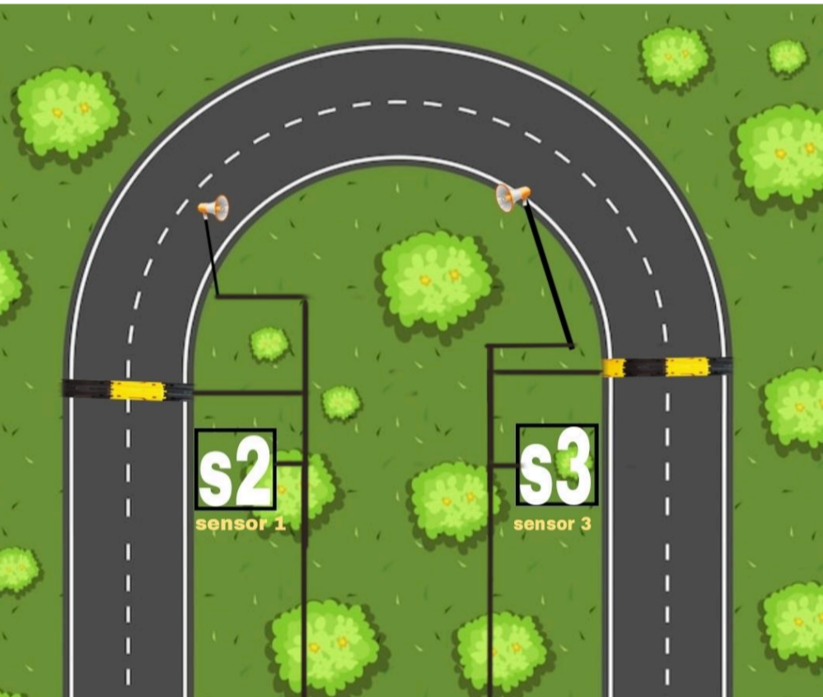
INITIATION
INITIATION

Slide 4
OBJECTIVES
1.
To design and implement a laser–LDR-based vehicle detection system using a BC547 transistor.
2.
The system will detect the interruption of a laser beam caused by a passing vehicle.
3.
It will generate an automatic response by activating an LED indicator when the beam is interrupted.The project aims to demonstrate the basic principles of light-controlled switching using simple electronic components.

Slide 5
PROBLEM STATEMENT
In many traffic and security scenarios, there is a need for a simple, reliable, and cost-effective method to detect vehicles or moving objects without physical contact.
Lack of detection can cause collisions at blind turns or gates.

Slide 6
WORKING CONDITION-1(NO VEHICLE)
When the laser light continuously falls on the LDR, its resistance becomes very low, allowing more current to flow through it. As a result, the voltage at the transistor’s base is too low to turn it ON. The BC547 transistor remains in the cutoff region, and no current flows through the collector–emitter path. Consequently, the LED remains OFF, indicating that the road is clear and no vehicle is present.

Slide 7
WORKING CONDITION-2(VEHICLE PASSES)
When a vehicle passes between the laser and the LDR, the light beam is blocked, and the LDR is exposed to darkness. Its resistance suddenly increases, which raises the base voltage of the BC547 transistor. This drives the transistor into saturation, allowing current to flow from the collector to the emitter. The LED turns ON, providing a clear visual indication that the laser path is interrupted by a moving vehicle.

Slide 8
COMPONENTS
LDR (1): Light sensor
Laser Pointer (1): Light source
BC547 Transistor (1): Switching device
10kΩ Resistor (2): Used for biasing and voltage divider
470Ω Resistor (1): LED current limiting resistor
LED (1): Output indicator
9V Battery (1): Power supply

Slide 9
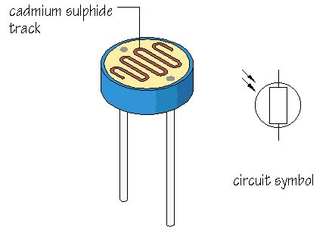
LDR
Function: Acts as a light sensor that changes its resistance based on the intensity of light falling on it.
Working Principle:
High light intensity → Low resistance
Low light intensity (or darkness) → High resistance
Role in Project: Detects the interruption of the laser beam when a vehicle passes, triggering the transistor to switch the LED indicator.

Slide 10
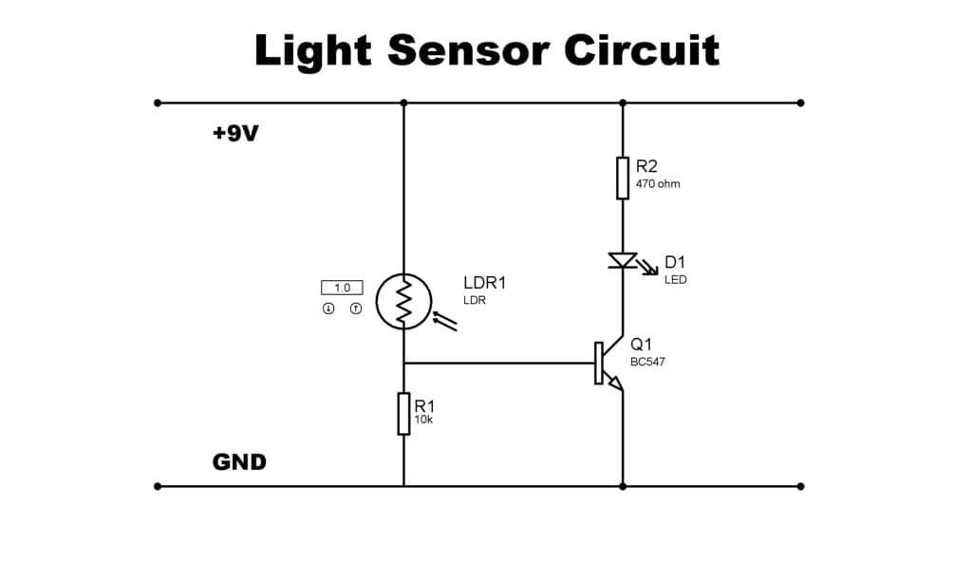
CIRCUIT DIAGRAM

Slide 11
CIRCUIT DESCRIPTION
The circuit consists of an LDR and a 10kΩ resistor forming a voltage divider connected to the base of a BC547 transistor through another 10kΩ resistor. When the laser light falls on the LDR, its resistance remains low, keeping the transistor OFF and the LED OFF. When the beam is interrupted, the LDR’s resistance increases, providing sufficient base voltage to turn the transistor ON, allowing current to flow and lighting the LED.

Slide 12
ADVANTAGES
Simple and affordable: Uses common, low-cost components.
Low power use: Operates efficiently on a 9V battery.
No contact needed: Detects vehicles without physical touch.
Expandable: Can easily be integrated to control relays, buzzers, or alarms.

Slide 13
APPLICATIONS
Vehicle detection: Detects vehicles at gates or parking areas.
Automatic doors/barriers: Opens or closes automatically when the laser beam is interrupted.
Security systems: Detects intruders or movement in restricted areas.
Traffic automation: Triggers signals when vehicles are detected.

Slide 14
FUTURE SCOPE
This project can be further developed into an advanced vehicle monitoring and automation system. By integrating microcontrollers such as Arduino or Raspberry Pi, it can enable digital counting, data logging, and wireless communication.
it suitable for smart parking, traffic control, and modern security applications.

Slide 15
CONCLUSION
This project shows how a light-based sensor can detect objects using a laser and LDR. It’s reliable, easy to build, and useful for automation and security systems. The setup helps understand how light intensity controls a transistor and can be developed into more advanced systems.

Slide 16
REFERENCES/ACKNOWLEDGEMENTS
Sources: Online electronics tutorials and datasheets.
Guidance: Faculty support and technical advice.
Testing: Verified through personal experimentation

Slide 17
THANK YOU

