Slide 1
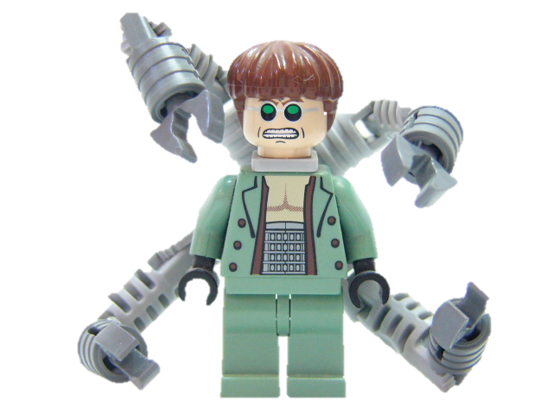
Team Octopus Project: TV Guide
Team Members:
Jack Flowers
Alex Will
Jake King

Slide 2
Overview
Expand on Traditional TV Guide
Add more functionality to a basic TV Guide
Allow for customization.
Team Octopus
Project Overview
Team Member: Alex Will

Slide 3
Snapshots
Team Octopus
Low-Fidelity Prototype
Team Member: Alex Will

Slide 4
Questions
Team Octopus
Low-Fidelity Prototype
Team Member: Alex Will

Slide 5
Improvements
Team Octopus
Low-Fidelity Prototype
Team Member: Alex Will

Slide 6
Affinity Diagram
Team Octopus
Work Models & Affinity Diagram
Team Member: Jack Flowers

Slide 7
Flow Model
Team Octopus
Work Models & Affinity Diagram
Team Member: Jack Flowers

Slide 8
Cultural Model
Team Octopus
Work Models & Affinity Diagram
Team Member: Jack Flowers

Slide 9
Sequence Model
Team Octopus
Work Models & Affinity Diagram
Team Member: Jack Flowers

Slide 10
Artifact Model
Team Octopus
Work Models & Affinity Diagram
Team Member: Jack Flowers

Slide 11
Physical Model
Team Octopus
Work Models & Affinity Diagram
Team Member: Jack Flowers

Slide 12
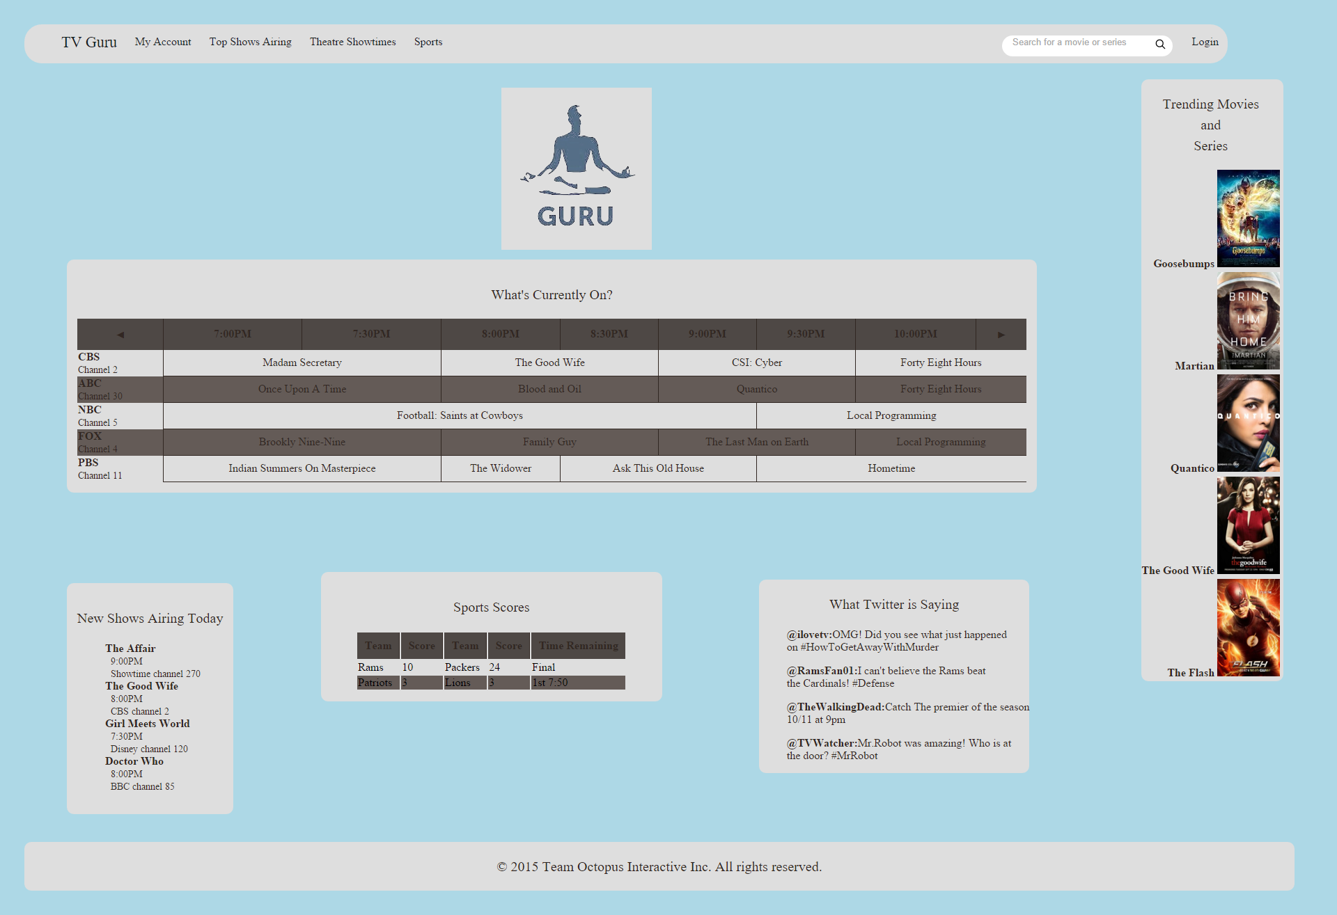
Questions
Tasks
Logging in
Searching
Look up trending items
View favorites
Look up a sports team
See theater show times
Questions
Task follow-ups
Colors
Layout
Easy to navigate
Team Octopus
High-Fidelity Prototype
Team Member: Jack Flowers

Slide 13
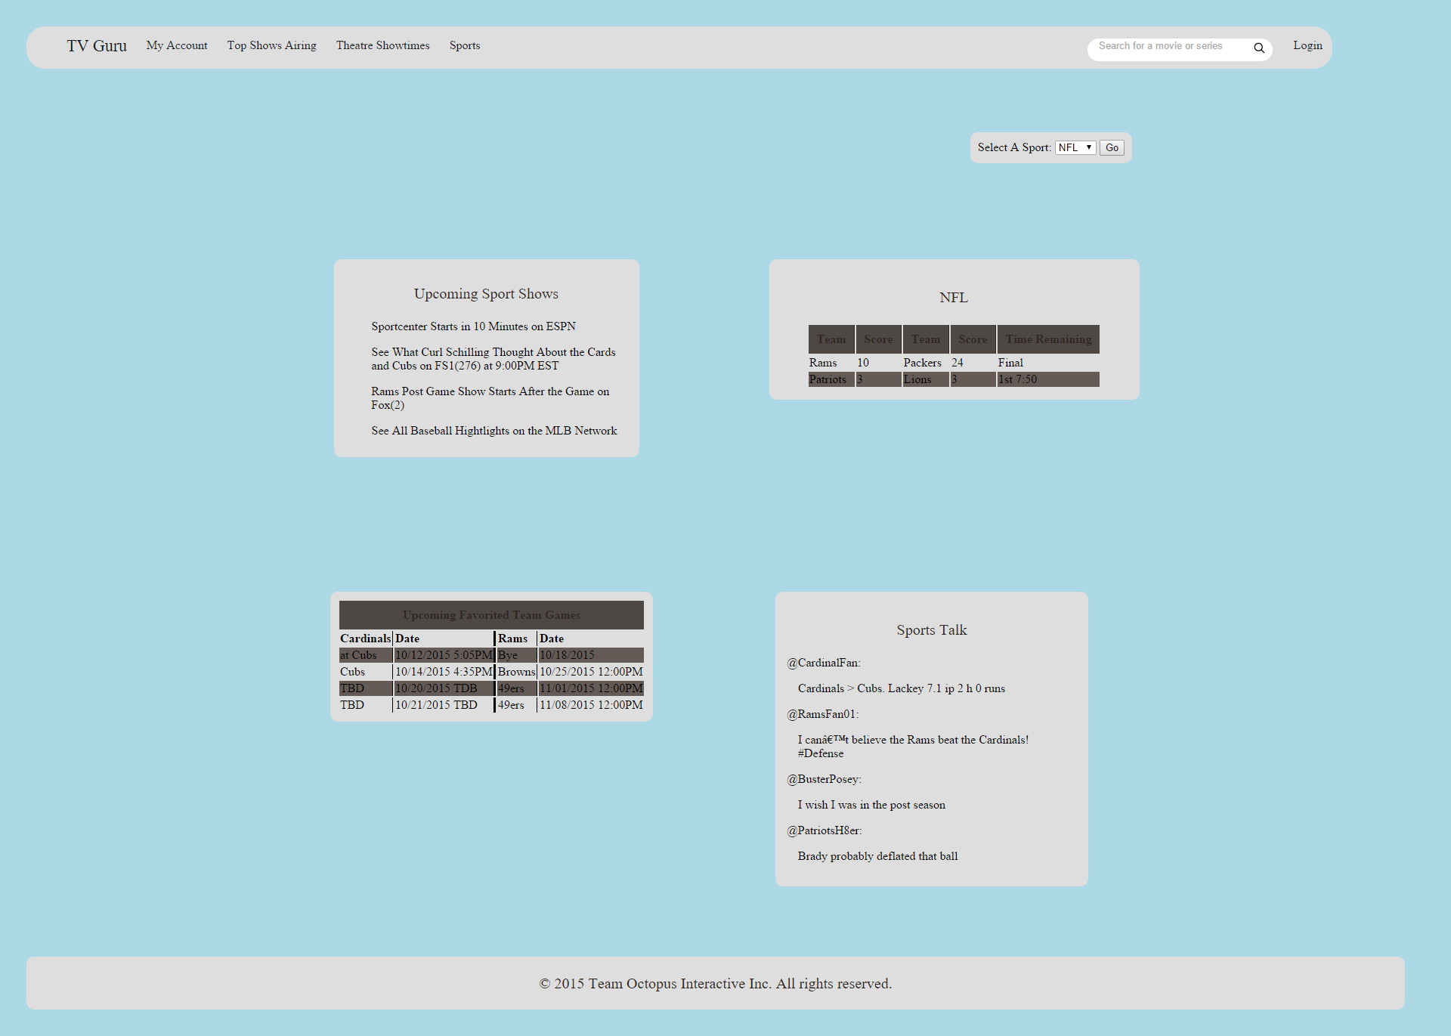
Improvements
Improvements
Color Scheme
Background
Tables
Page layouts
Sports page
Home page
Info page
Team Octopus
High-Fidelity Prototype
Team Member: Jack Flowers

Slide 14
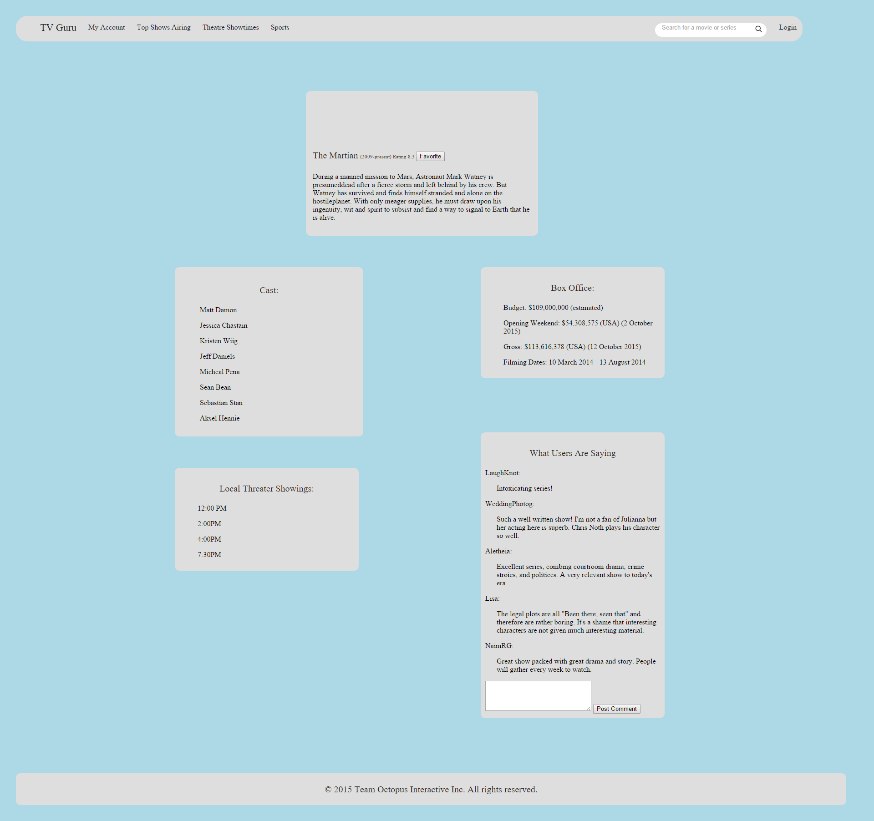
Info Page
Team Octopus
High-Fidelity Prototype
Team Member: Jack Flowers

