Slide 1

Team Octopus Project: TV Guide
Team Members:
Jack Flowers
Alex Will
Jake King

Slide 2
Overview
Expand on Traditional TV Guide
Add more functionality to a basic TV Guide
Allow for customization.
Team Octopus
Project Overview
Team Member: Alex Will

Slide 3
Contextual Inquiry: Added Features
We added sports, after I pointed out that is why I use TV Guide and our interviews suggested people would want it
We added the social media aspect to it, so people could comment on videos
We also added a top shows page, to show which shows were trending
Team Octopus
Contextual Inquiry
Team Member: Jake King

Slide 4
Team Octopus
Contextual Inquiry
Team Member: Jake King

Slide 5
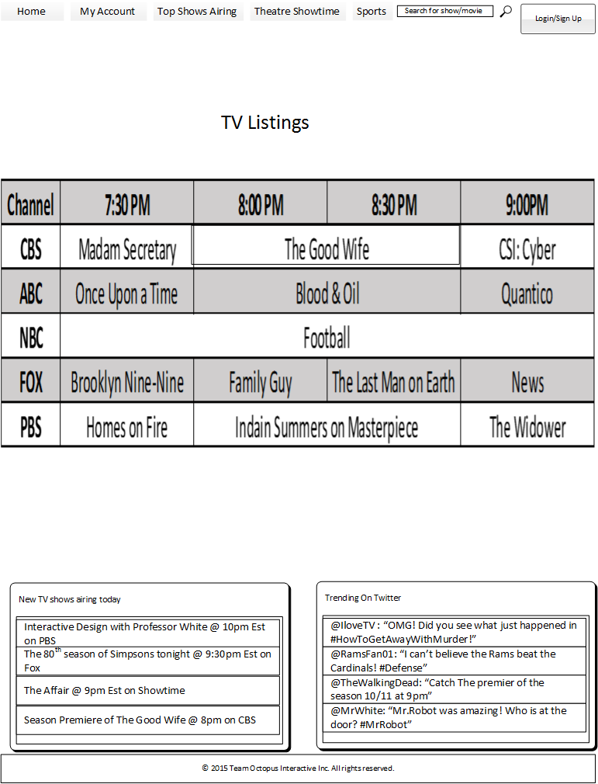
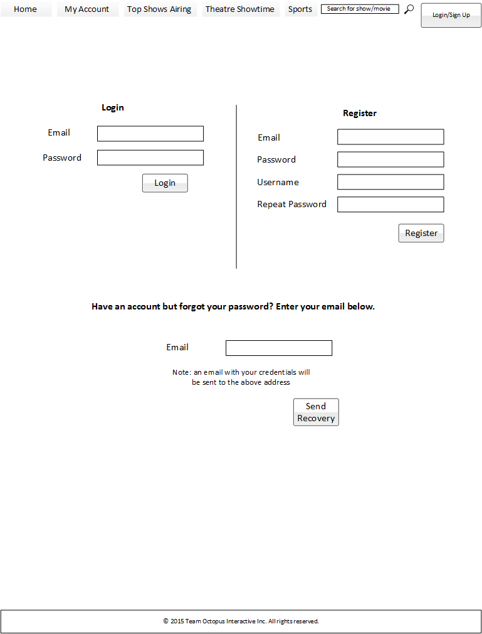
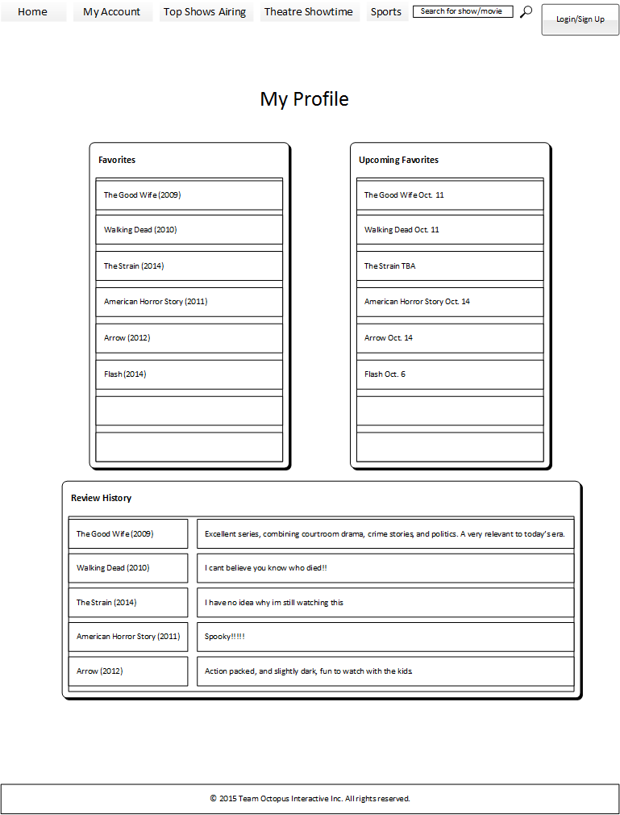
Snapshots
Team Octopus
Low-Fidelity Prototype
Team Member: Alex Will

Slide 6
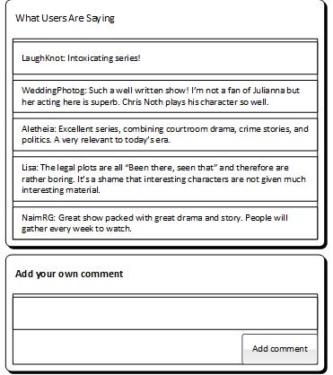
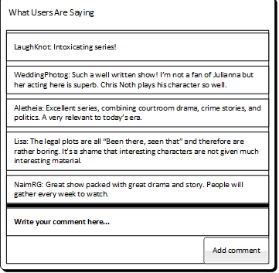
Questions
Focused on layout and features.
Compared different pages for preference.
Team Octopus
Low-Fidelity Prototype
Team Member: Alex Will

Slide 7
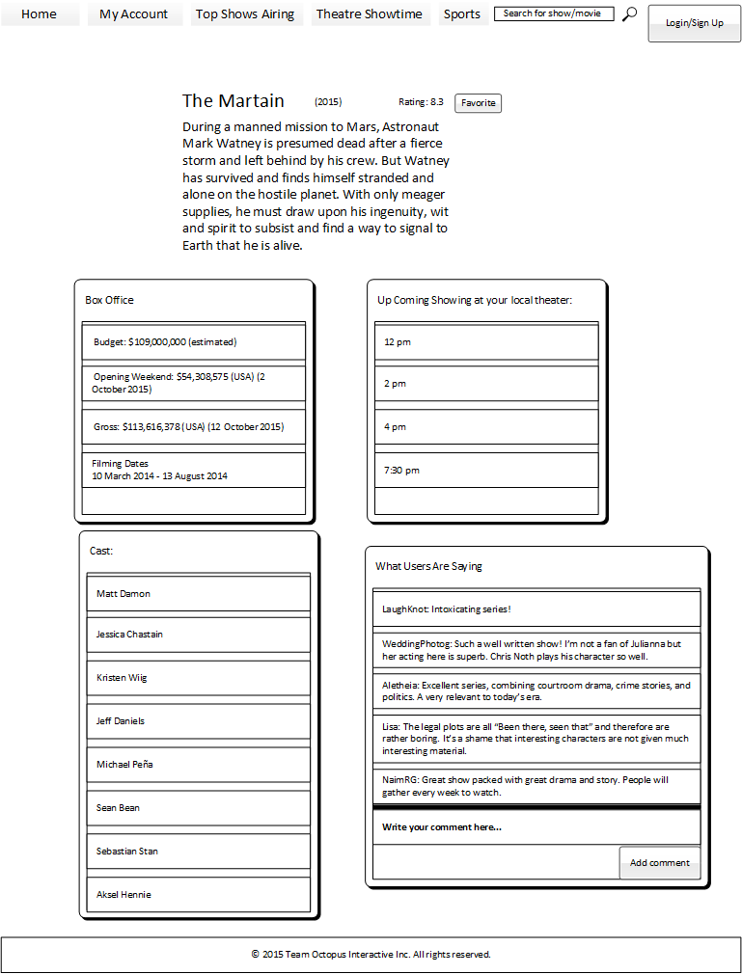
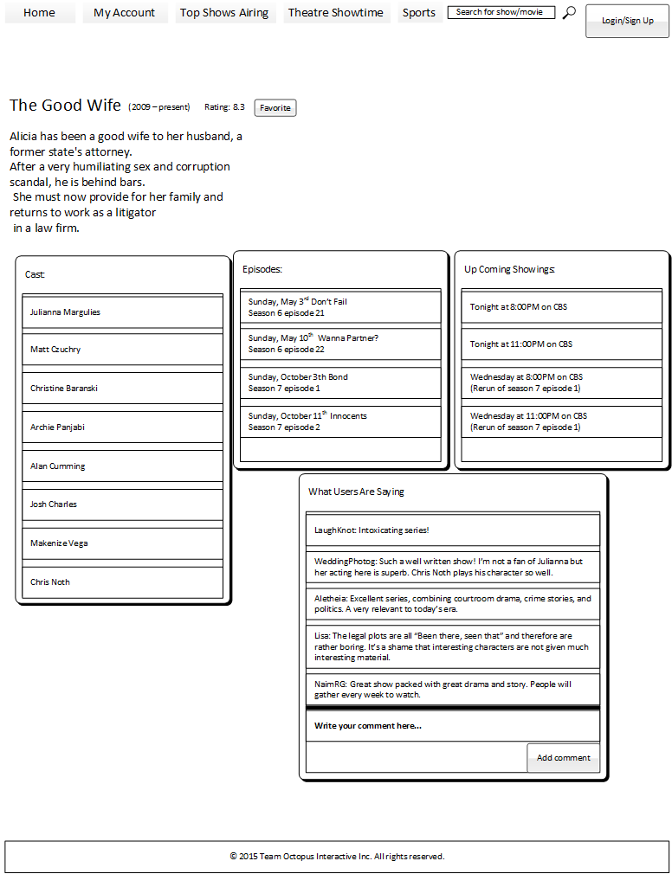
Improvements
Team Octopus
Low-Fidelity Prototype
Team Member: Alex Will

Slide 8
Affinity Diagram
Team Octopus
Work Models & Affinity Diagram
Team Member: Jack Flowers

Slide 9
Flow Model
Team Octopus
Work Models & Affinity Diagram
Team Member: Jack Flowers

Slide 10
Cultural Model
Team Octopus
Work Models & Affinity Diagram
Team Member: Jack Flowers

Slide 11
Sequence Model
Team Octopus
Work Models & Affinity Diagram
Team Member: Jack Flowers

Slide 12
Artifact Model
Team Octopus
Work Models & Affinity Diagram
Team Member: Jack Flowers

Slide 13
Physical Model
Team Octopus
Work Models & Affinity Diagram
Team Member: Jack Flowers

Slide 14
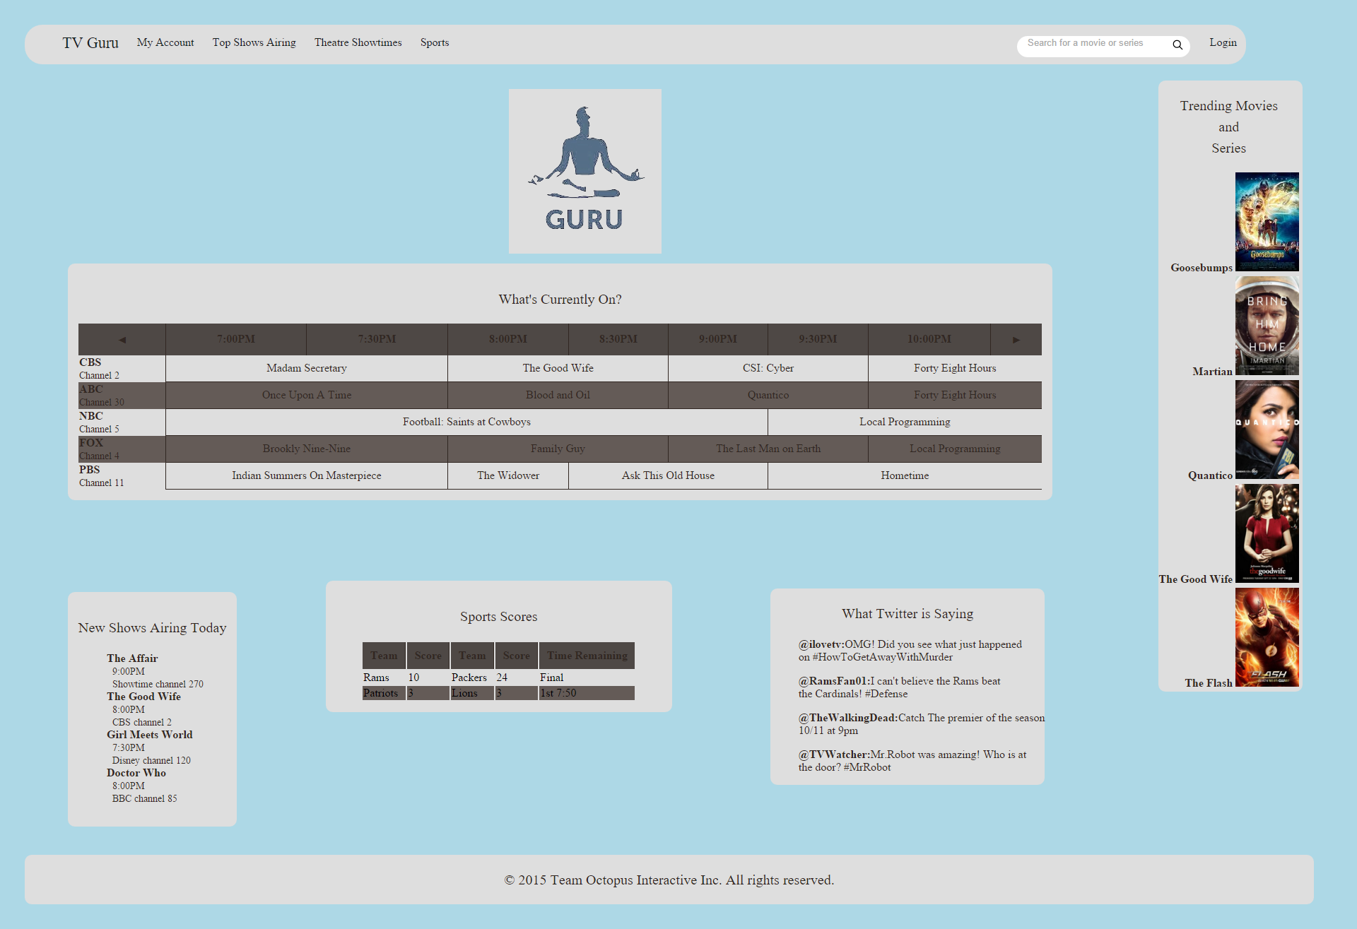
Questions
Tasks
Logging in
Searching
Look up trending items
View favorites
Look up a sports team
See theater show times
Questions
Task follow-ups
Colors
Layout
Easy to navigate
Team Octopus
High-Fidelity Prototype
Team Member: Jack Flowers

Slide 15
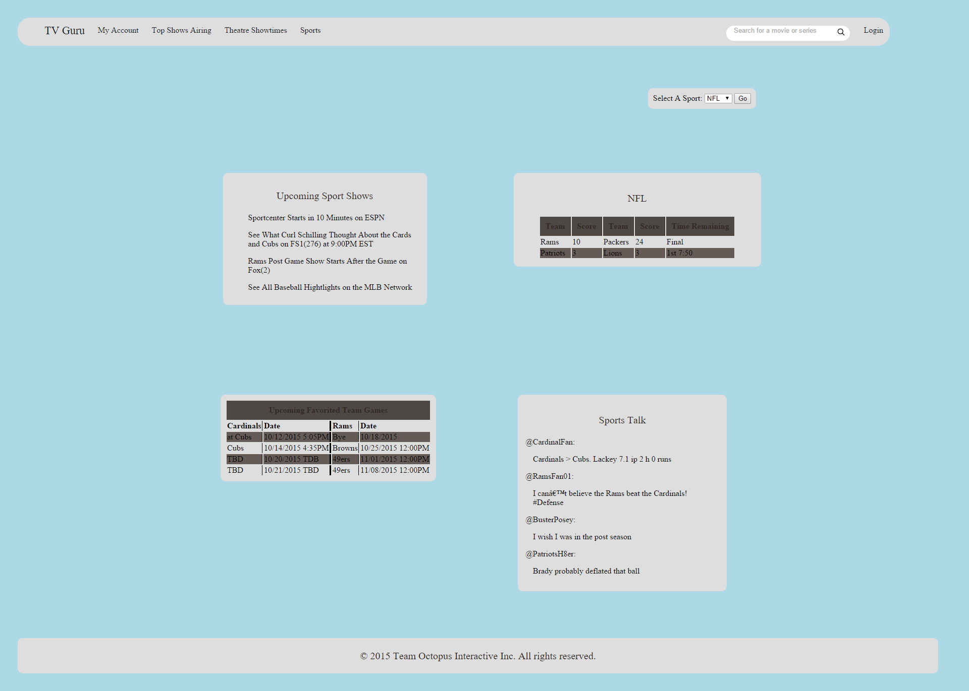
Improvements
Improvements
Color Scheme
Background
Tables
Page layouts
Sports page
Home page
Info page
Team Octopus
High-Fidelity Prototype
Team Member: Jack Flowers

Slide 16
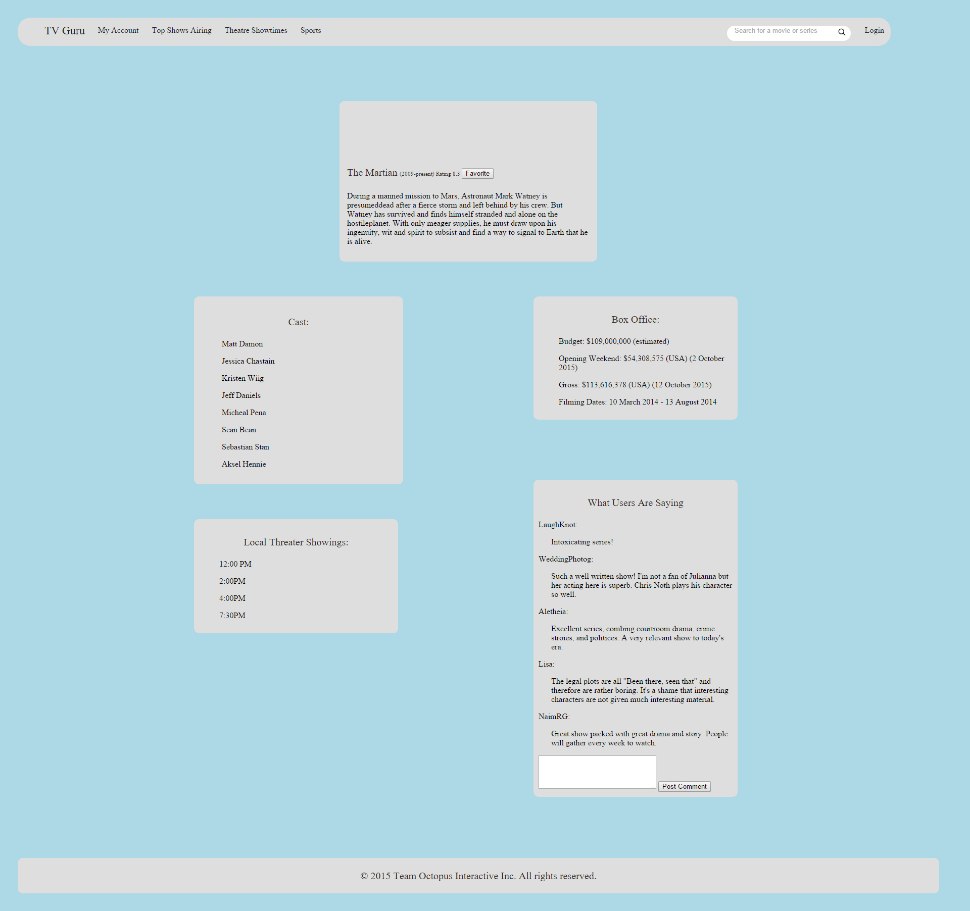
Info Page
Team Octopus
High-Fidelity Prototype
Team Member: Jack Flowers

Slide 17
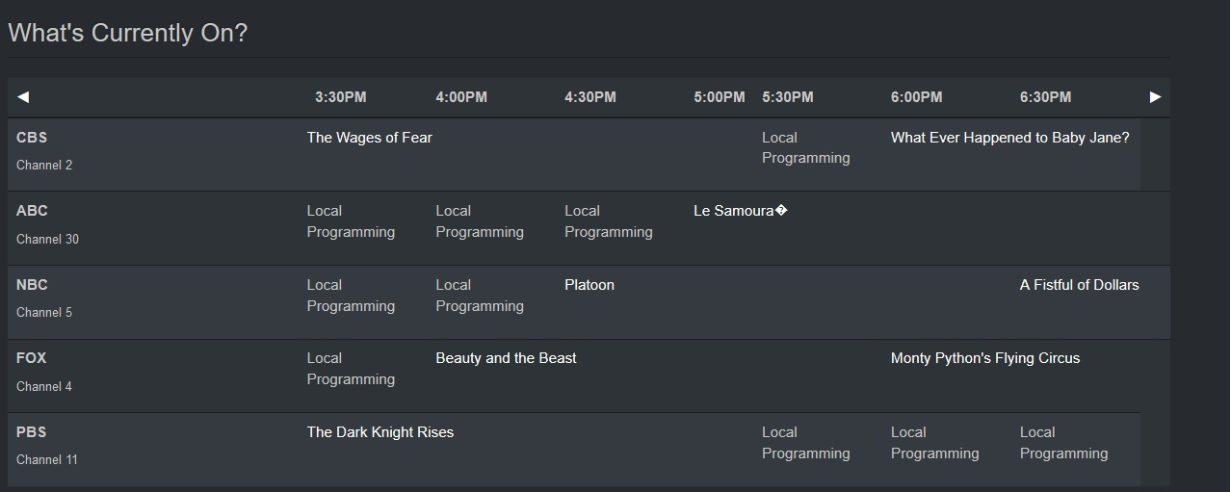
Fully Functional TV Guide
Team Octopus
Final Implementation
Team Member: Jake King

Slide 18
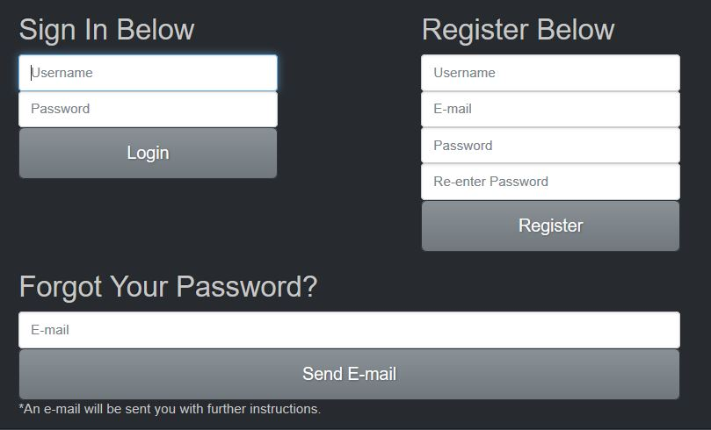
Login Page / Navigation page
Team Octopus
Final Implementation
Team Member: Jake King

Slide 19
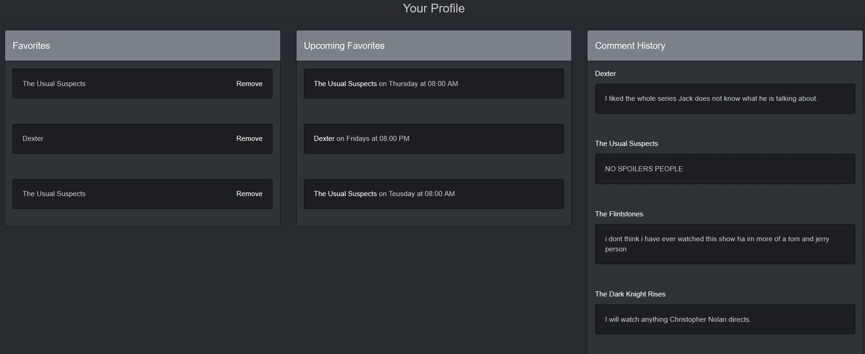
My Profile Page
Team Octopus
Final Implementation
Team Member: Jake King

Slide 20
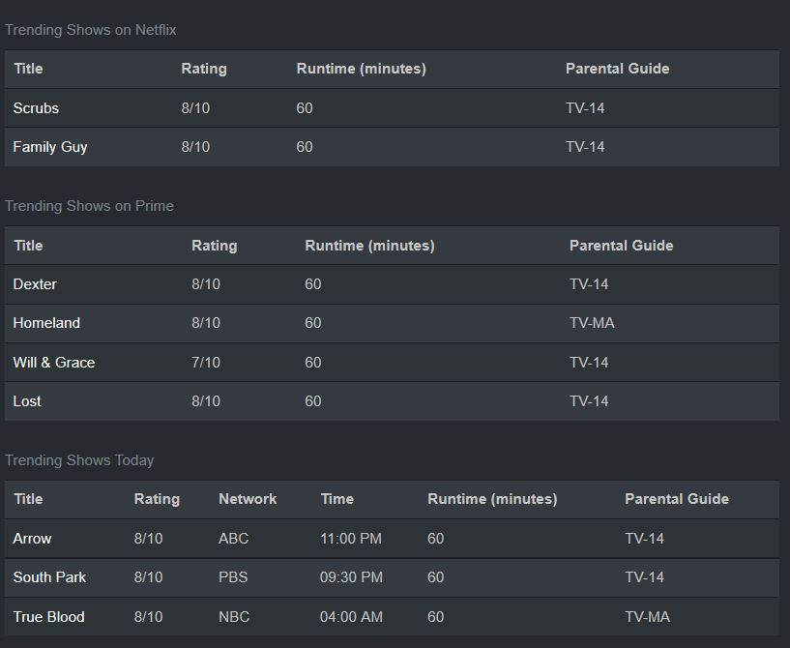
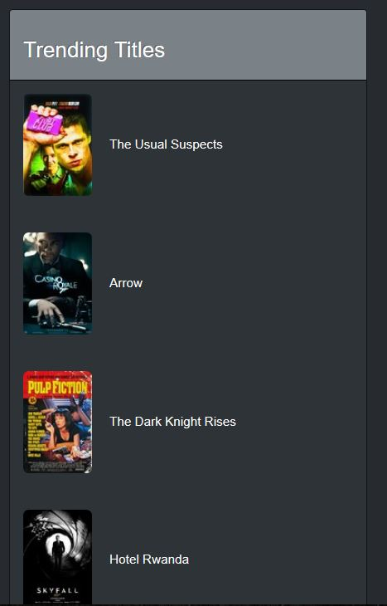
Trending Shows
Team Octopus
Final Implementation
Team Member: Jake King

Slide 21
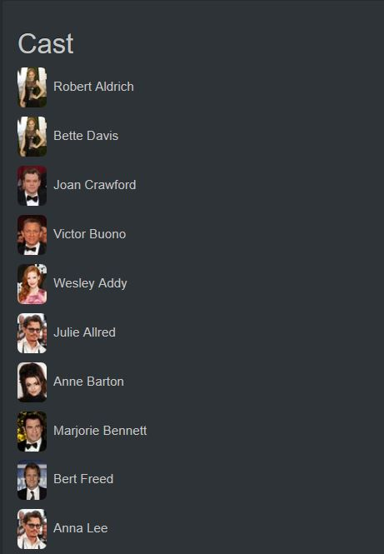

Information Page
Team Octopus
Final Implementation
Team Member: Jake King

Slide 22
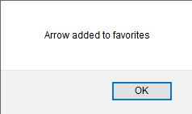
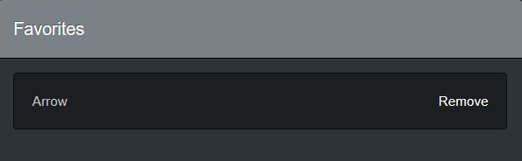



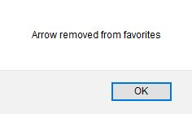
Favorites list
OR
Team Octopus
Final Implementation
Team Member: Jake King

Slide 23
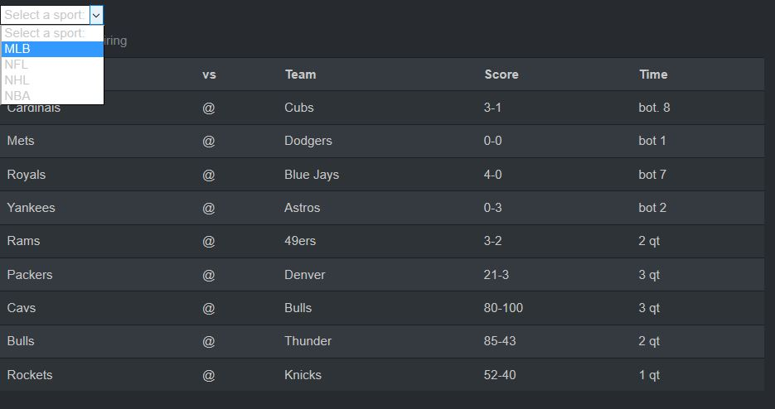
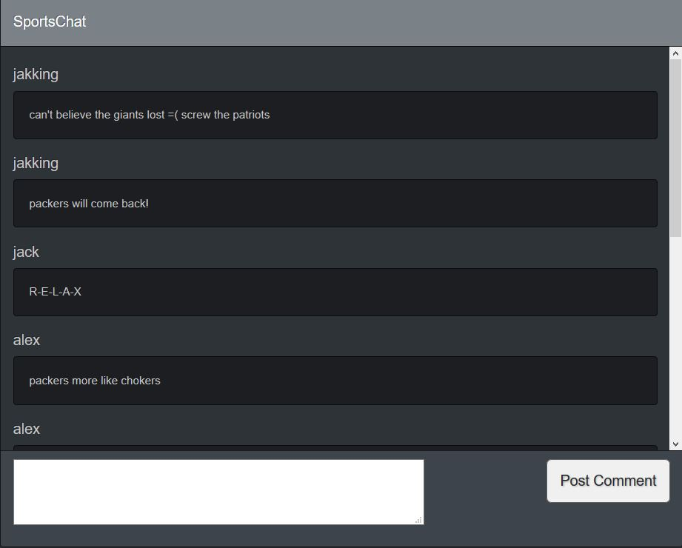
Sports Page
Team Octopus
Final Implementation
Team Member: Jake King

