Slide 1

HIGHCLOUD AIRLINES PROJECT
DONE BY: ALWIN J

Slide 2

Agenda
INTRODUCTION
PROBLEM STATEMENT
TECHNOLOGIES APPLIED
BUSINESS OBJECTIVE
PROJECT SCOPE
DATA MODEL CHALLANGES
KEY FINDINGS
VISUALIZATIONS
RECOMMENDATIONS
KEY INSIGHTS
CONCLUSION

Slide 3
Introduction
HighCloud Airline, a leading player in the aviation sector, has been at
the forefront of providing seamless air travel experiences.
Established with a commitment to excellence, HighCloud has consistently set industry standards in terms of reliability, safety, and customer satisfaction.
Extensive network of routes spans across regions, connecting people
and cultures, making HighCloud a preferred choice for millions of travelers globally.
HighCloud embraces innovation and modern technology to enhance
operational efficiency and stay at the forefront of the aviation landscape.

Slide 4
PROBLEM STATEMENT
Analyze Load Factor Trends: Determine load factor percentages by year, quarter, and month to identify patterns and opportunities for improvement.
Evaluate Carrier Performance: Analyze load factor performance by carrier name to identify areas of strength and weakness.
Identify Passenger Preferences: Determine the top 10 carrier names based on passenger preference, providing insights for marketing and service optimization.
Optimize Route Selection: Identify the top routes (from-to city) based on the number of flights, allowing for better resource allocation and route planning.
Understand Weekend vs. Weekday Demand: Analyze load factor differences between weekends and weekdays to understand demand patterns and adjust scheduling accordingly.
Categorize Flights by Distance: Identify the number of flights within different distance groups to support pricing strategies and resource allocation."

Slide 5

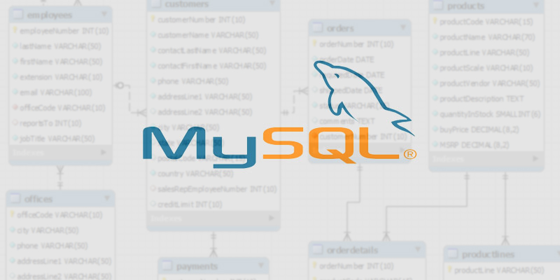


TECHNOLOGIES APPLIED

Slide 6
BUSINESS OBJECTIVE
The High Cloud Airlines Project aims to enhance the overall customer experience by delivering personalized services and seamless digital interactions , which will lead to increased passenger satisfactions.
This will involve investigating load factors, identifying top carrier names based on passenger preference, analyzing popular routes, and exploring other key metrics.
The ultimate goal is to provide actionable recommendations that can enhance operational efficiency and profitability.

Slide 7

PROJECT SCOPE
The airline industry faces ongoing challenges to optimize operational efficiency and enhance customer satisfaction.
This project aimed to leverage the power of data analysis to extract valuable insights and optimize high-cloud airline operations and performance. The project's specific scope focused on analyzing key performance indicators (KPIs) to gain a deeper understanding of:
Load Factor
Passenger Preferences
Popular Routes
Operational Efficiency

Slide 8
DATA MODEL CHALLANGES
Throughout our analysis, we encountered various challenges in handling the data. Overcoming these challenges is crucial for accurate insights.
Data Volume: Managing and Processing large datasets efficiently.
Data Quality: Ensuring accuracy and reliability of the data.
Complex Relationships: Establishing connections between different data points.

Slide 9
KEY FINDINGS
Load factor is a key metric for benchmarking an airline's performance against competitors. Airlines may compare their load factors with industry averages to assess their relative position in the market.
Based on the available data, we have analyzed 207 airlines, spanning 4 regions and operating in 106 countries.
As per the Analysis 2013(78.12%) has the highest load factor and 2008(75.30%) has the lowest load factor which directly impacts the airlines’ financial performance.
Regarding the load factor, we observed that the airline load capacity is higher on weekdays than on weekends, indicating that the flight seats on weekdays are filled more than on weekends.
Also, Globespan Airways has the highest load factor which is 94.76 %.
Airlines known for consistently high load factors may be perceived as operationally efficient and capable of maximizing revenue through effective capacity utilization and can be successful in revenue generation
Passengers often associate crowded flights with popular routes and may choose carriers with higher load factors for a sense

Slide 10
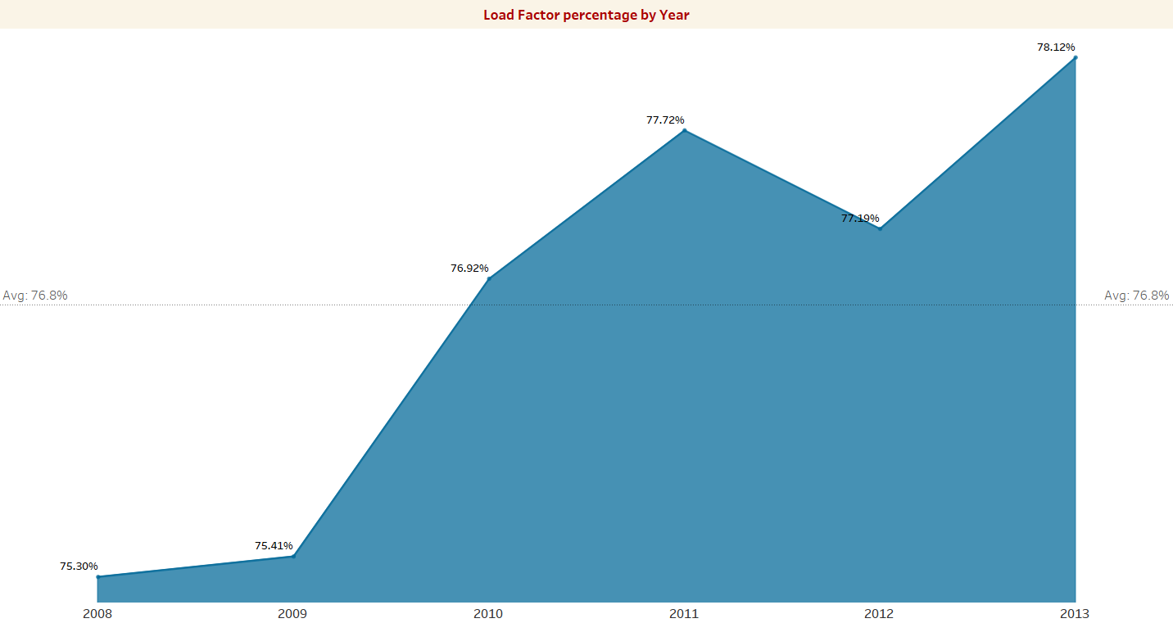
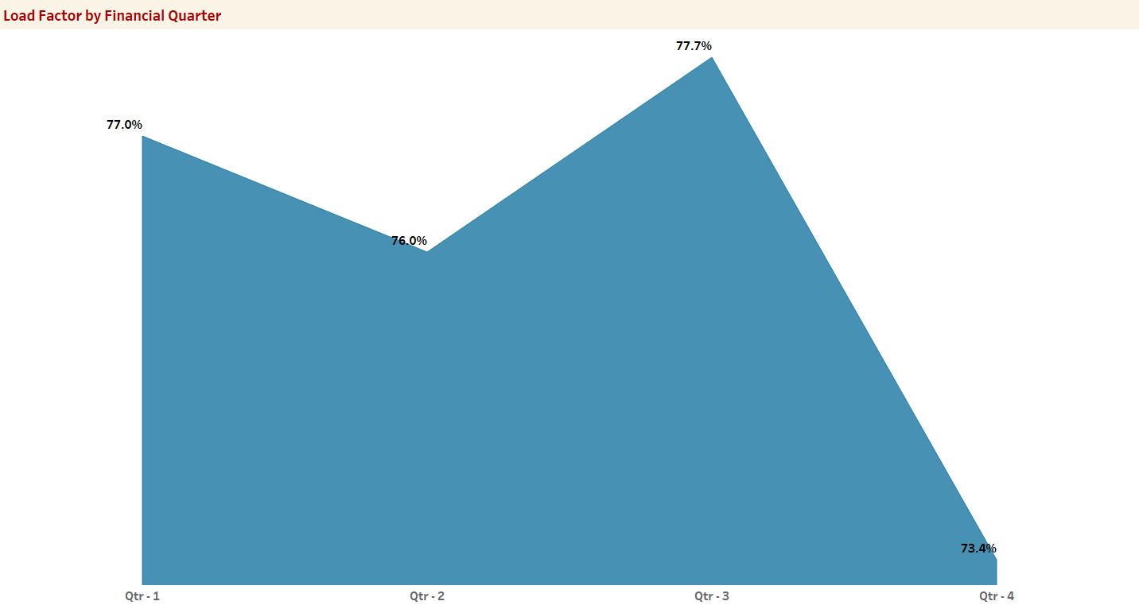
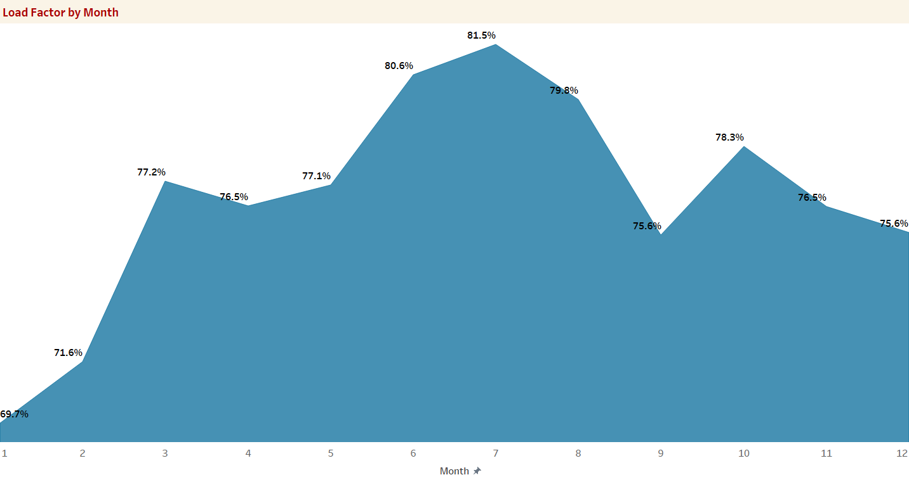
Identify the Load Factor Percentage on a Yearly Quarterly and Monthly basis
2013 has the highest load factor with 78.12% and 2008 has the lowest load factor with 75.30%.
There is a gradual increase throughout the years, ensuring more seat occupancy.
Load factor in June, July, and August period of months has the highest indicating that the passengers most preferred month period to travel.
Financial Q4 is less preferred traveling period with a 73.4% load factor which is low compared to other quarters.

Slide 11
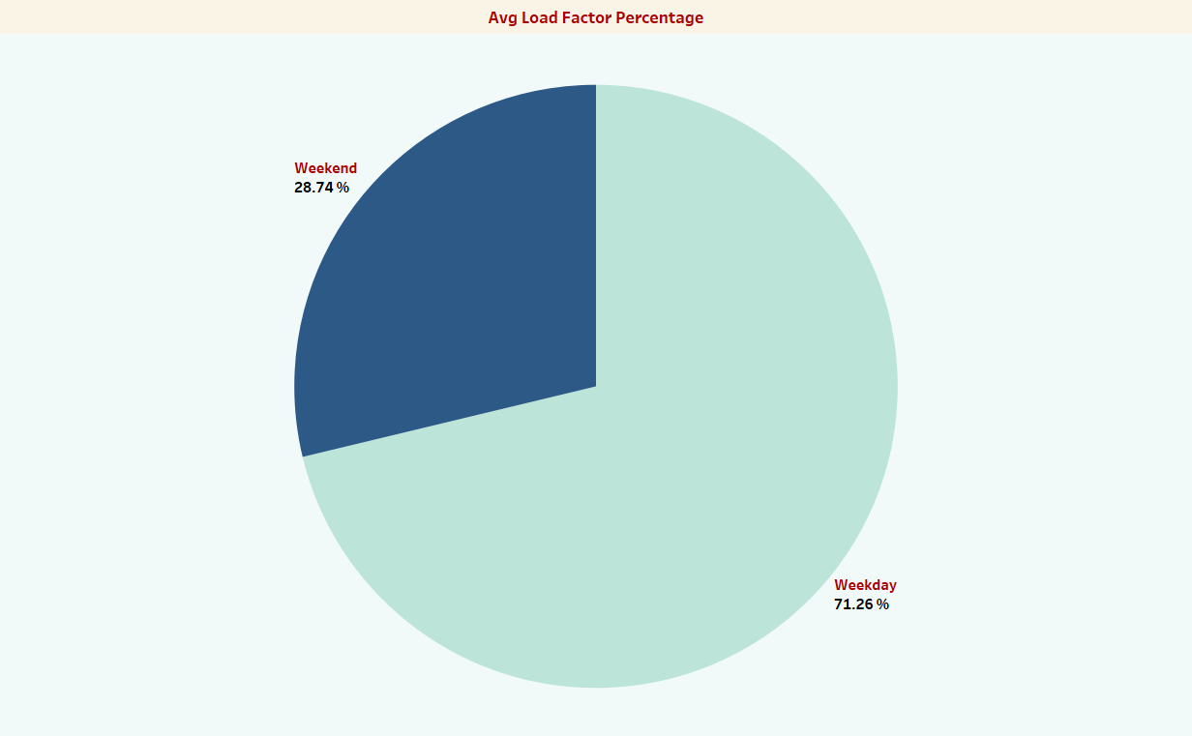
Identify how much load factor is occupied on Weekends vs Weekdays
The occupancy rate on weekdays at 71.26% is more than on weekends at 28.74% indicating that the flight seats on weekdays are filled more than on weekends

Slide 12
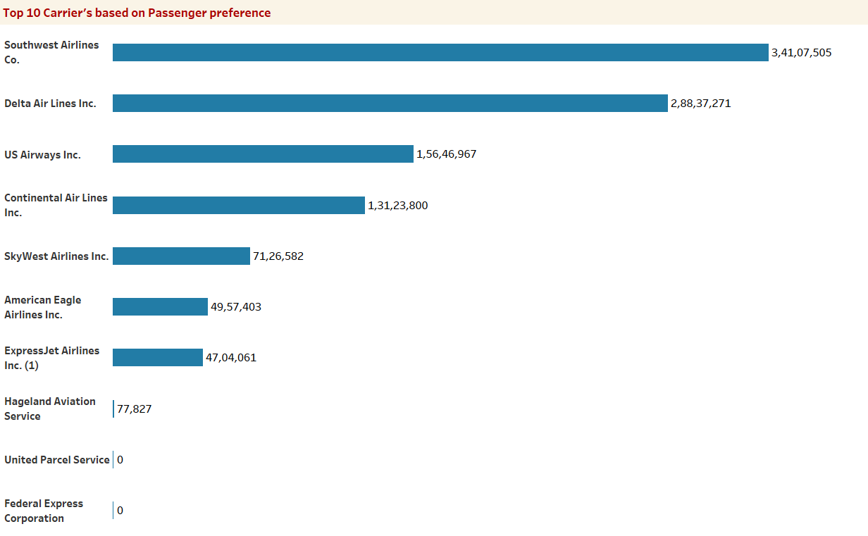
Identify the Top 10 Airlines based passenger preference
Southwest Airlines co with 34M passengers traveled all time
Delta Airlines Inc. with 29M secures the second position
Alaska Airlines Inc is the least preferred with 4.8M passengers

Slide 13
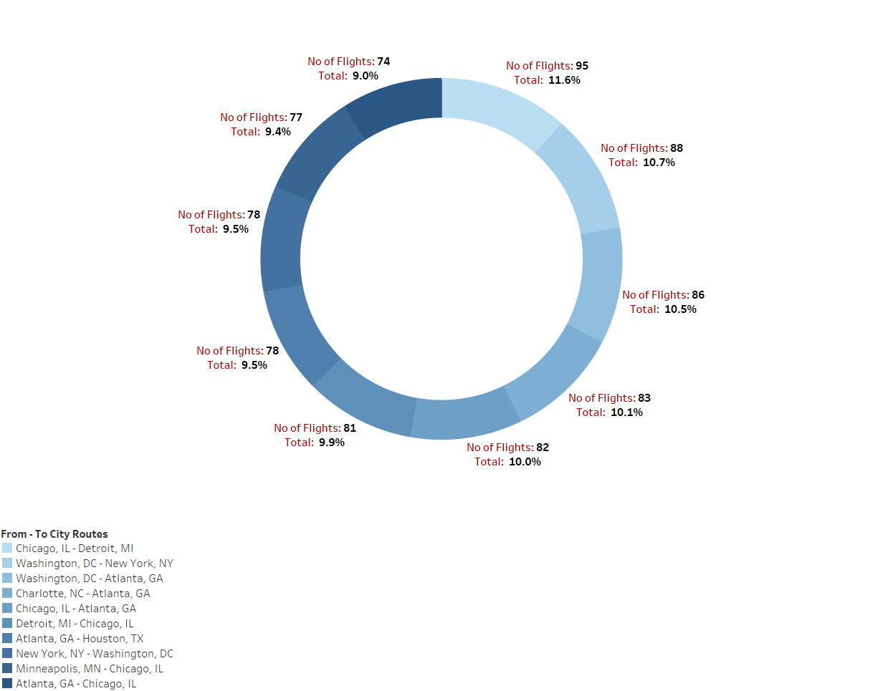
Display top Routes (from to City) based on the Number of Flights
Chicago to Detroit route is the most preferred route with the highest no of flights travelled with 11.6%.
Minneapolis to Chicago and Atlanta to Chicago is the least popular routes with only a 9.4% and 9% travel rate

Slide 14
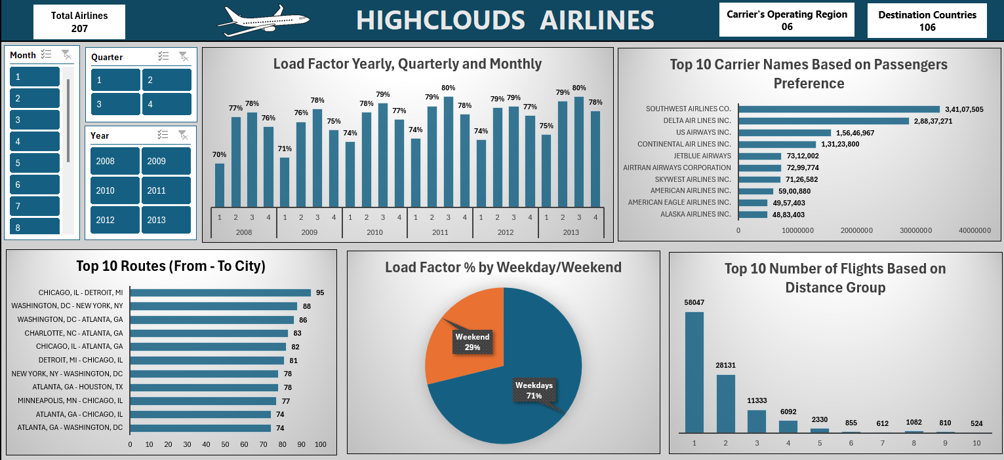
EXCEL DASHBOARD

Slide 15
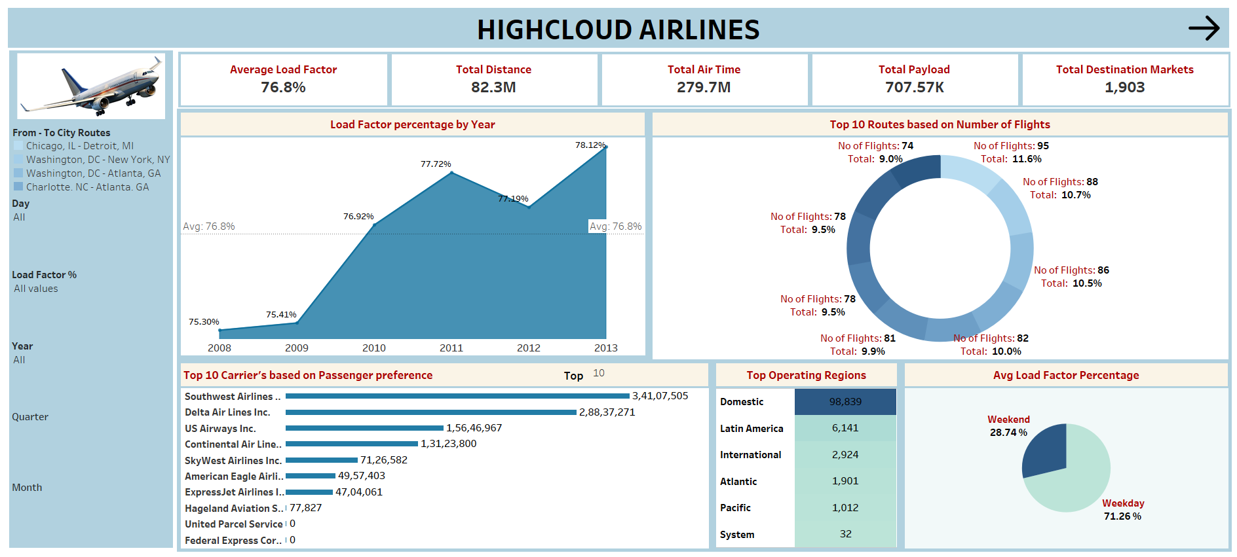
TABLEAU DASHBOARD

Slide 16
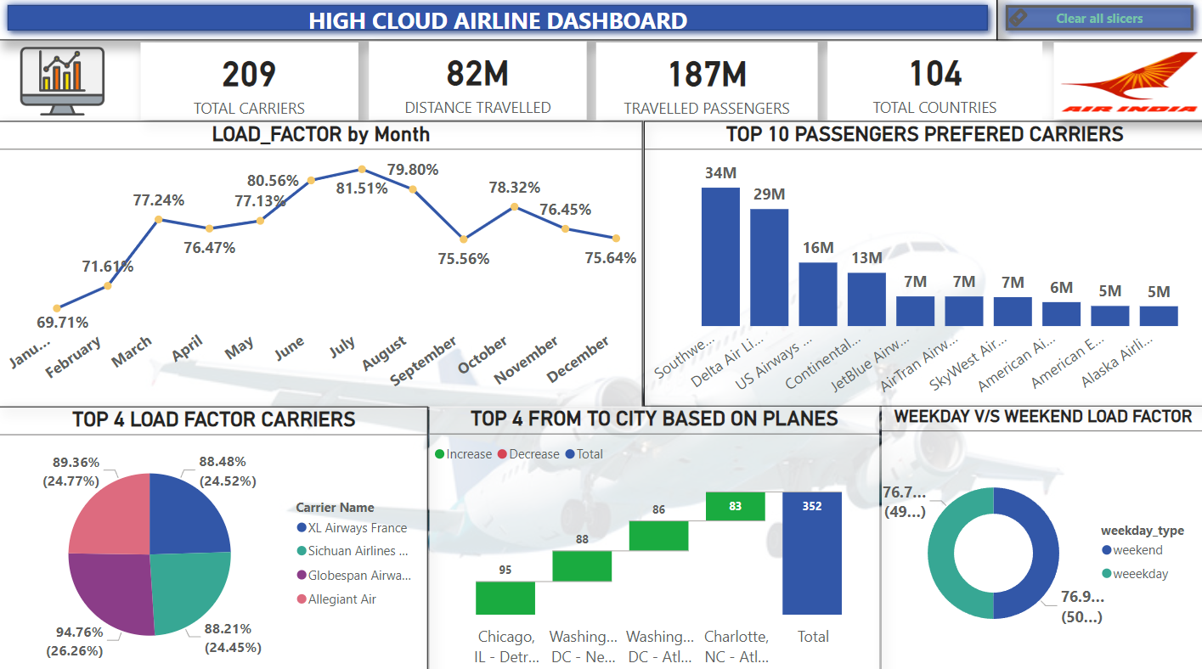
POWER BI DASHBOARD

Slide 17
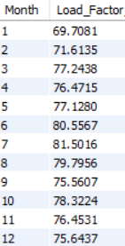
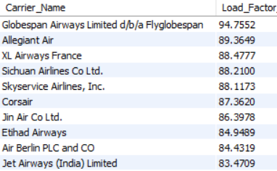
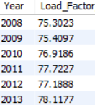

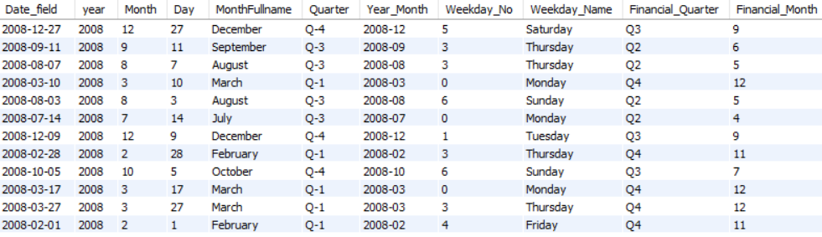
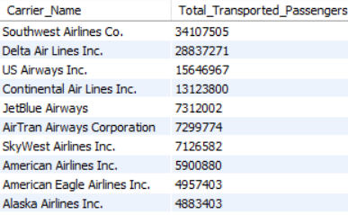
SQL OUTPUT

Slide 18
RECOMMENDATIONS
Optimize Fight Routes: Utilize insights from up routes and flights to Optimize schedule and resource allocation.
Strategic Carrier Partnership: Collaborate with top carriers to maximize passenger transportation and enhance overall performance.
Enhance Load Factor: Leverage load factor analysis to identify trends and implement strategies for increased efficiency.
Resource Allocation: Allocate resources strategically based on flight schedules and passenger volume data. This ensures efficient operation and minimizes wait times at airports with high passenger traffic.

Slide 19
KEY INSIGHTS
Evaluate overall cost structures and Identify opportunities for cost optimization and efficiency improvements
Evaluate Fleet composition which is influenced by the types of routes and passenger demand.
Identify the overall on- time performance of flights and explore any patterns or trends in delays or cancellations
Identify high-demand routes and potential growth opportunities based on origin- destination analysis.
Evaluate the performance of different carriers operating in the market and assess market share
Understand the performance and demand patterns. across different cities, states, and countries

Slide 20


