Slide 1
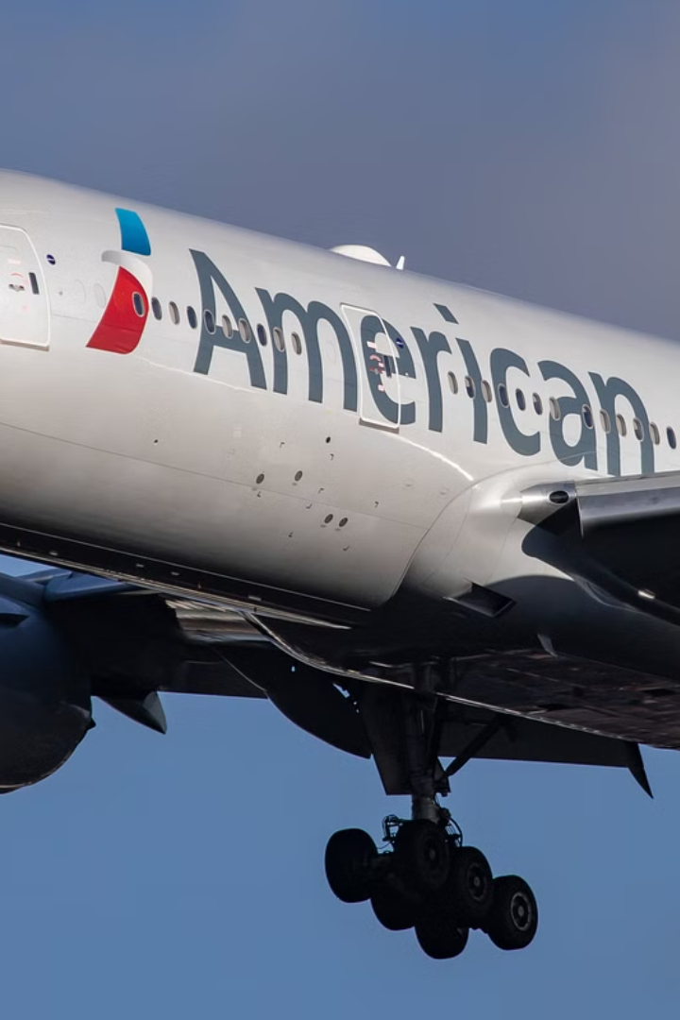
HIGHCLOUD AIRLINES PROJECT
DONE BY: ALWIN J

Slide 2
Agenda
1
Introduction
2
Problem Statement
3
Technologies Applied
4
Business Objective
5
Project Scope
6
Data Model Challenges
7
Key Findings
8
Visualizations
9
Recommendations
10
Thank You

Slide 3

Introduction
1
Leading Player
2
Commitment to Excellence
HighCloud Airline, a leader in aviation.
Sets industry standards for reliability, safety, and customer satisfaction.
3
Global Network
4
Innovation
Connects people and cultures across regions.
Embraces modern technology to enhance operational efficiency.

Slide 4
PROBLEM STATEMENT
Analyze Load Factor Trends
Evaluate Carrier Performance
Determine load factor percentages by year, quarter, and month.
Analyze load factor performance by carrier name.
Identify Passenger Preferences
Optimize Route Selection
Determine the top 10 carrier names based on passenger preference.
Identify the top routes based on the number of flights.
Understand Weekend vs. Weekday Demand
Categorize Flights by Distance
Identify the number of flights within different distance groups.
Analyze load factor differences between weekends and weekdays.

Slide 5





TECHNOLOGIES APPLIED
SQL
Excel
Tableau
Power BI

Slide 6

BUSINESS OBJECTIVE
1
Enhanced Customer Experience
2
Increased Passenger Satisfaction
Deliver personalized services and seamless digital interactions.
Investigate load factors, identify top carriers, and analyze popular routes.
3
Actionable Recommendations
Enhance operational efficiency and profitability.

Slide 7
PROJECT SCOPE
Challenges
Data Analysis
Key Performance Indicators
Optimize operational efficiency and enhance customer satisfaction.
Leverage data analysis to extract valuable insights.
Analyze KPIs to gain a deeper understanding.
1
Load Factor
2
Passenger Preferences
3
Popular Routes
4
Operational Efficiency

Slide 8

DATA MODEL CHALLANGES
1
Data Volume
2
Data Quality
3
Complex Relationships
Managing and processing large datasets efficiently.
Ensuring accuracy and reliability of the data.
Establishing connections between different data points.

Slide 9
KEY FINDINGS
1
Load Factor Benchmarking
2
Highest Load Factor
3
Lowest Load Factor
2013 (78.12%) has the highest load factor.
2008 (75.30%) has the lowest load factor.
Key metric for benchmarking airline performance.
4
Weekday vs. Weekend Demand
5
Highest Load Factor Airline
6
High Load Factor Perception
Higher load capacity on weekdays than weekends.
Globespan Airways has the highest load factor at 94.76%.
Airlines with consistently high load factors are perceived as operationally efficient.

Slide 10
Load Factor Analysis
78.12%
75.30%
Q4
2013
2008
Financial Q4
Highest Load Factor
Lowest Load Factor
Lowest Load Factor Quarter
July, Aug
Weekdays
Peak Travel
Load Capacity
Highest Load Factor Months
Highest Load Capacity

Slide 11
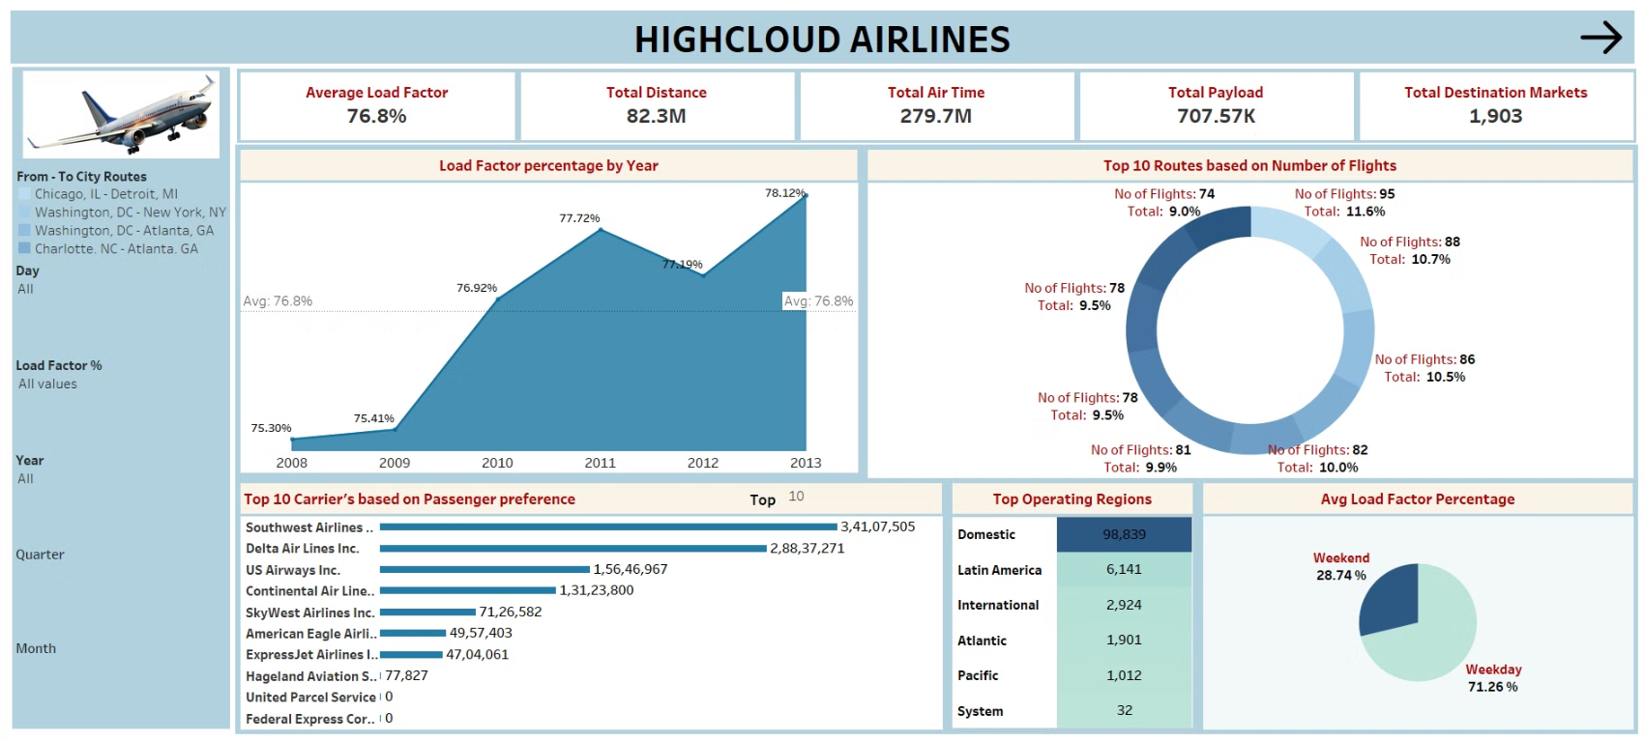
Visualization

Slide 12
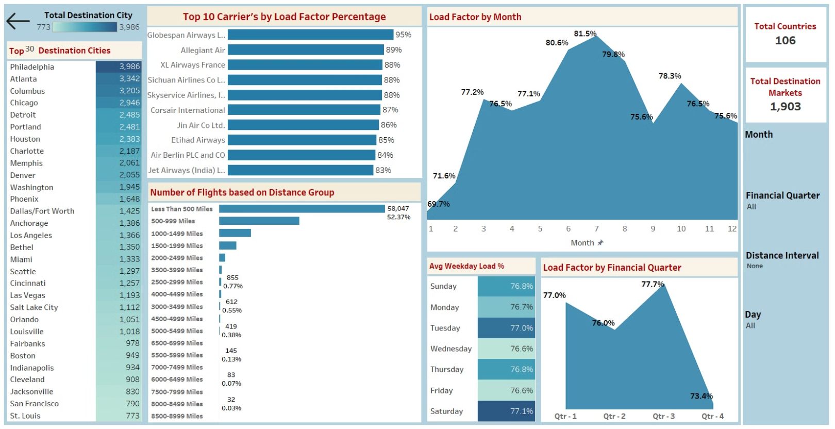

Slide 13
Recommendations
Optimize Fight Routes: Utilize insights from up routes and flights to Optimize schedule and resource allocation.
Enhance Load Factor: Leverage load factor analysis to identify trends and implement strategies for increased efficiency.
Collaborate with top carriers to maximize passenger transportation and enhance overall performance.
Resource Allocation: Allocate resources strategically based on flight schedules and passenger volume data. This ensures efficient operation and minimizes wait times at airports with high passenger traffic.

Slide 14

Thank You!
Portfolio
Contact
For more details about my work, please visit my portfolio.
Feel free to reach out if you have any questions or want to discuss potential projects.
Email: alwin16.j@gmail.com
LinkedIn: https://www.linkedin.com/in/alwinj16

