Slide 1


Animal Map

Slide 2
Introduction
Why us?
Simple GUI.
Responsive system.
Fully detailed documents.
Tested for efficiency.

Slide 3
“I need assurance that the system conforms to modern coding practices and this is flexible and easily maintained”
Jack Hogwood - Parks and Wildlife CIO

Slide 4
““I need assurance that thorough study is made of [the system’s] effect on Parks and Wildlife net bandwidth and our current servers.””
Jack Hogwood - Parks and Wildlife CIO

Slide 5
I want to select the approximate location of a feral pest sighting on a map so that I do not need to record the exact location at the time of sighting.
  Darren Clarke – Farmer
I want to be presented with a list of species when reporting a sighting, so that I can provide information when I do not know the species of a pest.
  Darren Clarke – Farmer
I want the information about feral pests to be presented in an easy to understand way, so that large quantities of data can be easily understood.
  James Cameron – Parks and Wildlife General Manager
Etc…

Slide 6
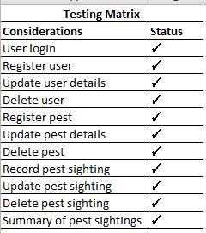

Slide 7

Support

Slide 8

User Support
Simplistic design
Support page available if needed

Slide 9
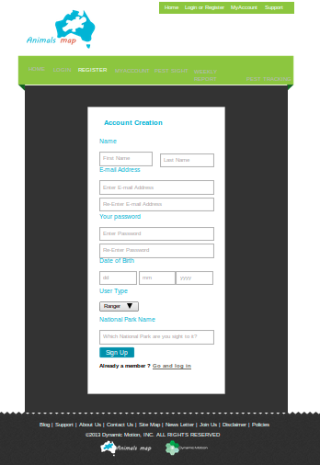
Simple
Verification
Authenticity

Slide 10
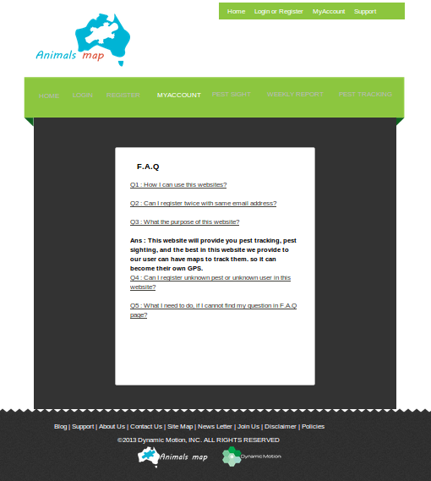
Common question to be answered
Not really necessary

Slide 11

Park and Wildlife Support
Documentation will be provided for future modification or expansions.
Database Schema provided.
Possible future partnership.

Slide 12
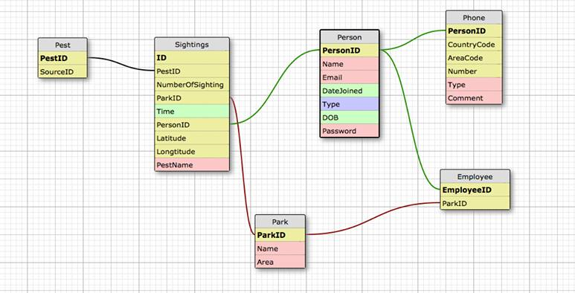
DB Schema

Slide 13
Deployment
“Fully Licensed source code to be transferred”
“Easy readable code”
“Simple system installation”

