Slide 1
Homework of Enzyme Kinetics
B05B02059 陳昱宏
B05B02050 趙伯宣
The result was equally contributed from two person.

Slide 2
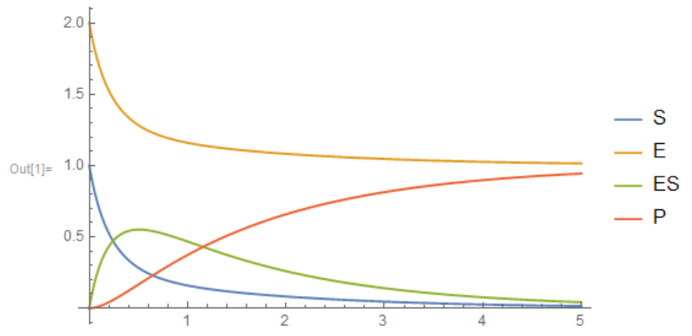
Debug of teacher’s code?
In a independent reaction and isolated system, the participant should not be added or removed, e.g., E + ES = E₀. However, how come the E and ES having the decreasing trend simultaneously?

Slide 3
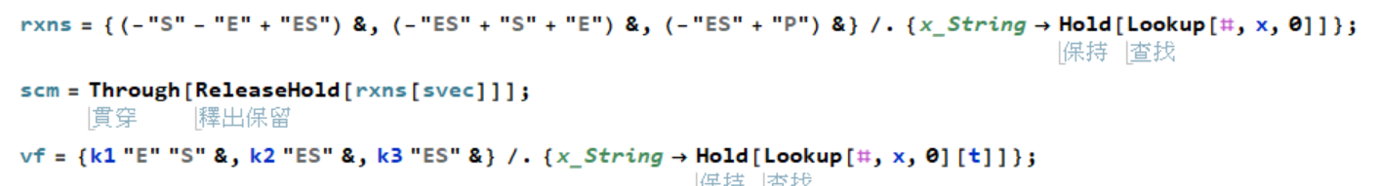
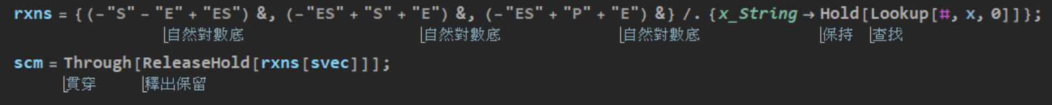

Oops! Here is the BUG

Slide 4
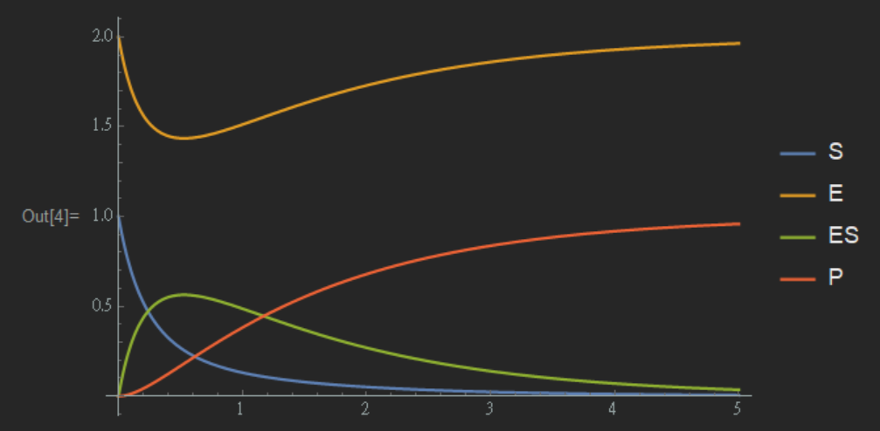
Let’s see the revision!
Hmm…Much better! The curve of E has been corrected!

Slide 5
Homework starts from Here!

Slide 6

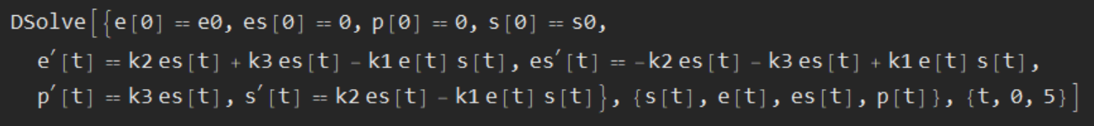
Pre-equilibrium Approximation (PEA)
In this approximation, reactants and intermediate in a consecutive reaction are assumed to be equilibrium. Since the first step is relatively faster than the second (k1>>k3), the accumulation of intermediate can be observed initially.

Slide 7

Steady State Approximation (SSA)
This approximation is applies to a consecutive reaction with a slow first step and a fast second step (k1<<k3). If the first step is very slow in comparison to the second step, there is no accumulation of intermediate product.

Slide 8
Check out the Simulation!

Slide 9
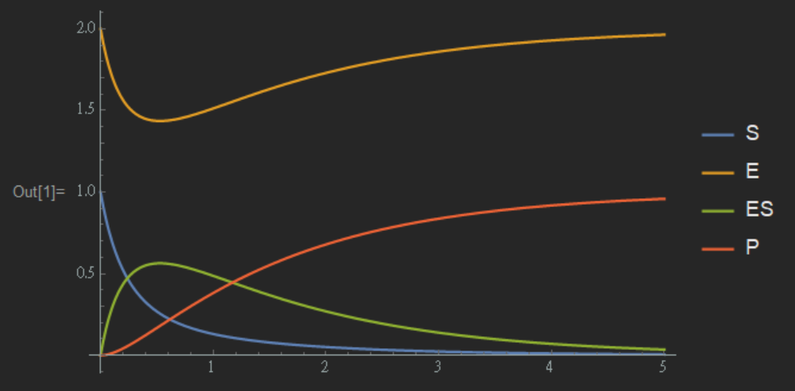
Pre- Teacher
This is for our reference to observe the differences in the following cases.

Slide 10
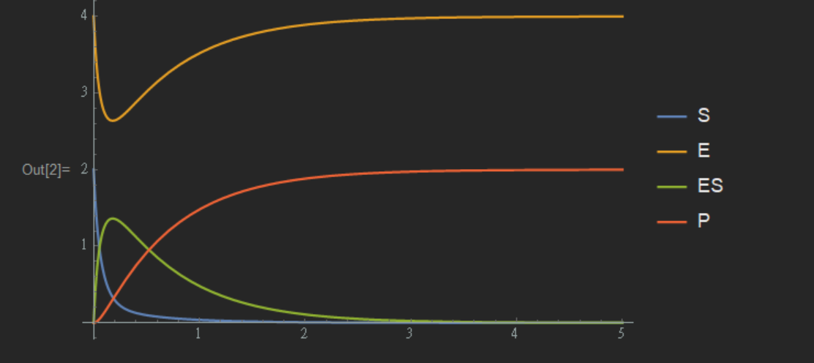

Pre-#1
Reference
Test
2 X
Double height of peak
Faster rate

Slide 11


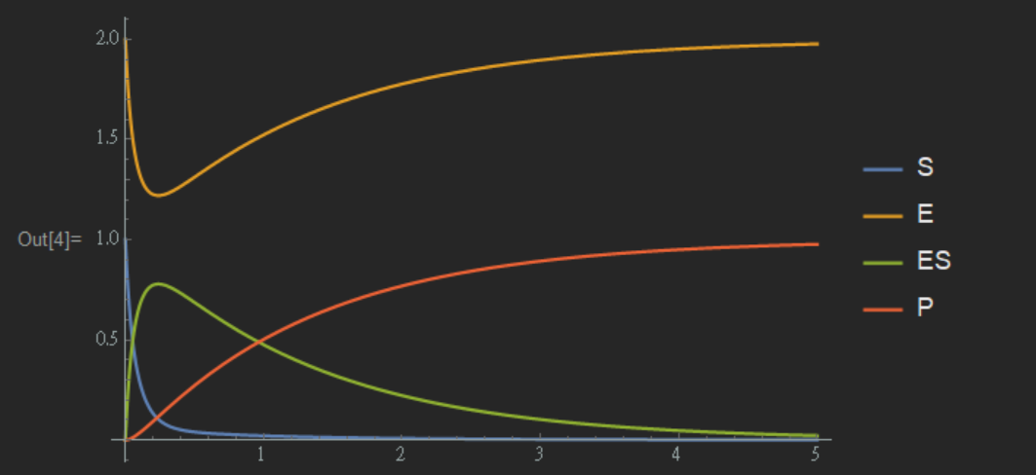
Pre-#2
4 X
Reference
Test
Good example of PEA

Slide 12

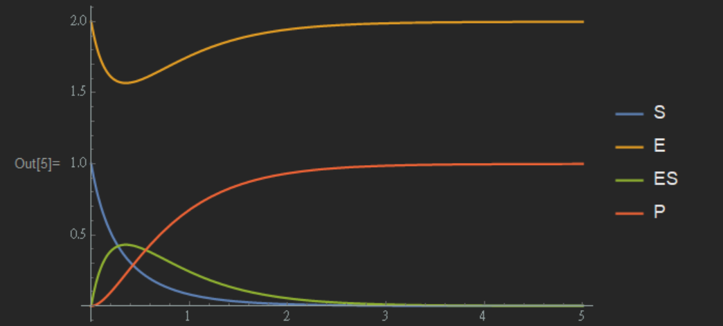
Pre-#3
Reference
Test
The rise and decline of the peak of [ES] have alike slant.

Slide 13

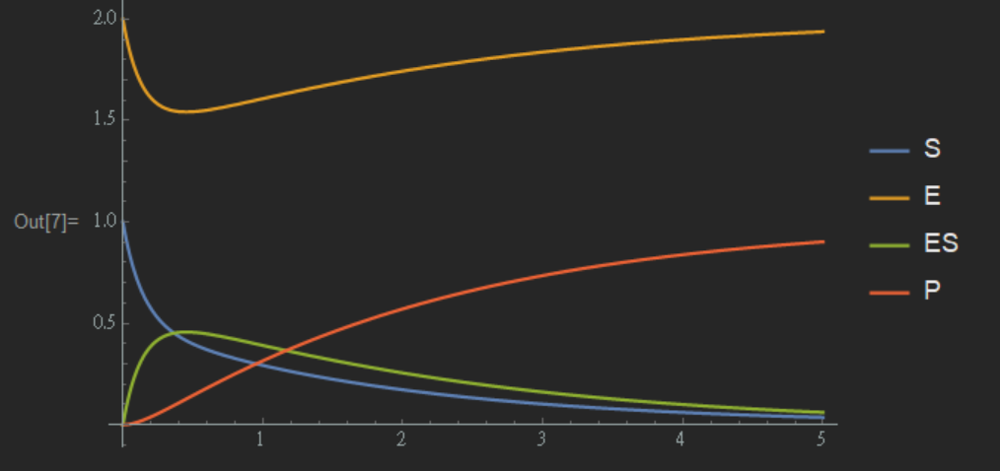
Pre-#4
Reference
Test
The supplement of ES is in a stable manner, resulting in smooth decline of ES.

Slide 14
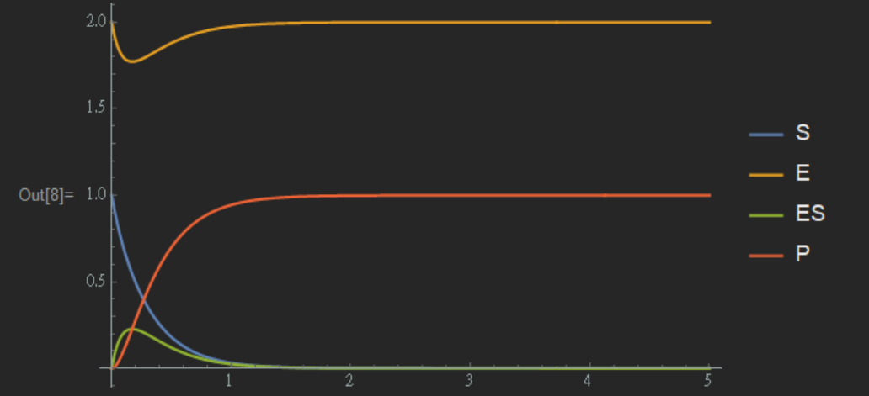

Pre-#5
Reference
Test
SSA model

Slide 15

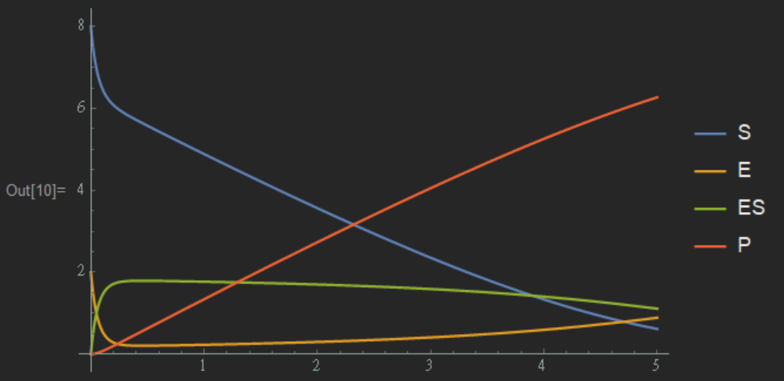
Pre-#6
Reference
Test
SSA model

Slide 16

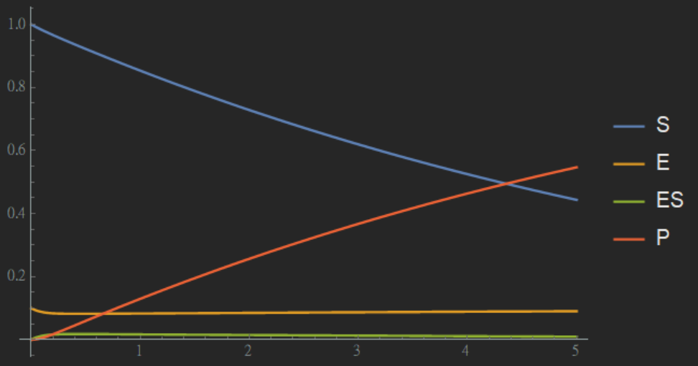
Pre-#5+6
Reference
Test
Good SSA model

Slide 17
Steady State Approximation
The rate constant of the first step must be slower than the rate constant of the second step.
Enzyme concentration must be significantly lower than the substrate concentration to keep the first step slower than the second step.

Slide 18
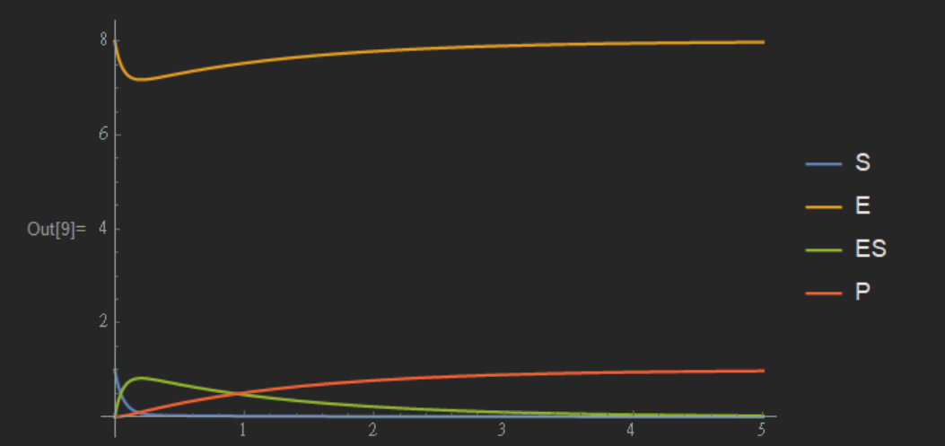
Pre-#7
Reference
Test
Too much enzyme
Faster reaction
Compression and increased peak of [ES]

Slide 19
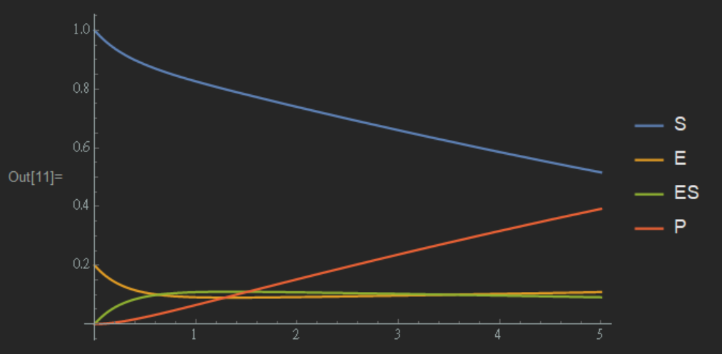
Pre-#8
Reference
Test
Lack of enzyme
Slower reaction
Extension and decline of peak of [ES]

Slide 20
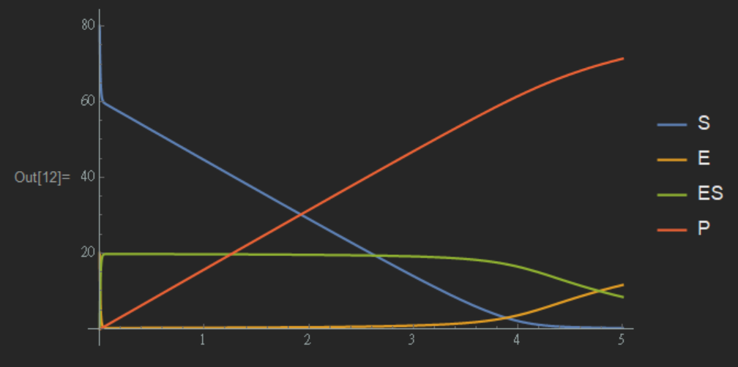
Pre-#9
Reference
Test
Pre 9 and 10 see the effect of secondary reaction on rate.

Slide 21
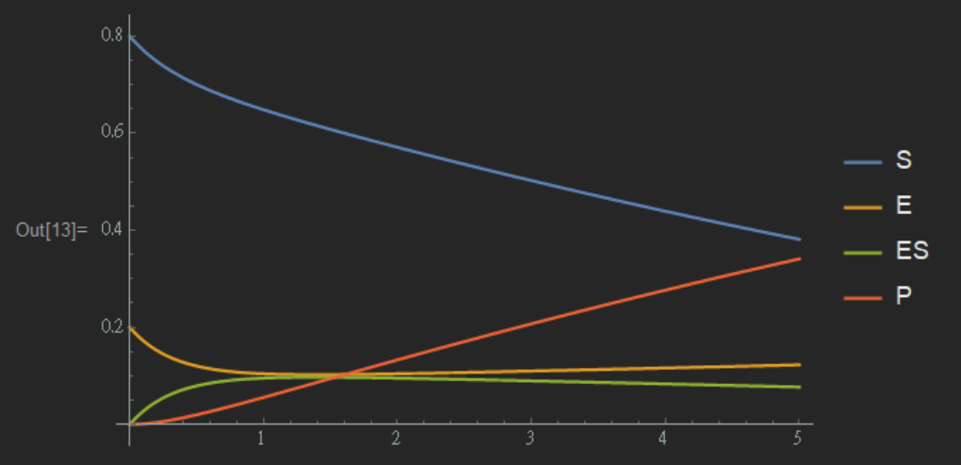
Pre-#10
Reference
Test
Pre 9 and 10 see the effect of secondary reaction on rate.

Slide 22
Steady State Approximation
The rate constant of the first step must be slower than the rate constant of the second step.
Enzyme concentration must be significantly lower than the substrate concentration to keep the first step slower than the second step.

Slide 23
Pre-#5+6
Reference
Test
Good SSA model

Slide 24
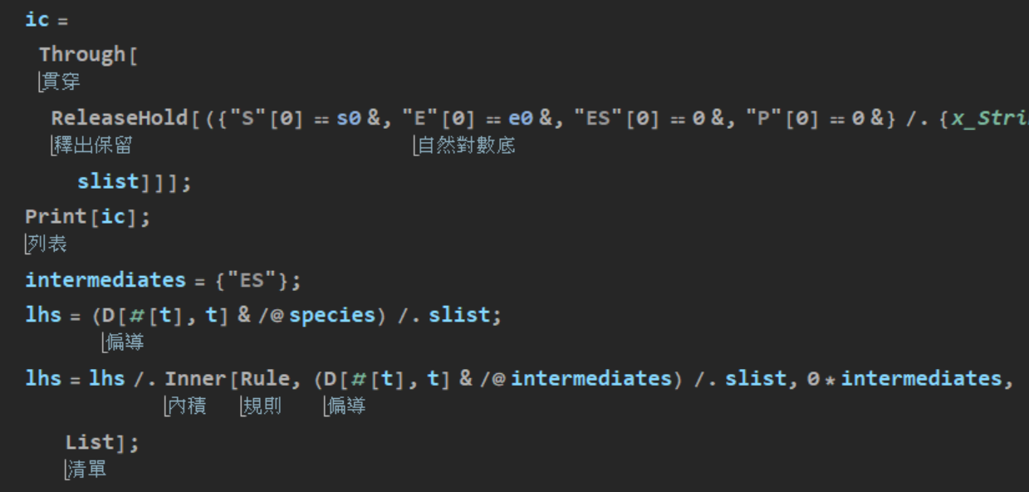
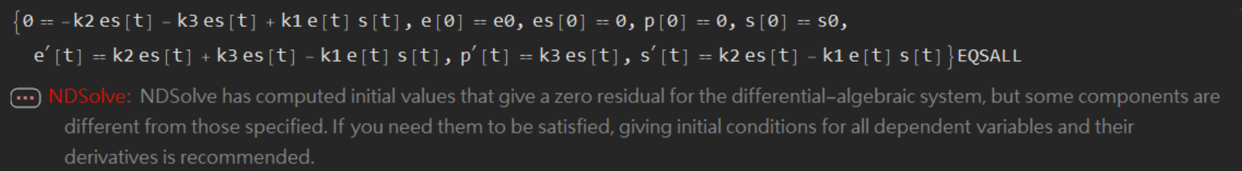
BUG???

Slide 25
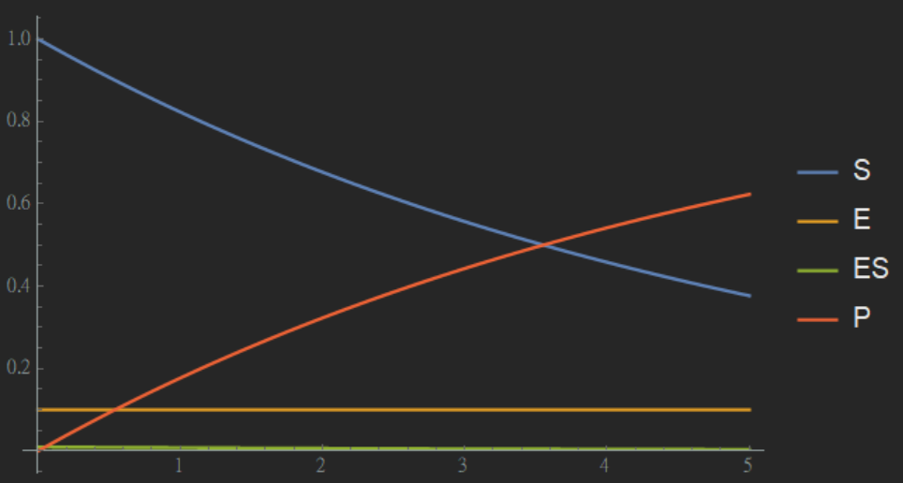
If satisfy
Reference
Test
Good SSA model

Slide 26
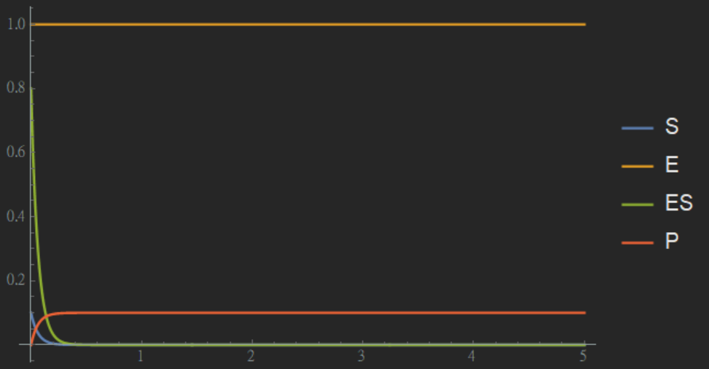
If satisfy
Reference
Test
Bad SSA model

Slide 27
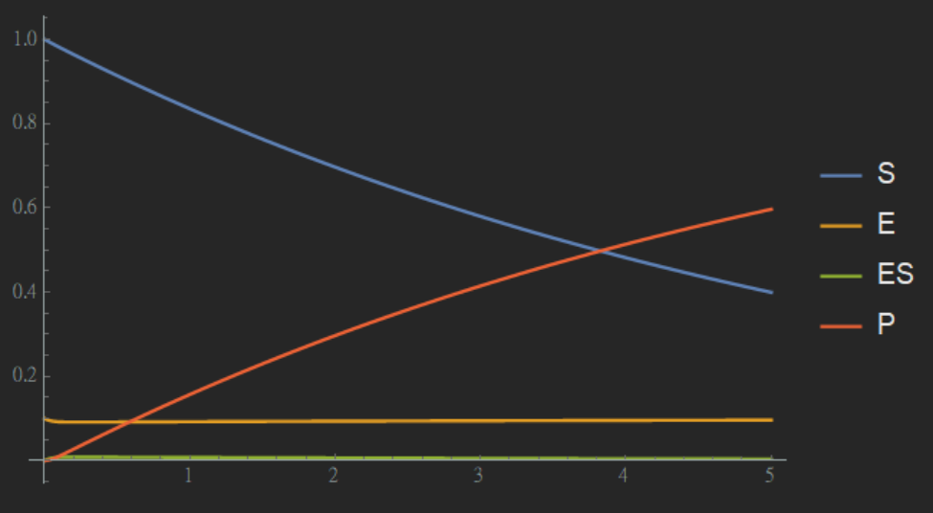
Test
PEA model
SSA model
The simulation still occur slightly different!

Slide 28
Reference
http://flashman.chem.ox.ac.uk/docs/Flashman_Enzymology_2nd_Year_L1.pdf
https://chem.libretexts.org/Bookshelves/Physical_and_Theoretical_Chemistry_Textbook_Maps/Supplemental_Modules_(Physical_and_Theoretical_Chemistry)/Kinetics/Rate_Laws/Reaction_Mechanisms/Reaction_Mechanisms/Reaction_Mechanisms_1
https://chem.libretexts.org/Bookshelves/Biological_Chemistry/Supplemental_Modules_(Biological_Chemistry)/Enzymes/Enzymatic_Kinetics/Michaelis-Menten_Kinetics

Slide 29
Reference
https://chem.libretexts.org/Bookshelves/Physical_and_Theoretical_Chemistry_Textbook_Maps/Supplemental_Modules_(Physical_and_Theoretical_Chemistry)/Kinetics/Rate_Laws/Reaction_Mechanisms/Steady_State_Approximation
https://chem.libretexts.org/Bookshelves/Physical_and_Theoretical_Chemistry_Textbook_Maps/Supplemental_Modules_(Physical_and_Theoretical_Chemistry)/Kinetics/Rate_Laws/Reaction_Mechanisms/Pre-equilibrium_Approximation
https://openwetware.org/wiki/IGEM:IMPERIAL/2007/Projects/Modelling/Tutorial

Slide 30
Reference
https://www.uscibooks.com/changten.pdf
https://slideplayer.com/slide/10037862/
https://www.ncbi.nlm.nih.gov/pubmed/15158492
https://www.ebi.ac.uk/interpro/potm/2004_2/Page2.htm

