Slide 1
CIVIC GUARD
GUIDE:MR.R.MATHUNITHI
TEAM MEMBERS:
ALWIN JOSEPH
SAKTHIVEL
KRISHNAKUMAR

Slide 2

AGENDA
Project Introduction​
Tools To be Used
​flow chart
Basic design
Front end design
Back end design
​Summary​

Slide 3
INTRODUCTION
ABSTRACT:
Web app: Facilitates user-friendly complaint submissions.
Interface: Allows detailed complaints with multimedia attachments.
Anonymity: Enables reporting without revealing identity.
Organization: Categorizes and tags complaints for efficiency.
Updates: Real-time mechanism keeps users informed.
Engagement: Encourages community involvement.
JavaScript: Provides dynamic data visualization.
Dashboard: Empowers administrators for effective management.
Data: Supports informed decision-making.
Proactive: Addresses public concerns with seamless experience.

Slide 4

TOOLS TO BE USED
……….

Slide 5




TOOLS
Flask is a micro web framework written in Python. It is classified as a microframework because it does not require particular tools or libraries.
HTML&CSS:It is a frontend tool used for making an web application .
PYTHON:It is a backend tool used as a connecting tool between frontend and database.
SQLLITE: It is database tool for storing the end user information.

Slide 6
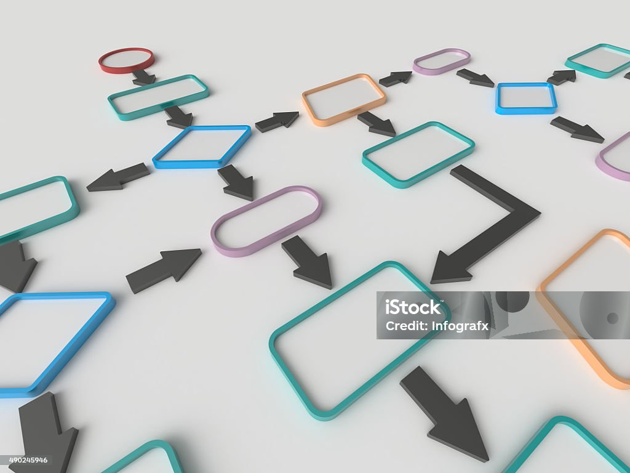
PROJECT FLOW CHART FOR LOGIN PAGE & HOME PAGE

Slide 7
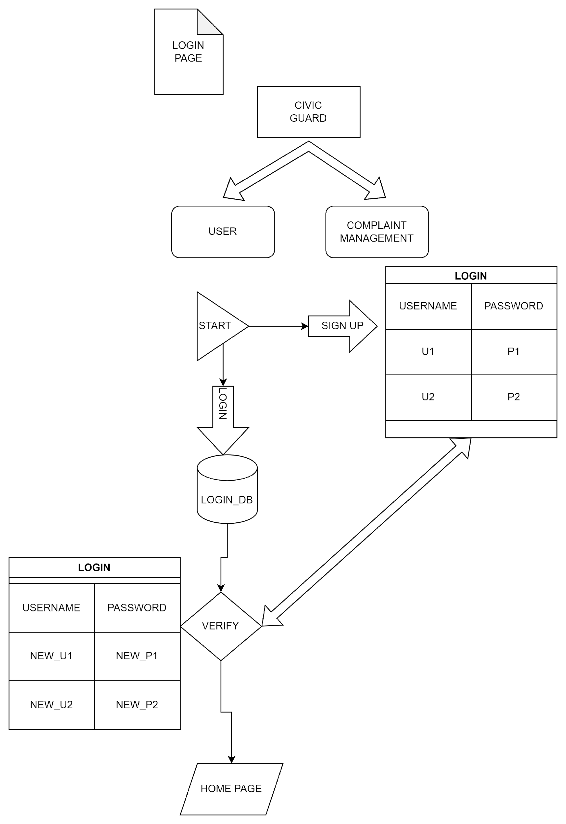
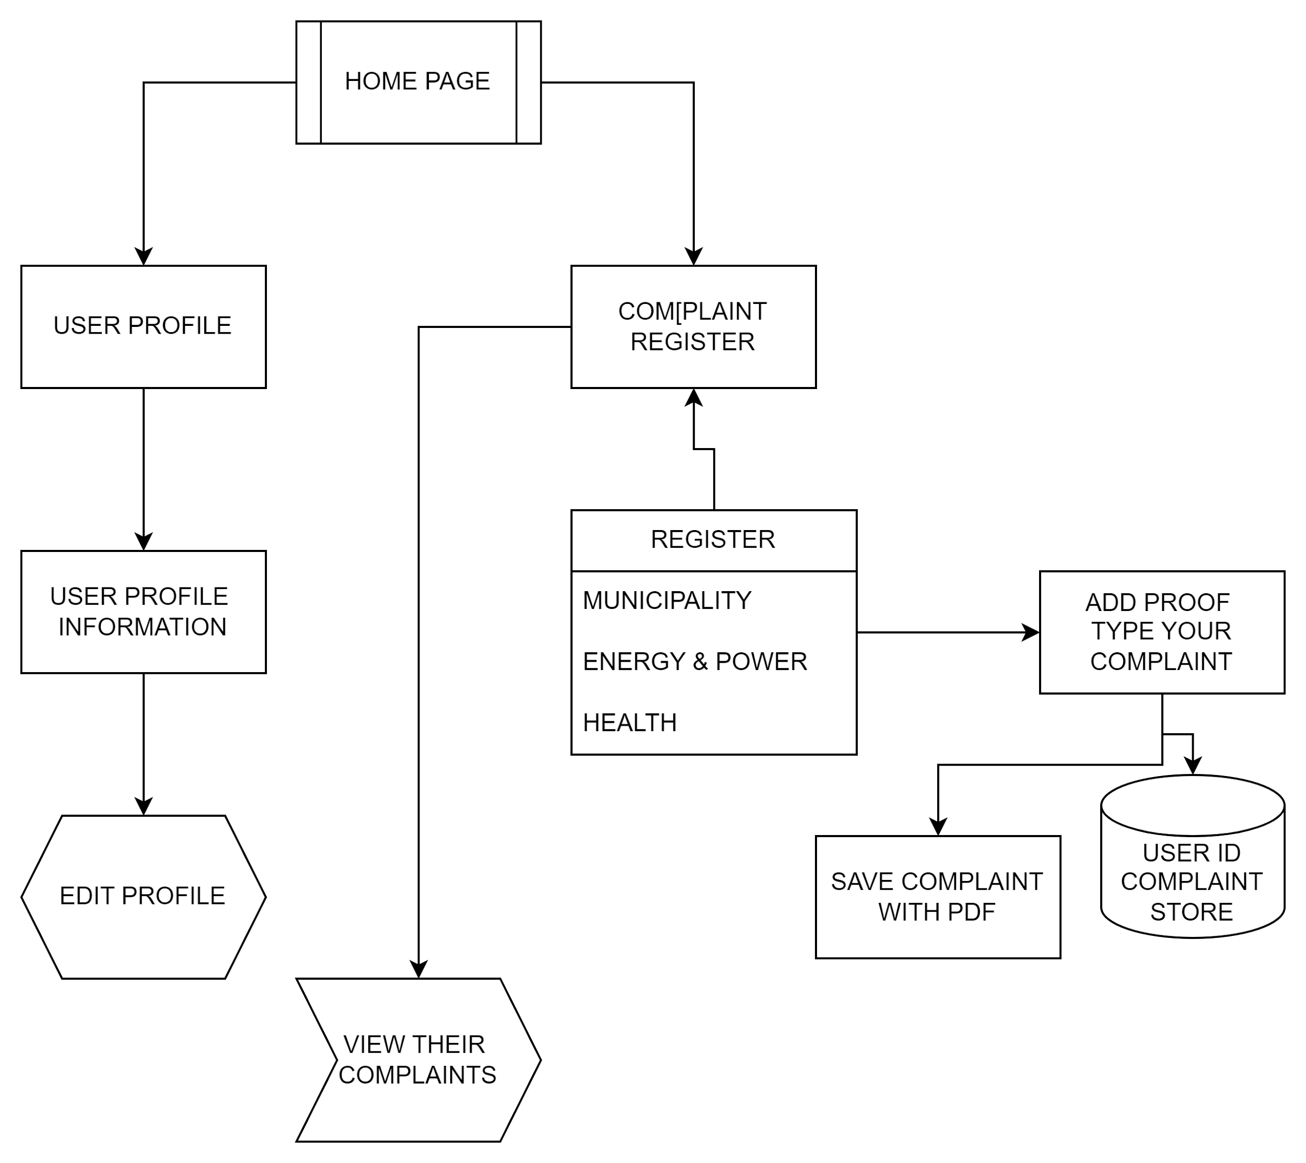

Slide 8
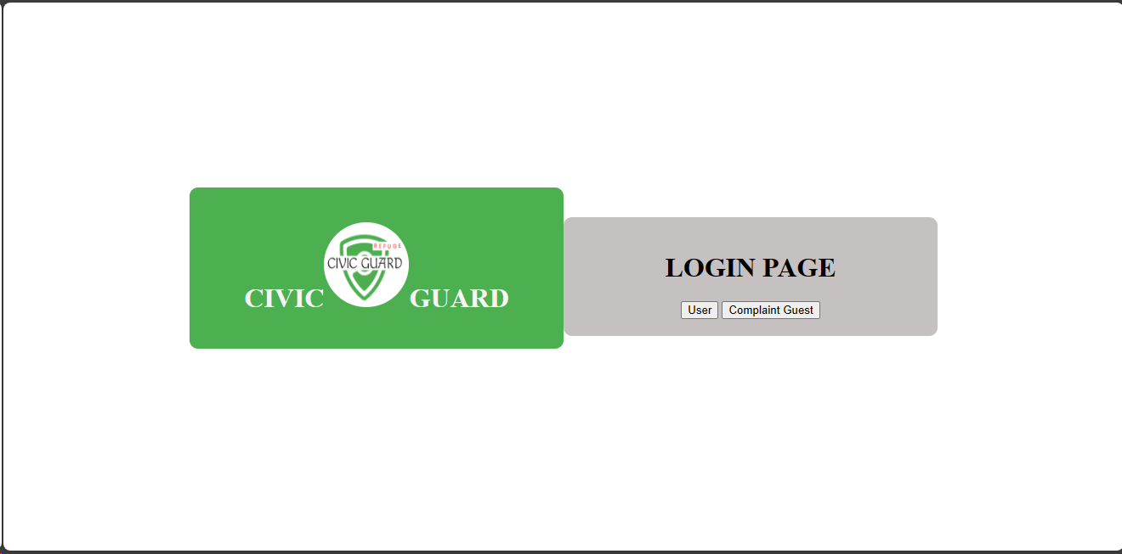
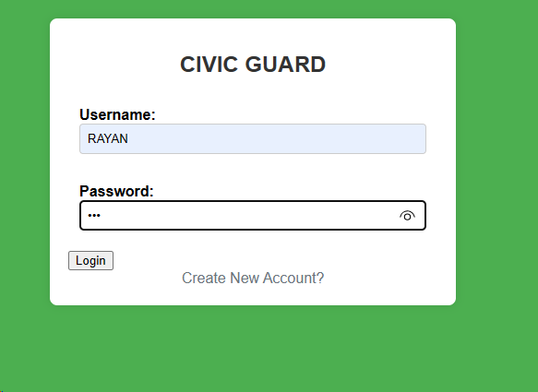
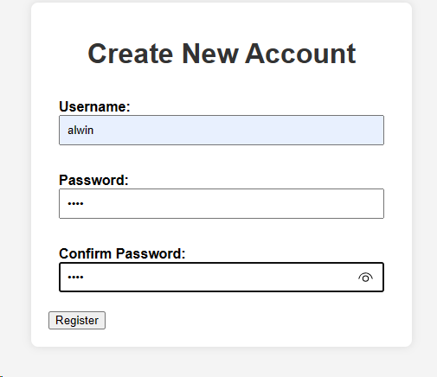
BASIC SAMPLE DESIGN

Slide 9
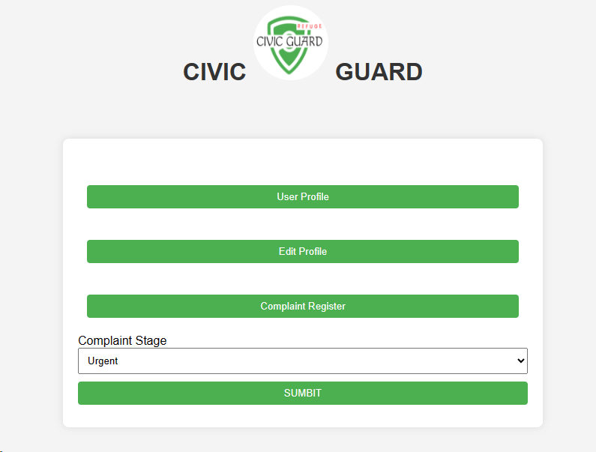
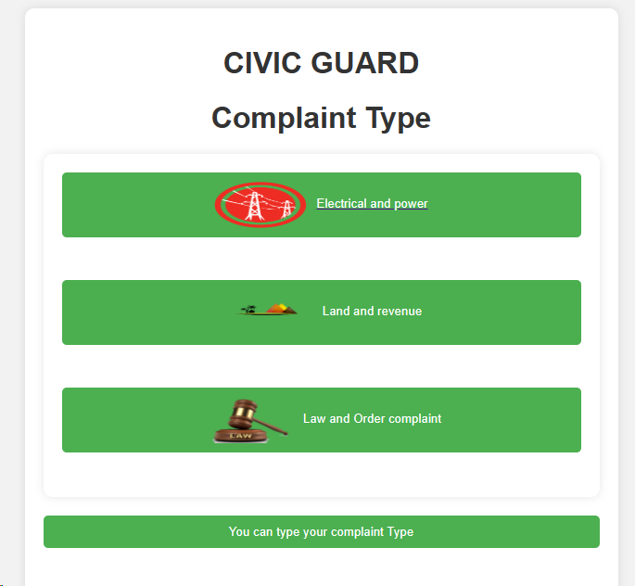
HOME PAGE DESIGN

Slide 10
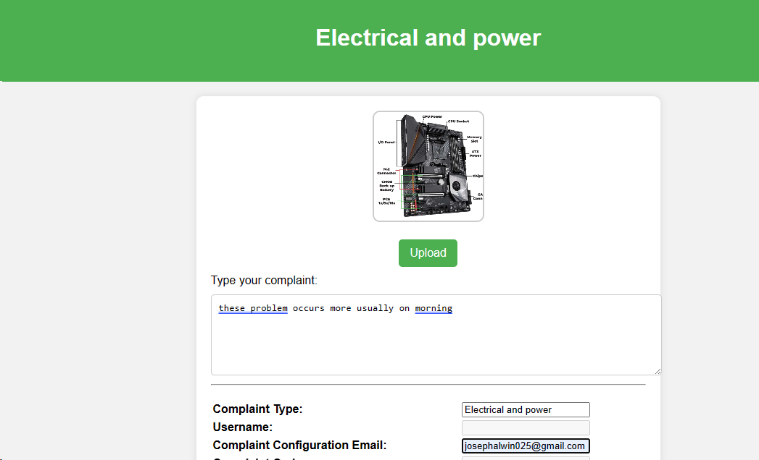
COMPLAINT REGISTER
For example of selecting any type of complaint
I selected the Electrical and power
We can able to select the proof photo
And the complaint description can able to type
Provide valid email for complaint

Slide 11
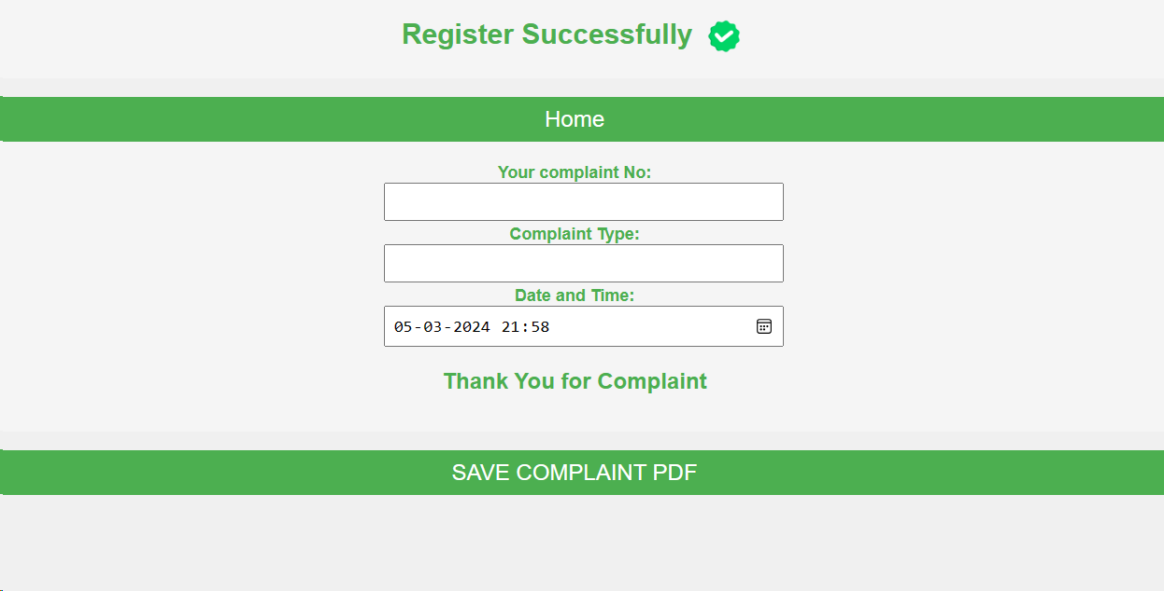
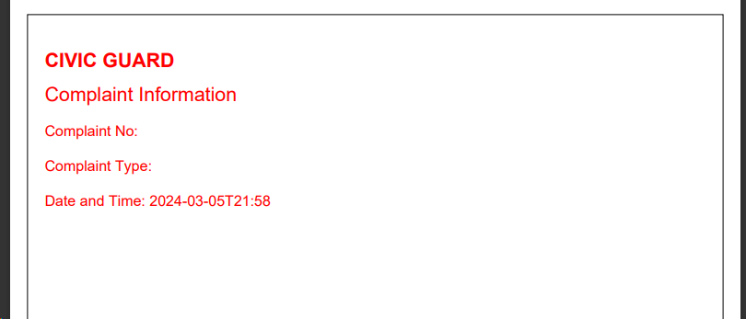
AFTER SUCCESSFULLY REGISTERED THE COMPLAINT
Can able to download the complaint information as document

Slide 12
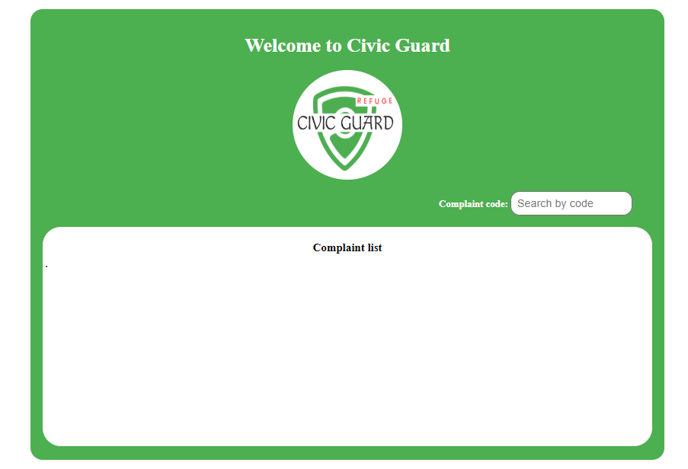
ON PROCCESSING OF GUEST COMPLAINT VIEW
The guest complaint view is dynamically add in the complaint list box .
Only the user knows the complaint code so they can easily find their complaints.
Other than user nobody can find the complaint posted person identity they only see all type of complaint information in this page.
So the user information is very secured in this application

Slide 13
SUMMARY & USAGE
PLANNING
DESIGNING
TOOLS
IDENTIFY,SETUP
FRONTEND
BACKEND
&DATBASE
COMPLETED
COMPLETED
COMPLETED
COMPLETED
ON PROCCESS

Slide 14
THANK YOU
BY:
CIVIC GUARD
TEAM MEMBERS
>L ALWIN JOSEPH
>M SAKTHIVEL
>C KRISHNAKUMAR

