Slide 1
SMS SPAM DETECTION
GROUP – F
Guided by: Meysam Effati

Slide 2
GROUP MEMBERS
Alwin Kannyakonil Scaria [c0894287]
Anisha Susan Mathew [c0907393]
Ashna Viji Alex [c0901082]
Jobin Philip [c0895950]
Mohamed Afthab [c0891945]

Slide 3
Introduction
The problem of spam detection is significant in SMS communication.
This project aims to build a predictive model to classify SMS messages as spam or not using natural language processing (NLP) and machine learning.

Slide 4
Dataset Overview
The dataset is sourced from the SMS Spam Collection. It contains SMS messages labeled as either 'ham' (legitimate) or 'spam'.

Slide 5
Data Preprocessing
Data Cleaning
Dropped unnecessary columns
Renamed column:
As class and text: where spam = 1 and ham = 0.

Slide 6
Text Preprocessing
Text Cleaning
Stop words removal
Stemming
PorterStemmer()

Slide 7
TRANSFORMATION
Vectorization
Text to Numerical Feature Vectors.
Data Splitting:
Splitting Data into X and y:
X represents the input features (i.e., the text of SMS messages).
y represents the target labels (i.e., spam or ham).

Slide 8
FEATURE ENGINEERING
Balancing Our Dataset with SMOTE:
Our SMS dataset has many more "ham" messages than "spam.“
This imbalance can cause the model to be biased toward "ham.“
Why Balance the Data?
To improve spam detection, we need a balanced dataset.
SMOTE Technique:
Purpose: SMOTE (Synthetic Minority Over-sampling Technique)
It generates synthetic "spam" messages by combining existing ones and balancing the dataset.

Slide 9
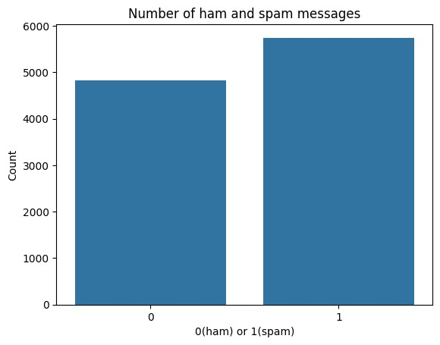

Slide 10
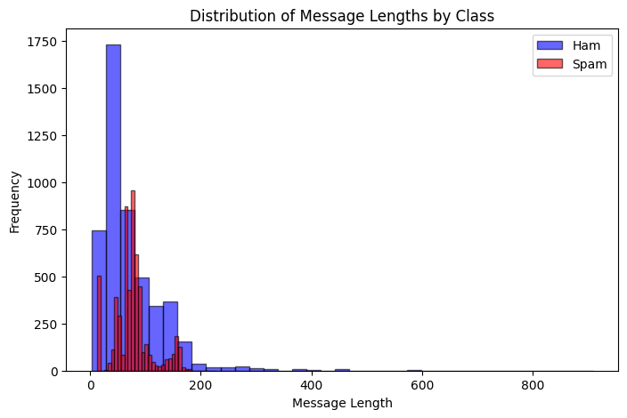

Slide 11
MODEL TRAINING
Classification models:
Logistic Regression
Naive Bayes Classifier
Random Forest Classifier
Gradient Boosting
SVM (Support Vector Machine)
Stochastic Gradient Descent.

Slide 12
Model Evaluation Metrics
Models were evaluated using accuracy, precision, recall, and F1-score.
Confusion matrices were used to understand the performance in detail.

Slide 13
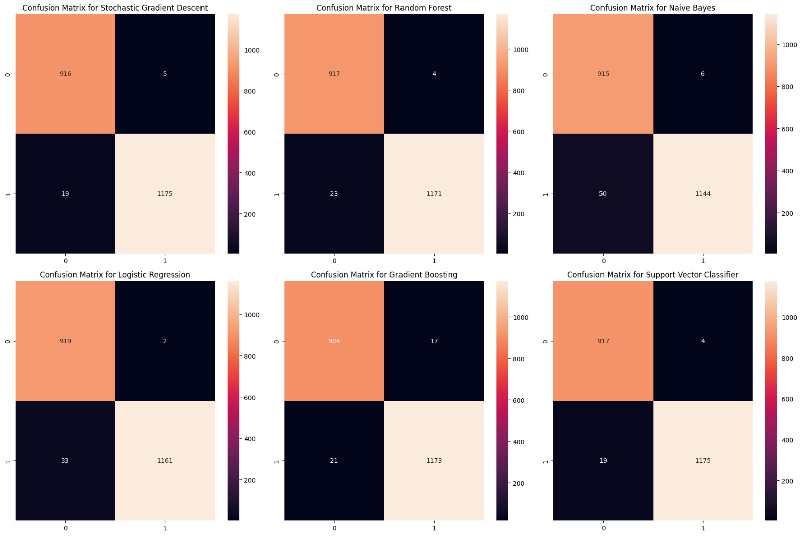
Comparative Analysis

Slide 14
Model Performance
Best Model: Support Vector Classifier
Key Metrics:
Accuracy: 98.91%
Precision: 98.82%
Recall: 98.99% (Best Performance)
The Support Vector Classifier is the most reliable model for SMS spam detection based on its highest recall and strong overall performance.

Slide 15
Model Deployment
This project is deployed on Oracle Cloud Infrastructure using the following technologies:
Oracle VM Instance: The virtual machine instance on Oracle Cloud where the application is hosted.
Flask: The web framework used to develop the application.
Gunicorn: A WSGI HTTP server for serving the Flask application in a production environment.
WSGI: The Web Server Gateway Interface standard used to interface between the web server and the Flask application.
Nginx: A high-performance web server used as a reverse proxy to handle incoming requests and serve the Flask application.

Slide 16
LIVE DEMO
SMS SPAM DETECTION

Slide 17
Limitations
The code struggles to accurately detect ambiguous messages that could be classified as either spam or ham.
Example: Messages like "Click here for iPhone" might be challenging for the model to categorize correctly due to the subtlety of the language and context.

Slide 18
Future Work
Advanced models like BERT, deeper NLP techniques, and further optimizing the real-time processing capabilities of the system can be implemented.

Slide 19
Conclusion
A machine-learning SMS spam detection model was developed and deployed using the flask application.
The Support Vector Classifier emerged as the most effective model, achieving the highest recall.
Addressed key challenges like class imbalance using SMOTE and improved model performance through feature engineering.
Future plans include implementing advanced models like BERT.

Slide 20

DEMO
http://detectsms.online

Slide 21
References
Chawla, N. V., Bowyer, K. W., Hall, L. O., & Kegelmeyer, W. P. (2002). SMOTE: Synthetic Minority Over-sampling Technique.
Pedregosa, F., Varoquaux, G., Gramfort, A., et al. (2011). Scikit-learn: Machine Learning in Python.

Slide 22

Thank You

