Slide 1

Personalized Workout & Diet Planner with AI
PRESENTED BY : ALWIN K SUNNY
COLLEGE NAME : VIDYA ACADEMY OF SCIENCE AND TECHNOLOGY, THRISSUR
DEPARTMENT :ELECTRONICS & COMMUNICATION ENGINEERING
COURSE NAME – AI/ML INTERNSHIP PROJECT – EDUNET FOUNDATION.

Slide 2
OUTLINE
1)Problem Statement
2)Proposed Solution
3)System Development Approach
4)Algorithm & Deployment
5)Result
6)Conclusion
7)Future Scope
8)References

Slide 3
❗PROBLEM STATEMENT
Most fitness apps give generic workout or diet plans that don’t consider individual student needs, cultural food habits, or available resources. Students require a system that generates personalized routines and meal plans using AI, ensuring they are practical, budget-friendly, and effective.

Slide 4
💡PROPOSED SOLUTION
Develop an AI-powered Personalized Workout & Diet Planning System for students.
Collect user-specific inputs such as age, weight, height, fitness goal, diet preference, budget, and available time.
Use AI logic to generate customized workout routines based on individual fitness levels.
Create personalized diet plans considering cultural food habits and affordability.
Provide budget-friendly meal recommendations using locally available food options.
Generate weekly schedules that balance workouts and nutrition effectively.
Offer practical plans that adapt to student lifestyle and time constraints.
Present results through a simple, interactive web-based interface.
Allow users to modify inputs and instantly regenerate updated plans.
Ensure recommendations are realistic, achievable, and health-focused.

Slide 5
⚙️ System Approach
The Personalized Workout & Diet Planner adopts an intelligent and user-centric system approach to help students maintain a healthy lifestyle in a practical and affordable manner. The process begins with an interactive user interface where students provide essential details such as age, height, weight, fitness goals, diet preferences, budget limits, and daily time availability. The system collects and organizes these inputs and processes them through an AI-driven recommendation engine. This engine analyzes user requirements and matches them with predefined workout routines, nutritional guidelines, and budget-friendly meal options. Based on this analysis, the system generates a fully personalized weekly workout schedule and diet plan tailored to individual needs and constraints. The results are presented in a simple, clear, and structured format, allowing users to easily follow the recommendations. The system also allows users to modify their inputs at any time, enabling dynamic plan regeneration. This modular and scalable approach ensures that students receive effective, realistic, and customized fitness guidance while maintaining ease of use and accessibility.

Slide 6
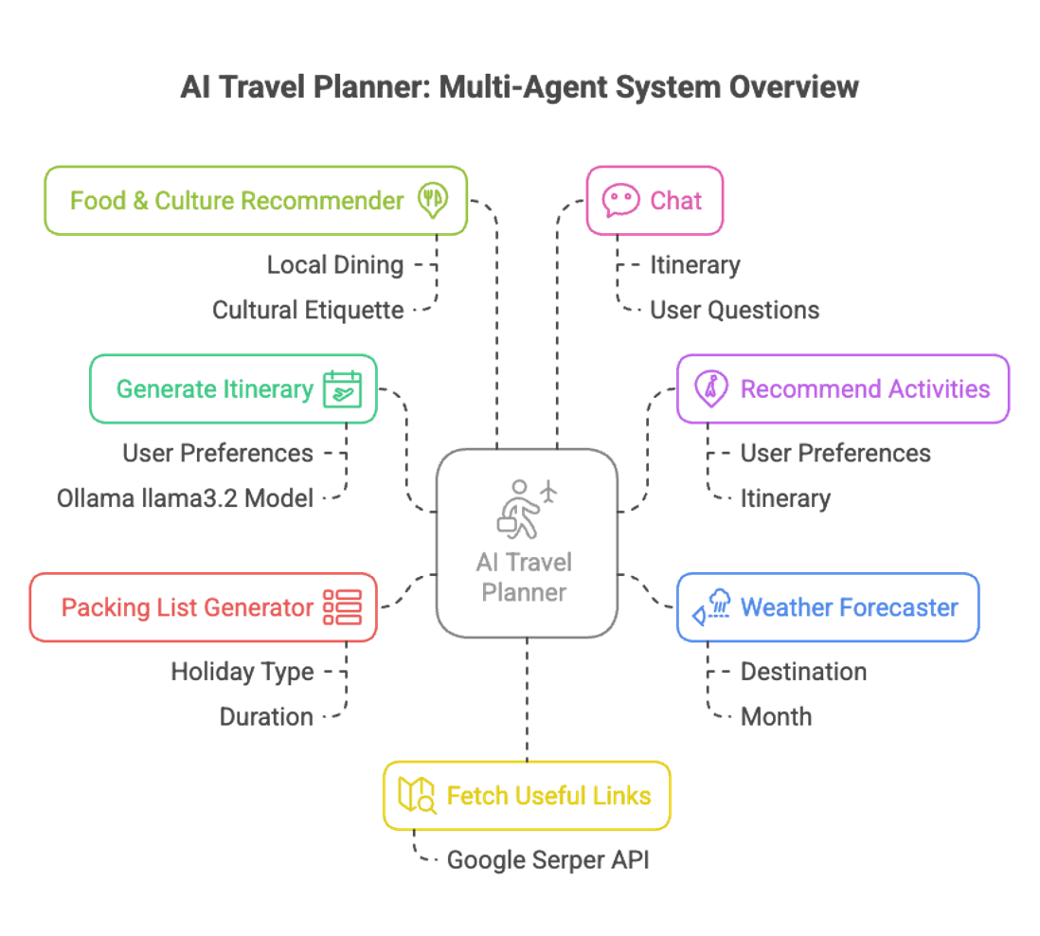
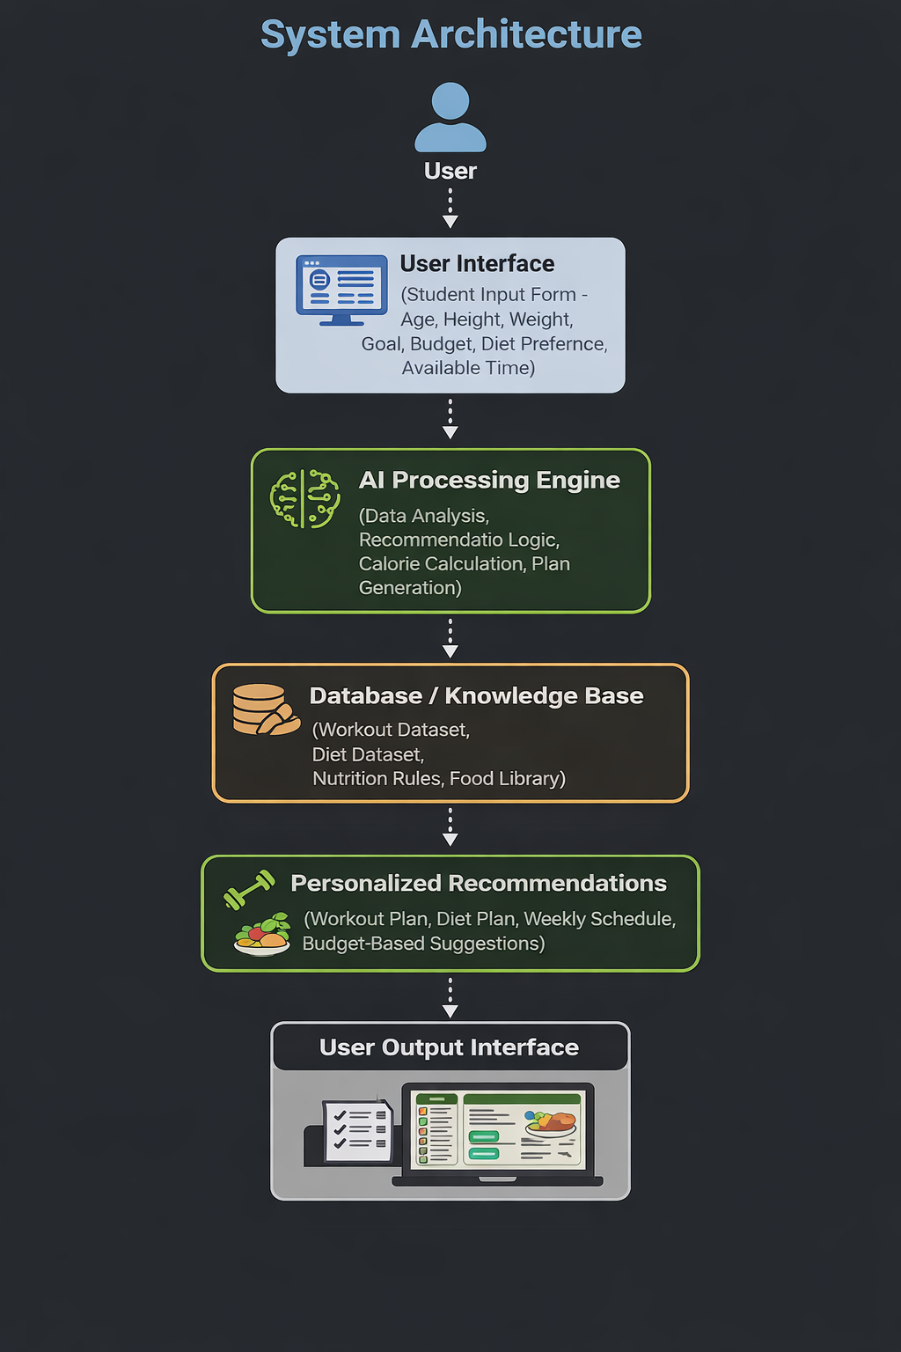
🏗️ System Architecture

Slide 7
🔍 Algorithm & Deployment
Algorithm
Accept user inputs such as age, height, weight, fitness goal, diet preference, budget, and available time.
Validate and preprocess the input data for accuracy and completeness.
Calculate user requirements including BMI, calorie needs, and fitness level.
Apply AI-based decision logic to analyze user goals and constraints.
Match user profile with appropriate workout routines from the workout database.
Generate diet recommendations based on cultural preference and budget.
Combine workout and diet plans to create a personalized weekly schedule.
Display structured recommendations through the user interface.
Allow users to modify inputs and regenerate updated plans dynamically.
.

Slide 8
Deployment
The system is developed as a web-based application using Python and Streamlit.
AI logic runs in real time to generate instant recommendations.
The application can be executed locally without additional software installation.
The project can be hosted on Streamlit Cloud or GitHub Pages for online access.
Supports easy updates and scalability for future enhancements.
Accessible from any device through a standard web browser.

Slide 9
Advantages
Provides personalized fitness & diet plans based on user goals and preferences.
Saves time by automating workout and meal planning, reducing guesswork.
Tailors plans according to fitness level, diet type, budget, and daily commitment.
Supports multiple health tools such as workout routines, diet charts, and progress tracking.
Enables anytime access via a web-based Streamlit interface.
Improves consistency and motivation through visual progress dashboards and interactive feedback.

Slide 10
RESULTS
Key Features & Functionality:
The system successfully generates personalized workout and diet plans based on individual user inputs.
Students receive customized weekly fitness schedules tailored to their goals and time availability.
Diet recommendations are created considering budget limits and cultural food preferences.
Users can instantly modify their details and regenerate updated plans in real time.
The application provides clear and structured output that is easy to understand and follow.
The system reduces dependency on generic fitness apps by delivering practical and realistic plans.
Overall, the project demonstrates effective use of AI for affordable and personalized health management.

Slide 11
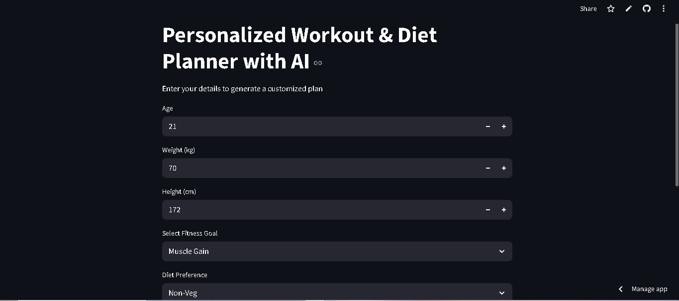
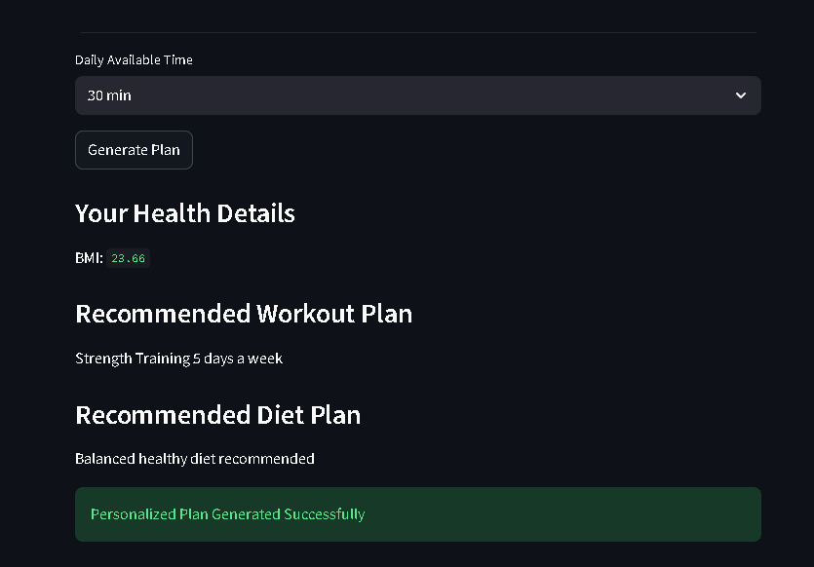
Project image

Slide 12
Conclusion
The Personalized Workout & Diet Planner project demonstrates how artificial intelligence can be effectively used to support student health and fitness management. By analyzing individual inputs such as fitness goals, dietary preferences, budget constraints, and available time, the system generates customized workout routines and diet plans tailored to each user. The project provides a practical, affordable, and user-friendly solution that helps students maintain a healthy lifestyle without the need for expensive trainers or generic applications. Through its interactive web-based interface and AI-driven recommendations, the system simplifies fitness planning and encourages consistency and better lifestyle habits. This project highlights the potential of AI in creating intelligent, personalized, and accessible wellness solutions for everyday use.

Slide 13
FUture scope
Integrate machine learning models to provide more intelligent and adaptive recommendations.
Add progress tracking and analytics to monitor user improvement over time.
Connect with wearable fitness devices for real-time health and activity data.
Implement AI-based calorie estimation from meals using image recognition.
Introduce multilingual support to serve students from diverse backgrounds.
Develop a mobile application version for better accessibility and convenience.
Add social features such as group challenges and peer motivation systems.

Slide 14
GithuB LINK
Repository root: https://github.com/alwinksunny/Personalized-Workout-Diet-Planner-AI
project link: https://workoutanddiet.streamlit.app/

Slide 15
📚 Reference
Streamlit Documentation – for building interactive web applications
https://docs.streamlit.io
Python Official Documentation – for core programming implementation
https://www.python.org/doc
World Health Organization (WHO) – fitness and nutrition guidelines
https://www.who.int
National Institute of Nutrition – dietary standards and recommendations
https://www.nin.res.in
American College of Sports Medicine – workout planning principles
https://www.acsm.org
Scikit-learn Documentation – machine learning techniques
https://scikit-learn.org

