Slide 1
Netflix Stock Profile V Dow Jones Industrial Average for 2017
By Alwin Solanky

Slide 2
A list of visulizations & my role
Distribution of Stock price per Quarter in 2017
Revenue V Earnings in 2017
Earned V Earnings per Share
Comparison of Netflix V Dow Jones
Interpreted the data and performed the analysis to produce this presentation, utilizing Jupyter notebooks and Python with packages of matplotlib, pandas and seaborn

Slide 3
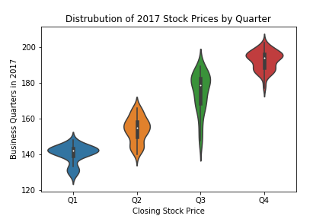
Visualization of the distribution of the stock prices for Netflix
Quarterly distributions
Distinct ‘Violins’

Slide 4
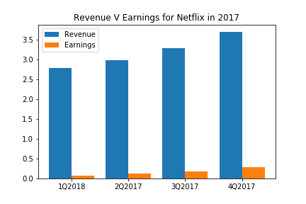
Visualization, summary of Netflix stock & revenue during past 4 quarters plus summary
Revenue Growth, about $500 million per Quarter
About 5% Revenue to Earnings
Revenue growth of $1.5 billion
Earnings growth of $300

Slide 5
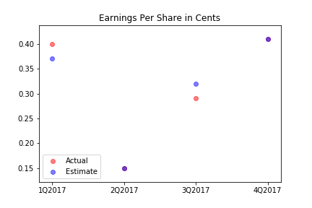
A visualization and a brief summary of their earned versus actual earnings per share
Earnings Per Share (EPS)
One share owned - $0.50 earned
Q2 & Q4 – EPS Estimated and Actual

Slide 6
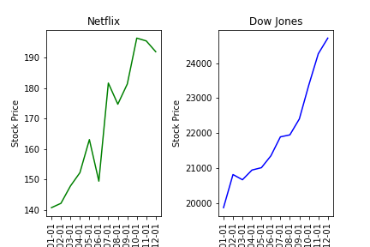
A visualization of Netflix stock against the Dow Jones stock in 2017
Better
More Volatile
About even

Slide 7
Thank You
Questions?

