Slide 1
IP SPOOFING
PRESENTED BY
ALWIN SONNY
S3 CSE A
ROLL.NO -12

Slide 2
Contents
Introduction
How IP Spoofing Works
Why IP Spoofing Is Used
Applications
Spoofing Attacks
Advantages
Disadvantages
Future Scope
Reference

Slide 3
Introduction
An IP (Internet Protocol) address is the address that reveals the identity of your Internet service provider and your personal Internet connection.
The address can be viewed during Internet browsing and in all of your correspondences that you send.

Slide 4
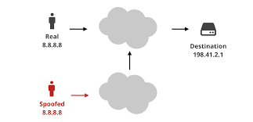
How IP Spoofing Works
When IP spoofing is used the information that is revealed on the source of the data is not the real source of the information. Instead the source contains a bogus IP address that makes the information packet look like it was sent by the person with that IP address.
If you try to respond to the information, it will be sent to a bogus IP address unless the hacker decides to redirect the information to real IP address.

Slide 5
Why IP Spoofing is Used
IP spoofing is used to commit criminal activity online and to breach network security. Hackers use IP spoofing so they do not get caught spamming and to perpetrate denial of service attacks.
The hacker does not get caught because the origin of the messages cannot be determined due to the bogus IP address.

Slide 6
Applications of IP spoofing
Many other attacks rely on IP spoofing mechanism to launch an attack, for example SMURF attack (also known as ICMP flooding) is when an intruder sends a large number of ICMP echo requests (pings) to the broadcast address of the reflector subnet.
The source addresses of these packets are spoofed to be the address of the target victim. For each packet sent by the attacker, hosts on the reflector subnet respond to the target victim, thereby flooding the victim network and causing congestion that results in a denial of service (DoS).

Slide 7
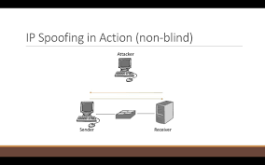
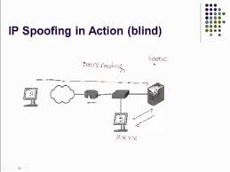
Spoofing Attacks
Non-Blind Spoofing :This type of attack takes place when the attacker is on the same subnet as the victim. The sequence and acknowledgement numbers can be sniffed, eliminating the potential difficulty of calculating them accurately. The biggest threat of spoofing in this instance would be session hijacking.
Blind Spoofing: This is a more sophisticated attack, because the sequence and acknowledgement numbers are unreachable. In order to circumvent this, several packets are sent to the target machine in order to sample sequence numbers.

Slide 8
Advantages
Multiple Servers : Sometimes you want to change where packets heading into your network will go. Frequently this is because you have only one IP address, but you want people to be able to get into the boxes behind the one with the `real' IP address.

Slide 9
Disadvantages
Blind to Replies: A drawback to ip source address spoofing is that reply packet will go back to the spoofed ip address rather than to the attacker. This is fine for many type of attack packet. However in the scanning attack as we will see next the attacker may need to see replies .in such cases, the attacker can not use ip address spoofing.

Slide 10
Future Scope
If the suggestion as given in my paper will be implemented practically; it is the most chances to free our internet from IP Spoofed Attack and also chances to explore my idea in future to enhance the security in the field of Internet & Network too.

Slide 11
REFERENCE
www.iplocation.net/ip-spoofing
www.techopedia.com/definition/3993/ip-spoofing
www.youtube.com/watch?v=zopRwR0yhlg

Slide 12
Thank You

