Slide 1


Tech ABC Corp - HR Database
[Alwyn Pinto & 21-Sept-2024]

Slide 2
Business Scenario
Business requirement
Tech ABC Corp saw explosive growth with a sudden appearance onto the gaming scene with their new AI-powered video game console. As a result, they have gone from a small 10 person operation to 200 employees and 5 locations in under a year. HR is having trouble keeping up with the growth, since they are still maintaining employee information in a spreadsheet. While that worked for ten employees, it has becoming increasingly cumbersome to manage as the company expands.
As such, the HR department has tasked you, as the new data architect, to design and build a database capable of managing their employee information.
Dataset
The HR dataset you will be working with is an Excel workbook which consists of 206 records, with eleven columns. The data is in human readable format, and has not been normalized at all. The data lists the names of employees at Tech ABC Corp as well as information such as job title, department, manager's name, hire date, start date, end date, work location, and salary.
IT Department Best Practices
The IT Department has certain Best Practices policies for databases you should follow, as detailed in the Best Practices document.

Slide 3
Step 1
Data Architecture Foundations

Slide 4
Step 1: Data Architecture Foundations
Hi,
Welcome to Tech ABC Corp. We are excited to have some new talent onboard. As you may already know, Tech ABC Corp has recently experienced a lot of growth. Our AI powered video game console WOPR has been hugely successful and as a result, our company has grown from 10 employees to 200 in only 6 months (and we are projecting a 20% growth a year for the next 5 years). We have also grown from our Dallas, Texas office, to 4 other locations nationwide: New York City, NY, San Francisco, CA, Minneapolis, MN, and Nashville, TN.
While this growth is great, it is really starting to put a strain on our record keeping in HR. We currently maintain all employee information on a shared spreadsheet. When HR consisted of only myself, managing everyone on an Excel spreadsheet was simple, but now that it is a shared document I am having serious reservations about data integrity and data security. If the wrong person got their hands on the HR file, they would see the salaries of every employee in the company, all the way up to the president.
After speaking with Jacob Lauber, the manager of IT, he suggested I put in a request to have my HR Excel file converted into a database. He suggested I reach out to you as I am told you have experience in designing and building databases. When you are building this, please keep in mind that I want any employee with a domain login to be have read only access the database. I just don't want them having access to salary information. That needs to be restricted to HR and management level employees only. Management and HR employees should also be the only ones with write access. By our current estimates, 90% of users will be read only.
I also want to make sure you know that am looking to turn my spreadsheet into a live database, one I can input and edit information into. I am not really concerned with reporting capabilities at the moment. Since we are working with employee data we are required by federal regulations to maintain this data for at least 7 years; additionally, since this is considered business critical data, we need to make sure it gets backed up properly.
As a final consideration. We would like to be able to connect with the payroll department's system in the future. They maintain employee attendance and paid time off information. It would be nice if the two systems could interface in the future
I am looking forward to working with you and seeing what kind of database you design for us.
Thanks,
Sarah Collins
Head of HR

Slide 5
Data Architect Business Requirement
Purpose of the new database:
Move the HR data from an Excel to a Database to account for growth of company and employee base. User level access to be granted to this database.
Describe current data management solution:
Currently the data is stored in an excel. HR will be loading the data into a Database. This DB will be made available to the Architect.
Describe current data available:
The current data in Excel has the following columns:
“EMP_ID, EMP_NM, EMAIL, HIRE_DT, JOB_TITLE, SALARY, DEPARTMENT, MANAGER, START_DT, END_DT, LOCATION, ADDRESS, CITY, STATE, EDUCTATION_LEVEL”
Additional data requests:
A growth of 20% YOY is expected which may take the empoyee count to appx 500.
Who will own/manage data
The HR will own the data and only HR and management level employees will have read/write access to the DB
Who will have access to database
90% of the users will have read only access. HR and management level employees will have read/write access.
Estimated size of database
The estimates show 20% YOY growth will be only 500 employees and the current partition of 1GB for the Database should suffice.
Estimated annual growth
20% YOY growth. 200 employee to grow to 500 employees by Year 6 of the company’s existence.
Is any of the data sensitive/restricted
Salary data to be accessed by HR only and by the specific department heads only.
Database backup:
Standard back of DB: 1 x per week
Archive: 1 x per month; Retain data for 2 years.
Critical: 1 x per week with daily incremental data backup

Slide 6
Data Architect Technical Requirement
Justification for the new database
Sharing a file among a larger number of users is not feasable.
Address data integrity and data security.
Sensitive data access to specific authorized individuals only.
Database objects
List the database objects (tables, views, special procedures) that will be created for the database.
Tables to be created: :
Employee: EMP_ID, EMP_NM, EMAIL, HIRE_DT, START_DT, END_DT, EDUCATION_LEVEL
Sensitive_Data: EMPL_ID, SALARY [possibly a view which is restricted to certain users only]
Job_Title: EMP_ID, JOB_TITLE
Manager: MANAGER_ID, MANAGER_NM
Department: DEPT_ID, MANAGER_ID
LOCATION: LOCATION_ID, LOCATION, ADDRESS, CITY, STATE.
Data ingestion:
Data Ingestion will be Direct Feed from a Database. The database from where the data is going to be ingested will have domain authenticated access and user will have necessary access.

Slide 7
Data Architect Technical Requirement
Data governance (Ownership and User access)
Ownership: The HR Head will have access to create new employees and view all sensitive data.
User Access:
The HR and Manager of every Dept will have access to read sensitive data of their respective direct reports.
All users will be have read only access to the entire database except for the sensitive information.
Scalability
Replication would be the best approach for scalability as the DB is going to be read heavy and since this is a regulated data and the need for disaster recovery is very important.
Other factors also include, high availability and fault tolerance.
Flexibility:
Future data integration will be done via Direct Feed and in some cases where continous feed is needed, an API will be considered depending on the outcome of a IT Security evaluation.
Flat files can also be considered if data is update reguarly and a ETL process can be setup to ingest.
Storage & retention
The data will be primarily stored on spinning disks.
As in-memory data is expensive, data can be stored on such for real time data related implementations.
Retention:
As required by federal regulations to maintain this data for at least 7 years.
Backup
Critical: Backup schedule is full backup 1x per week, incremental backup daily.

Slide 8
Step 2
Relational Database Design

Slide 9
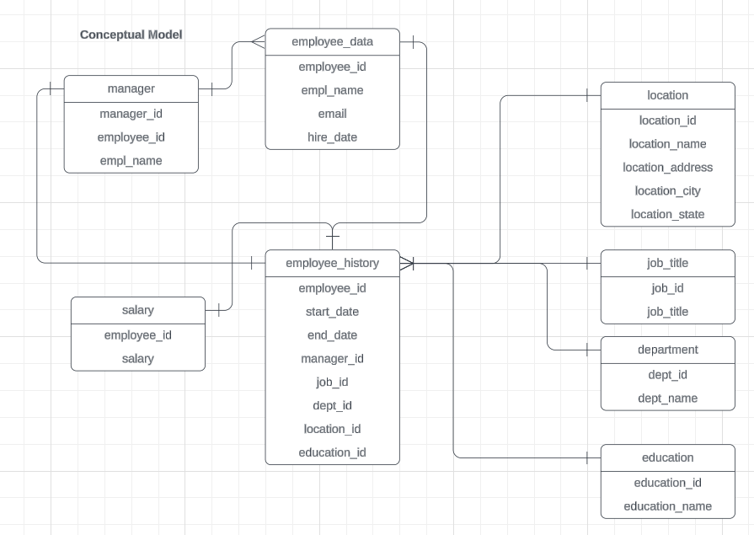
ERD
Conceptual

Slide 10
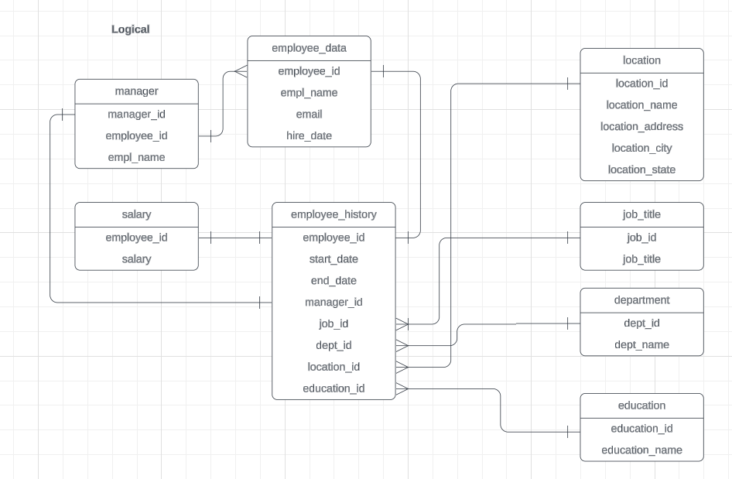
ERD
Logical

Slide 11
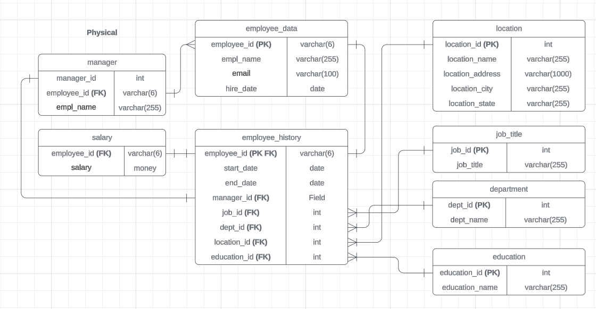
ERD
Physical

Slide 12
Step 3
Create A Physical Database

Slide 13
Step 3: Create A Physical Database
-- Create and insert into location
create table location(
location_id serial primary key,
location_name varchar(255),
location_address varchar(1000),
location_city varchar(255),
location_state varchar(255)
);
insert into location(location_name, location_address, location_city, location_state)
select distinct proj_stg.location, proj_stg.address, proj_stg.city, proj_stg.state from proj_stg;
-- create and insert job_title
create table job_title(
job_id serial primary key,
job_title varchar(255)
);
insert into job_title(job_title)
select distinct proj_stg.job_title from proj_stg;
-- create and insert department
create table department(
dept_id serial primary key,
dept_name varchar(255)
);
insert into department(dept_name)
select distinct proj_stg.department from proj_stg;
-- create and insert education:
create table education(
education_id serial primary key,
education_name varchar(255)
);
insert into education(education_name)
select distinct proj_stg.education_level from proj_stg;

Slide 14
-- create and insert into employee_data
create table employee_data(
empl_id varchar(6) primary key,
empl_name varchar(255),
empl_email varchar(255),
hire_dt date
);
insert into employee_data
select distinct proj_stg.empl_id, proj_stg.empl_name, proj_stg.email, proj_stg.hire_dt from proj_stg;
-- create and insert salary:
create table salary(
empl_id varchar(6) references employee_data(empl_id),
salary money
);
insert into salary(empl_id, salary)
select proj_stg.empl_id, proj_stg.salary from proj_stg;
-- create and insert manager table
create table manager (
manager_id serial primary key,
empl_id varchar(6) references employee_data(empl_id),
empl_name varchar(255)
);
insert into manager(empl_id, empl_name)
select proj_stg.empl_id, proj_stg.empl_name
from proj_stg
where job_title = 'Manager'
;

Slide 15
-- create mapping table employee_history
create table employee_history(
empl_id varchar(6) references employee_data(empl_id),
start_dt date,
end_dt date,
job_id int references job_title(job_id),
dept_id int references department(dept_id),
location_id int references location(location_id),
education_id int references education(education_id),
manager_id int references manager(manager_id)
);
insert into employee_history
select employee_data.empl_id,
proj_stg.start_dt,
proj_stg.end_dt,
job_title.job_id,
department.dept_id,
location.location_id,
education.education_id,
manager.manager_id
from proj_stg
join employee_data
on proj_stg.empl_id = employee_data.empl_id
join salary
on proj_stg.salary = salary.salary
join location
on proj_stg.location = location.location_name
join department
on proj_stg.department = department.dept_name
join education
on proj_stg.education_level = education.education_name
join job_title
on proj_stg.job_title = job_title.job_title
join manager
on proj_stg.manager = manager.empl_name
;
--select * from employee_history limit 30;

Slide 16
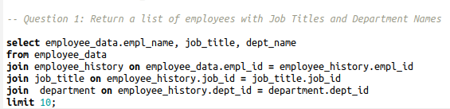
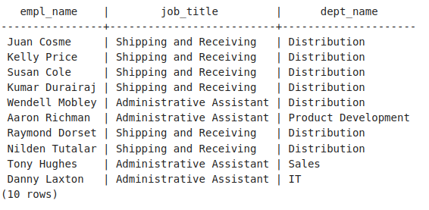
CRUD
Question 1: Return a list of employees with Job Titles and Department Names

Slide 17

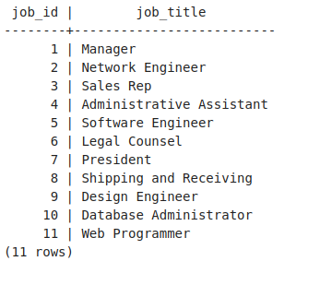
CRUD
Question 2: Insert Web Programmer as a new job title

Slide 18
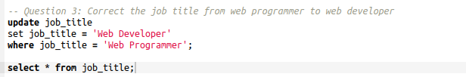
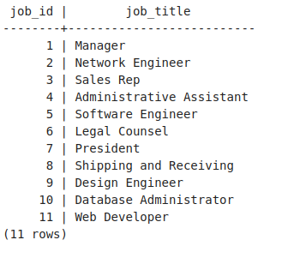
CRUD
Question 3: Correct the job title from web programmer to web developer

Slide 19
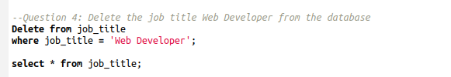
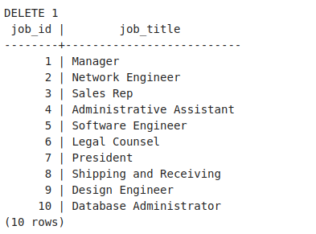
CRUD
Question 4: Delete the job title Web Developer from the database

Slide 20
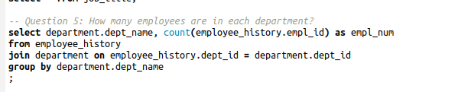
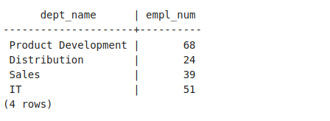
CRUD
Question 5: How many employees are in each department?

Slide 21
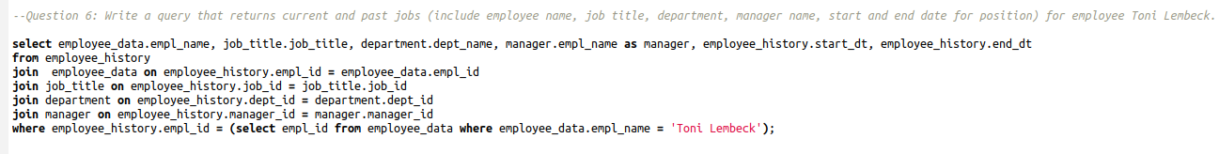
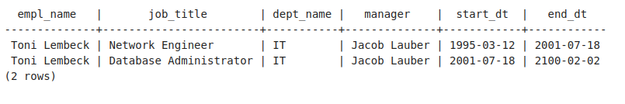
CRUD
Question 6: Write a query that returns current and past jobs (include employee name, job title, department, manager name, start and end date for position) for employee Toni Lembeck.

Slide 22
CRUD
Question 7: Describe how you would apply table security to restrict access to employee salaries using an SQL server.
>In my Model, the table/entity "salary" can be granted access to any one whose in the HR table and who is a Manager of a specific department.
>In addition, I would also grant access dept heads access to only their employees and not to all managers.

Slide 23
Step 4
Above and Beyond (optional)

Slide 24
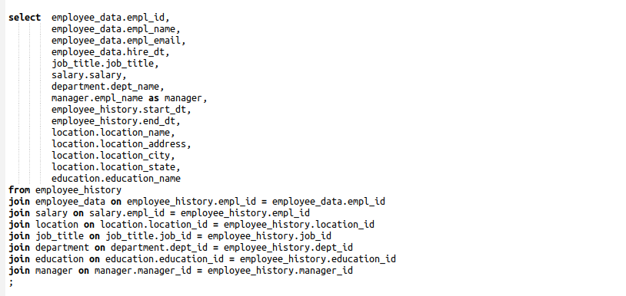
Standout Suggestion 1
Create a view that returns all employee attributes; results should resemble initial Excel file

Slide 25
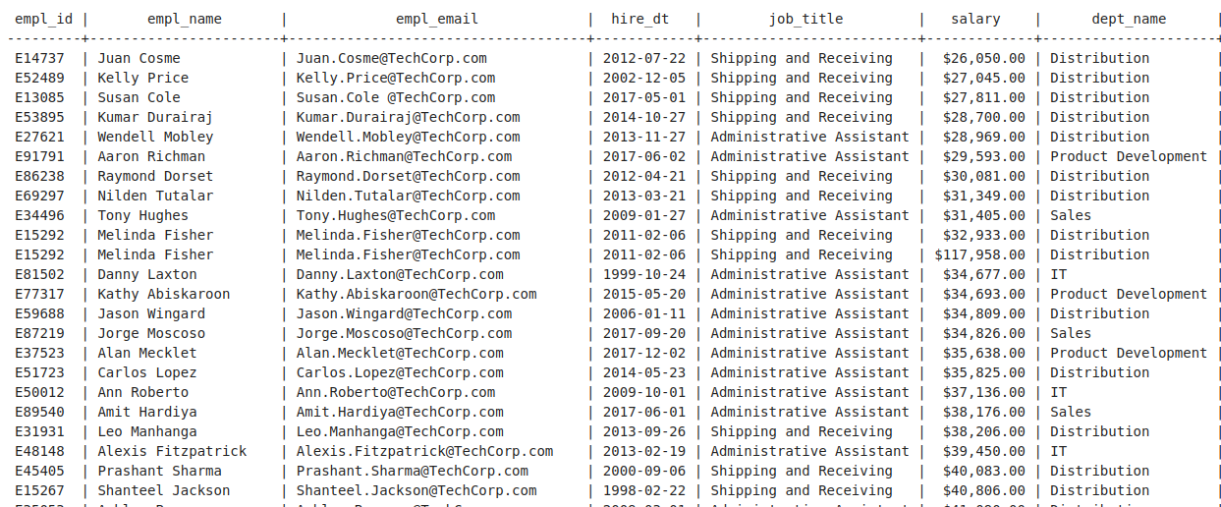
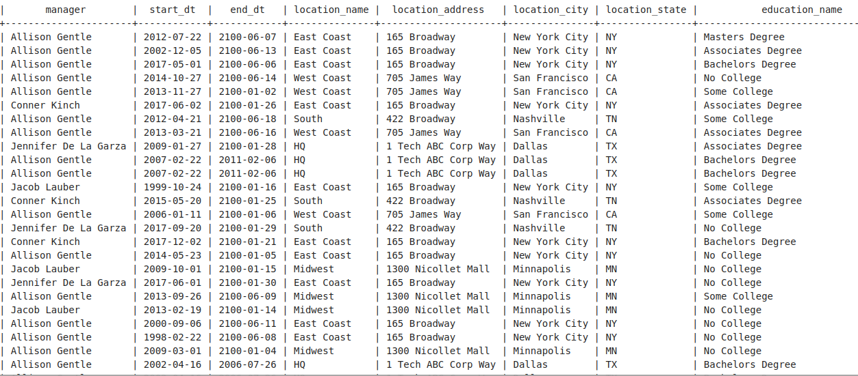
Standout Suggestion 1
Create a view that returns all employee attributes; results should resemble initial Excel file

Slide 26
Standout Suggestion 2
Create a stored procedure with parameters that returns current and past jobs (include employee name, job title, department, manager name, start and end date for position) when given an employee name.
** submit screenshot of stored procedure creation code, along with a screenshot of the stored procedure executed using Toni Lembeck as the parameter value

Slide 27
Standout Suggestion 3
Implement user security on the restricted salary attribute.
Create a non-management user named NoMgr. Show the code of how your would grant access to the database, but revoke access to the salary data.
Submit screenshot of code

Slide 28
Appendix

Slide 29
Additional Info
You can include supporting or additional information that supports your previous slides, but isn’t necessary for every person to see that looks at your slides.

