Slide 1
Reaching phase
High speed
Small forces
Manufacturing
Low speed
Large forces
Leg on the ground
Low speed
Large forces
Leg in the air
High speed
Small forces

Slide 2
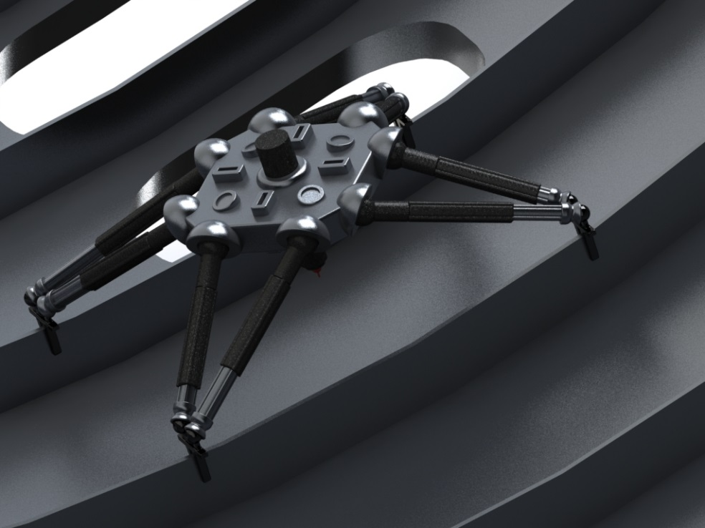

Slide 3
Motor
Force
50:1
selector
High force mode
(large reduction ratio)
output
High speed mode
(small reduction ratio)
1:1
Speed

Slide 4
Force manipulability ellipsoid
Velocity manipulability ellipsoid
High-speed mode
High-force mode
Full high-speed mode
Directional hybrid mode
Full high-force mode

Slide 5
Locomotion
Manufacturing
Directional high-force aligned with gravity load
Full high-speed mode
Full high-force mode

Slide 6
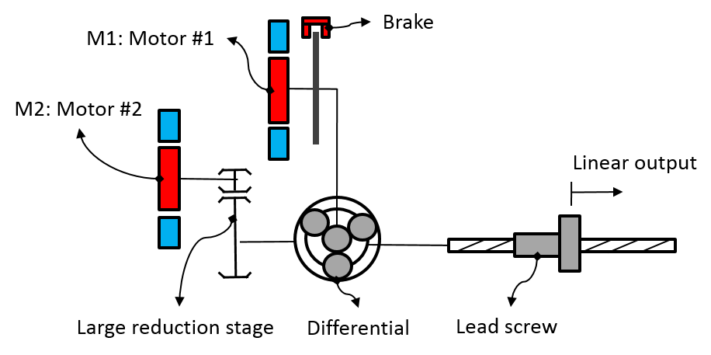
System level design
Long term view: Embedded architecture
Brake
Planetary differential
Winding 2
Reduction stage
Output shaft
Winding 1
Stator

Slide 7
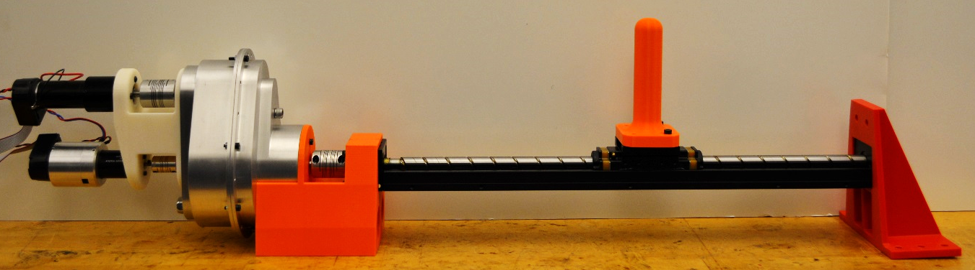
M2
3-ports gearbox
Output (handle)
Brake
M1
Lead Screw

Slide 8
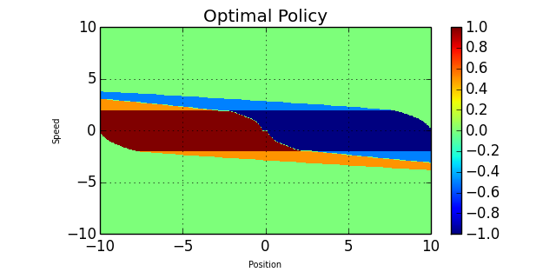
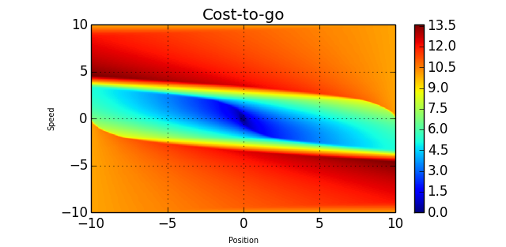

Slide 12


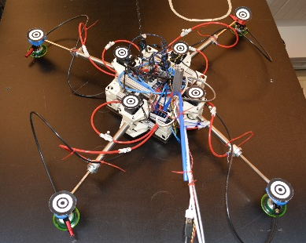
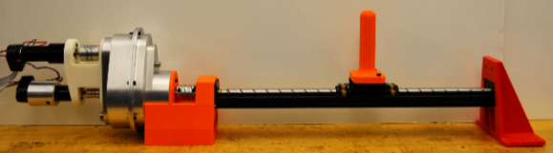
Thesis topic? outline for thesis propoal:
Control of robots using hybrid actuator (DSDM) with application to climbing manufacturing robot
 | Design | Control
High-level
Low-level
High force-to-weight ratio climbing robot architecture
Include the discrete gearshift input in the planning and control of the whole robot
2D climbing robot prototype
Explore model reduction techniques that work for hybrid system to simplify the control/planning
Focus?
Update the prototype with DSDM actuators
DSDM actuator technology
Novel nullspace controller
for seamless gearshifts
Proof-of-concept
Experimental demonstration
Product-like DSDM actuator design

Slide 13
Torque
Power
Efficiency
Speed
Large torque at low speed
High speed no load
reaching phases

Slide 14
M1: Motor #1
Brake
M2: Motor #2
Output
Large reduction stage
3-ports gearbox

Slide 15
Brake
Planetary differential
Winding 2
Reduction stage
Output shaft
Winding 1
Stator

Slide 16
Output
Locking
Brake
M2: Displacement source
M1: Force source

Slide 19
Force
High force mode region, M2 + brake ON
High speed mode region, both motors operating at the same time
Fail safe zone
Speed
M2 alone
M1 alone

Slide 20





















M1
$$τ_{1}$$
$$R_{1}$$
$$k_{m}I$$
$$J_{1}$$
$$V_{1}$$
$$I_{1}$$
$$E_{1}$$
$$b_{1}$$
$$k_{m}ω$$
$$τ_{ext}$$
M2
$$τ_{2}$$
$$R_{2}$$
$$J_{O}$$
$$k_{m}I$$
$$J_{2}$$
$$b_{O}$$
$$V_{2}$$
$$I_{2}$$
$$E_{2}$$
$$b_{2}$$
0-Junction
$$k_{m}ω$$

Slide 21
$$ω_{1}$$
$$\frac{1}{Z_{1}\left(s\right)}$$
$$I_{1}$$
$$k_{1}$$
+
-
$${1/R}_{1}$$
$${1/R}_{1}$$
$$τ_{o}$$
$$τ_{1}$$
$$ω_{O}$$
$$τ_{ext}$$
+
-
$$Z_{O}(s)$$
+
$$τ_{2}$$
$$τ_{o}$$
$${1/R}_{2}$$
$${1/R}_{2}$$
+
$$\frac{1}{Z_{2}\left(s\right)}$$
$$I_{2}$$
$$k_{2}$$
-
$$ω_{2}$$

Slide 22













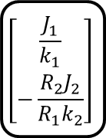



Torque limit
$$τ_{max}$$
Plant
Impedance target
+
+
$$τ_{d}$$
$$I_{1d}$$
$$I_{1e}$$
PWM
$$\frac{1}{R_{1}k_{1}}$$
$$\frac{k_{i}}{s}$$
M1 Drive
Position target
$$Z_{d}(s)$$
$$x_{d}$$
$$x_{e}$$
M1 current ($i_{1}$)
Current Sensor
$$\left[\begin{matrix}\frac{J_{1}}{k_{1}} \\ −\frac{R_{2}J_{2}}{R_{1}k_{2}}\end{matrix}\right]$$
Secondary objective
$$I_{2d}$$
$$I_{2e}$$
PWM
$$f(x)$$
$$\frac{k_{i}}{s}$$
M2 Drive
Feedback linearization
M2 current ($i_{2}$)
Current Sensor
Nullspace projection
Output position ($x)$
Position Sensor

Slide 23

Large load AND large desired impedance
$$w_{1}<ε$$
High-Speed mode + Braking law
Close Brake
Small load OR small desired impedance
High-Speed Mode
Release Brake
High-Force Mode

Slide 24
M2
3-ports gearbox
Output (handle)
Brake
M1
Lead Screw

