Slide 1





Dynamic system hierarchy
Examples
Tools
S
Simulation
Dynamic System (Mother class)
Car
Plane
$$\dot{x}=f\left(x,u,t\right)$$
$$y=h(x,u,t)$$
S
Phase plane
S
Modal analysis
2nd order
Drone
x
x
Linear System
Mechanical System
$$\dot{x}=Ax+Bu$$
$$y=Cx+Du$$
$$H\left(q\right)\ddot{q}+C\left(q,\dot{q}\right)\dot{q}+d\left(q,\dot{q}\right)+g\left(q\right)=B\left(q\right)u$$
S
2 DoF arm
Bode
Linearization
Kinematic
equations
Robot Manipulator
Transfer
Function
siso
$$H\ddot{q}+C\dot{q}+d+g=Bu+J^{T}f$$
$$y\left(s\right)=H\left(s\right) u(s)$$
$$r=k\left(q\right) \dot{r}=J\left(q\right) \dot{q}$$

Slide 2







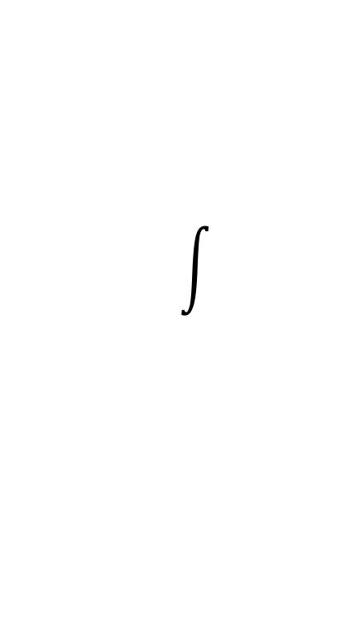

Dynamic System Core Architecture
input
states
output
$$u$$
$$x$$
$$y$$
$$\dot{x}=f\left(x,u,t\right)$$
$$y=h(x,u,t)$$
Graphic output
config.
$$q$$
lines
$$q\left(x,u,t\right)$$
$$fwd_kinematic$$

