Slide 1
Structural 8-bit ALU
A Verilog implementation: add / sub / Booth multiply / radix-2 divide
Computer Architecture • University Project
Repository: Structural-8bit-ALU
Structural 8-bit ALU • Verilog implementation
1 / 24

Slide 2
Agenda
What we will cover
• Project scope and external interface
• Top-level architecture and dataflow
• Control unit FSM (IDLE / LOAD / EXEC / DONE)
• Add/Subtract engine (carry-select adder + XOR word-gate)
• Booth radix-4 multiplier engine
• Radix-2 restoring divider engine
• Common structural building blocks
• Verification: testbench operations and example results
• Performance, latency and trade-offs
• Summary
Structural 8-bit ALU • Verilog implementation
2 / 24

Slide 3
1. Scope and Functional Definition
• Two 8-bit operands: A_raw, B_raw
• 2-bit opcode selects operation
• Unified 16-bit result bus
• Handshake protocol: start → done
• Status flags: carry_out, overflow (add/sub)
• Fully structural Verilog design
Opcode Map
00 → ADD result = A + B
01 → SUB result = A - B
10 → MUL result = A * B (signed)
11 → DIV result = {rem, quot}
Structural 8-bit ALU • Verilog implementation
3 / 24

Slide 4
2. External Interface (alu_top)
module alu_top (
input clk,
input rst,
input start,
input [1:0] opcode,
input [7:0] A_raw,
input [7:0] B_raw,
output wire [15:0] result,
output carry_out,
output overflow,
output done
);
• clk: rising-edge sampled
• rst: async, active high
• start: 1-cycle pulse OK
• opcode: 2-bit selector
• result: encoding depends on opcode
• done: asserted in DONE state
Structural 8-bit ALU • Verilog implementation
4 / 24

Slide 5
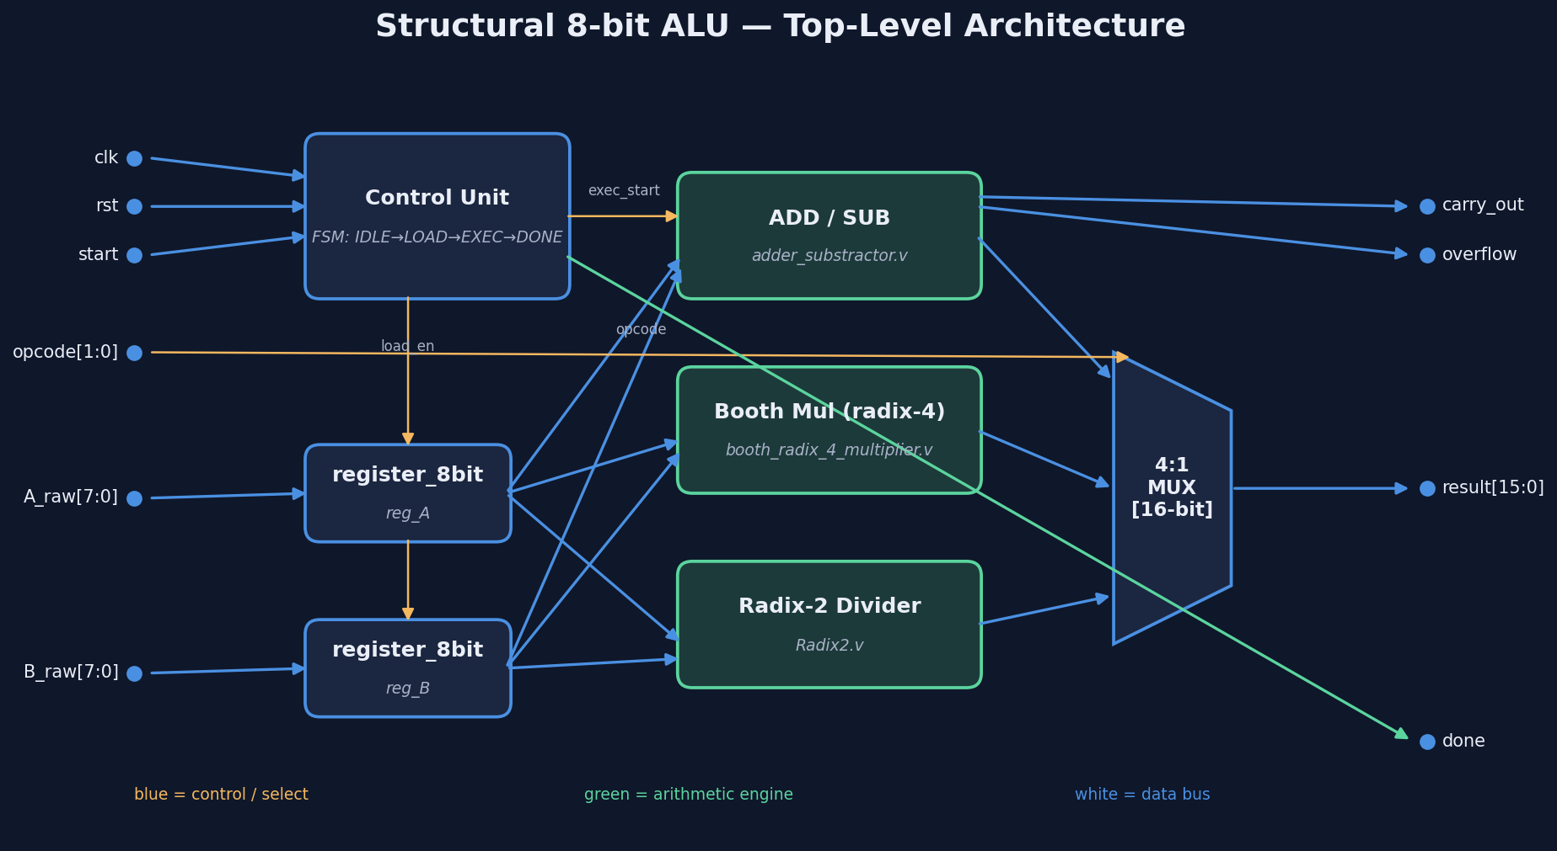
3. Top-Level Architecture
alu_top integrates control + datapath
• Opcode decode → engine select
• Operand capture in register_8bit (×2)
• Dispatch start to selected engine
• Merge engine busy/done into FSM
• Merge engine results into one bus
Structural 8-bit ALU • Verilog implementation
5 / 24

Slide 6
Architecture Diagram
Top-level block diagram
Structural 8-bit ALU • Verilog implementation
6 / 24

Slide 7
3.1 Top-Level Structural Composition
alu_top.v — module instantiations
control_unit brain (
.clk(clk), .rst(rst), .start(start),
.exec_done(effective_done), .exec_busy(effective_busy),
.load_en(load_en), .exec_start(exec_start), .done(done));
register_8bit reg_A (.clk(clk), .rst(rst), .load_en(load_en),
.data_in(A_raw), .data_out(A_internal));
register_8bit reg_B (.clk(clk), .rst(rst), .load_en(load_en),
.data_in(B_raw), .data_out(B_internal));
adder_substractor add_sub_unit (.clk(clk), .rst(rst), .start(exec_start),
.op1(A_internal), .op2(B_internal),
.enable(sel_addsub), .sub_mode(sel_sub),
.busy(addsub_busy), .done(addsub_done),
.c_out(addsub_cout), .overflow(addsub_overflow), .result(addsub_result));
booth_radix_4_multiplier mul_unit (.clk(clk), .rst(rst), .start(exec_start),
.multiplicand(A_internal), .multiplier(B_internal),
.enable(sel_mul), .busy(mul_busy), .done(mul_done), .product(mul_result));
radix2_div div_unit (.clk(clk), .reset(rst), .start(exec_start & sel_div),
.dividend(A_internal), .divisor(B_internal),
.quotient(div_quotient), .remainder(div_remainder),
.ready(div_ready), .done(div_done));
// Result MUX built from two structural mux2to1 instances
mux2to1 #(.w(16)) mux_result_muldiv (.in0(mul_result),
.in1({div_remainder, div_quotient}), .sel(opcode[0]), .out(result_muldiv));
mux2to1 #(.w(16)) mux_result (.in0({8'b0, addsub_result}),
.in1(result_muldiv), .sel(opcode[1]), .out(result));
Structural 8-bit ALU • Verilog implementation
7 / 24

Slide 8
4. Control Unit FSM
src/control/control_unit.v
localparam IDLE=2'b00, LOAD=2'b01,
EXEC=2'b10, DONE=2'b11;
reg [1:0] state, next_state;
always @(posedge clk or posedge rst)
if (rst) state <= IDLE;
else state <= next_state;
always @(*) case (state)
IDLE: next_state = start ? LOAD : IDLE;
LOAD: next_state = EXEC;
EXEC: next_state = exec_done ? DONE : EXEC;
DONE: next_state = start ? DONE : IDLE;
endcase
always @(*) begin
load_en = (state == LOAD);
exec_start = (state == EXEC) && !exec_busy && !exec_done;
done = (state == DONE);
end
• IDLE → wait for start
• LOAD → latch A_raw, B_raw
• EXEC → drive engine, wait for done
• DONE → assert top-level done
• Transitions on rising clk edge
• Async reset returns FSM to IDLE
Structural 8-bit ALU • Verilog implementation
8 / 24

Slide 9
5. Add / Subtract Engine
adder_substractor.v (structural)
// op2_xor = op2 XOR {8{sub_mode}}
xor_wordgate #(.w(8)) gate (
.in(op2), .bit_in(sub_mode), .out(op2_xor)
);
// 8-bit add: result = op1 + op2_xor + sub_mode
carry_select_adder add (
.op1(op1), .op2(op2_xor),
.c_in(sub_mode),
.result(adder_result),
.c_out(adder_c_out)
);
assign overflow_raw =
(op1[7] == op2_xor[7]) &&
(adder_result[7] != op1[7]);
• Two's complement add/sub
• sub_mode = 0: A + B
• sub_mode = 1: A + ~B + 1
• Carry-select adder core
• 1-cycle done pulse
• Status: carry, signed overflow
Structural 8-bit ALU • Verilog implementation
9 / 24

Slide 10
6. Booth Radix-4 Multiplier
booth_radix_4_multiplier.v (structural add path)
// Booth recoding selects operand and sub flag
case (y_ext[2:0])
3'b001,3'b010: begin booth_operand=x_shift; booth_sub=0; end
3'b011 : begin booth_operand=x2; booth_sub=0; end
3'b100 : begin booth_operand=x2; booth_sub=1; end
3'b101,3'b110: begin booth_operand=x_shift; booth_sub=1; end
default : begin booth_operand=16'b0; booth_sub=0; end
endcase
// 16-bit accumulate built from two 8-bit carry-select adders
xor_wordgate #(.w(8)) inv_lo (.in(booth_operand[7:0]),
.bit_in(booth_sub), .out(booth_operand_xor[7:0]));
xor_wordgate #(.w(8)) inv_hi (.in(booth_operand[15:8]),
.bit_in(booth_sub), .out(booth_operand_xor[15:8]));
carry_select_adder add_lo (.op1(acc[7:0]), .op2(booth_operand_xor[7:0]),
.c_in(booth_sub), .result(add_lo_result), .c_out(add_lo_cout));
carry_select_adder add_hi (.op1(acc[15:8]), .op2(booth_operand_xor[15:8]),
.c_in(add_lo_cout),.result(add_hi_result), .c_out(add_hi_cout));
• Signed 8×8 → 16-bit
• 4 recoding iterations
• FSM: IDLE → CALC → FINISH
• Reduces partial products vs. shift-add
• Native signed arithmetic
Structural 8-bit ALU • Verilog implementation
10 / 24

Slide 11
7. Radix-2 Restoring Divider
Radix2.v (structural sub & restore)
// shifted_A = {A[W-2:0], Q[W-1]}
wire [WIDTH-1:0] shifted_A = {A[WIDTH-2:0], Q[WIDTH-1]};
// M_inv = ~M (for two's-complement subtract)
xor_wordgate #(.w(WIDTH)) neg_m (
.in(M), .bit_in(1'b1), .out(M_inv));
// Trial subtract: shifted_A - M = shifted_A + ~M + 1
carry_select_adder sub_adder (
.op1(shifted_A), .op2(M_inv), .c_in(1'b1),
.result(sub_result), .c_out(sub_cout));
// Restore path: sub_result + M (used when subtract was negative)
carry_select_adder restore_adder (
.op1(sub_result), .op2(M), .c_in(1'b0),
.result(restore_result), .c_out());
• Unsigned, WIDTH = 8
• Registers: A (rem), M (div), Q (quot)
• 1 quotient bit per cycle (8 cycles)
• Result = {remainder, quotient}
• No divide-by-zero exception
Structural 8-bit ALU • Verilog implementation
11 / 24

Slide 12
8. Common Structural Blocks
src/common/
• full_adder_cell — 1-bit full adder primitive
• ripple_carry_adder — parameterized ripple chain
• adder_level — dual-carry precompute/select stage
• carry_select_adder — 8-bit ripple + carry-select
• xor_wordgate — word-wise XOR with replicated control
• mux2to1 — generic 2:1 mux
• register_8bit — operand storage register
// carry_select_adder.v (8-bit, structural)
module carry_select_adder(
input [7:0] op1, op2,
input c_in,
output [7:0] result,
output c_out);
wire c_mid;
ripple_carry_adder #(.w(4)) least_significand_part (
.op1(op1[3:0]), .op2(op2[3:0]),
.c_in(c_in),
.result(result[3:0]), .c_out(c_mid));
adder_level most_significand_part (
.op1(op1[7:4]), .op2(op2[7:4]),
.c_in(c_mid),
.result(result[7:4]), .c_out(c_out));
endmodule
Structural 8-bit ALU • Verilog implementation
12 / 24

Slide 13
9. End-to-End Functional Timing
• 1. start asserted with stable A_raw, B_raw, opcode
• 2. Control enters LOAD → operands latched
• 3. Control enters EXEC → exec_start to engine
• 4. Engine asserts local done
• 5. Control enters DONE → top-level done = 1
• 6. Caller deasserts start → return to IDLE
Structural 8-bit ALU • Verilog implementation
13 / 24

Slide 14
10. Performance & Latency
Clock period = 10 ns
Operation Engine cycles Top-level cycles Time @10ns
ADD 1 4 40 ns
SUB 1 4 40 ns
MUL 6 9 90 ns
DIV 9 12 120 ns
• Add/Sub fastest: combinational datapath + handshake
• Mul: 4 Booth iterations (radix-4 reduces count)
• Div: 1 quotient bit per cycle + restore overhead
Structural 8-bit ALU • Verilog implementation
14 / 24

Slide 15
11. Verification — Integrated Testbench
sim/alu_tb.v
task run_op;
input [7:0] in_a, in_b;
input [1:0] in_op;
input [15:0] expected;
input [8*20-1:0] label;
begin
@(negedge clk);
A_raw=in_a; B_raw=in_b; opcode=in_op; start=1'b1;
@(negedge clk); start=1'b0;
wait (done == 1'b1); #1;
if (result !== expected)
$fatal(1, "FAIL [%s]", label);
else
$display("PASS [%0s]: A=%0d B=%0d result=%0d",
label, in_a, in_b, result);
wait (done == 1'b0);
end
endtask
• Drives all 4 opcodes
• Edge cases: 0, wrap, signed
• Self-checking: exp vs got
• Halts on FAIL via $fatal
• Generates alu_sim.vcd
Structural 8-bit ALU • Verilog implementation
15 / 24

Slide 16
11.1 Test Vectors Overview
// ADD (opcode 00)
ADD 5+3 → 8
ADD 100+55 → 155
ADD 255+1 wrap → 0
ADD 128+128 wrap → 0
// SUB (opcode 01)
SUB 10-4 → 6
SUB 0-1 wrap → 255
SUB 200-50 → 150
// MUL (opcode 10, signed Booth)
MUL 7*6 → 42
MUL 15*15 → 225
MUL 127*2 → 254
MUL -1*2 signed → 0xFFFE
// DIV (opcode 11) → {rem, quot}
DIV 42/6 → {0, 7}
DIV 17/5 → {2, 3}
DIV 255/16 → {15, 15}
DIV 100/7 → {2, 14}
Structural 8-bit ALU • Verilog implementation
16 / 24

Slide 17
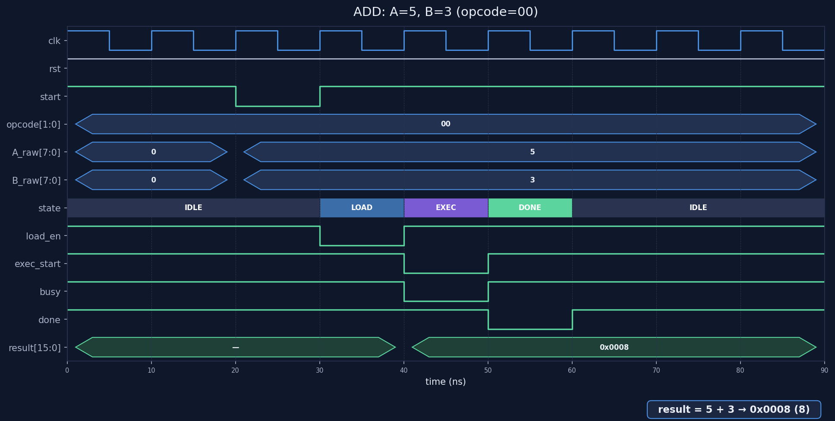
Example: ADD 5 + 3
Expected result = 8
run_op(8'd5, 8'd3, 2'b00,
16'd8, "ADD 5+3");
PASS [ADD 5+3]:
A=5 B=3
result=8 (0x0008)
carry=0 ovf=0
Cycle-accurate waveform of the ADD operation
Structural 8-bit ALU • Verilog implementation
17 / 24

Slide 18

Example: SUB 10 - 4
Expected result = 6
run_op(8'd10, 8'd4, 2'b01,
16'd6, "SUB 10-4");
PASS [SUB 10-4]:
A=10 B=4
result=6 (0x0006)
carry=1 ovf=0
Cycle-accurate waveform of the SUB operation
Structural 8-bit ALU • Verilog implementation
18 / 24

Slide 19
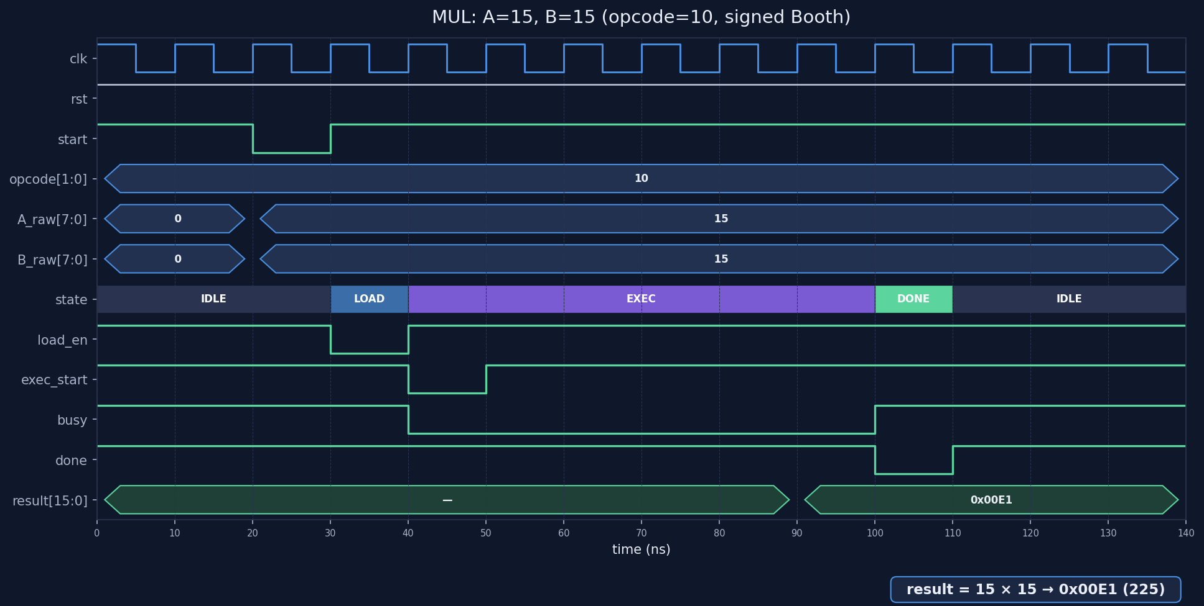
Example: MUL 15 × 15
Expected result = 225
run_op(8'd15, 8'd15, 2'b10,
16'd225, "MUL 15*15");
PASS [MUL 15*15]:
A=15 B=15
result=225 (0x00E1)
Booth radix-4 multiplier (6 EXEC cycles)
Structural 8-bit ALU • Verilog implementation
19 / 24

Slide 20
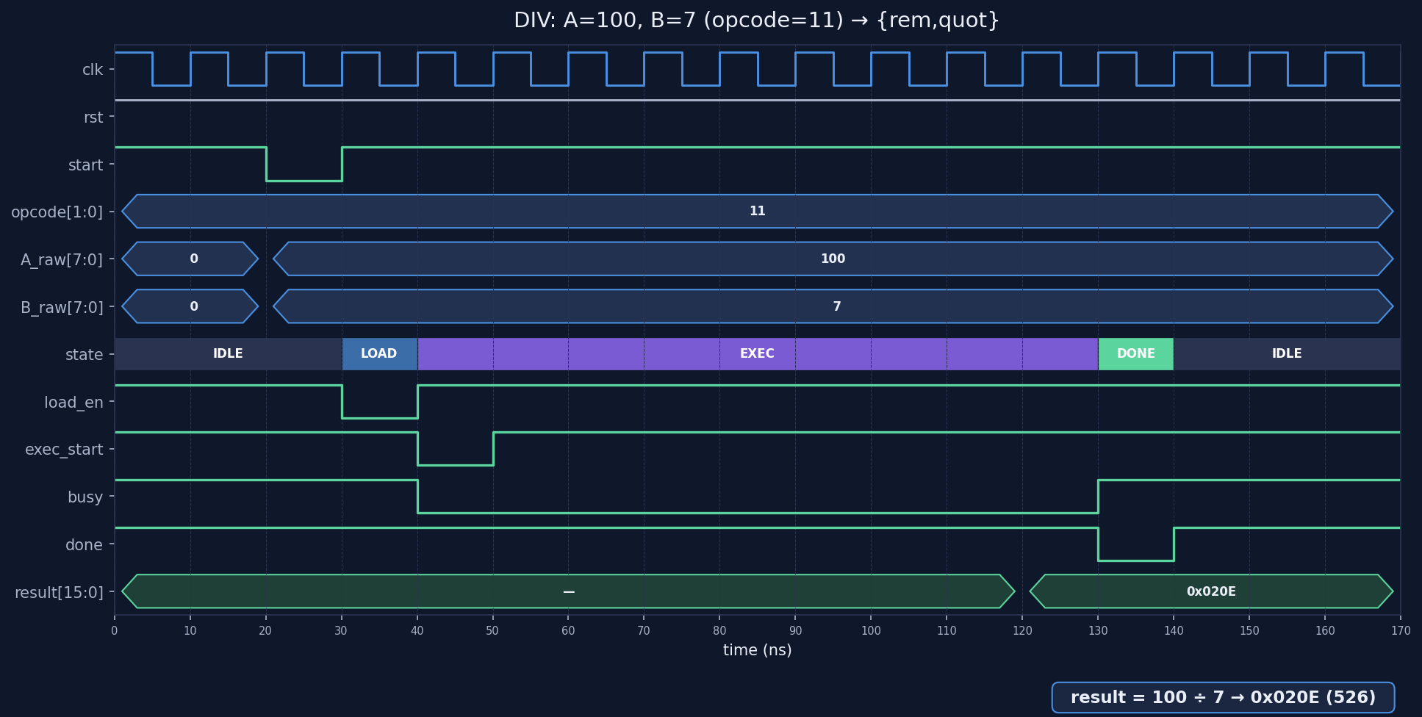
Example: DIV 100 / 7
Expected = {rem=2, quot=14}
run_op(8'd100, 8'd7, 2'b11,
{8'd2, 8'd14}, "DIV 100/7");
PASS [DIV 100/7]:
A=100 B=7
result=0x020E
rem=2 quot=14
Radix-2 restoring divider (9 EXEC cycles)
Structural 8-bit ALU • Verilog implementation
20 / 24

Slide 21
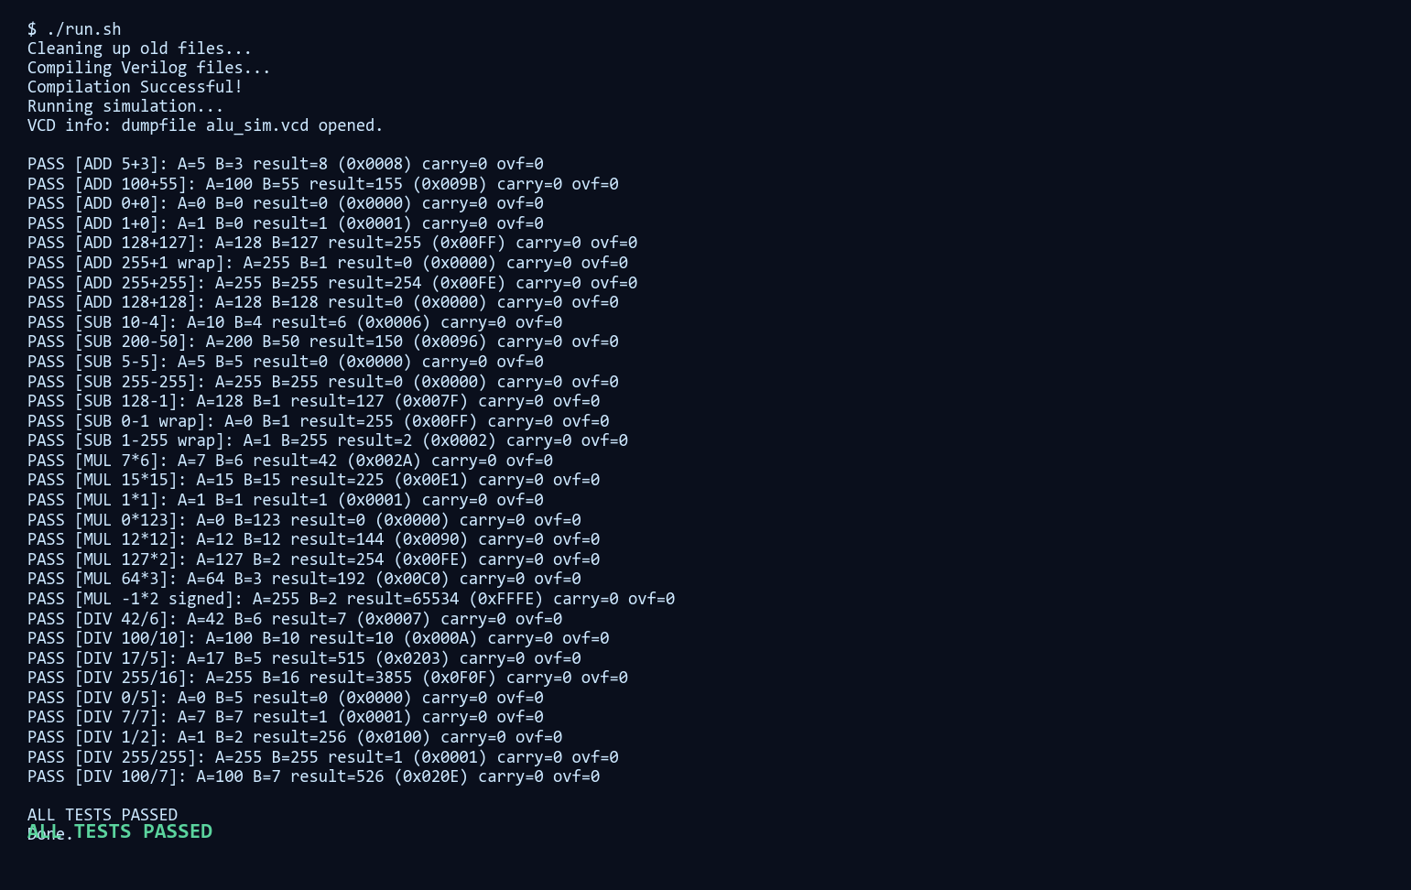
Simulation Run Output
Console transcript from run.sh
Structural 8-bit ALU • Verilog implementation
21 / 24

Slide 22
12. Algorithm Trade-offs
• Add/Sub: carry-select adder — faster than ripple, more area
• Multiply: Booth radix-4 — fewer iterations, signed-native, multi-cycle
• Divide: radix-2 restoring — simple control, highest latency
• Overall priority: structural clarity & module reuse
• Trade: not minimum latency, not maximum throughput
Structural 8-bit ALU • Verilog implementation
22 / 24

Slide 23
Summary
• Fully structural 8-bit ALU in Verilog
• Unified handshake (start/done) across 4 engines
• Clear FSM control + reusable common primitives
• Verified with self-checking integrated testbench
• Architecture captured in alu_architecture.circ (Logisim Evolution)
Structural 8-bit ALU • Verilog implementation
23 / 24

Slide 24
Questions?
Thank you
Structural 8-bit ALU • Verilog implementation
24 / 24

