Slide 1
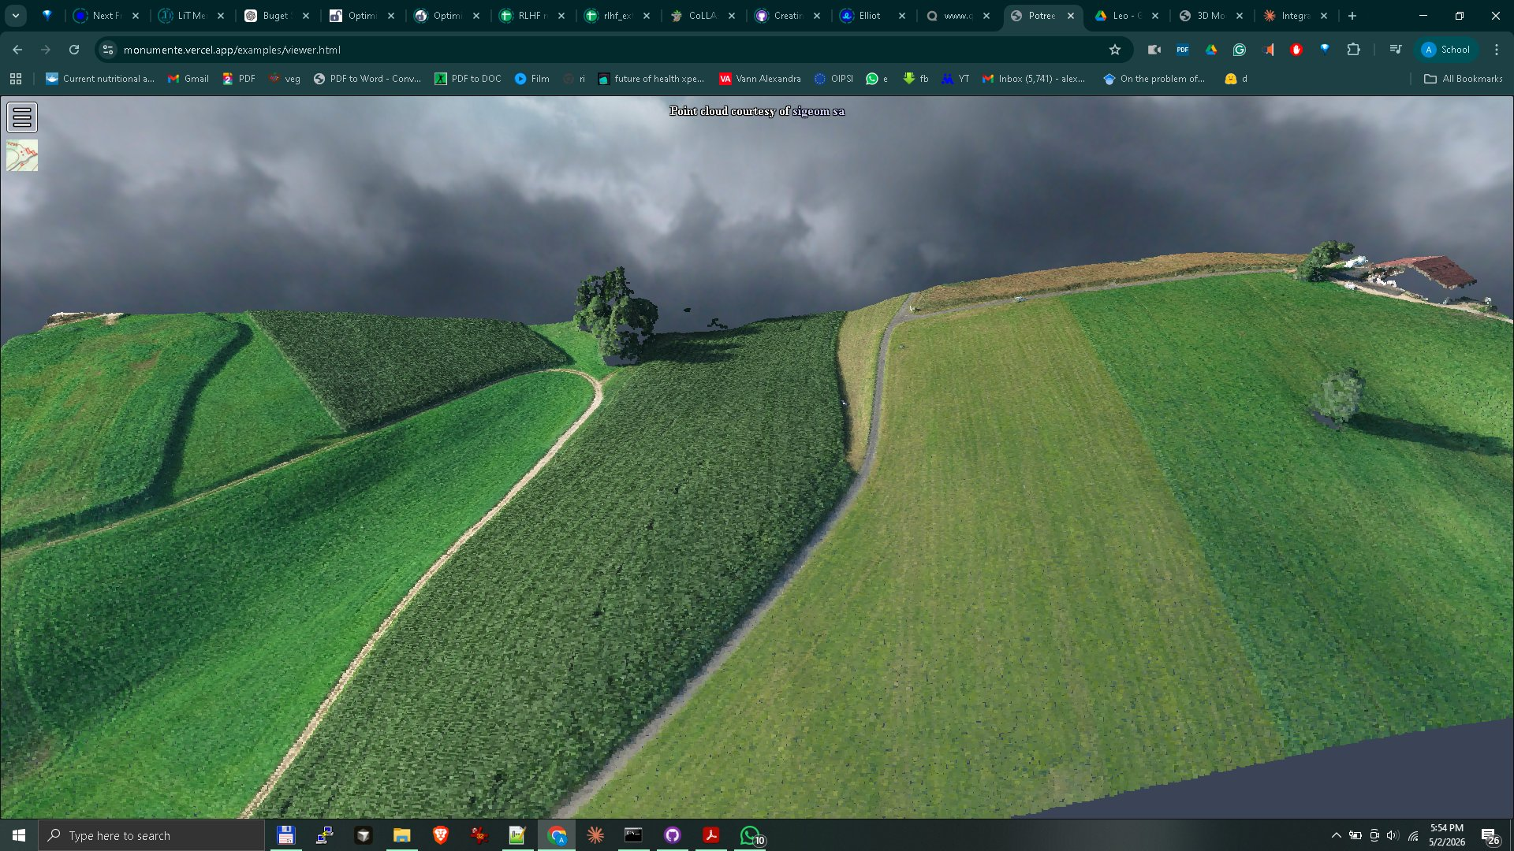
MINISTRY OF CULTURE
National Heritage
Digitization Program
End-to-end 3D scanning, processing
and web-based delivery at national scale
2,000+
€925
18 mo
monuments
per scan
delivery
eyemap.ai | 2025

Slide 2
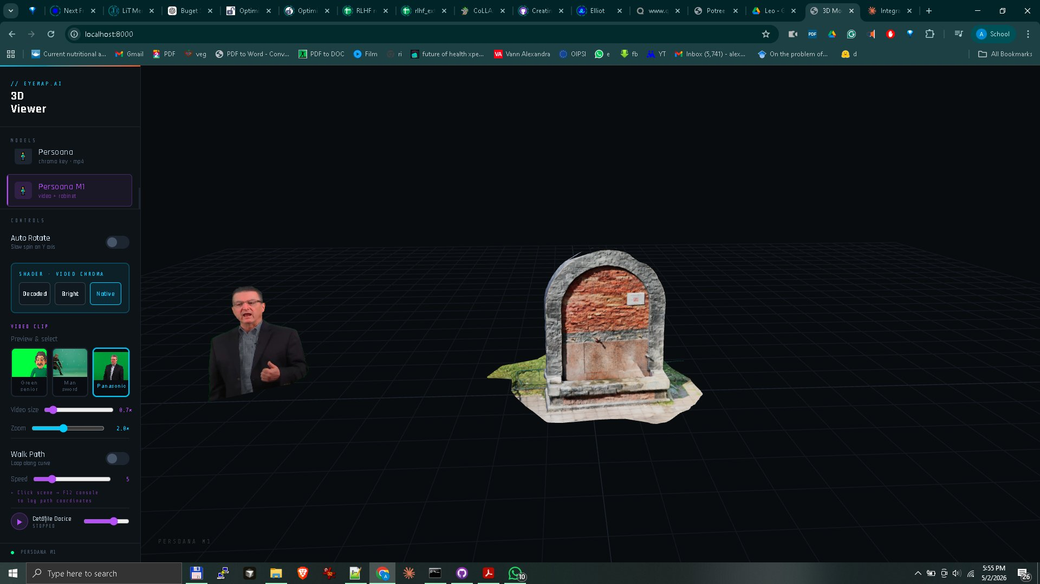
Research-Driven Expertise
Built on a decade of academic and applied research in 3D digitization, our platform bridges heritage science and scalable technology.
PhD Research, 2010–2016
Chalmers University of Technology, Gothenburg, Sweden — DIVA Project (CRS4 / Chalmers). Focus: 3D reconstruction, interactive visualization and low-cost scanning setups.
Published Research
"Low-cost Experimental Setups for Mid-air 3D Reconstruction" — Eurographics 2015. Scanned a 23m statue using an octocopter drone and open-source libraries.
Applied Platform
Eyemap.ai — scalable Potree-based 3D viewer, field-proven on real monuments in Romania.
Live 3D Viewer — eyemap.ai platform
eyemap.ai | Heritage Digitization Proposal 2025

Slide 3
Academic Foundation — Published Research
EUROGRAPHICS 2015
Low-cost Experimental Setups
for Mid-air 3D Reconstruction
▶
Dancu, Fratarcangeli, Fourgeaud, Franjcic,
Chindea, Fjeld — The Eurographics Association
Key result: scanned and reconstructed a 23m high statue using an octocopter drone, off-the-shelf embedded components and open-source libraries — zero external hardware.
Watch Demo
youtu.be/ZQuhXnyS1Fw
Mid-air 3D reconstruction using depth sensor
+ octocopter drone — Eurographics 2015
DOI: 10.2312/stag.20151286
DIVA Project, CRS4 — Chalmers Univ. of Technology, Gothenburg, Sweden | 2010–2016
DIVA Project — CRS4 / Chalmers University of Technology, Gothenburg 2010–2016
eyemap.ai | Heritage Digitization Proposal 2025

Slide 4
Scan Types & Pricing per Model
Each price includes capture, processing/cleanup, QA and delivery to the visualization platform.
TYPE A
TYPE B
TYPE C
TYPE D
Large monuments
Small objects (<1m)
Human-size (1–2m)
Medium statues (<5m)
Buildings, sites, outdoor
Vases, artefacts, museum pieces
Statues, busts, equipment
Monuments, outdoor sculptures
Drone LiDAR + photogrammetry
Studio turntable, automated
Indoor/outdoor scan
Ground + small drone
Capture
€500
Capture
€5
Capture
€40
Capture
€120
Processing
€250
Processing
€10
Processing
€50
Processing
€100
QA
€125
QA
€5
QA
€20
QA
€30
TOTAL / SCAN
€875
TOTAL / SCAN
€20
TOTAL / SCAN
€110
TOTAL / SCAN
€250
eyemap.ai | Heritage Digitization Proposal 2025

Slide 5
Visualization Platform & Services
Beyond scanning — a complete delivery ecosystem
Potree-based 3D viewer
Web & mobile, no plugins required. Point clouds up to 1B+ points rendered in real-time.
Model cleanup & mesh generation
Full pipeline: noise removal, decimation, UV mapping, texture baking.
Cloudflare R2 + CDN delivery
Global edge delivery. 3-year infrastructure included. €5,000 total.
Metadata & catalogue system
Each model tagged with GPS coordinates, type, era, condition — searchable national inventory.
Eyemap.ai — live monument 3D viewer demo
XR / AR export
Visualization package
Every model exportable to GLTF/GLB for augmented reality and museum kiosks.
Included in scan fee + €90,000 platform dev
Infrastructure 3 yr: €5,000 | CDN global delivery
eyemap.ai | Heritage Digitization Proposal 2025

Slide 6
Type A — Aerial LiDAR Scan Demo
Point cloud captured at monumente.vercel.app/examples/viewer.html
Sensor
Coverage
Point density
Processing
Delivery
Drone LiDAR + RGB
Full site + context
>50 pts/m²
Potree-ready output
Web viewer, no plugin
Based on research conducted at Chalmers University of Technology, Gothenburg — DIVA Project 2010–2016

Slide 7
Quality, Expertise & Performance
Mixed LiDAR + Photogrammetry
Industrial throughput
PhD-level processing chain
Ground LiDAR for precise geometry, drone photogrammetry for texture and context. Every model cross-validated.
2 field teams: 10–12 monuments/day. Studio pipeline: 50–150 small objects/day. 2,000 monuments in 18 months.
Every model undergoes: noise removal → registration → mesh → texture bake → LOD → Potree conversion → QA sign-off.
National-scale infrastructure
Open standards
Documented provenance
Cloudflare R2 + CDN. 3-year SLA. Sub-second load times globally. Mobile-ready. No plugin required.
Output: LAS/LAZ, PLY, OBJ, GLTF/GLB, Potree octree. No vendor lock-in. Interoperable with GIS systems.
GPS-tagged, date-stamped, condition-logged. Feeds directly into Romania's national monument register (LMI).
eyemap.ai | Heritage Digitization Proposal 2025

Slide 8
Project Budget & Timeline
Category | Cost (€)
Acquisition (scanning) | 1,000,000
Processing & cleanup | 500,000
Equipment | 220,000
Platform development | 90,000
Accommodation | 120,000
Transport | 60,000
Per diem | 75,000
Infrastructure (3 yr) | 5,000
TOTAL | 1,850,000
18-Month Delivery Plan
Prototype
Pilot
Production
3 months
6 months
9 months
Prototype — 3 months
20 monuments
Pilot — 6 months
200 monuments
Production — 9 months
1,800 monuments
Cost per monument: €925 | Target: 2,000 monuments
eyemap.ai | Heritage Digitization Proposal 2025

Slide 9
Why Choose This Program?
Research-backed
✓
Founded on PhD research at Chalmers University of Technology (2010–2016) and published Eurographics peer-reviewed results.
Proven field capability
✓
2 dedicated field teams, LiDAR + photogrammetry equipment ready. 10–12 monuments/day throughput.
End-to-end ownership
✓
We scan, process, clean, model, host and deliver. One contract, one point of contact, zero outsourcing.
National scale, local expertise
✓
Designed specifically for Romania's monument typology, terrain and LMI requirements.
Transparent pricing
✓
Fixed cost per scan — no surprises. From €20 (small objects) to €875 (large monuments).
Contact: eyemap.ai | Ready to begin within 30 days of contract signing

