Slide 1
Movement Monitoring — Tasks, Workflows, Data
1 Sep 2026 · branch application-motion-monitoring
Three real-world scenarios, three tasks · encoder-to-prediction workflow · how the training and evaluation data is built

Slide 2

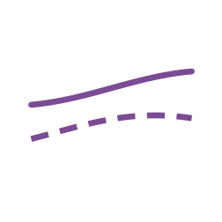
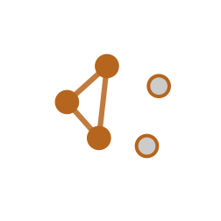
Three real-world scenarios, three tasks
Each task imitates one concrete situation a clinician, patient, or ergonomist is in.
TASK 1
TASK 2
TASK 3
DETECT
COMPARE
DISCOVER
Scenario: a clinician demonstrates an exercise; later, did it happen again?
Scenario: is this week's exercise different from last week's, for this person?
Scenario: an ergonomist reviews an unlabeled shift and finds what repeats.
Given a few reference executions, locate that same movement in a continuous recording — different session, speed, or device mounting.
For repeated executions of one task, quantify how it changed relative to the person's own accepted baseline — not a population norm.
Cluster recurring motion motifs in a continuous recording with no reference and no predefined activity vocabulary.
One shared primitive underneath all three: timestamped patch embeddings, never pooled into a single vector per recording.

Slide 3
Task 1 — Detect
Given one or a few reference executions, did the movement occur in a later recording, and where?
Real-world scenario
What the system must handle
A clinician records several acceptable repetitions of a prescribed exercise in clinic — or a worker demonstrates an arbitrary personal task, “exercise one.”
The system later scans a continuous home or field recording, counts detected repetitions, and returns the matching intervals for inspection.
The reference's language label is irrelevant — names are never a required input.
The later execution may differ in speed, amplitude, ordinary repetition variability, session, or device mounting.
Reference and query must be independent executions — never two windows from one bout.
Recordings with no target occurrence, and hard negatives from the same person, device, and activity family.
Output: event intervals, match scores, and the retrieved reference evidence behind each match.

Slide 4
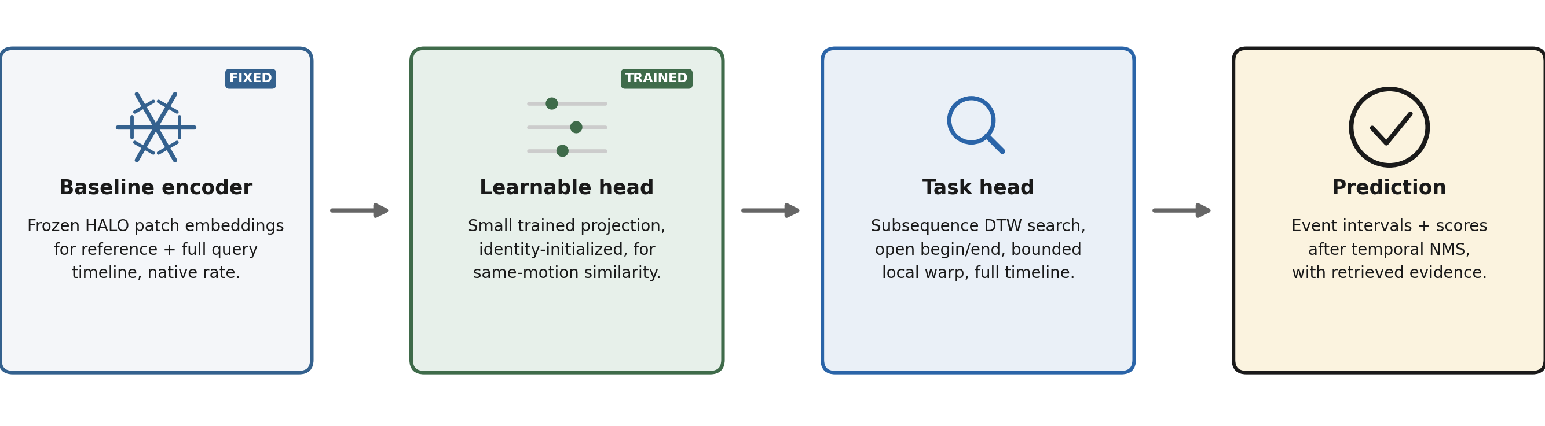
Task 1 — workflow
Reference executions and a continuous query timeline, both through the same frozen encoder.
The task head is a search over the whole timeline, not a per-window classifier — background dominates a continuous recording.

Slide 5
Task 2 — Compare
For executions known to represent the same task, which differences are ordinary variation and which are a persistent change?
Real-world scenario
What the system must handle
Track whether a rehabilitation exercise, or a worker's task execution, is changing across days or weeks.
The comparison is always against that person's own accepted baseline — not against another person or a population average.
Alignment should ignore properties like speed while keeping others, like duration, visible rather than discarding them.
Separate test-retest and device-remounting noise from a real persistent change — the change must exceed that noise floor.
Isolated outliers should be suppressed while persistent drift and its uncertainty are retained.
Without external ground truth the output is difference, never “quality” or “improvement.”
Output: aligned latent-shape deviation, phase-local deviation, duration / intensity / smoothness deltas, and uncertainty vs. personal baseline.

Slide 6
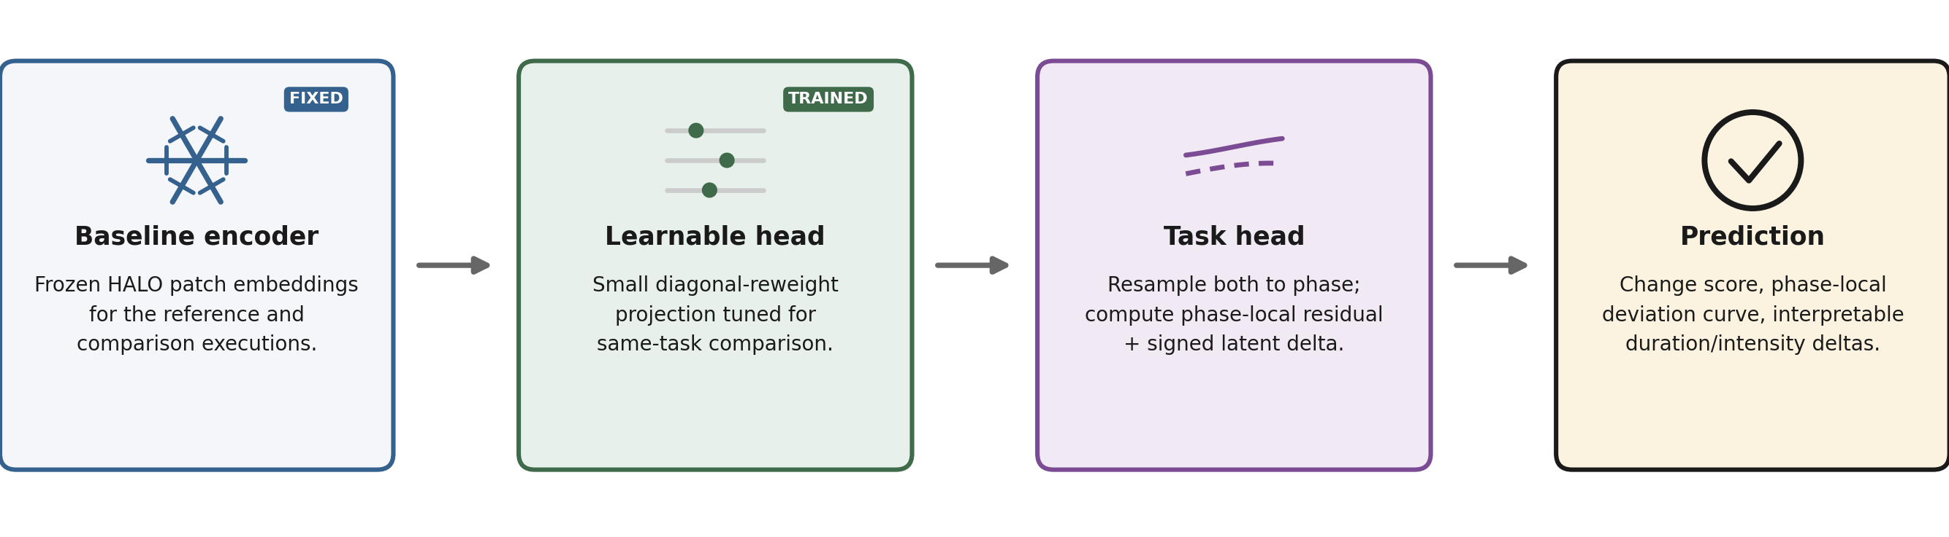
Task 2 — workflow
Two independent executions of the same declared task, reference and comparison.
The task head aligns by phase, not by clock time, so duration differences stay visible instead of being warped away.

Slide 7
Task 3 — Discover
Which coherent motion motifs recur frequently in an unlabeled continuous recording?
Real-world scenario
What the system must handle
An ergonomist records a work shift with no reference and no predefined activity vocabulary.
The system surfaces the most frequently recurring motion motifs for review; the ergonomist names the ones that matter.
Named motifs are promoted into Task 1 as references for future monitoring.
IMU data cannot prove intent — a coherent motif is not assumed meaningful until a human confirms it.
The same-motion metric trains on arbitrary labeled event identities; evaluation identities and label names stay hidden from clustering.
Recurrence, stable internal ordering, and within-cluster similarity greater than similarity to local background.
Output: recurring motif clusters — count, duration, cadence, representative examples, and timeline locations, pending human confirmation.

Slide 8
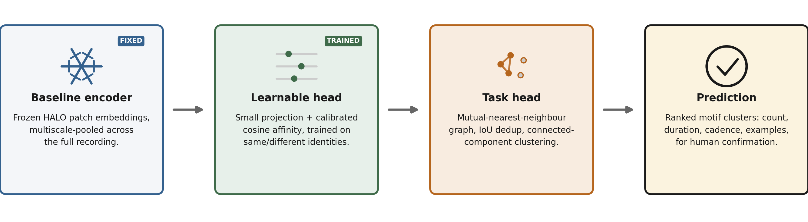
Task 3 — workflow
One continuous, unlabeled recording; no reference, no vocabulary.
The task head never sees a label name — only which candidates were marked the same event during training.

Slide 9
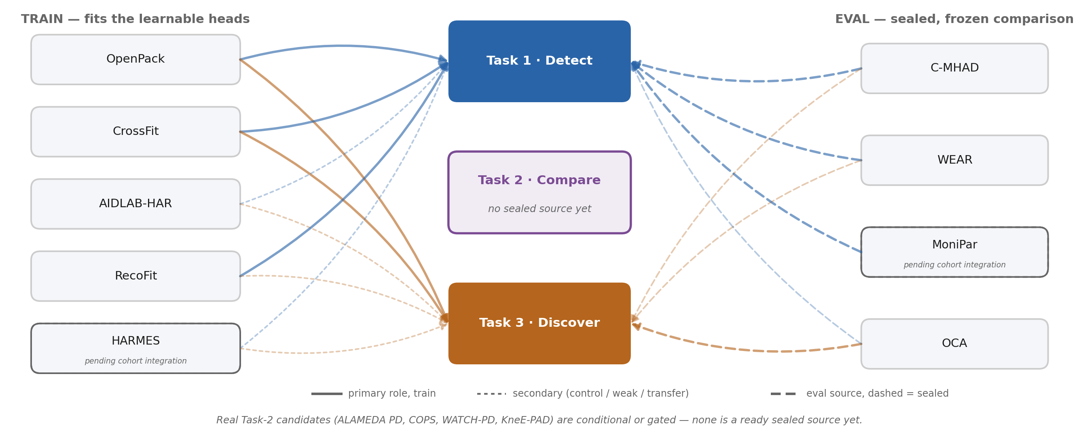
How the training and evaluation data is built
No dataset both trains and evaluates the same arm.
Training sources never contribute to a sealed test, and a sealed source is never fit or calibrated on.

Slide 10
Dataset detail
The eight newly-verified sources behind Tasks 1–3. Highlighted rows are sealed eval sources; the rest are train. HARMES (existing corpus source) is tracked in the corpus docs, not repeated here.
dataset | recordings | length / recording | total length | subjects | labels (#) | labels & acquisition
C-MHAD | 240 streams (12 subj × 2 apps × 10 runs) | ~119–122 s | 8.0 h | 12 | 12 | 5 TV gestures + 7 sit/stand/lie transitions · wrist or waist Shimmer3 IMU 50 Hz + sync video (unused)
WEAR | 24 sessions | ~50 min avg (varies) | 19.0 h | 22 | 18 (+NULL) | 18 outdoor sports activities · 4 limb Bangle.js watches 50 Hz, 2 arm streams used, + egocentric video (unused)
MoniPar | 174 weekly sessions | 405–445 s (~7 min) | ~20 h* | 28 (21 PD + 7 ctrl) | 9 | 9 clinical exercise labels · wrist smartwatch 50 Hz, gravity present, weekly protocol
OCA | 12 sessions (13 parts) | ~14–56 min (varies) | 6.0 h | 5 | 6 (+NULL) | 6 assembly-phase labels · 4 BNO055 IMUs (2 upper-arm, 2 chest/vest), ~20–27 Hz native, arm-support flag
OpenPack | 416 IMU segments (gap-split) | varies by session | 53.8 h | 16 (21 raw IDs, 5 aliased) | n/a—interval IDs | Nested fine-action / operation / box-cycle identities, not a closed vocabulary · wrist+arm ATR IMU ~30 Hz, 4 sensors/subject
CrossFit | 446 exercise arrays (+5,461 rep slices) | ~31 s avg (derived) | 3.834 h | 57 codes (50 active; paper: 54 people) | 10 (+NULL) | 10 exercises, repetition starts cued by watch vibration · wrist+ankle smartwatch ~100 Hz, authors' 10 ms interpolation
AIDLAB-HAR | 180 EDF recordings | short, unstated exact | not stated | 90 codes (not verified unique) | 16 | 13 exercises + 3 background-like classes · chest AIDLAB IMU 50 Hz, acceleration only (no raw gyro)
RecoFit | 126 visits | varies (continuous) | 79.4 h | 94 | n/a—weak labels | Broad weakly-labeled exercise-set vocabulary + explicit non-exercise background · right-forearm 50 Hz acceleration + gyroscope
* MoniPar total length is derived (sessions × median duration); the release does not publish a total directly. MoniPar serves Task 1 (cross-week) only — its states are not independent repetition executions, so it is excluded from Task 2. MoniPar and HARMES are not yet in the frozen COHORT_V1 manifest (older storage, pending a reviewed adapter revision) — the other six rows are. “not stated” / “n/a” cells are genuine gaps in the source documentation, not omissions.

