Slide 1
HALO — Weekly Update
24 Aug 2026 · sealed adaptation_v1 manifest · fingerprint 1bd89d35…
The best model we have · how everyone is adapted · why our own engine is the problem

Slide 2
How HALO works
One encoder, a frozen text tower, and a memory you drop examples into.
The model
How it adapts
Input is deliberately unconstrained. Any channel set, any sampling rate, any body placement — no resampling to a common grid.
Filterbank front end. Fixed Gabor filters at physical frequencies, so 5 Hz means 5 Hz whether the device sampled at 20 Hz or 200 Hz.
Temporal trunk. Three attention layers over one-second patches, width 128 — one 128-d vector per (patch, sensor) row.
Text is an input, not a head. A frozen sentence encoder embeds the label names and a description of the acquisition setup.
Adaptation is memory, not gradient. Enrolled examples are encoded once and dropped into a memory bank. Nothing is retrained, ever.
The native engine retrieves the top-64 memory rows for a query, mixes them with the candidate names, and votes.
1.01 M trainable parameters — the smallest model in this comparison by two to three orders of magnitude.
Today's headline model does not use the engine. It is the HALO encoder read out with plain nearest-neighbour — slides 11-13 are about why.

Slide 3
How everything here is measured
One sealed manifest, seven held-out datasets, five seeds — identical for every model.
The protocol
Two decisions we made this week
Seven held-out datasets, in nobody's pretraining: four ordinary (everyday activity) and three specialized / clinical (rehab and clinical motion).
Five seeds; support and query executions are execution-disjoint and subject-disjoint.
k = enrolled executions per class. Each execution is pooled to one vector, so a 56-window recording cannot outweigh a one-window recording.
Macro F1, averaged within a dataset, then equally across datasets.
Three readouts only — 1-NN, prototype, ridge. All gradient-free. We dropped the fitted linear head: it needs 200 Adam steps at deployment, which is not the regime we argue for.
HALO's memory at k ≥ 1 is enrolment only. No corpus rows, so every model sees exactly the same evidence. Slide 13 shows this costs us nothing.
Every number in this deck comes from that one manifest. No model was re-tuned for it.

Slide 4
RESULTS
Where the model actually stands
Best checkpoint long_4h_20260821 · frozen encoder + 1-NN · macro F1 on the sealed test set.

Slide 5
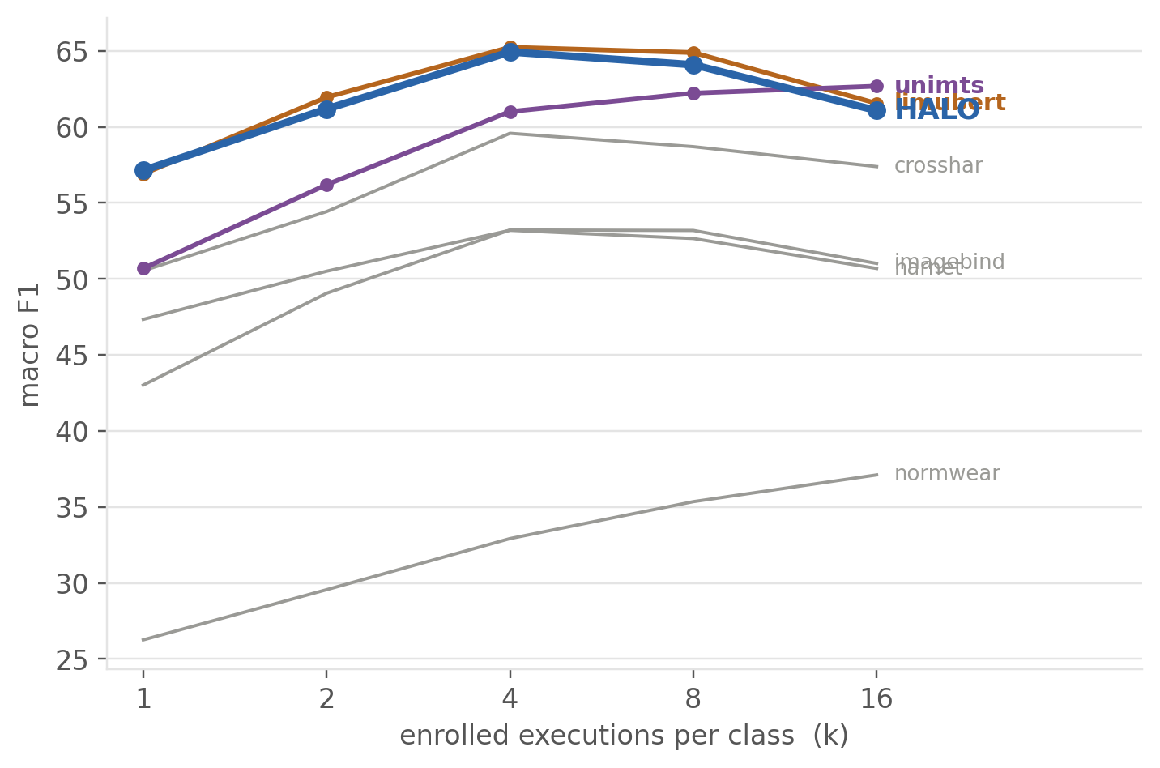
Ordinary activities
Every model is a frozen encoder read out with 1-NN. Nothing is fine-tuned.
model | k=1 | k=2 | k=4 | k=8 | k=16
LiMU-BERT | 56.9 | 62.0 | 65.2 | 64.9 | 61.5
HALO (ours) | 57.1 | 61.2 | 64.9 | 64.1 | 61.1
UniMTS | 50.7 | 56.2 | 61.0 | 62.2 | 62.7
CrossHAR | 50.5 | 54.4 | 59.6 | 58.7 | 57.4
harnet5 | 47.3 | 50.5 | 53.2 | 52.7 | 50.7
ImageBind | 43.0 | 49.1 | 53.2 | 53.2 | 51.0
NormWear | 26.3 | 29.6 | 32.9 | 35.4 | 37.1
HALO leads at k=1 and is level with LiMU-BERT after that. Call this a tie, not a win.

Slide 6
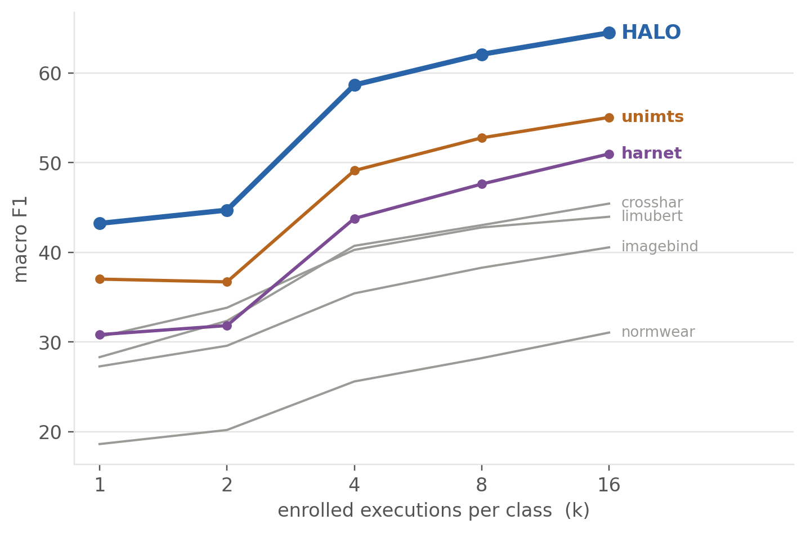
Specialized and clinical activities
Every model is a frozen encoder read out with 1-NN. Nothing is fine-tuned.
model | k=1 | k=2 | k=4 | k=8 | k=16
HALO (ours) | 43.2 | 44.7 | 58.7 | 62.1 | 64.5
UniMTS | 37.0 | 36.7 | 49.1 | 52.8 | 55.0
harnet5 | 30.8 | 31.8 | 43.8 | 47.6 | 51.0
LiMU-BERT | 30.6 | 33.8 | 40.3 | 42.8 | 44.0
CrossHAR | 28.3 | 32.4 | 40.7 | 43.0 | 45.4
ImageBind | 27.3 | 29.6 | 35.4 | 38.3 | 40.6
NormWear | 18.6 | 20.2 | 25.6 | 28.2 | 31.1
HALO is best at every k, by 6.2 to 9.5 F1 over UniMTS. This is the result worth defending.

Slide 7
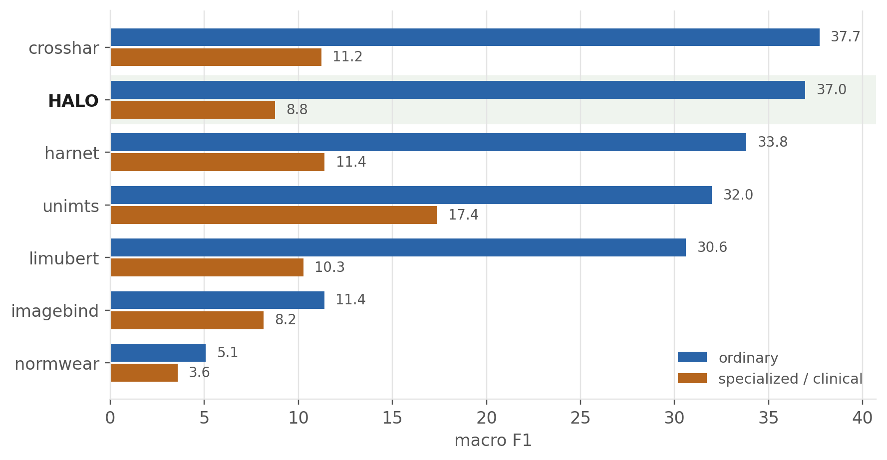
Zero-shot, with nothing enrolled
No enrolled examples: every model falls back on its own training knowledge, and chooses among the test dataset's labels only.
Competitive on everyday activity (37.0, second to CrossHAR); weak on the clinical set (8.8 against UniMTS at 17.4). One enrolled example takes that 8.8 to 43.2.

Slide 8
What “adaptation” means for each model at k ≥ 1
No backbone is fine-tuned anywhere in this comparison — ours included.
model | encoder | params | feat dim | pretraining | input contract | tuned at k≥1
HALO (ours) | filterbank + 3-layer temporal trunk | 1.01 M | 128 | our 18-dataset corpus | 6 ch, native rate | none
LiMU-BERT | masked IMU encoder | ~62 K | 72 | self-pretrained on our corpus | 6 ch @ 20 Hz | none
UniMTS | graph encoder + CLIP text tower | ~4 M | 512 | released ckpt, simulated IMU | 3 ch acc @ 20 Hz | none
harnet5 | ResNet-V2 | ~2 M | 512 | released ckpt, UK-Biobank | 3 ch acc @ 30 Hz | none
CrossHAR | masked + contrastive transformer | ~72 K | 72 | self-pretrained on our corpus | 6 ch @ 20 Hz | none
NormWear | channel-independent ViT + frozen LLM | 194 M | 2048 | released ckpt, clinical wearables | 6 ch @ 65 Hz | none
ImageBind | imagebind_huge | 1.2 B | 1024 | released ckpt, web-scale | 6 ch @ 200 Hz | none
Every encoder is frozen and no gradient step is taken at adaptation time. The only thing fitted is the readout — on the k enrolled executions of the target dataset alone.
Why gradient-free is the fair choice. A fitted head needs a learning rate, a step count and a weight decay that cannot be right for a 72-d feature and a 2048-d one at once — any single setting under-tunes somebody, and we would be benchmarking optimisers. A cosine has nothing to tune and is available to every model, whether its native head predicts logits (harnet, LiMU-BERT, CrossHAR) or aligns to language (UniMTS, ImageBind, NormWear).

Slide 9
The three readouts, and what each needs at deployment
All three see only the enrolled examples: no corpus data, no other dataset, no query labels.
readout | parameters fitted | optimiser | data it sees
1-NN (primary) | none | none — one cosine, one argmax | the k×C enrolled vectors
prototype | none (C centroids computed) | none — mean, then renormalise | the k×C enrolled vectors
ridge | D×C | one closed-form solve, α fixed at 1 | the k×C enrolled vectors
Why the memory is enrolment-only
What we still owe
The baselines' readouts see only enrolled examples. If our engine also carried 512 corpus rows, k would not mean the same thing across the table.
Measured cost of dropping them: −0.24 to +0.04 F1. It buys us nothing, so we give it up and take the cleaner comparison.
At k=1, prototype and 1-NN are mathematically identical — one vector per class, and its own normalised mean is itself.
The text-aligned baselines could in principle combine label text with enrolment at k ≥ 1. We give them features + 1-NN only. That is the first gap a reviewer will find.

Slide 10
THE PROBLEM
Our own engine is what is holding us back
Three architectures, three full runs, one consistent pattern.

Slide 11
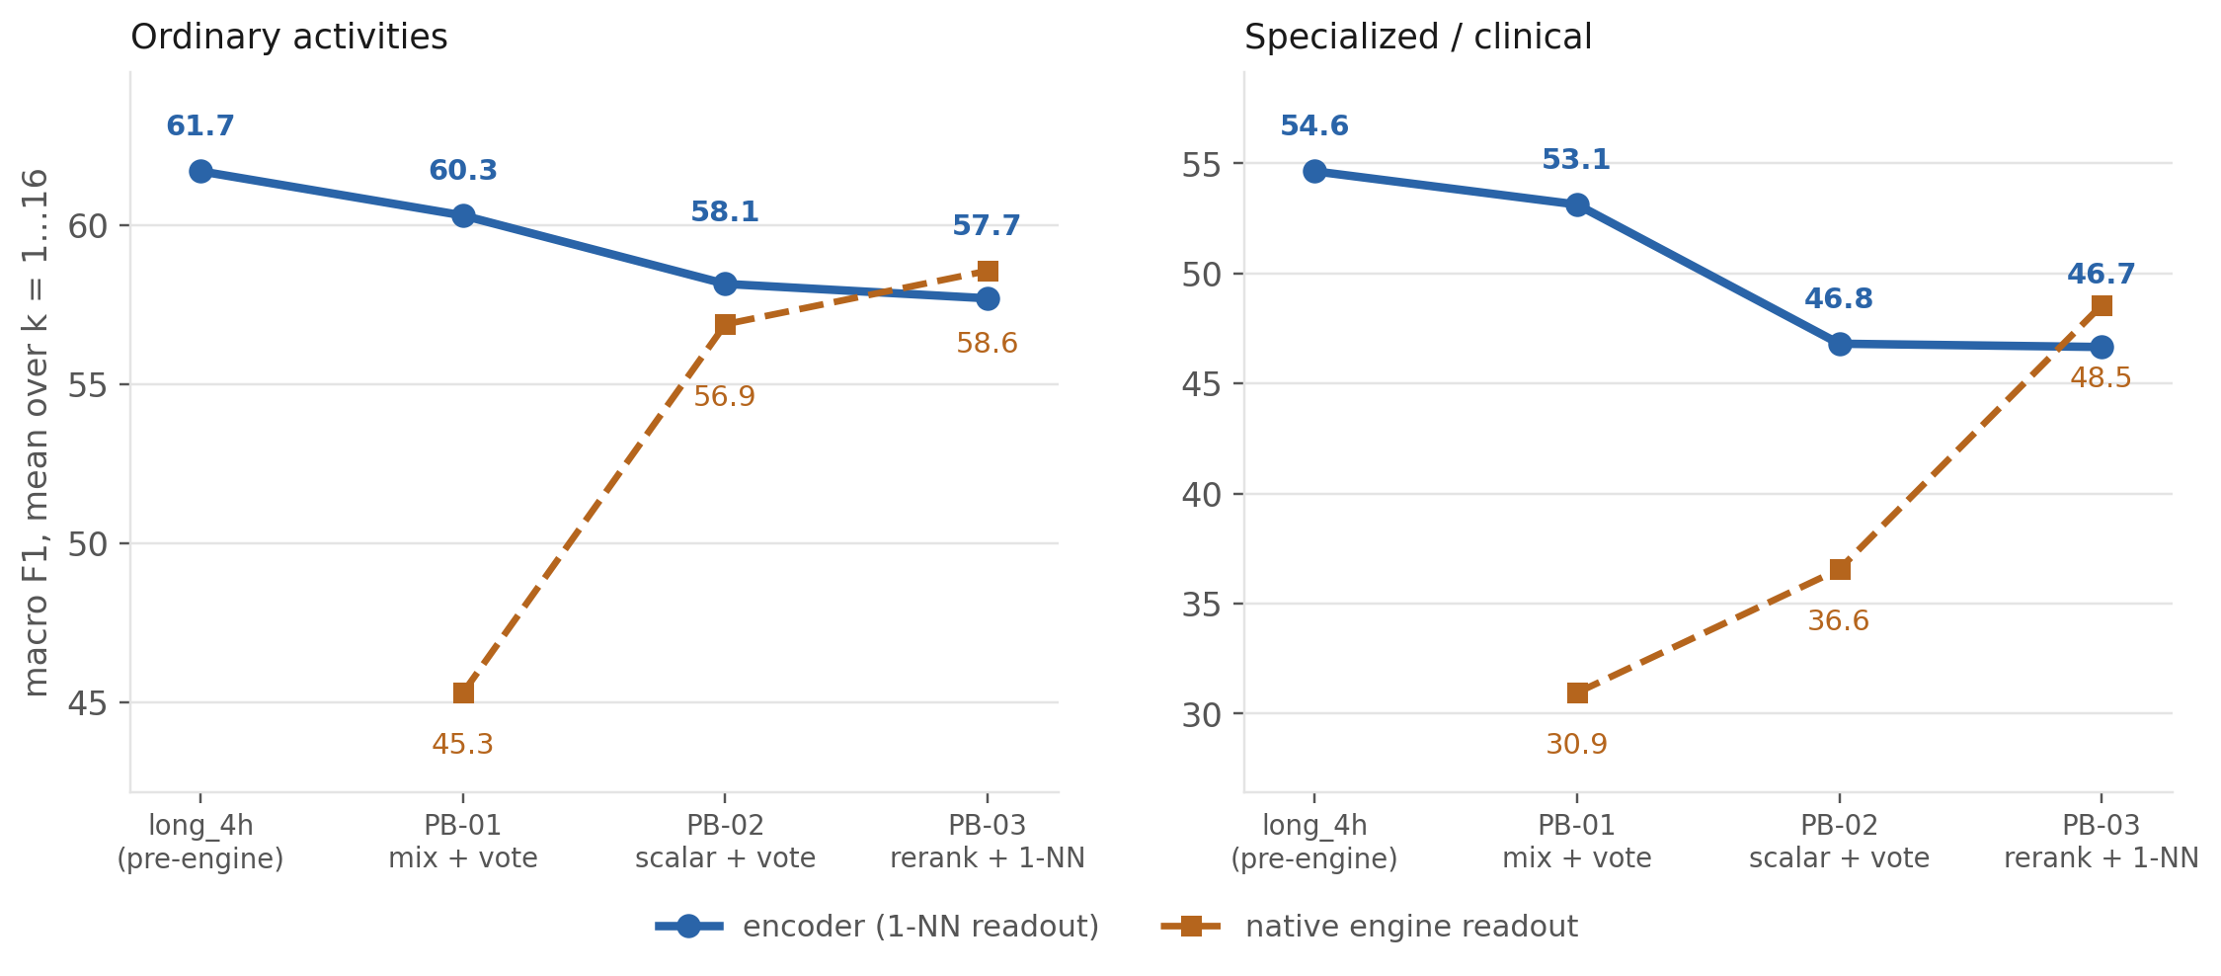
Every redesign fixed the readout and cost us the representation
Four trained versions, mean over k = 1…16.
PB-03's best-ever engine (58.6 / 48.5) still loses to the pre-engine checkpoint's plain 1-NN (61.7 / 54.6). We have been trading the part that works for the part that does not.

Slide 12
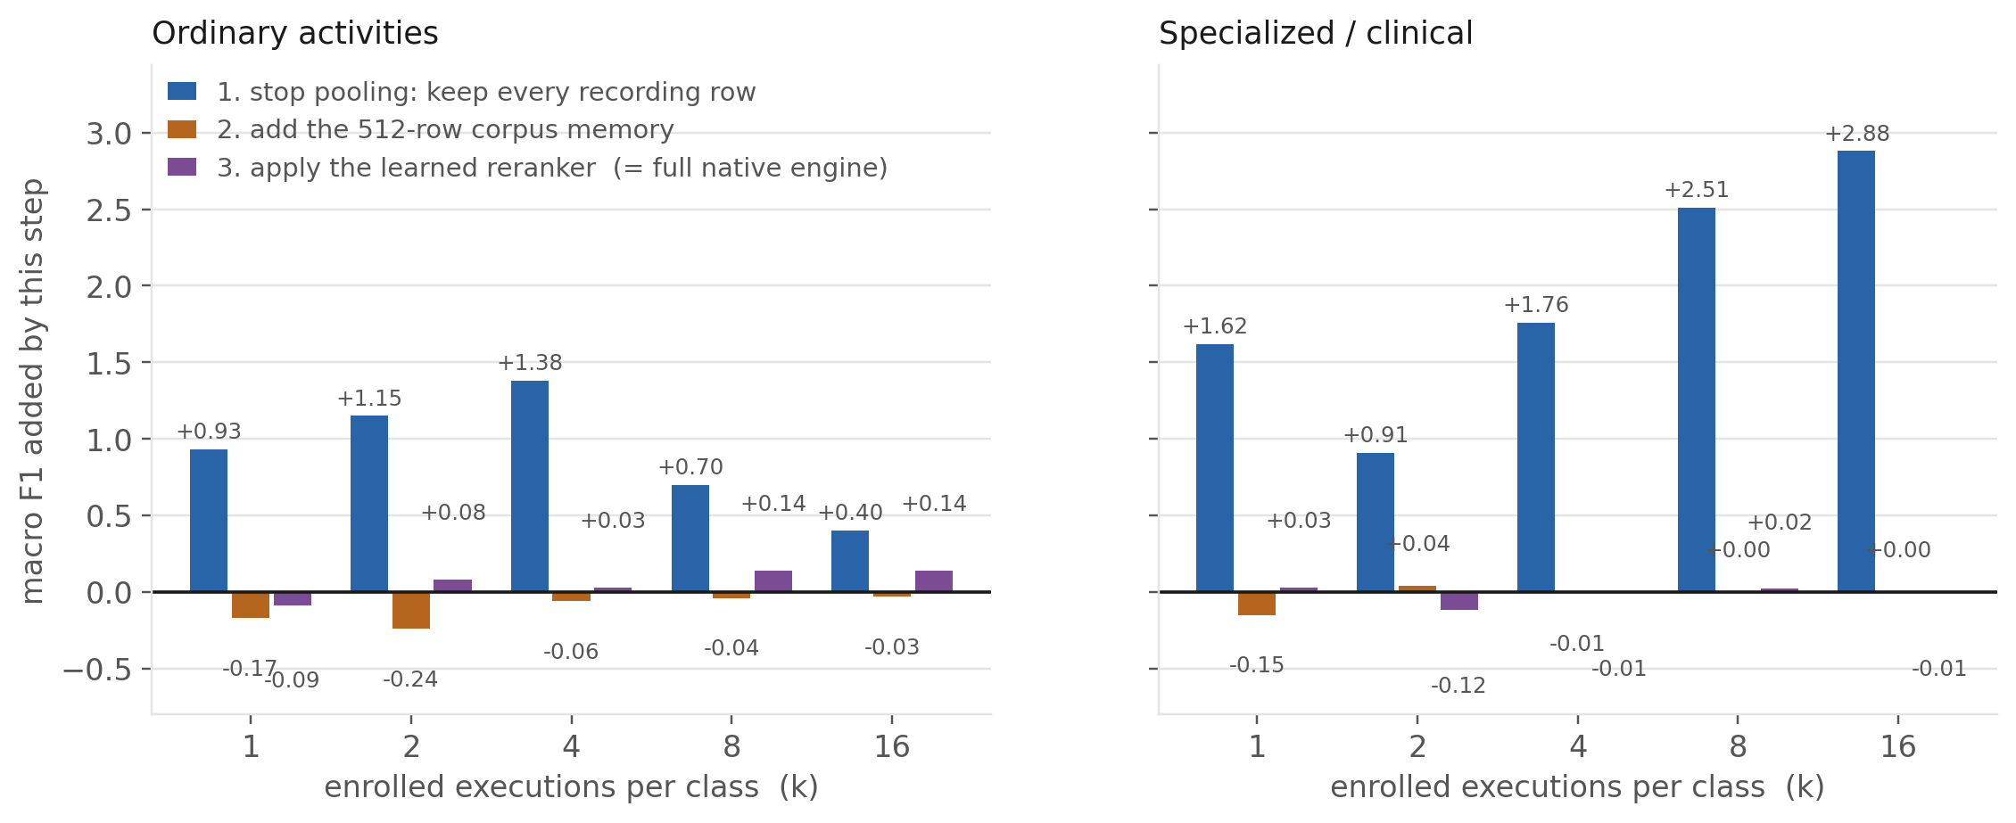
Which part of the engine actually earns anything
Starting from encoder + 1-NN, adding one engine component at a time, at every k.
The entire native-engine gain is un-pooling. Corpus memory costs 0.24 to 0.00. The learned reranker never moves the score by more than 0.14 F1 in either direction.

Slide 13
The same ladder, as numbers
Absolute macro F1, and the change each step makes.
Ordinary
Specialized / clinical
what the model does | k=1 | k=2 | k=4 | k=8 | k=16
HALO encoder + 1-NN | 53.3 | 56.8 | 60.3 | 60.0 | 58.0
+ keep every recording row | 54.2 +0.93 | 58.0 +1.15 | 61.7 +1.38 | 60.7 +0.70 | 58.4 +0.40
+ add 512-row corpus memory | 54.1 -0.17 | 57.7 -0.24 | 61.6 -0.06 | 60.7 -0.04 | 58.3 -0.03
+ learned reranker = native engine | 54.0 -0.09 | 57.8 +0.08 | 61.7 +0.03 | 60.8 +0.14 | 58.5 +0.14
what the model does | k=1 | k=2 | k=4 | k=8 | k=16
HALO encoder + 1-NN | 36.8 | 37.9 | 50.0 | 53.2 | 55.4
+ keep every recording row | 38.4 +1.62 | 38.8 +0.91 | 51.8 +1.76 | 55.8 +2.51 | 58.2 +2.88
+ add 512-row corpus memory | 38.2 -0.15 | 38.8 +0.04 | 51.8 -0.01 | 55.8 +0.00 | 58.2 +0.00
+ learned reranker = native engine | 38.3 +0.03 | 38.7 -0.12 | 51.7 -0.01 | 55.8 +0.02 | 58.2 -0.01
Retrieval over the corpus alone scores 20.7 ordinary and about 10 specialized. Retrieval is the mechanism this architecture is built around, and on the deployed path it is contributing nothing.
Un-pooling is a data-representation choice, not learning. Nothing we trained is carrying the result.

Slide 14
Three decisions
1
Do we keep trying to make the engine win?
2
Do we chase the encoder regression instead?
3
Do we re-train against the right control?
Three architectures, three runs. PB-03 finally beats its own 1-NN — but only by un-pooling, and its encoder is 4 to 8 F1 worse than the pre-engine one.
The 4–8 F1 the encoder lost under episodic training is larger than anything the engine has ever offered us.
Every run so far optimised against pooled-execution 1-NN. The ladder shows the real bar is un-pooled row 1-NN, which the engine has never once beaten.
→ Report the encoder + 1-NN result as the headline, and the engine as a measured negative with a named cause.
→ Yes. This is now the load-bearing experiment: find out why episodic training degrades the representation.
→ Change the training control before spending another 35k steps on the engine.
The strongest thing we own is a 1 M-parameter encoder that beats every baseline at every k on clinical motion, with no deployment-time training at all. Lead with that.

Slide 15
What we should state plainly
Everything a reviewer will find, said first.
Limits of this result
Confounds we have not resolved
Single training seed per HALO checkpoint; our own policy asks for three.
Zero-shot on specialized activities is weak (8.8 against UniMTS's 17.4).
The best checkpoint is pre-engine, and the current code cannot even load it — extending it needs a retrain.
LiMU-BERT and CrossHAR released no weights, so we pretrained them on our corpus. That cuts both ways and we should say so.
The best checkpoint's recipe also differed — learnable front end, alias episodes, max_support 4 — so “the engine broke the encoder” is the leading explanation, not a proven one.
We have not given the text-aligned baselines a text + enrolment readout, which is arguably part of their contribution.
Un-pooling helps our engine; we have not tested whether it would help the baselines too.
None of these change the headline. All of them belong in the paper before a reviewer finds them.

