Slide 1
Criminal Profiling Using OSINT(Environmental & Infrastructure Crimes)
CSE7101- Capstone Project
Review-1
Batch Number:
Roll Number | Student Name
20221CSE0013 | Albin Joy
20221CSE0016 | Shasank M
20221CSE0059 | Madhan D
Under the Supervision of,
Mr. Mohaideen A
Assistant Professor
School of Computer Science and Engineering
Presidency University
Name of the Program: B.TECH
Name of the HoD: Dr. Blessed Prince
Name of the Program Project Coordinator: Mr. Muthuraju V
Name of the School Project Coordinators: Dr. Sampath A K , Dr. Geetha A

Slide 2
Problem Statement Number:
Organization:
Category (Hardware / Software / Both) : Software
Problem Description: PSCS_586 Criminal Profiling Using Osint (Open Source Intelligence Tools) Security This problem invites the development of a novel solution leveraging digital technology to address societal or administrative challenges within public services, sustainability, or governance.
SDG 13 – Climate Action,
SDG 9 – Industry, Innovation and Infrastructure

Slide 3
Content
Problem Statement
Objectives
Background and Related work for title Selection
Analysis of Problem Statement
Innovation or Novel Contributions
GitHub Link
Timeline of the Project
References

Slide 4
Problem Statement
Environmental and infrastructure crimes such as illegal deforestation, industrial pollution, and unregulated land use often occur in remote regions.
These crimes leave multiple digital traces across satellites, fire-alert systems, and global registries.
The problem is: there is no unified system that correlates these diverse signals into a single “forensic dossier.”

Slide 5
Project Goal
Build a clean, runnable FastAPI backend + React/Tailwind dashboard that automatically compiles a cross-validated forensic dossier linking:
Environmental damage
Satellite indicators
Fire events
Industrial presence
Corporate entities
Public sentiment & evidence chain

Slide 6
Scope & Objectives
Scope:
Environmental crime detection
Infrastructure & company profiling
Satellite-based verification
Cross-source correlation
Objectives:
Detect fires, forest loss & alerts
Identify nearby industries
Enrich companies with LEI/registry data
Fetch public sentiment (news, GDELT, Reddit)
Build evidence chain & confidence score
Render interactive investigation dashboard

Slide 7
Background & Related Work
NASA FIRMS provides global fire alerts
Hansen GFC provides annual forest loss
GFW GLAD & RADD provide near real-time deforestation
Sentinel Hub enables NDVI/NBR/burn index
OSINT methods are widely used in cyber forensics, but rarely unified for environmental crime
This project brings all data sources together into one investigation engine

Slide 8
Innovation & Novel Contributions
First “Forensic Dossier Builder” for environmental crimes
Multi-satellite validation (NDVI, NBR, burn severity)
Correlation engine linking events + sentiment + infrastructure
Evidence Chain (human-readable)
Confidence scoring system (0–100)
UI that visualizes multi-layer satellite evidence
Graceful handling of limited dataset coverage (GLAD/RADD tropical bias)

Slide 9
Primary Data Sources
Hansen GFC — global forest loss
NASA FIRMS — MODIS/VIIRS fire points
GFW GLAD Alerts — optical deforestation (tropics)
GFW RADD Alerts — radar deforestation
Sentinel Hub API — NDVI, NBR, burn index, true color
Overpass (OSM) — factories / industrial nodes
GLEIF API — company enrichment
Google Custom Search API — targeted news
GDELT — global media tone
Reddit API — public community sentiment

Slide 10
Non-Functional Requirements
Python 3.10+, FastAPI, async httpx
EPSG:4326 normalization
12-sec timeout (15s for Sentinel)
Retry/backoff → 1s, 2s, 4s
No caching
Raw API responses saved
Centralized logger (logger_config.py)
Uniform API error model (source_errors[])
Dataset coverage awareness

Slide 11
Backend Architecture Overview
Modules include:
logger_config.py
config.py
satellite_intel.py
suspect_profiler.py
social_voice.py
correlation_engine.py
database.py
api_models.py
main_api.py

Slide 12
Backend: Satellite Intelligence
/satellite_intel.py implements:
fetch_hansen_stats()
fetch_firms()
fetch_glad_alerts()
fetch_radd_alerts()
fetch_sentinelhub_ndvi()
fetch_sentinelhub_nbr()
fetch_sentinelhub_burn_index()
fetch_sentinelhub_truecolor()
All return { data:…, error:… } with robust retries.

Slide 13
Backend: Suspect Profiling
/suspect_profiler.py
Identify nearby factories via Overpass
Fuzzy match factory names
Enrich with GLEIF API (LEI, parent company, jurisdiction)
Rank suspects using proximity + timing + sentiment impact

Slide 14
Backend: Social Voice Analysis
/social_voice.py
Fetches and computes sentiment:
Google News
GDELT
Reddit (with fallback if locked)
Weights: 0.5 (news) / 0.3 (GDELT) / 0.2 (Reddit)
Outputs:
sentiment_score
evidence of public concern

Slide 15
SLIDE 13 — Backend: Correlation Engine
Rules:
Fire within 14 days of loss
Proximity ≤ 5 km
NDVI drop / NBR drop increases weight
Burn index spike increases suspicion
Negative sentiment raises confidence
Output:
Evidence Chain (natural language)
Confidence Score (0–100)

Slide 16
Frontend: Dashboard Tech Stack
React (Vite)
Tailwind CSS
react-leaflet (map layers)
recharts (graphs)
lucide-react (icons)
axios/fetch

Slide 17
Dashboard Key Features
Multi-layer satellite map
NDVI / NBR overlays
Fire markers
Forest loss polygons
Industry nodes
Evidence polylines
Dossier viewer
Source errors & coverage notes
Health check widget
Sentinel preview panel

Slide 18
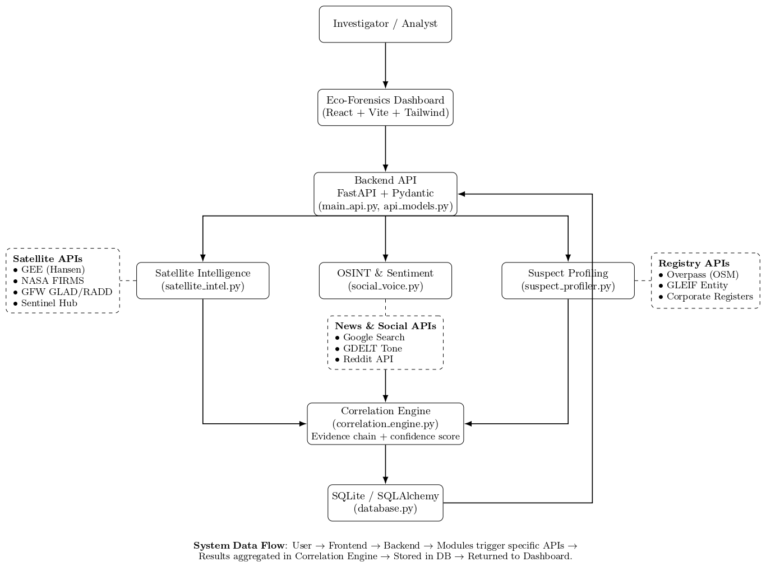
System Architecture Diagram

Slide 19
Workflow of the System
User selects Region or Bbox
Backend fetches multi-source data
Normalizes, correlates & stores raw results
Builds Forensic Dossier JSON
Frontend renders evidence on map
Shows confidence + suspects + sentiment

Slide 20
Expected Deliverables
Complete FastAPI backend
React dashboard
Forensic dossier generator
Multi-layer evidence visualizer
Project report
Unit + Integration tests
Docker environment
Raw data archive

Slide 21
GitHub Link
https://github.com/alxinjoy/Criminal-Profiling-Using-OSINT-Environmental-Infrastructure-Crimes-

Slide 22
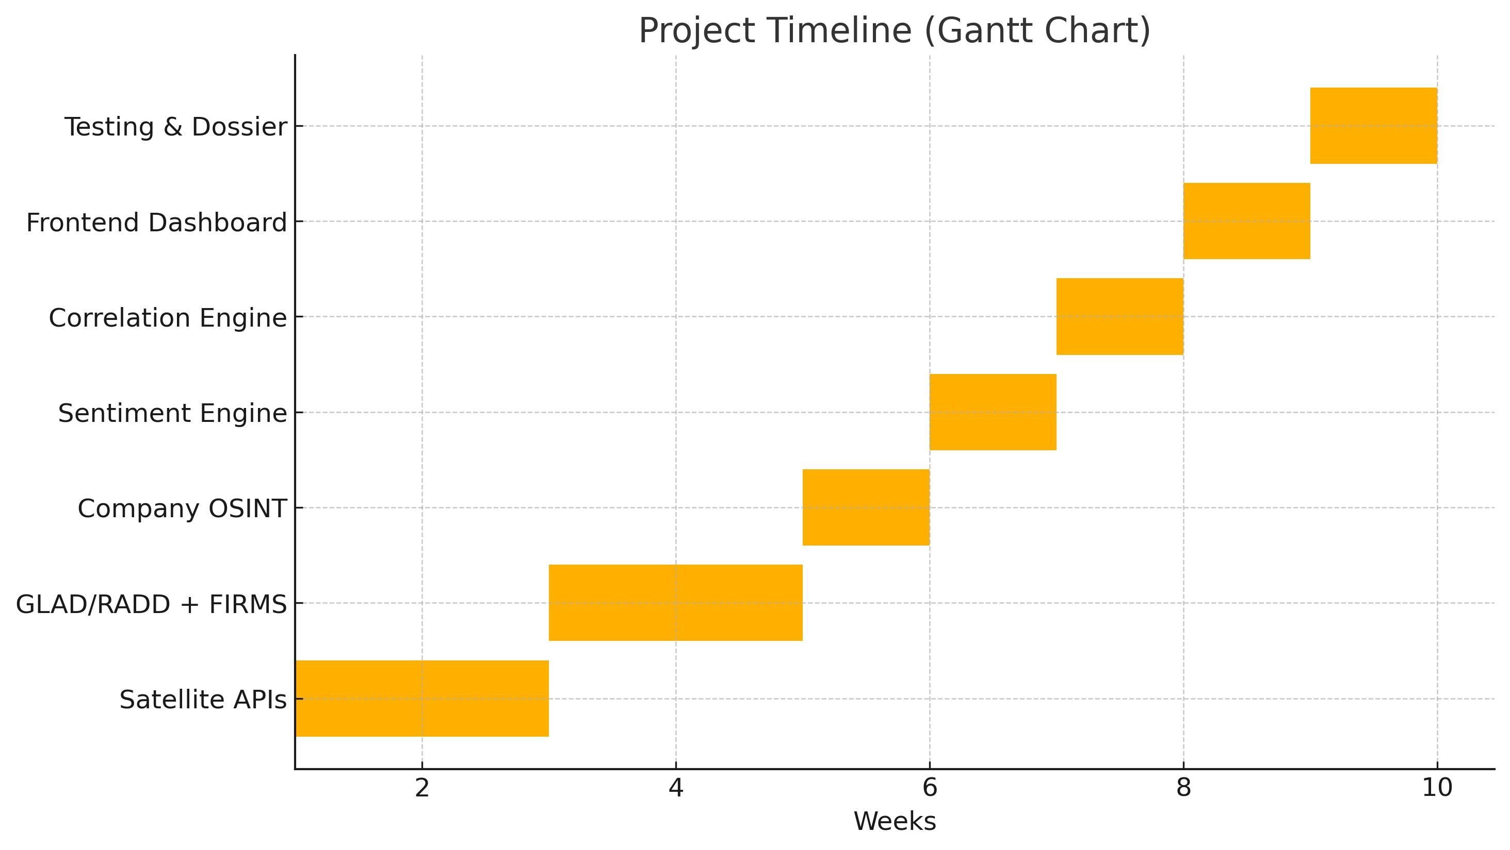
Timeline (Gantt Chart)

Slide 23
Conclusion
This project demonstrates how multi-source OSINT + satellite analytics can be unified to provide a defensible forensic chain for environmental crime investigations.

Slide 24
References
[1] Aditya, B.L.V.S. And Mohanty, S.N., 2023. Heterogenous Social Media Analysis for Efficient Deep Learning Fake-Profile Identification. IEEE Access, 11, pp.99342-99351.
[2] Bogomolov, A., Lepri, B., Staiano, J., Oliver, N., Pianesi, F. And Pentland, A., 2014. Once Upon a Crime: Towards Crime Prediction from Demographics and Mobile Data. arXiv preprint arXiv:1409.2983.[
3] Chainey, S.P. And Berbotto, A.A., 2021. A structured methodical process for populating a crime script of organized crime activity using OSINT. Trends in Organized Crime, 25(3), pp.298-318.[
4] Gibellini, F., Fraternali, P., Boracchi, G., Morandini, L., Martinoli, T., Diecidue, A. And Malegori, S., 2025. A Deep Learning Pipeline for Solid Waste Detection in Remote Sensing Images. Waste Management Bulletin. DOI: 10.1016/j.wmb.2025.100246.
[5] Hajela, G., Chawla, M. And Rasool, A., 2020. A Clustering Based HotspotIdentification Approach For Crime Prediction. Procedia Computer Science, 167, pp.1462-1470.
[6] Katzner, T., Thomason, E., Huhmann, K., Conkling, T., Concepcion, C., Slabe, V. And Poessel, S., 2022. Open-source intelligence for conservation biology. Conservation Biology, 37(1), p.e13988.
[7]Kebede, H.A., Assen, M.M. And Sharew, M.A., 2025. Crime Hotspot Analysis and Mapping Using Geospatial Technology in Dessie City, Ethiopia. arXiv preprint arXiv:2501.00036.
[8] Liu, Y., Shen, X., Zhang, Y., Wang, Z., Tian, Y., Dai, J. And Cao, Y., 2025. A systematic review of machine learning approaches for detecting deceptive activities on social media: methods, challenges, and biases. International Journal of Data Science and Analytics, 20(7), pp.6157-6182.
[9] Palaniswamy, S., Yadhunath, R., Srikanth, S. And Sudheer, A., 2019. Identification of Criminal Activity Hotspots using Machine Learning to Aid in Effective Utilization of Police Patrolling in Cities with High Crime Rates. In: 2019 4th International Conferenceon Computational Systems and Information Technology for Sustainable Solution (CSITSS).IEEE, pp. 268-273 (Approx. Page range).
[10] Zhang, X., Liu, L., Xiao, L. And Ji, J., 2020. Comparison of Machine LearningAlgorithms for Predicting Crime Hotspots. IEEE Access, 8, pp.181300-181310.

Slide 25


